Slide 1

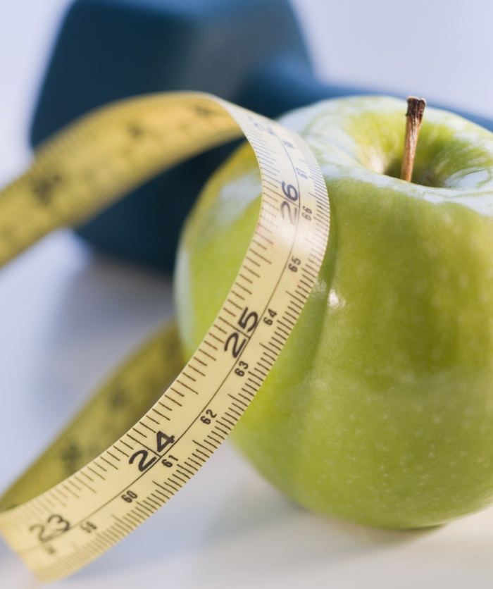

HUMAN ACTIVITY CLASSIFICATION
using IMU sensory data
Notes:
NOTE: To replace a picture, just select and delete it. Then use the Insert Picture icon to replace it with one of your own!

Slide 2
MOTIVATION
Fitness as a lifestyle is trending
Chronic conditions like obesity, diabetes, blood pressure, cholesterol are on the rise
Increase in usage of wearable devices has prompted the use of data mining
Wearable devices makes it easier than ever for people to monitor and set fitness and wellness goals.

Slide 3
PROJECT OBJECTIVES
Use data mining techniques on IMU and Heartbeat sensory data to accurately identify activity being performed by people
Go beyond the standard categories like walking, running and resting and classify up to 18 different categories with accuracy
Figure out an optimized way to classify the activities by removing the unnecessary IMU sensor datas

Slide 4
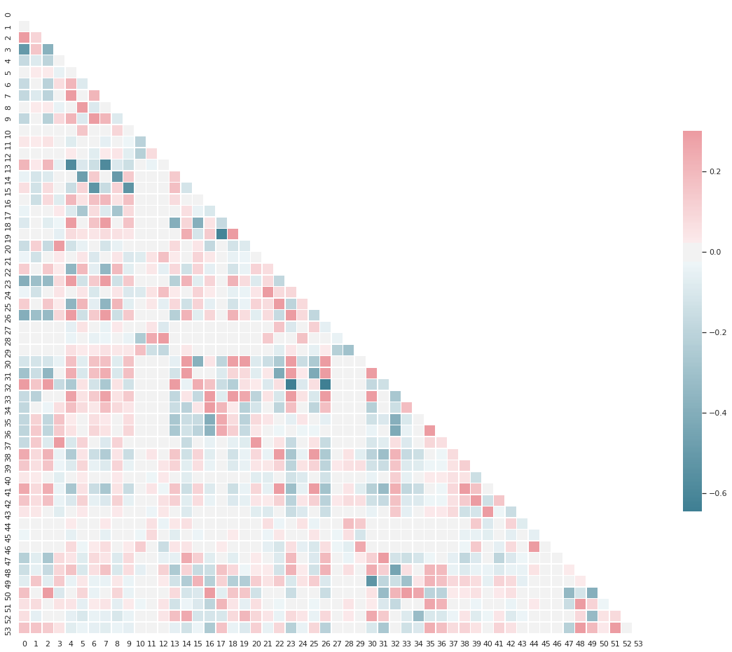
DATASET
PAMAP2 Physical Activity Monitoring Data Set (from UCI Machine Learning Repository)
3.8 million instances with 52 attributes spanning 18 annotated activities across 9 subjects.
This dataset includes raw 9-axis IMU data streams (from the hand, chest, and ankle) as well as heart rate data from nine different subjects performing various activities.

Slide 5
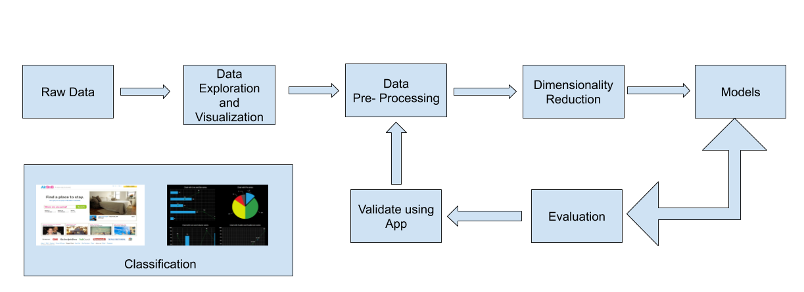
METHODOLOGY

Slide 6
PREPROCESSING AND FEATURE ENGINEERING
Removed noise data
Interpolated missing data using neighbouring values
Merged subject’s demographics data
Removed unwanted features
Normalized data using z-scores
Removed chest and ankle IMU sensor data (for alternative models)
Dimensionality Reduction using PCA and SVD

Slide 7
Model Evaluation
Accuracy and F1 score were used as metrics for evaluation.
Model | Hyperparameters used | Accuracy |  | F1 Score
 |  | With 3 IMUs | With Hand IMU only | With 3 IMUs | With Hand IMU only
Logistic Regression | solver='lbfgs', multi_class='multinomial', C=0.01, penalty=’l2’ | 0.7007 | 0.5674 | 0.6557 | 0.5144
Decision Tree | criterion='gini', max_depth=20 | 0.9451 | 0.9408 | 0.9394 | 0.9317
Adaboost | Total_trees = 500, max_depth=20 | 0.9776 | 0.9650 | 0.9699 | 0.9595
SVM | kernel=linear/rbf, c=1-100 | 0.9978 | 0.9933 | 0.9816 | 0.9711
Random Forest | Total_trees = 100, max_depth=20 | 0.98 | NA | 0.9767 | NA
CNN | Number of Neurons = 756, epoch = 200 | 0.9331 | NA | 0.9246 | NA

Slide 8
CONCLUSION
Performing dimensionality reduction helps a lot with unnecessary computations
Applying normalization also reduced the runtime of training models and yielded more effective results.
SVM classifier performs the best but also takes up more space which may affect the use cases
Boosted decision trees performed similar to Random Forest

