Slide 1
Best practices

Slide 2
IN Clause Issue
Consider
CREATE TABLE authors ( name text, year int, title text, publisher text, isbn text, PRIMARY KEY (name, year, title) );
SELECT * FROM authors WHERE name IN ( 'T', 'M', 'D' );

Slide 3
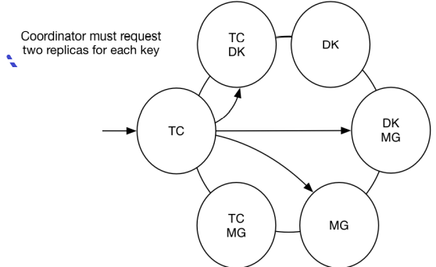

Slide 4
When using the IN clause, it's best to keep the number of keys small.
In fact, it is often advisable to issue multiple queries in parallel as opposed to utilizing the IN clause.
While the IN clause may save you from multiple network requests to Cassandra, the coordinator must do more work
When using the IN clause, if any one key times out, you will have to retry the entire query. On the other hand, using separate queries allows you to retry only the query that timed out. Secondary in

Slide 5
Prefer Indexes on high cardinality as compared to low
If you decide to use a secondary index for a use case where performance and availability are not critical, make sure you only index on lowcardinality values, as high-cardinality indices do not scale well. But don't go so low that your index is rendered useless. For example, booleans are bad, as are UUIDs, but birth year could be a reasonable column to index.

Slide 6
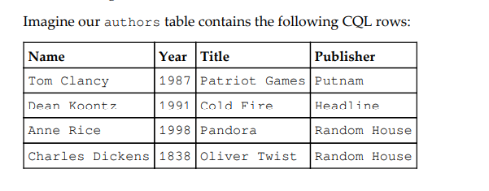
What is the problem with secondary index?

Slide 7
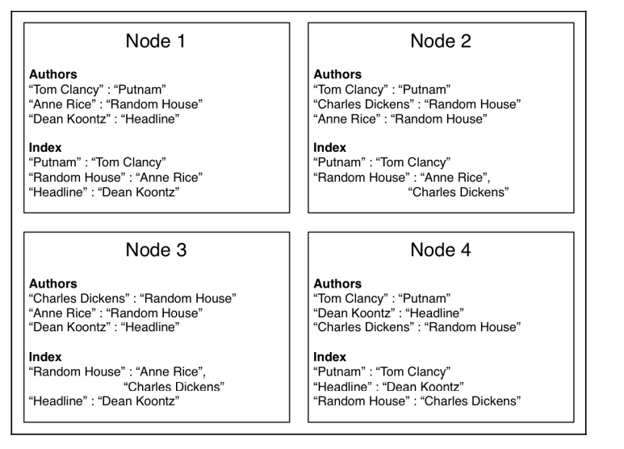

Slide 8
Distributed joins
If you find yourself querying multiple large tables and then joining them in your application based on some shared key, you are performing a distributed join. This should almost always be avoided in favor of a denormalized data model. The only exception is for very small lookup tables that can fit easily in memory. Otherwise, you should always write your data the way you intend to read it.

Slide 9
Tombstone trick
To ensure that deleted data never resurfaces, make sure you run repair at least once every gc_grace_seconds, and never let a node stay down for longer than this time period

Slide 10
Why Tombstone
Cassandra employs a log-structured storage engine, where all writes are immutable appends to the log. The implication is that data cannot actually be deleted at the time a DELETE statement is issued. Cassandra solves this by writing a marker, called a tombstone, with a timestamp greater than the previous value. This has the effect of overwriting the previous value with an empty one, which will then be compiled in subsequent queries for that column in the same manner as any other update.

Slide 11
TTL use
INSERT INTO authors (name, title, year)
VALUES ('Tom Clancy', 'Patriot Games', 1987)
USING TTL 86400;
UPDATE authors USING TTL 86400
SET publisher = 'Putnam'
WHERE name = 'Tom Clancy'
AND title = 'Patriot Games'
AND year = 1987;

Slide 12
TTL anti-pattern
CREATE TABLE comments ( articleID uuid, timestamp int, username text, comment text, PRIMARY KEY (articleID, timestamp, username) ) WITH CLUSTERING ORDER BY (timestamp DESC);
INSERT INTO comments (articleID, timestamp, username, comment) VALUES (36f08b19-fc6d-4930-81f6-6704f627ca83, 1413146590, 'rs_atl', 'Nice article!
') USING TTL 10800;
SELECT * FROM comments WHERE articleID = 36f08b19-fc6d-4930-81f6-6704f627ca83;

Slide 13
Old values will disappear from the result set, and for a period of time this query will perform perfectly well. But we will gradually accumulate tombstones as columns reach their expiration time, and this query requires that we read all columns in the storage row. Eventually, we will reach a point where Cassandra will be reading more tombstones than real values!
The solution is simple. We must add a range filter on timestamp, which will tell Cassandra to stop scanning columns at approximately as far back in time as the tombstones will start. In this case, we don't want to read any columns older than 3 hours, so our new query looks like this: SELECT * FROM comments WHERE articleID = 36f08b19-fc6d-4930-81f6-6704f627ca83 AND timestamp > [current_time - 10800];

Slide 14
Do not explicitly set null
We know that Cassandra stores columns sparsely, meaning that unspecified values simply aren't written. So it would seem logical that setting a column to null would result in a missing column. In fact, writing a null is the same thing as explicitly deleting a column, and therefore a tombstone is written for that column!

