Slide 1
Cassandra overview
By Vishwa

Slide 2
What is Cassandra?
is a distributed database management system
is built to handle large amounts of data across multiple data centers and the cloud
Written in Java
Is a part of NOSQL family

Slide 3
Brief history
Apache Cassandra was originally developed at Facebook in 2008 to power Facebook’s in-box search feature.
The original authors were Avinash Lakshman, who also is one of the authors of the Amazon Dynamo paper, and Prashant Malik.

Slide 4
Features
Highly scalable
Offers high availability
Has no single point of failure
offers users “blazingly fast writes,” and the speed or accuracy is unaffected by large volumes of data

Slide 5
Features continued
Flexible data storage.
Flexible data distribution.
can handle structured, semi-structured, and unstructured data, giving users flexibility with data storage.
uses multiple data centres, which allows for easy data distribution wherever or whenever needed.

Slide 6
Cassandra is influenced from?
Distribution of data
Amazon DynamoDb
Data Model
Google’s Big table

Slide 7
Eagle view of Cassandra
Node 1
Node 2
Node 3
Node 4
Node 5
Peer to Peer
Any node can perform read or write

Slide 8
Few important terminology
Node
Is an instance of cassandra
Cluster:
two or more Cassandra instances working together
Homogenous environment
means that each and every Cassandra node contains everything required to complete a cluster
Rack
rack is a logical grouping of nodes within the ring., A rack is a collection of servers

Slide 9
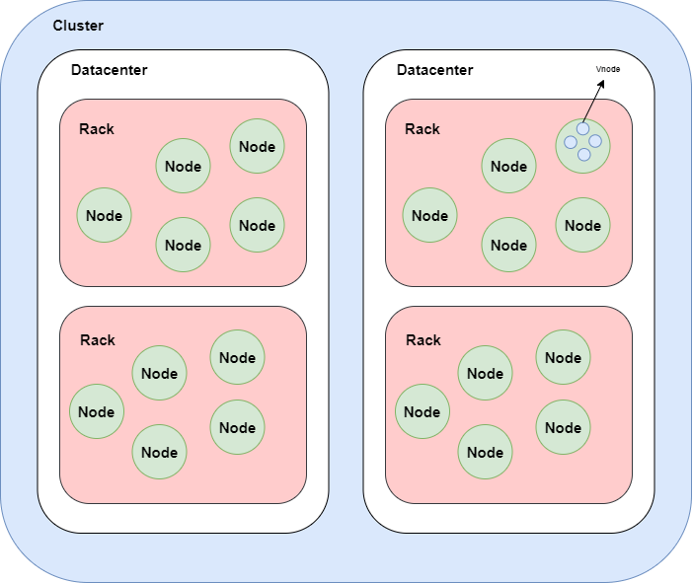

Slide 10
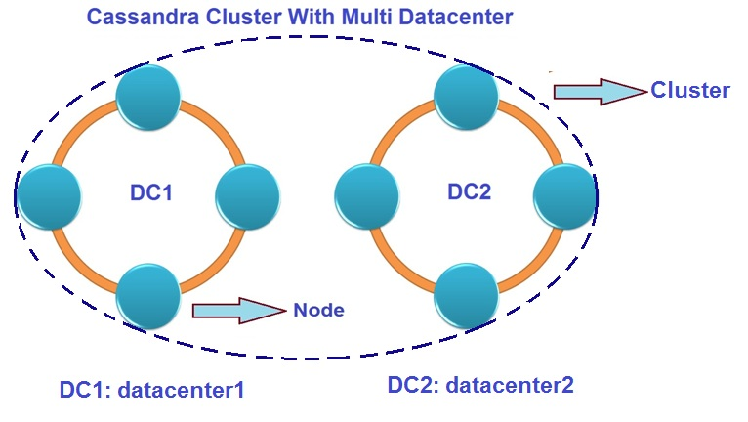

Slide 11
Cassandra is typically classified as an AP system, meaning that availability and partition tolerance are generally considered to be more important than consistency in Cassandra
But Cassandra can be tuned with replication factor and consistency level to also meet C.

Slide 12
Replication factor
is a setting that determines how many copies of the data will reside in the cluster
A replication factor of 3 means that there will be three copies of the data within a cluster
The replication factor is the total number of replicas across the cluster

Slide 13
Quorum Consistency
Quorum consistency is consistency in Cassandra for high mechanism and to ensure that how many nodes will respond when we will define the read and write consistency in Cassandra.
A quorum read/write means that the query will be sent to (RF/2 +1)
Given an RF of 3, the query will be sent to two nodes (decimals are always rounded down)

Slide 14
Tunable consistency
different application reads/writes may have different needs in terms of consistency
ANY is for writes only and ensures that the write will persist on any server in the cluster.
ONE ensures that at least one server within the replica set will persist the write or respond to the read; this is the minimum consistency level for reads.
CL QUORUM means the read/write will go to half of the nodes in the replica set plus one
CL LOCAL_QUORUM is like QUORUM but applies to only those nodes within the same data center
CL EACH_QUORUM is like QUORUM but ensures a quorum read/write on each of the data centers
CL ALL ensures that all nodes in a replica set will receive the read/write

Slide 15
Components of Cassandra
Node
Data center
Cluster
Commit log
Mem-table −
SSTable
Bloom filter
It is the place where data is stored, single machine.
It is a collection of related nodes.
A cluster is a component that contains one or more data centers.
The commit log is a crash-recovery mechanism in Cassandra. Every write operation is written to the commit log.
A mem-table is a memory-resident data structure. After commit log, the data will be written to the mem-table. Sometimes, for a single-column family, there will be multiple mem-tables.
It is a disk file to which the data is flushed from the mem-table when its contents reach a threshold value.
These are nothing but quick, nondeterministic, algorithms for testing whether an element is a member of a set. It is a special kind of cache. Bloom filters are accessed after every query.

Slide 16
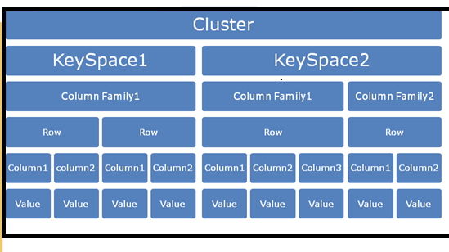
Cassandra Architecture
Keyspace is the outermost container for data in Cassandra. It is close in semantics to database.
Column Family
A column family is a container for an ordered collection of rows. Each row, in turn, is an ordered collection of columns. It has close meaning to a SQL table.

Slide 17
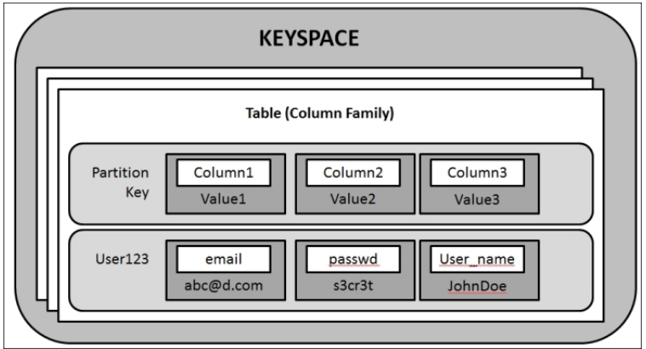

Slide 18
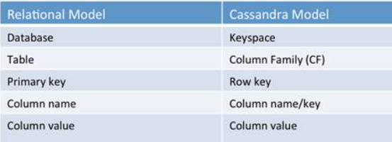

Slide 19
Cassandra Modelling
When creating a table we inform Cassandra not only what the name and type of data are, but also how to store and distribute data

Slide 20
Cassandra Modelling terminology
Primary Key = Partition Key + [Clustering Columns]
Partition keys
On how data should be divides across nodes
Clustering keys:
On how to arrange the data in node

Slide 21
SAMPLE 1
DEFINITION 1:
CREATE TABLE server_logs(
log_hour timestamp PRIMARYKEY,
log_level text,
message text,
server text
)
partition key: log_hour
clustering columns: none

Slide 22
SAMPLE 2
DEFINITION 2:
CREATE TABLE server_logs(
log_hour timestamp,
log_level text,
message text,
server text,
PRIMARY KEY (log_hour, log_level)
)
partition key: log_hour
clustering columns: log_level

Slide 23
SAMPLE 3
CREATE TABLE server_logs(
log_hour timestamp,
log_level text,
message text,
server text,
PRIMARY KEY ((log_hour, server))
)
partition key: log_hour, server
clustering columns: none

Slide 24
SAMPLE 4
DEFINITION 4:
CREATE TABLE server_logs(
log_hour timestamp,
log_level text,
message text,
server text,
PRIMARY KEY ((log_hour, server),log_level)
)WITH CLUSTERING ORDER BY (log_level DESC);
partition key: log_hour, server
clustering columns: log_level

Slide 25
Tokens
Cassandra read and write operations are performed using a partition key on a table
Cassandra uses ‘tokens’ (a long value out of range -2^63 to +2^63 -1) for data distribution and indexing.
The tokens are mapped to the partition keys using a ‘partitioner’. The partitioner applies a partitioning function to convert any given partition key to a token.
Each node in a Cassandra cluster owns a set of data partitions using this token mechanism. The data is then indexed on each node with the help of the partition key.
Cassandra uses a partition key to determine which node store data on and where to find data when it’s needed.

Slide 26
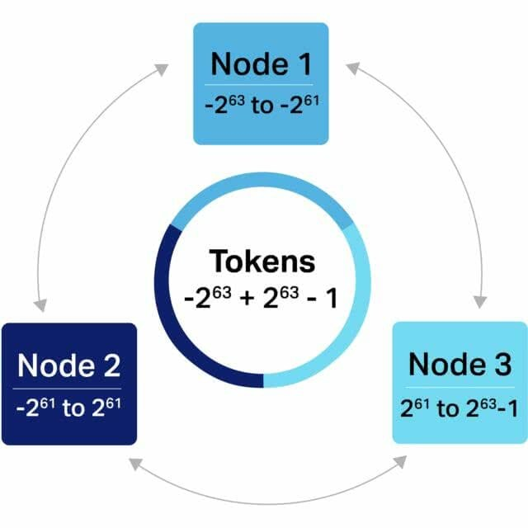

Slide 27
Few important points
A partition key for a table should be designed to satisfy its access pattern and with the ideal amount of data to fit into partitions.
A partition key should not allow ‘unbounded partitions’. An unbounded partition grows indefinitely in size as time passes.
In the server_logs table example, if the server column is used as a partition key it will create unbounded partitions as logs for a server will increase with time. The time attribute of log_hour, in this case, puts a bound on each partition to accommodate an hour worth of dat

Slide 28
Few more important points
A partition key should not create partition skew, in order to avoid uneven partitions and hotspots. A partition skew is a condition in which there is more data assigned to a partition as compared to other partitions and the partition grows indefinitely over time.
In the server_logs table example, suppose the partition key is server and if one server generates way more logs than other servers, it will create a skew.
Partition skew can be avoided by introducing some other attribute from the table in the partition key so that all partitions get even data. If it is not feasible to use a real attribute to remove skew, a dummy column can be created and introduced to the partition key. The dummy column then distinguishes partitions and it can be controlled from an application without disturbing the data semantics.
In the skew example above, consider a dummy column partition smallint is introduced and the partition key is altered to server, partition. Now the application logic sets the partition attribute to 1 until there are enough rows in a partition and then it sets partition to 2 for the same server.

Slide 29
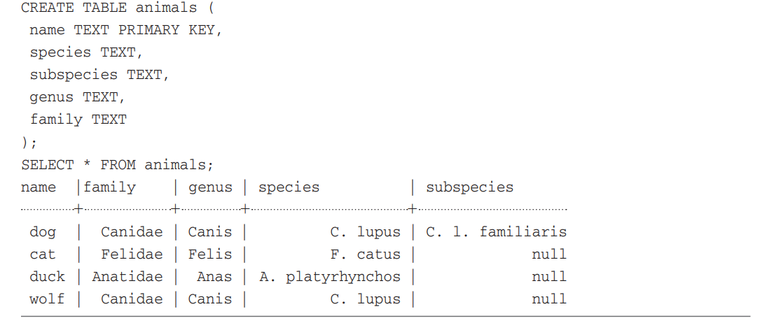
Example 1 ---Predict the distribution in 5 node cluster

Slide 30
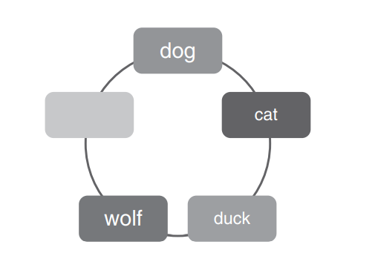
Example 1 Answer

Slide 31
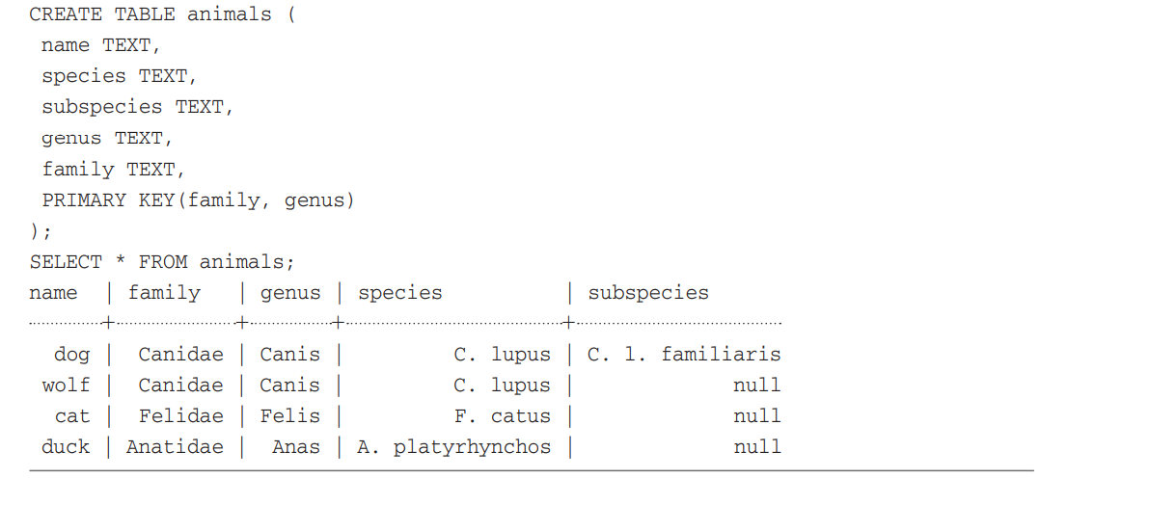
Example 2 ---Predict the distribution in 5 node cluster

Slide 32
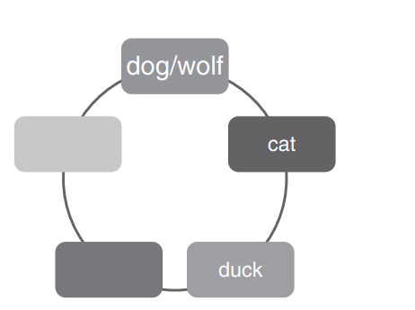
Answer

Slide 33
Paradigm shift in Cassandra
Decide query first before deciding the model
Row is not segmented, Entire row exists in node
Check for HOTSPOTS and how data will get divided
Hot spots occur when a particular key (row) gets so many queries that it causes the load on the machine to spike
Think on row size
A single row has to fit on disk; if you have a single row containing billions of columns, it may extend past the amount of available disk space on the drive

Slide 34
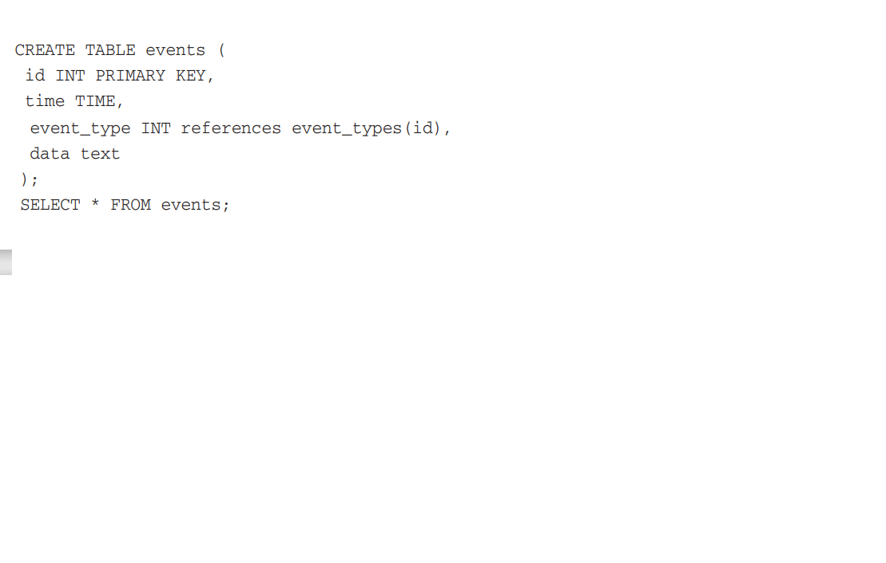
The primary concern with this model is that each row has a single event.
This makes it very difficult to find events that belong to a particular time or event type
the ID of the even needs to be known to get its information without doing a full scan of the ColumnFamily

Slide 35
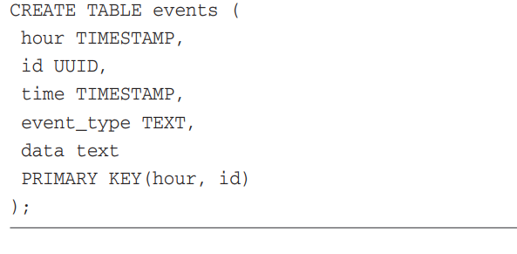
In case of heavy reads and/or writes, we may need to segment the row into multiple rows.
Seeing as an event per row is difficult to query, and a row every hour can lead to hot spots, as all reads and writes are going to the same files on disk

Slide 36
