Slide 1
Introduction to NoSQL and Cassandra
Vishwa

Slide 2
What does NOSQL stand for?
Not Only SQL database
is an alternative to traditional relational databases
useful for working with large sets of distributed data

Slide 3
How does NoSQL vary from RDBMS?
Looser schema definition
•Applications written to deal with specific documents/ data
•Applications aware of the schema definition as opposed to the data
•Designed to handle distributed, large databases
•Relaxation of the ACID properties

Slide 4
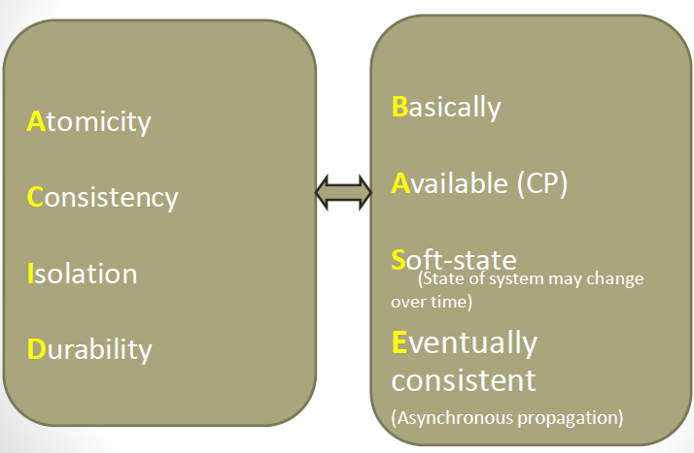

Slide 5
CAP theorem
Consistency
Means all the nodes see the same data at same time
Query on any node will return same result
Any update would be reflected every where
Availability
Requester will get response either success/failure
Ability to continue in case of system/hard ware failures in part of system
Partition Tolerance
Ability to distribute data in multiple nodes

Slide 6
Benefits of NoSQL
Elastic Scaling
RDBMS scale up –bigger load , bigger server
NO SQL scale out –distribute data across multiple hosts seamlessly
DBA Specialists
RDMS require highly trained expert to monitor DB
NoSQL require less management, automatic repair and simpler data models
Big Data
Huge increase in data RDMS: capacity and constraints of data volumes at its limits
NoSQL designed for big data
Flexible data models
Change management to schema for RDMS have to be carefully managed
NoSQL databases more relaxed in structure of data
Database schema changes do not have to be managed as one complicated change unit
Application already written to address an amorphous schema
Economics
RDMS rely on expensive proprietary servers to manage data
No SQL: clusters of cheap commodity servers to manage the data and transaction volumes
Cost per gigabyte or transaction/second for NoSQL can be lower than the cost for a RDBMS

Slide 7
Types of No SQL
Key-value stores
pairs a unique key with an associated value
Are extremely performing and highly scalable for session management and caching in web applications
they are oriented to work with RAM, solid-state drives or disk drives

Slide 8
Types of No SQL
Document databases
also called document stores
store semi-structured data and descriptions of that data in document format
allow developers to create and update programs without needing to reference master schema
JSON format support though XML is also supported
are used for content management and mobile application data handling

Slide 9
Types of No SQL
Wide-column stores
organize data tables as columns instead of as rows
can query large data volumes faster than conventional relational databases
used for recommendation engines, catalogs, fraud detection and other types of data processing

Slide 10
Types of No SQL
Graph stores
organize data as nodes, which are like records in a relational database, and edges, which represent connections between nodes
support richer representations of data relationships
the graph data model can evolve over time and use
reservation systems or customer relationship management

Slide 11
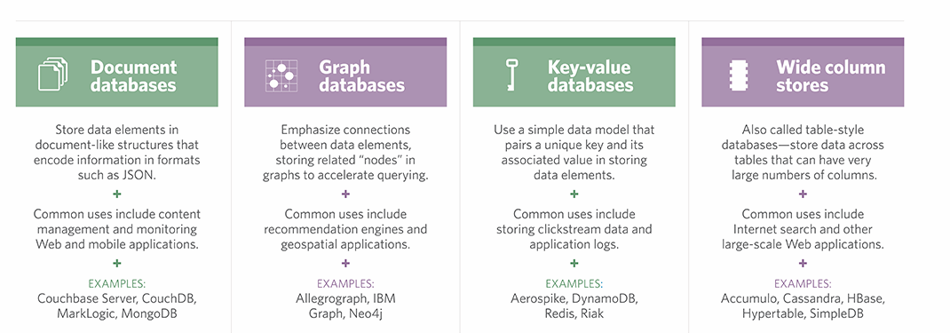
Different types of NO SQL

Slide 12
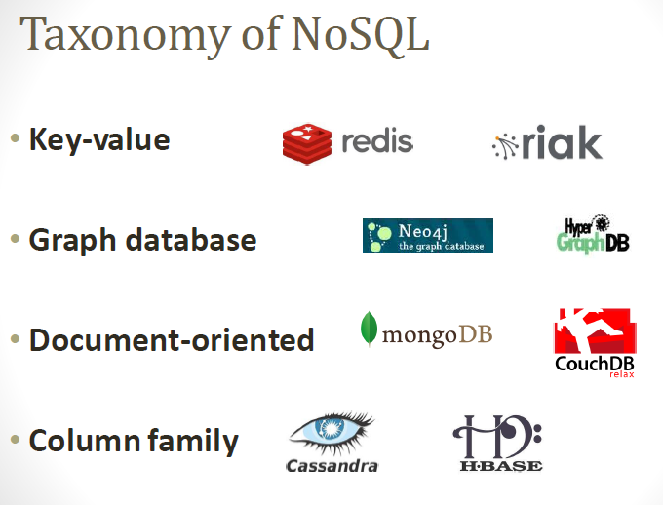

Slide 13
