Slide 1
LLM Fundamentals &
Prompt Engineering
Build Smarter Autonomous AI Systems

Slide 2
Agenda
LLM basics
Working of LLM
Tokenization
Embedding
Prompt Engineering: Core Principles
Prompt patterns

Slide 3
LLM Fundamentals & Prompt Engineering
A complete journey from basics → advanced concepts
Includes illustrations, analogies, examples, and best practices
Hands-on Python exercises included
Notes:
Set context for the session.

Slide 4
What Are Large Language Models?
LLMs are neural networks trained on massive amounts of text data
They learn statistical patterns → generate text, classify, summarize
Built on the Transformer architecture
Think of them as 'text prediction engines' with deep contextual understanding
Notes:
Explain using the idea of predictive typing on steroids.

Slide 5
How LLMs Work (Illustration)
💡 Input Text → Tokenization → Neural Network (Transformer) → Output Tokens
⚙ Key Components:
• Embeddings — numeric representation of text
• Attention — decides which words matter most
• Decoder — predicts next token step-by-step

Slide 6
Transformer Architecture — Visual Breakdown
🔹 Encoder (optional depending on model type)
🔹 Decoder (LLMs are usually decoder-only)
🔹 Multi-Head Attention mechanism
🔹 Feed-Forward layers
🔹 Residual connections & LayerNorm
📌 LLMs use stacked Transformer blocks (e.g., 24–200 layers)
Notes:
Walk learners through block diagram on whiteboard.

Slide 7
Training LLMs: The Three Stages
1️⃣ **Pretraining** — Learn general language patterns using massive datasets
• Example: next-token prediction on internet-scale text
2️⃣ **Fine-tuning** — Adapt to specific tasks/domains
• Example: medical Q&A, customer support
3️⃣ **Instruction Tuning / RLHF** — Make model follow human instructions
• Use human ratings, preference models

Slide 8
Tokenization (Illustrated)
Text → Subword Units (Tokens)
Example:
"playing football" → ["play", "ing", " football"]
Why it matters:
• Models operate on tokens, not words
• Token count = cost + latency
• Different tokenizers → different token splits

Slide 9
Embeddings — Understanding Meaning As Numbers
Embeddings convert words/sentences into vectors (e.g., 1536 dimensions)
Illustration:
• 'king' - 'man' + 'woman' ≈ 'queen' (semantic relation)
Use-cases:
• Semantic search
• Clustering
• RAG (Retrieval-Augmented Generation)

Slide 10
Attention Mechanism (Key Intuition)
Attention tells the model *where to look* in the input sequence.
Example:
Sentence: “The trophy doesn’t fit in the suitcase because it is too big.”
Attention helps model resolve what “it” refers to.
🧠 Multiple heads learn different patterns simultaneously.

Slide 11
Decoding Strategies (Detailed)
**Greedy Search** —
**Beam Search** —
**Temperature** —
**Top-k Sampling** —
**Top-p Sampling (Nucleus)** —
Use different strategies based on task requirements.
pick best token each step (deterministic)
explore multiple best paths
controls randomness (0 = factual, >1 = creative)
choose from top k likely tokens
choose from smallest probability mass p

Slide 12
Prompt Engineering: Core Principles
📌 Be explicit, specific, and structured
📌 Provide examples (few-shot)
📌 Reduce ambiguity
📌 Break complex tasks into steps
📌 Define output format (JSON, table, bullet list)
Prompt = Instruction + Context + Input + Output Format

Slide 13
Prompt Patterns (With Examples)
🔹 **Zero-shot Prompting** — No examples
Example: “Summarize the paragraph below.”
🔹 **Few-shot Prompting** — Provide examples
Example: Show 3 labeled examples → ask model to label 4th
🔹 **Chain-of-Thought** — Tell model to reason step-by-step
🔹 **Role Prompting**
Example: “You are a Java performance expert…”

Slide 14
Advanced Prompting Techniques
🧩 Self-Consistency — generate multiple answers → choose consensus
🧩 ReAct Pattern — reasoning + action selection
🧩 Meta-Prompting — prompting to improve prompts
🧩 Prompt Chaining — break workflow into multiple LLM calls
🧩 Tool Use (Agentic AI) — LLM calls tools/APIs during reasoning

Slide 15
🧩 1. Self-Consistency
Generate multiple reasoning paths, then pick the most common answer.
Example
Prompt: “A farmer has 17 sheep. All but 9 die. How many remain?”
LLM generates three reasoning paths:
Path A → “If all but 9 die, 9 remain.”
Path B → “All but 9 die → survivors = 9.”
Path C → “Trick question: remaining sheep = 9.”
Consensus: 9
(Self-consistent answer)
Where used?
Math problems, logical puzzles, coding solutions.
Where used?
Agents, tool-using LLMs, retrieval-based assistants.

Slide 16
🧩 2. ReAct Pattern
Reason → Act using tools → continue.
Example
Task: “Find the weather in Bangalore and write a short summary.”
LLM:
Reason: “I need to call a weather API.”
Act: weather_api(location="Bangalore")
Observation: API returns: 28°C, cloudy
Reason: “Now I can summarize.”
Answer: “Bangalore is 28°C with cloudy skies today.”
Where used?
Agents, tool-using LLMs, retrieval-based assistants.

Slide 17
🧩 3. Meta-Prompting
The LLM improves your prompt instead of giving the answer directly.
Example
Your prompt:
“Fix my prompt: ‘Write code for chatbot’.”
Meta-prompt:
“Make this prompt more specific, structured, and goal-focused.”
LLM output:
“Write a Python chatbot using Flask that can answer FAQs. Include code comments, error handling, and an example API route.”
Where used?
Prompt engineering, refining tasks for higher accuracy.
.

Slide 18
🧩 4. Prompt Chaining
Break a complex task into multiple LLM calls (steps).
Example
Goal: Summarize a PDF and generate quiz questions.
Chain:
Call 1: Extract key points from PDF
Call 2: Summarize extracted points
Call 3: Generate quiz questions from summary
Each step becomes the input for the next.
Where used?
RAG systems, workflow orchestration, multi-step analytics.
.

Slide 19
🧩 5. Tool Use (Agentic AI)
LLM decides when to call external tools during reasoning.
Example
Task: “Find flight prices from Mumbai → Delhi for tomorrow.”
LLM reasoning:
“Need real-time data → call flight API.”
Act → flight_api.search("Mumbai","Delhi","tomorrow")
API returns prices
LLM summarizes result
Where used?
AI agents, automation, data lookup, API orchestration.

Slide 20
Safety & Hallucination Control
🚨 Prompts to reduce hallucination:
• “If unsure, state ‘I don’t know’.”
• “Cite sources from given context only.”
• “Verify your answer before responding.”
Best Practices:
• Use retrieval (RAG)
• Add validation rules
• Avoid open-ended generative prompts for factual tasks

Slide 21
RAG (Retrieval-Augmented Generation) — Introduction
Pipeline:
1. User Query
2. Embed query
3. Retrieve most relevant documents
4. Construct context
5. LLM generates grounded answer
Benefits:
• Lower hallucinations
• Domain-specific accuracy
• Updatable knowledge

Slide 22
Wrapping Up — Key Takeaways
🔹 Understand LLM internals → better prompts
🔹 Use structure, clarity, and examples
🔹 Evaluate prompts systematically
🔹 Apply RAG for advanced workflows
🔹 Experiment + iterate to improve

Slide 23
Explain the Retrieval-Augmented Generation (RAG) pattern. How is it typically implemented in Python, and what problem does it solve for LLMs?
RAG is an LLM application design pattern that combines an LLM's generative ability with an external knowledge base to produce more accurate, grounded, and context-aware responses.

Slide 24
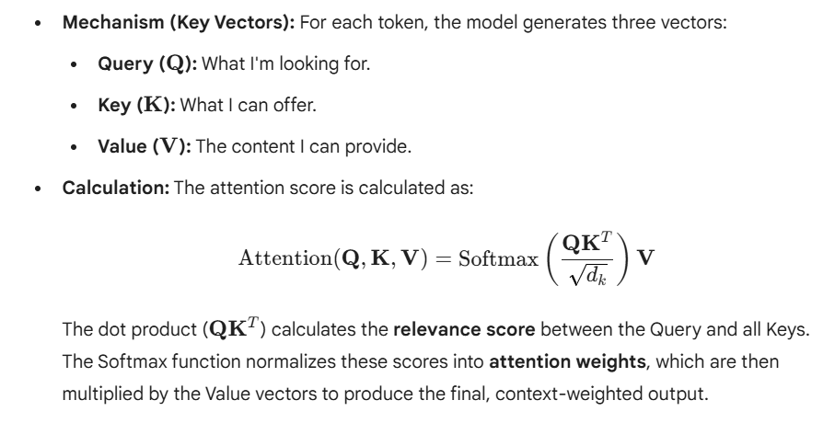
The Transformer is the foundation of LLMs. What is the fundamental mechanism that allows it to capture long-range dependencies in text, and how is it calculated?
The fundamental mechanism is the Self-Attention Mechanism (specifically, Scaled Dot-Product Attention).
Function: It allows the model to weigh the importance of every other token in the input sequence when processing a specific token

