Slide 1
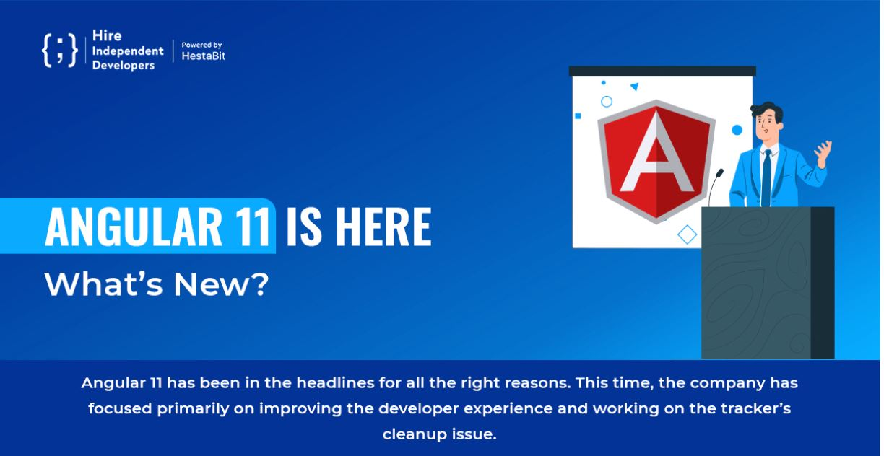

Slide 2


Improved Performance:
The new APIs and advancement in the performance have made it easier to work with asynchronous actions during tests. This was achieved by enabling multiple asynchronous interactions.

Slide 3
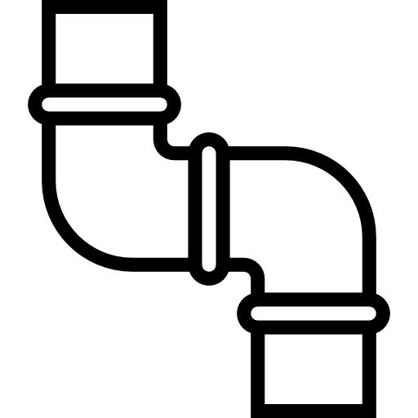
Stricter Pipes:
Several new stricter types are employed for Date pipes and number pipes so that misuses can be handled, such as an array or passing an observable.

Slide 4
Interesting, right?
This is just a sneak preview of the full presentation. We hope you like it! To see the rest of it, just click here to view it in full on PowerShow.com. Then, if you’d like, you can also log in to PowerShow.com to download the entire presentation for free.

