Slide 1


© 2012 coreservlets.com and Dima May
Hadoop Introduction
.

Slide 2

Agenda
Big Data
Hadoop Introduction
History
Comparison to Relational Databases
Hadoop Eco-System and Distributions
Resources
4
Big Data
Information Data Corporation (IDC) estimates data created in 2010 to be
1.2 ZETTABYTES
(1.2 Trillion Gigabytes)
Companies continue to generate large amounts of data, here are some 2011 stats:
Facebook ~ 6 billion messages per day
EBay ~ 2 billion page views a day, ~ 9 Petabytes of storage
Satellite Images by Skybox Imaging ~ 1 Terabyte per day
Sources:
"Digital Universe" study by IDC; http://www.emc.com/leadership/programs/digital-universe.htm Hadoop World 2011 Keynote: Hugh E. Williams, eBay
Hadoop World 2011: Building Realtime Big Data Services at Facebook with Hadoop and HBase Hadoop World 2011: Indexing the Earth – Large Scale Satellite Image Processing Using Hadoop
5

Slide 3


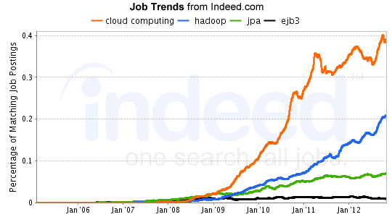
Hadoop
Existing tools were not designed to handle such large amounts of data
"The Apache™ Hadoop™ project develops open-source software for reliable, scalable, distributed computing." - http://hadoop.apache.org
Process Big Data on clusters of commodity hardware
Vibrant open-source community
Many products and tools reside on top of Hadoop
6
Hadoop Jobs
7
Source: http://www.indeed.com/jobanalytics/jobtrends?q=cloud+computing%2C+hadoop%2C+jpa%2C+ejb3&l=

Slide 4











Who Uses Hadoop?
8
Source: http://wiki.apache.org/hadoop/PoweredBy
Data Storage
Storage capacity has grown exponentially but read speed has not kept up
– 1990:
Store 1,400 MB
Transfer speed of 4.5MB/s
Read the entire drive in ~ 5 minutes
– 2010:
Store 1 TB
Transfer speed of 100MB/s
Read the entire drive in ~ 3 hours
Hadoop - 100 drives working at the same time can read 1TB of data in 2 minutes
9

Slide 5






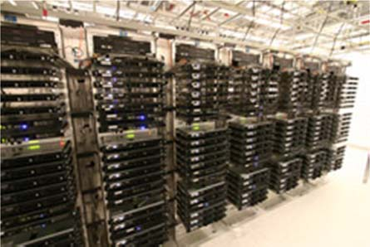
Hadoop Cluster
client
client
client
Hadoop Cluster
10
Hadoop Cluster
A set of "cheap" commodity hardware
Networked together
Resides in the same location
– Set of servers in a set of racks in a data center
11

Slide 6
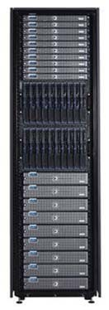
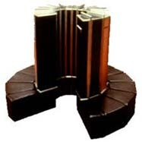

Use Commodity Hardware
“Cheap” Commodity Server Hardware
No need for super-computers, use commodity unreliable hardware
Not desktops
NOT
BUT
12
Hadoop System Principles
Scale-Out rather than Scale-Up
Bring code to data rather than data to code
Deal with failures – they are common
Abstract complexity of distributed and concurrent applications
13

Slide 7
Scale-Out Instead of Scale-Up
It is harder and more expensive to scale-up
Add additional resources to an existing node (CPU, RAM)
Moore’s Law can’t keep up with data growth
New units must be purchased if required resources can not be added
Also known as scale vertically
Scale-Out
Add more nodes/machines to an existing distributed application
Software Layer is designed for node additions or removal
Hadoop takes this approach - A set of nodes are bonded together as a single distributed system
Very easy to scale down as well
14
Code to Data
Traditional data processing architecture
nodes are broken up into separate processing and storage nodes connected by high-capacity link
Many data-intensive applications are not CPU demanding causing bottlenecks in network
Processing
Node
Load Data
Save Results
Storage
Node
Processing
Node
Load Data
Storage
Node
Save Results
Risk of bottleneck

Slide 8
Code to Data
Hadoop co-locates processors and storage
Code is moved to data (size is tiny, usually in KBs)
Processors execute code and access underlying local storage
Processor
Processor
Hadoop Cluster
Storage
Storage
Hadoop Node
Hadoop Node
Processor
Processor
Storage
Storage
16
Hadoop Node
Hadoop Node
Failures are Common
Given a large number machines, failures are common
Large warehouses may see machine failures weekly or even daily
Hadoop is designed to cope with node failures
Data is replicated
Tasks are retried
17

Slide 9
Abstract Complexity
Hadoop abstracts many complexities in distributed and concurrent applications
Defines small number of components
Provides simple and well defined interfaces of interactions between these components
Frees developer from worrying about system- level challenges
race conditions, data starvation
processing pipelines, data partitioning, code distribution
etc.
Allows developers to focus on application development and business logic
18
History of Hadoop
Started as a sub-project of Apache Nutch
Nutch’s job is to index the web and expose it for searching
Open Source alternative to Google
Started by Doug Cutting
In 2004 Google publishes Google File System (GFS) and MapReduce framework papers
Doug Cutting and Nutch team implemented Google’s frameworks in Nutch
In 2006 Yahoo! hires Doug Cutting to work on Hadoop with a dedicated team
In 2008 Hadoop became Apache Top Level Project
http://hadoop.apache.org
19

Slide 10
Naming Conventions?
Doug Cutting drew inspiration from his family
Lucene: Doug’s wife’s middle name
Nutch: A word for "meal" that his son used as a toddler
Hadoop: Yellow stuffed elephant named by his son
20
Comparisons to RDBMS
Until recently many applications utilized Relational Database Management Systems (RDBMS) for batch processing
Oracle, Sybase, MySQL, Microsoft SQL Server, etc.
Hadoop doesn’t fully replace relational products; many architectures would benefit from both Hadoop and a Relational product(s)
Scale-Out vs. Scale-Up
RDBMS products scale up
Expensive to scale for larger installations
Hits a ceiling when storage reaches 100s of terabytes
Hadoop clusters can scale-out to 100s of machines and to petabytes of storage
21

Slide 11
Comparisons to RDBMS (Continued)
Structured Relational vs. Semi-Structured vs. Unstructured
RDBMS works well for structured data - tables that conform to a predefined schema
Hadoop works best on Semi-structured and Unstructured data
Semi-structured may have a schema that is loosely followed
Unstructured data has no structure whatsoever and is usually just blocks of text (or for example images)
At processing time types for key and values are chosen by the implementer
Certain types of input data will not easily fit into Relational Schema such as images, JSON, XML, etc...
22
Comparison to RDBMS
Offline batch vs. online transactions
Hadoop was not designed for real-time or low latency queries
Products that do provide low latency queries such as HBase have limited query functionality
Hadoop performs best for offline batch processing on large amounts of data
RDBMS is best for online transactions and low-latency queries
Hadoop is designed to stream large files and large amounts of data
RDBMS works best with small records
23

Slide 12



Comparison to RDBMS
Hadoop and RDBMS frequently complement each other within an architecture
For example, a website that
has a small number of users
produces a large amount of audit logs
1
2
3
Hadoop
Web Server
RDBMS
4
1
Utilize RDBMS to provide rich User Interface and enforce data integrity
3
All logs are kept in Hadoop; Various analytics are executed periodically
2
RDBMS generates large amounts of audit logs; the logs are moved periodically to the Hadoop cluster
4
Results copied to RDBMS to be used by Web Server; for example "suggestions" based on audit history
24
Hadoop Eco System
At first Hadoop was mainly known for two core products:
HDFS: Hadoop Distributed FileSystem
MapReduce: Distributed data processing framework
Today, in addition to HDFS and MapReduce, the term also represents a multitude of products:
HBase: Hadoop column database; supports batch and random reads and limited queries
Zookeeper: Highly-Available Coordination Service
Oozie: Hadoop workflow scheduler and manager
Pig: Data processing language and execution environment
Hive: Data warehouse with SQL interface
25

Slide 13
Hadoop Eco System
To start building an application, you need a file system
In Hadoop world that would be Hadoop Distributed File System (HDFS)
In Linux it could be ext3 or ext4
Addition of a data store would provide a nicer interface to store and manage your data
HBase: A key-value store implemented on top of HDFS
Traditionally one could use RDBMS on top of a local file system
HBase
Hadoop Distributed FileSystem (HDFS)
26
Hadoop Eco System
For batch processing, you will need to utilize a framework
In Hadoop’s world that would be MapReduce
MapReduce will ease implementation of distributed applications that will run on a cluster of commodity hardware
MapReduce HBase
Hadoop Distributed FileSystem (HDFS)
27

Slide 14
Hadoop Eco System
Many problems lend themselves to a MapReduce solution with multiple jobs
– Apache Oozie is a popular MapReduce workflow and coordination product
Oozie MapReduce HBase
Hadoop Distributed FileSystem (HDFS)
28
Hadoop Eco System
MapReduce paradigm may not work well for analysts and data scientists
– Addition of Apache Pig, a high-level data flow scripting language, may be beneficial
Oozie
Pig
MapReduce
HBase
Hadoop Distributed FileSystem (HDFS)
29

Slide 15
Hadoop Eco System
Your organization may have a good number of SQL experts
– Addition of Apache Hive, a data warehouse solution that provides a SQL based interface, may bridge the gap
Oozie
Pig
Hive
MapReduce
HBase
Hadoop Distributed FileSystem (HDFS)
30
Hadoop Distributions
Let’s say you go download Hadoop’s HDFS and MapReduce from http://hadoop.apache.org/
At first it works great but then you decide to start using HBase
No problem, just download HBase from http://hadoop.apache.org/ and point it to your existing HDFS installation
But you find that HBase can only work with a previous version of HDFS, so you go downgrade HDFS and everything still works great
Later on you decide to add Pig
Unfortunately the version of Pig doesn’t work with the version of HDFS, it wants you to upgrade
But if you upgrade you’ll break HBase...
31

Slide 16





Hadoop Distributions
Hadoop Distributions aim to resolve version incompatibilities
Distribution Vendor will
Integration Test a set of Hadoop products
Package Hadoop products in various installation formats
Linux Packages, tarballs, etc.
Distributions may provide additional scripts to execute Hadoop
Some vendors may choose to backport features and bug fixes made by Apache
Typically vendors will employ Hadoop committers so the bugs they find will make it into Apache’s repository
32
Distribution Vendors
Cloudera Distribution for Hadoop (CDH)
MapR Distribution
Hortonworks Data Platform (HDP)
Apache BigTop Distribution
Greenplum HD Data Computing Appliance
33

Slide 17
Cloudera Distribution for Hadoop (CDH)
Cloudera has taken the lead on providing Hadoop Distribution
Cloudera is affecting the Hadoop eco-system in the same way RedHat popularized Linux in the enterprise circles
Most popular distribution
http://www.cloudera.com/hadoop
100% open-source
Cloudera employs a large percentage of core Hadoop committers
CDH is provided in various formats
Linux Packages, Virtual Machine Images, and Tarballs
34
Cloudera Distribution for Hadoop (CDH)
Integrates majority of popular Hadoop products
– HDFS, MapReduce, HBase, Hive, Mahout, Oozie, Pig, Sqoop, Whirr, Zookeeper, Flume
CDH4 is used in this class
35

Slide 18

Supported Operating Systems
Each Distribution will support its own list of Operating Systems (OS)
Common OS supported
Red Hat Enterprise
CentOS
Oracle Linux
Ubuntu
SUSE Linux Enterprise Server
Please see vendors documentation for supported OS and version
Supported Operating Systems for CDH4:
https://ccp.cloudera.com/display/CDH4DOC/Before+You+Install+CDH4+on+a+Cl uster#BeforeYouInstallCDH4onaCluster-SupportedOperatingSystemsforCDH4
36
Resources
Apache Hadoop Documentation
http://hadoop.apache.org
Each project will have their own documentation artifacts and usually a wiki
Each Hadoop Distribution Vendor provides documentation as well:
For example: https://ccp.cloudera.com/display/DOC/Documentation
37

Slide 19





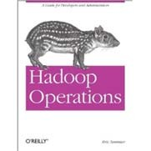
Resources: Books
Hadoop: The Definitive Guide
Tom White (Author)
O'Reilly Media; 3rd Edition (May6, 2012)
Hadoop in Action
Chuck Lam (Author) Manning Publications; 1st Edition (December, 2010)
MapReduce Design Patterns
Donald Miner (Author), Adam Shook (Author) O'Reilly Media (November 22, 2012)
38
Resources: Books
HBase: The Definitive Guide
Lars George (Author)
O'Reilly Media; 1 edition (September 20, 2011)
Programming Pig
Alan Gates (Author) O'Reilly Media; 1st Edition (October, 2011)
Hadoop Operations
Eric Sammer (Author)
O'Reilly Media (October 22, 2012)
39

