Slide 1
Agenda
What is Hadoop?
What is Impala?
Use-­‐cases for Impala
Architecture of Impala
Impala comparisons and performance

Slide 2


Intro to Hadoop

Slide 3






What is Apache Hadoop?
Apache Hadoop is an open source platform for data storage and processing that is…
✓✓ Distributed
✓✓ Fault tolerant
✓✓ Scalable
CORE HADOOP SYSTEM COMPONENTS
Hadoop Distributed File System (HDFS)
Self-Healing, High Bandwidth Clustered Storage
MapReduce
Distributed Computing Framework
Has the Flexibility to Store and Mine Any Type of Data
▪▪ Ask questions across structured and unstructured data that were previously impossible to ask or solve
▪▪ Not bound by a single schema
Excels at Processing Complex Data
▪▪ Scale-out architecture divides workloads across multiple nodes
▪▪ Flexible file system eliminates ETL bottlenecks
Scales Economically
▪▪ Can be deployed on commodity hardware
▪▪ Open source platform guards against vendor lock

Slide 4
MapReduce -­‐ the good and the bad
The Good
Versatile
Flexible
Scalable
The Bad
High latency
Batch oriented
Not all paradigms ﬁt very well
Only for developers

Slide 5
What are Hive and Pig?
MR is hard and only for developers
Higher level platforms for converting declarative syntax to MapReduce
SQL – Hive
workﬂow language – Pig
Build on top of MapReduce (although they are being made more pluggable now)
But jobs are still as slow as MapReduce

Slide 6
Impala

Slide 7
What is Impala?
General-­‐purpose SQL engine
Real-­‐time queries in Apache Hadoop
Beta version released since October 2012
General availability (v1.0) release out since April 2013
Open source under Apache license
Latest release (v1.3.1) released on May 1st, 2014

Slide 8
Impala Overview: Goals
General-­‐purpose SQL query engine:
Works for both for analytical and transactional/single-­‐row workloads
Supports queries that take from milliseconds to hours
Runs directly within Hadoop:
reads widely used Hadoop ﬁle formats
talks to widely used Hadoop storage managers
runs on same nodes that run Hadoop processes
High performance:
C++ instead of Java
runtime code generation
completely new execution engine – No MapReduce

Slide 9
User View of Impala: Overview
Runs as a distributed service in cluster: one Impala daemon on each node with data
Highly available: no single point of failure

Slide 10
User View of Impala: Overview
There is no ‘Impala format’!
Supported ﬁle formats:
uncompressed/lzo-­‐compressed text ﬁles
sequence ﬁles and RCFile with snappy/gzip compression
Avro data ﬁles
Parquet columnar format (more on that later)
HBase

Slide 11
User View of Impala: SQL
SQL support:
essentially SQL-­‐92, minus correlated subqueries
only equi-­‐joins; no non-­‐equi joins, no cross products
Order By requires Limit
(Limited) DDL support
SQL-­‐style authorization via Apache Sentry (incubating)
UDFs and UDAFs are supported

Slide 12
User View of Impala: SQL
Functional limitations:
No ﬁle formats, SerDes
no beyond SQL (buckets, samples, transforms, arrays, structs, maps, xpath, json)
Broadcast joins and partitioned hash joins supported
Smaller table has to ﬁt in aggregate memory of all executing nodes

Slide 13
Use Cases of Impala

Slide 14

Impala Use Cases
Cost-effective, ad hoc query environment that offloads/replaces the data warehouse for:
Interactive BI/analytics on more data
Asking new questions – exploration, ML
Data processing with tight SLAs Query-able archive w/full fidelity

Slide 15

Global Financial Services Company
Saved 90% on incremental EDW spend & improved performance by 5x
Offload data warehouse for query-able archive
Store decades of data cost-effectively
Process & analyze on the same system
Improved capabilities through interactive query on more data

Slide 16

Digital Media Company
20x performance improvement for exploration & data discovery
Easily identify new data sets for modeling
Interact with raw data directly to test hypotheses
Avoid expensive DW schema changes Accelerate ‘time to answer’

Slide 17
Architecture of Impala

Slide 18
Impala Architecture
Three binaries: impalad, statestored, catalogd
Impala daemon (impalad) – N instances
handles client requests and all internal requests related to query execution
State store daemon (statestored) – 1 instance
Provides name service and metadata distribution
Catalog daemon (catalogd) – 1 instance
Relays metadata changes to all impalad’s

Slide 19
Impala Architecture: Query Execution
Request arrives via odbc/jdbc
SQL App
HiveMeta store
HDFS NN
Statestore
+
Catalogd
ODBC
SQL
request
Query Planner
Query Coordinator
Query Executor
HDFS DN | HBase
Query Planner
Query Coordinator
Query Executor
HDFS DN | HBase
Query Planner
Query Coordinator
Query Executor
HDFS DN | HBase

Slide 20
Impala Architecture: Query Execution
Planner turns request into collections of plan fragments Coordinator initiates execution on remote impalad's
SQL App
HiveMeta store
HDFS NN
Statestore
+
Catalogd
ODBC
Query Planner
Query Coordinator
Query Executor
HDFS DN | HBase
Query Planner
Query Coordinator
Query Executor
HDFS DN | HBase
Query Planner
Query Coordinator
Query Executor
HDFS DN | HBase

Slide 21
Impala Architecture: Query Execution
Intermediate results are streamed between impalad's Query results are streamed back to client
SQL App
HiveMeta store
HDFS NN
Statestore
+
Catalogd
ODBC
query results
Query Planner
Query Planner
Query Planner
Query Coordinator
Query Coordinator
Query Coordinator
Query Executor
Query Executor
Query Executor
HDFS DN HBase
HDFS DN HBase
HDFS DN
HBase

Slide 22
Query Planning: Overview
2-­‐phase planning process:
single-­‐node plan: le+-­‐deep tree of plan operators
plan partitioning: partition single-­‐node plan to maximize scan locality, minimize data movement
Parallelization of operators:
All query operators are fully distributed

Slide 23
Query Planning: Single-­‐Node Plan
Plan operators: Scan, HashJoin, HashAggregation, Union,
TopN, Exchange

Slide 24
Single-­‐Node Plan: Example Query
SELECT t1.custid, SUM(t2.revenue) AS revenue
FROM LargeHdfsTable t1
JOIN LargeHdfsTable t2 ON (t1.id1 = t2.id)
JOIN SmallHbaseTable t3 ON (t1.id2 = t3.id) WHERE t3.category = 'Online'
GROUP BY t1.custid
ORDER BY revenue DESC LIMIT 10;

Slide 25
Query Planning: Single-­‐Node Plan
Single-­‐node plan for example:
TopN
Agg
HashJoin
Scan: t3
HashJoin
Scan: t2
Scan: t1

Slide 26
Query Planning: Distributed Plans
at HDFS DN
TopN
Broadcast
TopN
at HBase RS
MergeAgg
at coordinator
hash t1.custid
Pre-Agg
HashJoin
Broadcast
Scan: t3
Scan: t1
hash t1.id1
HashJoin
hash t2.id
Scan: t2

Slide 27
Metadata Handling
Impala metadata:
Hive’s metastore: logical metadata (table deﬁnitions, columns, CREATE TABLE parameters)
HDFS Namenode: directory contents and block replica locations
HDFS DataNode: block replicas’ volume IDs

Slide 28
Impala Execution Engine
Written in C++ for minimal execution overhead
Internal in-­‐memory tuple format puts ﬁxed-­‐width data at ﬁxed oﬀsets
Uses intrinsics/special cpu instructions for text parsing, crc32 computation, etc.
Runtime code generation for “big loops”

Slide 29
Impala Execution Engine
More on runtime code generation
example of "big loop": insert batch of rows into hash table
known at query compile time: # of tuples in a batch, tuple layout, column types, etc.
generate at compile time: unrolled loop that inlines all function calls, contains no dead code, minimizes branches
code generated using llvm

Slide 30
Comparing Impala to Dremel
What is Dremel?
columnar storage for data with nested structures
distributed scalable aggregation on top of that
Columnar storage in Hadoop: Parquet
stores data in appropriate native/binary types
can also store nested structures similar to Dremel's ColumnIO
Parquet is open source: github.com/parquet
Distributed aggregation: Impala
Impala plus Parquet: a superset of the published version of Dremel (which didn't support joins)

Slide 31
Performance
32

Slide 32
Impala Performance Results
Impala’s Latest Milestone:
Comparable commercial MPP DBMS speed
Natively on Hadoop
Three Result Sets:
Impala vs Hive 0.12 (Impala 6-­‐70x faster)
Impala vs “DBMS-­‐Y” (Impala average of 2x faster)
Impala scalability (Impala achieves linear scale)
Background
20 pre-­‐selected, diverse TPC-­‐DS queries (modiﬁed to remove unsupported language)
Suﬃcient data scale for realistic comparison (3 TB, 15 TB, and 30 TB)
Realistic nodes (e.g. 8-­‐core CPU, 96GB RAM, 12x2TB disks)
Methodical testing (multiple runs, reviewed fairness for competition, etc)
Details: http://blog.cloudera.com/blog/2014/01/impala-­‐performance-­‐dbms-­‐class-­‐speed/
33

Slide 33
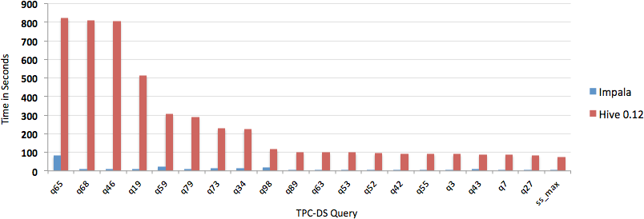
Impala vs Hive 0.12 (Lower bars are better)
34

Slide 34
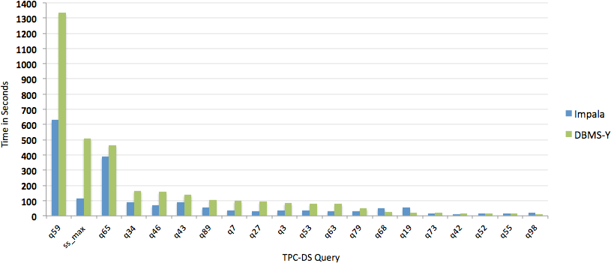
Impala vs “DBMS-­‐Y” (Lower bars are better)
35

Slide 35
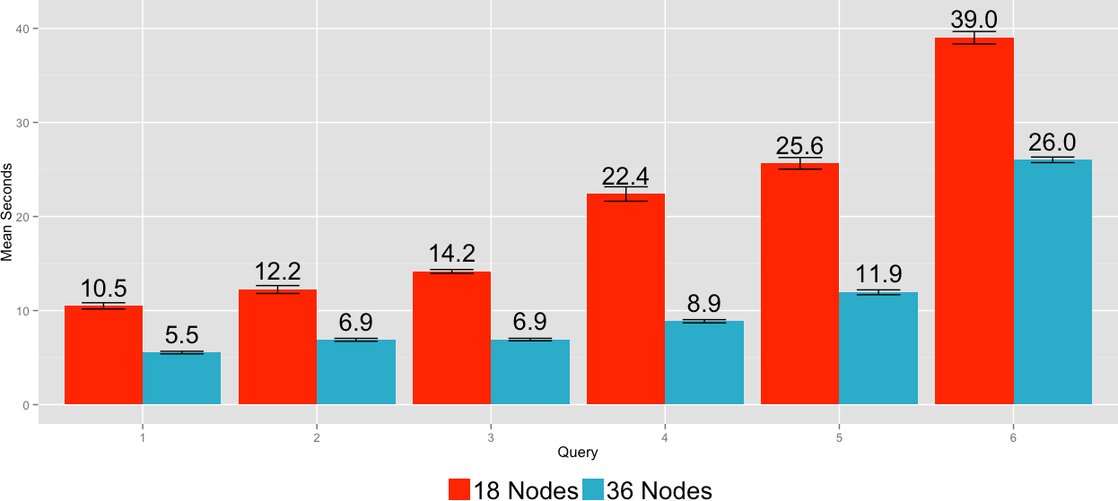
Impala Scalability: 2x the Hardware (Expectation: Cut Response Times in Half)
36

Slide 36
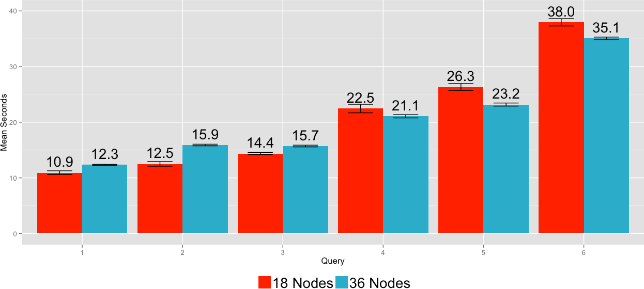
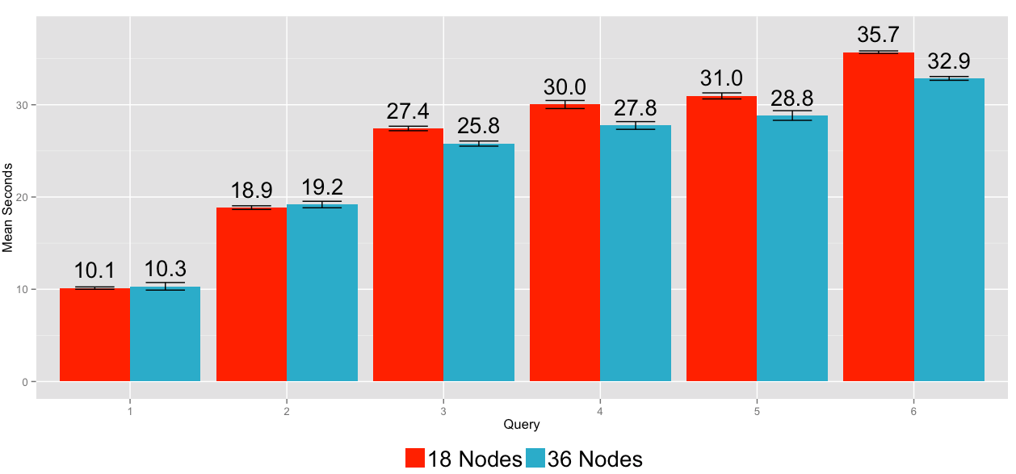
Impala Scalability: 2x the Hardware and 2x Users/Data (Expectation: Constant Response Times)
2x the Users, 2x the Hardware
2x the Data, 2x the Hardware
37

