Slide 1
RAC

Slide 2
What is a rack?
The Rack is the collection of around 40-50 DataNodes connected using the same network switch. If the network goes down, the whole rack will be unavailable. A large Hadoop cluster is deployed in multiple racks.
What is Rack Awareness in Hadoop HDFS?
In a large Hadoop cluster, there are multiple racks. Each rack consists of DataNodes. Communication between the DataNodes on the same rack is more efficient as compared to the communication between DataNodes residing on different racks.
To reduce the network traffic during file read/write, NameNode chooses the closest DataNode for serving the client read/write request. NameNode maintains rack ids of each DataNode to achieve this rack information. This concept of choosing the closest DataNode based on the rack information is known as Rack Awareness.

Slide 3
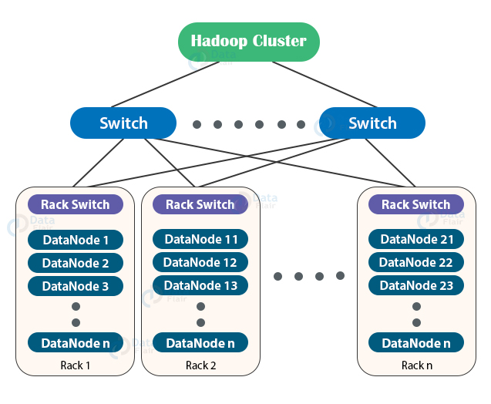

Slide 4
Why Rack Awareness?
The reasons for the Rack Awareness in Hadoop are:
To reduce the network traffic while file read/write, which improves the cluster performance.
To achieve fault tolerance, even when the rack goes down (discussed later in this article).
Achieve high availability of data so that data is available even in unfavorable conditions.
To reduce the latency, that is, to make the file read/write operations done with lower delay.
NameNode uses a rack awareness algorithm while placing the replicas in HDFS.

Slide 5
Replica placement via Rack awareness in Hadoop
We know HDFS stores replicas of data blocks of a file to provide fault tolerance and high availability. Also, the network bandwidth between nodes within the rack is higher than the network bandwidth between nodes on a different rack.
If we store replicas on different nodes on the same rack, then it improves the network bandwidth, but if the rack fails (rarely happens), then there will be no copy of data on another rack.
Again, if we store replicas on unique racks, then due to the transfer of blocks to multiple racks while writes increase the cost of writes.
Therefore, NameNode on multiple rack cluster maintains block replication by using inbuilt Rack awareness policies which says:
Not more than one replica be placed on one node.
Not more than two replicas are placed on the same rack.
Also, the number of racks used for block replication should always be smaller than the number of replicas.
For the common case where the replication factor is three, the block replication policy put the first replica on the local rack, a second replica on the different DataNode on the same rack, and a third replica on the different rack.
Also, while re-replicating a block, if the existing replica is one, place the second replica on a different rack. If the existing replicas are two and are on the same rack, then place the third replica on a different rack.

Slide 6
