Slide 2
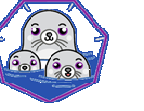

Agenda
Introduction to Containerization
Advantages of Containerization
Images and Containers
Container Management Tools – docker ,podman
Docker commands
Docker Compose
Podman Commands
Kubernetes

Slide 3
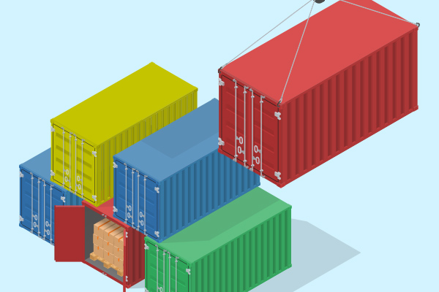
Introduction to Containerization
Containerization is the process of packaging software code, its required dependencies, configurations, libraries and other details like setup etc. which can run in a target computing environment in a smooth and efficient manner
Containerization abstracts an application and its required environment.
Frees technology and vendor lock-in
Successful in eliminating the conflict of different work environments that affected the productivity and efficiency previously and helps Operations and Development team to collaborate better

Slide 4
Containers versus Virtual machines
GB
MB
Utilization
Size
Boot up
Utilization
Size
Boot up
Virtual Machine
Virtual Machine
Container
Container
Application
Application
Libs
Deps
Libs
Deps
Application
Application
OS
OS
Libs
Deps
Libs
Deps
Hypervisor
Docker
OS
OS
Hardware
Hardware

Slide 5
Advantages of containerization
Portable in Nature
  A container image can be deployed to a new system easily,
  Facilitate deployment of a single app on different flavors of OS
  Easy migration to new environments like cloud without worrying about dependencies
Maximum Utilization of Resources
  Containerization makes maximum utilization of computing resources like memory and CPU, and utilize far fewer resources than VMs.
  Better sharing of hardware resources
DevOps friendly
  developers and testers work collaboratively on the application,
  Speed up environment provisioning
  Launch the distributed applications quickly without replicating the OS layer frequently
  Faster scalability
Simplified Security
  Containers provide process isolation

Slide 6
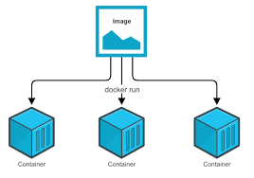
Images and containers
An image is an executable package that includes everything needed to run an application--the code, a runtime, libraries, environment variables, and configuration files.
Images are built as Layers – every layer is an image
Images can be stored on docker hub or antifactory
A container is a runtime instance of an image--what the image becomes in memory when executed (that is, an image with state, or a user process).

Slide 7
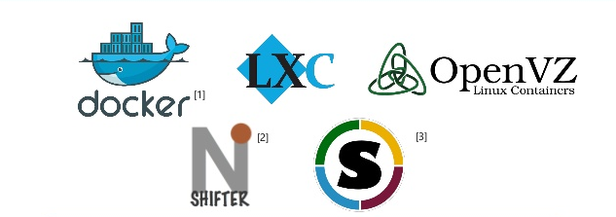
Popular Linux Containers

Slide 8
Agenda
What is docker
Docker Architecture
Docker images
Working with docker
  downloading images
  managing containers
  extending containers

Slide 9
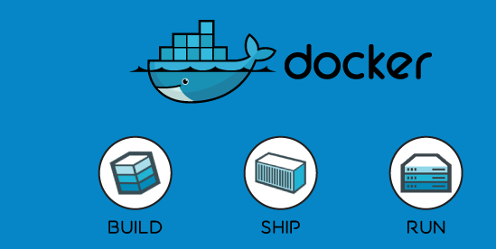
Docker
Docker is a popular Open-Source Linux Container Engine, developed by DotCloud
Simplifies the process of creating and managing containers
Serves as a base for Container Orchestration

Slide 10
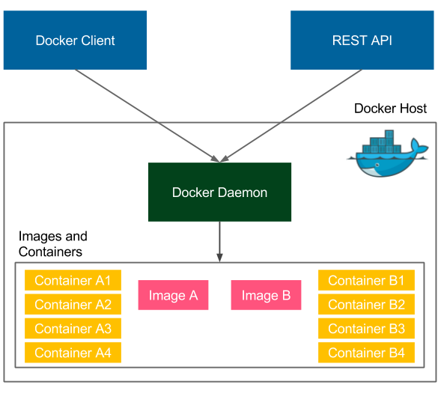
Docker Engine Architecture

Slide 11
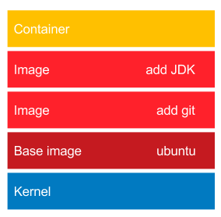
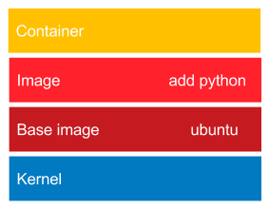
Understanding Docker images
Image is a collection of all files necessary to run application along with its dependencies
Images are layered, each layer is intermediate image and can be reused
Images are immutable
Docker is intelligent in reusing image
Base images for most open sources are available in docker registry - dockerhub

Slide 12
Working with docker
Pulling an image from a repository
Viewing the list of images
Creating a container
Viewing containers
Getting inside Containers
Stopping and removing Containers
docker pull postgres:latest
Saving the container as new image
docker commit c1 <newimagename>
docker images
docker run -d –name c1 <imageid> / <imagename>
docker ps
docker exec –it c1 –exec <cmd>
docker stop c1
docke rm c1

Slide 13
Dockerfile
A text file which contains all the commands, in order, needed to build a given image
Docker can build the image by reading the instructions from the script
Dockerfile is composed of various commands/instructions and arguments to automatically perform actions on a base image in order to create a new one.
Default name is Dockerfile, but can have any other name indicated using –f option
  FROM ubuntu:16.04
  MAINTAINER Shashidhar K
  RUN apt-get update && \
  apt-get install -y python
  COPY hello.py .
  ENTRYPOINT ["python", "hello.py"]
docker build –t <pathname>
AUTHOR-NAME

Slide 14
Docker life cycle
Docker commit
Docker Image 2
More s/w
Exit Container
yum install
Docker
File
Docker Image 1
Docker Container
Docker exec
Docker build
Docker run

Slide 15
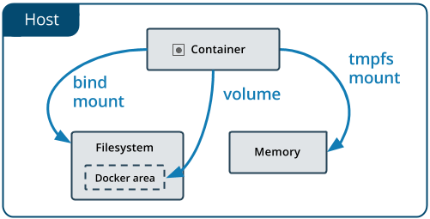
Managing data in docker
--mount
Container's data is internally stored hence moving data or retrieving data is not possible
Data available options
  Volumes
  Bind Mounts
  Tmpfs Mount
Volumes are stored in a part of the host filesystem which is managed by Docker -- /var/lib/docker/volumes/
A given volume can be mounted into multiple containers simultaneously
docker volume create
docker run –d myc1 –mount type=volume, source=vol1 target= /app1
Bind mounts are similar to volumes, but the directory can be anywhere in the host file system.
docker run –d myc1 –mount type=bind , source = /hostdir target=/app1

Slide 16
Volume vs Bind Mount
Volumes
  Sharing data amongst containers
  Decouple host environment from containers
  Migrate/backup data from one Docker Host to another
Bind Mount
  Sharing files from the host machine to containers
  File system of the host are consistent

Slide 17
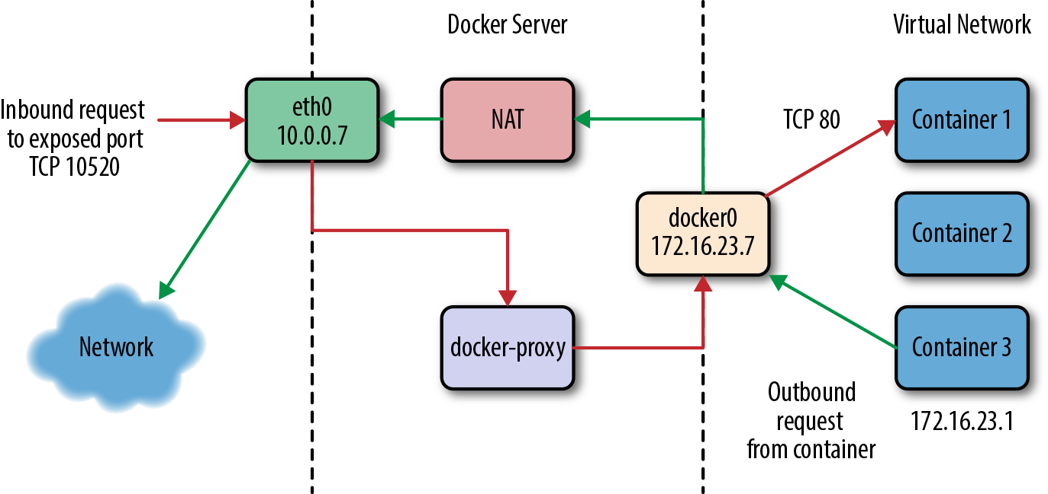
Docker Networking
-p, --publish <host_port>:<container_port>
e.g. docker run -d -p 8080:8080 tomcat
Notes:
Even though Docker containers are largely made up of processes running on the host system itself, they usually behave quite differently from other processes at the network layer. Docker initially supported a single networking model, but now supports a robust assortment of configurations that handle most application requirements. Most people run their containers in the default configuration, called bridge mode. So let’s take a look at how it works.
To understand bridge mode, it’s easiest to think of each of your Docker containers as behaving like a host on a private network. The Docker server acts as a virtual bridge and the containers are clients behind it. A bridge is just a network device that repeats traffic from one side to another. So you can think of it like a mini–virtual network with each container acting like a host attached to that network.
The actual implementation, as shown in Figure 2-4, is that each container has its own virtual Ethernet interface connected to the Docker bridge and its own IP address allocated to the virtual interface. Docker lets you bind and expose individual or groups of ports on the host to the container so that the outside world can reach your container on those ports. That traffic passes over a proxy that is also part of the Docker daemon before getting to the container.
Docker allocates the private subnet from an unused RFC 1918 private subnet block. It detects which network blocks are unused on the host and allocates one of those to the virtual network. That is bridged to the host’s local network through an interface on the server called docker0. This means that all of the containers are on a network together and can talk to each other directly. But to get to the host or the outside world, they go over the docker0 virtual bridge interface. As we mentioned, inbound traffic goes over the proxy. This proxy is fairly high performance but can be limiting if you run high-throughput applications in containers.

Slide 18
Setting up docker compose
Needs the package docker-compose
Uses the directory name as the project name
Create a YAML file with entries for creating containers, exposing ports, connecting containers etc.
Default name docker-compose.yml

Slide 19
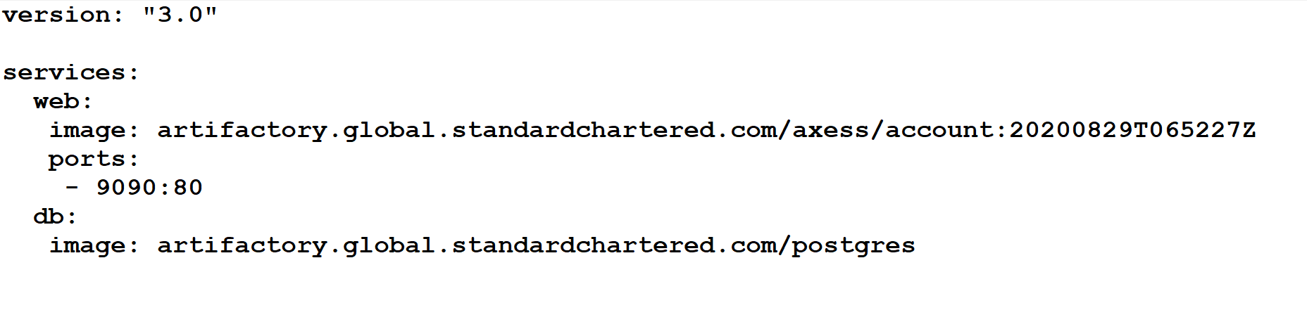
Docker-compose file
Version
Services
  Build
  Image
  Environment
  Ports
  Volumes
Volumes
Networks
docker-compose up --detach

Slide 20
Docker-compose commands
Creating and starting containers
List all the containers
Stops all containers
Scales to number of containers
$ docker-compose up -d
$ docker-compose ps
$ docker-compose down
$ docker-compose --scale web=3

Slide 21
List of commands
build Build or rebuild services
help Get help on a command
kill Kill containers
logs View output from containers
port Print the public port for a port binding
ps List containers
pull Pulls service images
rm Remove stopped containers
run Run a one-off command
scale Set number of containers for a service
start Start services
stop Stop services
restart Restart services
up Create and start containers

Slide 22
Docker-compose explained
---
version: '2'
services:
zookeeper:
image: confluentinc/cp-zookeeper:latest
environment:
ZOOKEEPER_CLIENT_PORT: 2181
ZOOKEEPER_TICK_TIME: 2000
kafka:
image: confluentinc/cp-kafka:latest
depends_on:
- zookeeper
ports:
- 9092:9092
environment:
KAFKA_BROKER_ID: 1
KAFKA_ZOOKEEPER_CONNECT: zookeeper:2181
KAFKA_ADVERTISED_LISTENERS: PLAINTEXT://kafka:29092,PLAINTEXT_HOST://localhost:9092
KAFKA_LISTENER_SECURITY_PROTOCOL_MAP: PLAINTEXT:PLAINTEXT,PLAINTEXT_HOST:PLAINTEXT
KAFKA_INTER_BROKER_LISTENER_NAME: PLAINTEXT
KAFKA_OFFSETS_TOPIC_REPLICATION_FACTOR: 1

Slide 23
Kubernates
Open source platform which automates container operations – deploying , scaling , resource management,configuring etc
Originated at Google later donated to CNCF – Cloud Native Computing Foundation
Can be used with/out docker
Kubernetes runs containers as pods – which is one or more containers sharing resources and sitting in same Node
Kubernetes finds a machine with enough compute capacity to launch a pod
A node agent, called a Kubelet, manages pods, their containers and their images. Kubelets also automatically restart a container if it fails.

Slide 24
Kubernetes
Desired State Configuration
P1 R1, P2 R1
Worker 1/Node
(Kuberlet + container run time)
App.yaml
K
POD 1:
Container 1
Container 2
Replicas : 3
POD 2:
Container 3
Replicas : 2
K8S Cluster
Service
P1 R2
Worker 2/Node
API
K
Apiserver, controller, scheduler
P1 R3, P2 R2
Worker 3/Node
K

