Slide 1
Introduction to NoSQL
Vishwa

Slide 2
What does NOSQL stand for?
Not Only SQL database
is an alternative to traditional relational databases
useful for working with large sets of distributed data

Slide 3
How does NoSQL vary from RDBMS?
Looser schema definition
•Applications written to deal with specific documents/ data
•Applications aware of the schema definition as opposed to the data
•Designed to handle distributed, large databases
•Trade offs:
•No strong support for ad hoc queries but designed for speed and growth of database
•Query language through the API
•Relaxation of the ACID properties

Slide 4
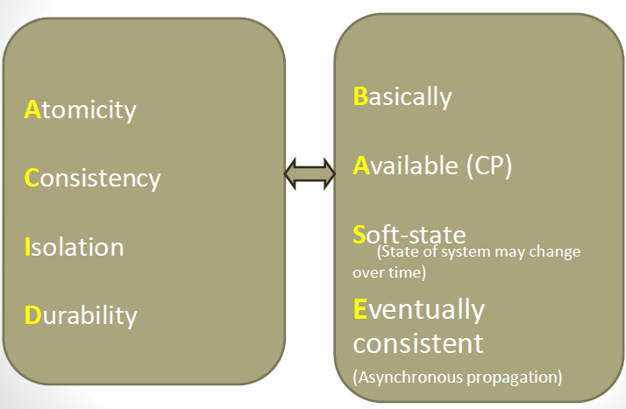

Slide 5
Benefits of NoSQL
Elastic Scaling
•RDBMS scale up –bigger load , bigger server
•NO SQL scale out –distribute data across multiple hosts seamlessly
DBA Specialists
•RDMS require highly trained expert to monitor DB
•NoSQL require less management, automatic repair and simpler data models
Big Data
•Huge increase in data RDMS: capacity and constraints of data volumes at its limits
•NoSQL designed for big data
Flexible data models
•Change management to schema for RDMS have to be carefully managed
•NoSQL databases more relaxed in structure of data
•Database schema changes do not have to be managed as one complicated change unit
•Application already written to address an amorphous schema
Economics
•RDMS rely on expensive proprietary servers to manage data
•No SQL: clusters of cheap commodity servers to manage the data and transaction volumes
•Cost per gigabyte or transaction/second for NoSQL can be lower than the cost for a RDBMS

Slide 6
Drawbacks of NoSQL
•Support
•RDBMS vendors provide a high level of support to clients
•Stellar reputation
•NoSQL –are open source projects with startups supporting them
•Reputation not yet established
•Maturity
•RDMS mature product: means stable and dependable
•Also means old no longer cutting edge nor interesting
•NoSQL are still implementing their basic feature set

Slide 7
Types of No SQL
Key-value stores
pairs a unique key with an associated value
Are extremely performing and highly scalable for session management and caching in web applications
they are oriented to work with RAM, solid-state drives or disk drives

Slide 8
Types of No SQL
Document databases
also called document stores
store semi-structured data and descriptions of that data in document format
allow developers to create and update programs without needing to reference master schema
JSON format support though XML is also supported
are used for content management and mobile application data handling

Slide 9
Types of No SQL
Wide-column stores
organize data tables as columns instead of as rows
can query large data volumes faster than conventional relational databases
used for recommendation engines, catalogs, fraud detection and other types of data processing

Slide 10
Types of No SQL
Graph stores
organize data as nodes, which are like records in a relational database, and edges, which represent connections between nodes
support richer representations of data relationships
the graph data model can evolve over time and use
reservation systems or customer relationship management

Slide 11
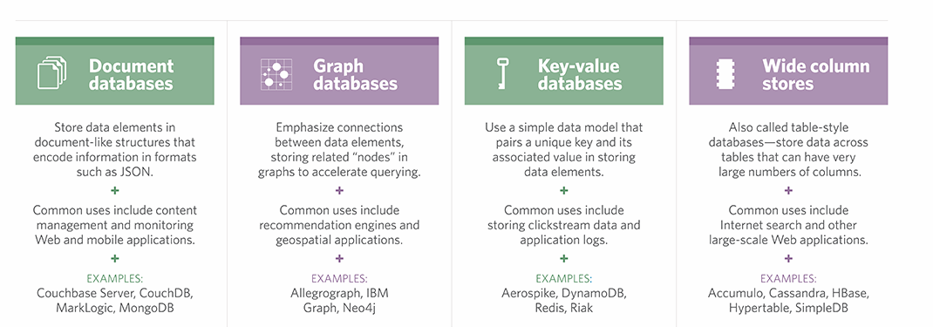
Different types of NO SQL

Slide 12
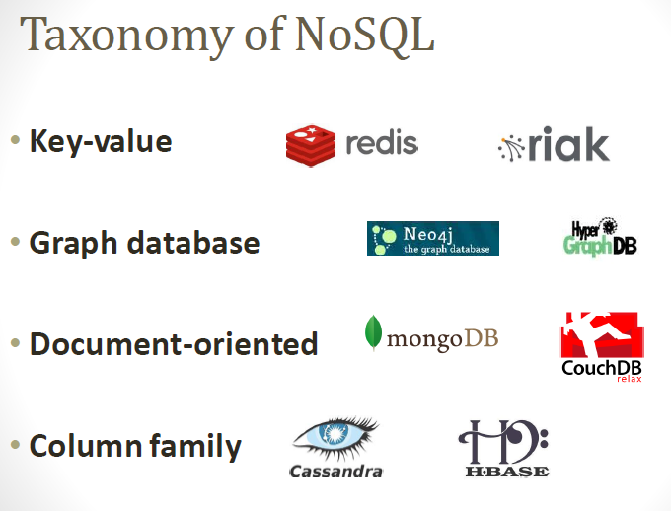

Slide 13
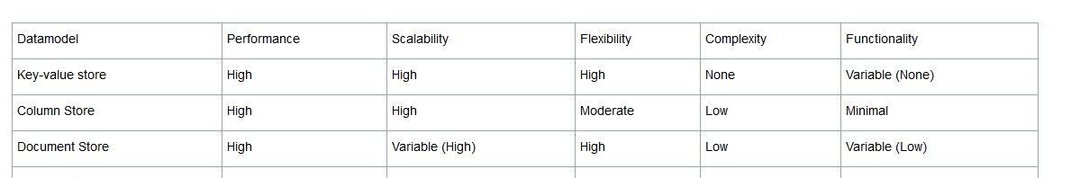

Slide 14
Mongo db
A document-oriented database
– documents encapsulate and encode data (or
information) in some standard formats or encodings
• NoSQL database
– non-adherence to the widely used relational database
– highly optimized for retrieve and append operations
• uses BSON format
• schema-less
– No more configuring database columns with types
• No transactions
• No joins

Slide 15
Mongo db history
Developed by 10gen
•Founded in 2007
•A document-oriented, NoSQL database
•Hash-based, schema-less database
•No Data Definition Language
•In practice, this means you can store hashes with any keys and values that you choose
•Keys are a basic data type but in reality stored as strings
•Document Identifiers (_id) will be created for each document, field name reserved by system
•Application tracks the schema and mapping
•Uses BSON format
•Based on JSON –B stands for Binary
•Written in C++
•Supports APIs (drivers) in many computer languages
•JavaScript, Python, Ruby, Perl, Java, JavaScala, C#, C++, Haskell, Erlang

Slide 16
Functionality of MongoDB
•Dynamic schema
•No DDL
•Document-based database
•Secondary indexes
•Query language via an API
•Atomic writes and fully-consistent reads
•If system configured that way
•Master-slave replication with automated failover (replica sets)
•Built-in horizontal scaling via automated range-based partitioning of data (sharding)
•No joins nor transactions

Slide 17
MongoDB Features
•Document-Oriented storage
•Full Index Support
•Replication & High Availability
•Auto-Sharding
•Querying
•Fast In-Place Updates
•Map/Reducefunctionality

Slide 18
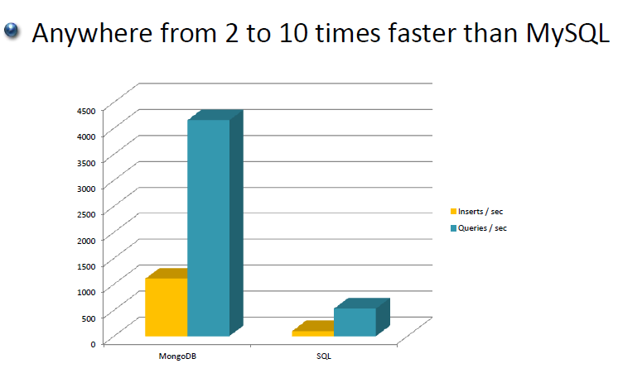

Slide 19
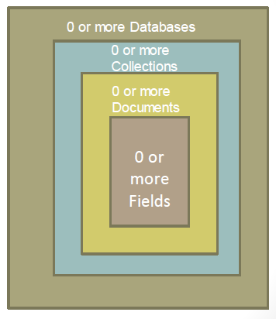
MongoDB: Hierarchical Objects

Slide 20
MongoDB: Hierarchical Objects
A MongoDB instance may have zero or more ‘databases’
•A database may have zero or more ‘collections’.
•A collection may have zero or more ‘documents’.
•A document may have one or more ‘fields’.
•MongoDB ‘Indexes’ function much like their RDBMS counterparts

Slide 21
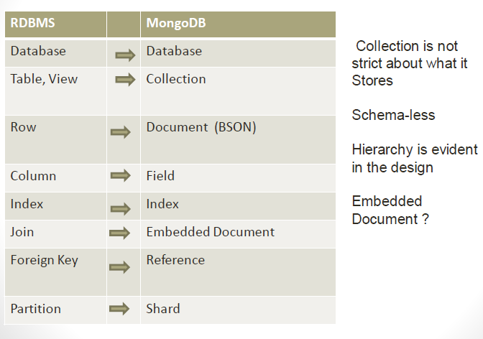

Slide 22
BSON format
•Binary-encoded serialization of JSON-like documents
•Zero or more key/value pairs are stored as a single entity
•Each entry consists of a field name, a data type, and a value
•Large elements in a BSON document are prefixed with a length field to facilitate scanning

Slide 23
JSON format
•Data is in name / value pairs
•A name/value pair consists of a field name followed by a colon, followed by a value:
•Example: “name”: “R2-D2”
•Data is separated by commas
•Example: “name”: “R2-D2”, race : “Droid”
•Curly braces hold objects
•Example: {“name”: “R2-D2”, race : “Droid”, affiliation: “rebels”}
•An array is stored in brackets []
•Example [ {“name”: “R2-D2”, race : “Droid”, affiliation: “rebels”},
•{“name”: “Yoda”, affiliation: “rebels”} ]

Slide 24
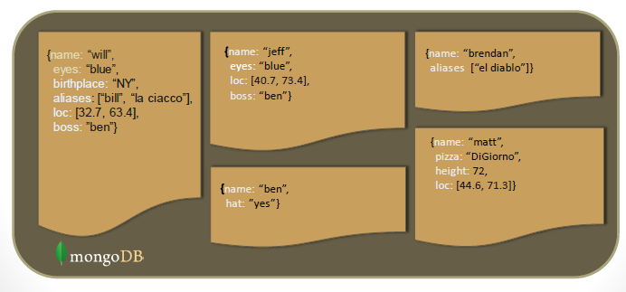
Schema Free name

Slide 25
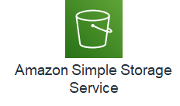
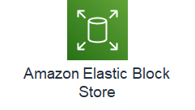
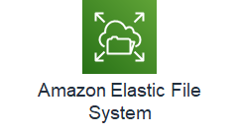

AWS Storage options
Object storage
Block storage
File storage

Slide 26
Amazon S3 (Simple Storage Service)
Storage for the internet
Object level storage (Max limit of 5 TB per object)
Designed for 11 nines durability: replicated to six copies across >= 3 Azs
Replication is consistent for reads and writes - synchronous (real time)
Data stored inside Buckets (soft limit of 100 buckets per account)
Very low cost (charged at per GB per month)
Ideal for Write Once, Read Many (WORM) kind of requirements
Supports Event triggers (e.g. when a file is uploaded)
Accessed through HTTP URL which should be DNS compliant
Private to the owner by default ; access can be controlled through policies
Supports versioning (delete does not remove the item, only puts a delete marker and enables a new version to be created. Possible to retrieve earlier version)
Notes:
Object level storage means there is no concept of update to a file – entire file needs to be re-uploaded
There is no restriction to amount of data inside a bucket
Pay for storage and transfer out to other regions and for the read and put/post requests
Not pay for transfer IN to S3 and for moving to EC2 instances in same region

Slide 27




S3 Concepts
S3 stored data as objects inside buckets
Bucket name is globally unique across accounts and regions
An object is composed of a file plus any meta-data that describes the file
You can have up to 100 buckets in an account
Maximum object size is 5 TB
Three states of a S3 bucket :
Un-versioned (default)
Versioning enabled
Versioning suspended
Amazon Simple Storage Service
Bucket with objects
Bucket
Object
An Object Key is the unique identifier for an object in a bucket
http://doc.s3.amazon.com/2006-03-01/AmazonS3.html
Bucket
Key / Object
Notes:
Cannot have buckets inside buckets

Slide 28
S3 Storage Classes
S3 Standard
99.99 % Availability
S3 Intelligent tiering
99.9 % Availability
COST
S3 standard - IA
99.9 % Availability
S3 1 Zone - IA
All replicas on same Zone
99.5 % Availability
Glacier
Ideal for Archival data.
Data encrypted and stored inside vaults
Retrieval time of minutes to hours
Deep Archival
For long term data retention (7 – 10 years)
Ideal alternative to tape libraries
Retrieval time within 12 hours
Lifecycle management rules dictate how objects are managed during their lifetime.
Can be used to dictate transitioning between the storage classes above
Notes:
Lifecycle policies to transition between storage classes
All storage classes support 11 nines durability
Refer - https://aws.amazon.com/s3/storage-classes/

Slide 29
Transferring files to S3 and typical use cases for S3
Transferring files to S3
Using console / SDK / API
Data Sync: For high speed transfer from on-premise to S3/EFS
AWS hosted full managed SFTP service
Multi part upload: Breaks down file into smaller chunks and uploads separately ; S3 combines the part to create the full object
Transfer acceleration : Uses edge location and backbone network
Use cases for S3
Storing and distributing static web content and media
( https://[bucketname].s3.amazon.com)
Data store for large computation and large scale analytics (clickstream analysis, financial transaction analysis) : Due to horizontal scaling
Data backup and archival – due to high durability, scalability and low cost. Can store copies to other regions
Storing AMIs and Snapshots

Slide 30


Transferring large data
Petabyte scale data transport
Appliance sent to premise for transferring data
Shipped back to Amazon facility and transferred to S3
AWS Snowball
Exabyte scale data transport
45 ft shipping container pulled by a semi-trailor
100 PB per snowmobile
High security – video surveillance, GPS, 256 bit encryption
AWS Snowmobile

Slide 31
Block storage
Instance store
Disks physically attached to host computer
Ephemeral storage - data stored is not persistent through instance stops, terminations, or hardware failures
Ideal for temporary data like buffer, cache, data replicated across load balanced servers
EBS (Elastic Block Storage)
Durable detachable, block storage for EC2
Consistent and Low latency performance
Stored data is automatically replicated within the AZ
Data persists through shut down
Recommended when data must be quickly accessible and requires long term persistence
OS root volumes
Database files
Enterprise applications
Notes:
Ephemeral -
Free, part of the instance
Block storage
No guarantee of performance
Ideal for Buffer, cache, replicated data, scratch
EBS
Supports incremental snapshots (on private area in S3)
Can be moved to other AZs

Slide 32
EBS Life-cycle
Create volume
Attach to EC2 instance
Format and Use
Snapshot to S3
Detach from EC2
Delete volume
Notes:
Can create a volume from an existing snapshot

Slide 33
EBS types
Type | General Purpose SSD | Provisioned IOPS SSD
SSD Backed | Balances price and performance for wide variety of workloads (1 GB to 16 TB) | High performance SSD for mission critical low latency / high throughput workloads (e.g. large databases) 4 GB to 16 TB)
Type | Throughput optimized HDD | Cold HDD
HDD Backed | Low cost HDD designed for frequently accessed throughput intensive workloads E.g. streaming, Big Data, log processing 500 GB to 16 TB) | Lowest cost HDD designed for less frequently accessed workloads E.g. large volume of data accessed infrequently 500 GB to 16 TB)
Notes:
Gp SSD – the IOPS scales linearly per GB with a minimum of 100 IOPS and a maximum of 16000 IOPS
Provisioned IOPS allows you to specify a target IOPS for your application so you will get the guaranteed IOPS
SSD backed is good for transactional workloads involving frequent read / write operations with small I/O size , where dominant performance attribute is IOPS
HDD backed is good for large streaming workloads where throughput is a better measure than IOPS

Slide 34
Amazon EFS (Elastic File System)
Network File System for Linux
Can be shared across EC2 instances in different AZ, regions, VPCs and accounts
Uses NFSv4 protocol
Mounted to an EC2 instance
Offers two storage classes (Standard and Infrequent access)
FSx is the equivalent option for Windows
Notes:
https://aws.amazon.com/efs/when-to-choose-efs/

Slide 35
Reboot vs Stop vs Terminate
Behavior | Reboot | Stop/Start | Terminate
Host computer | Instances stays on same computer | Instance runs on new computer
Public IP address | No change | New IP assigned
Elastic IP address | EIP remains associated with instance | EIP remains associated with instance | EIP disassociated from instance
Instance store volume | Preserved | Erased | Erased
EBS volume | Preserved | Preserved | Boot volume deleted by default
Billing | Instance billing hour doesn’t change | Stop incurring charges till Start | Stop incurring charges

