Slide 2






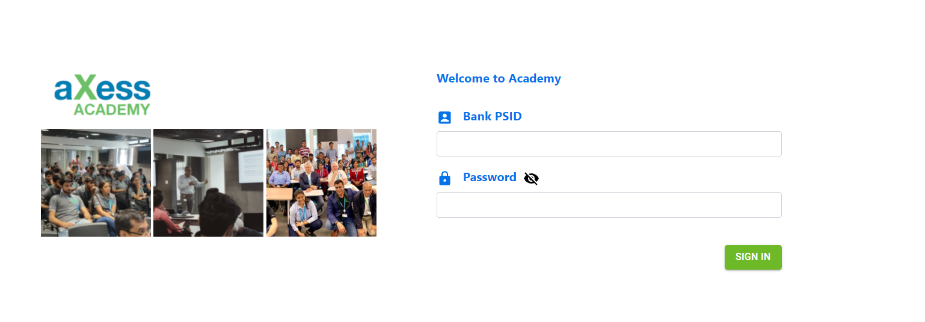
Session Guidelines
Post your questions in Chat Window
Raise your hand to ask queries
Keep your audio on mute unless you wish to interact
Respect timings and be punctual
Keep the playbook updated

Slide 3

Course contents
Introduction
Overview of Cloud and AWS
Bank strategy on Cloud
AWS VPC
AWS EC2
AWS RDS
EC2 Hand-on
AWS RDS Hands-on
AWS Storage
AWS Auto scaling
AWS Security & IAM
Demo on AWS EBS
Auto Scaling Hands-on
Wrap-up
Day 2
Day 1

Slide 4
Lab – Registration instructions
Sign up on https://www.qwiklabs.com using your personal email id
Share the email id with the facilitator so that it can be added to the Classroom share group
Search for the labs using the exact string specified in this document. Pay attention to the number of credits (each lab is either 1 credit or free)
Do not retake labs without the facilitators explicit permission as there is cost attached to each take

Slide 5

Course contents
Introduction
Overview of Cloud and AWS
Bank strategy on Cloud
AWS VPC
AWS EC2
AWS RDS
EC2 Hand-on
AWS RDS Hands-on
AWS Storage
AWS Auto scaling
AWS Security & IAM
Demo on AWS EBS
Auto Scaling Hands-on
Wrap-up
Day 2
Day 1

Slide 6
Cloud Computing at a glance
5 Characteristics
On-Demand
Broad network access
Resource Pooling
Rapid Elasticity
Measured Service
IAAS
PAAS
3 Service Models
SAAS
Private
Hybrid
Community
Public
4 Deployment
models
Notes:
Examples of PaaS – Azure, AWS Lambda, AWS Elastic Beanstalk, Google App Engine etc.
Hybrid Model – mix of private and public cloud to manage workloads. Usually there is some level of connection / orchestration between the two. E.g. cloud burst to scale workloads to public when high demand is witnessed OR move non sensitive processing to public like Big Data processing or Test /Dev environments

Slide 7
What is AWS
Amazon Web Services (AWS) is a set of remote cloud computing services offered over the internet
The AWS mission is to enable businesses and developers to use web services to build scalable, sophisticated applications
AWS provides web based cloud services for storage, computing, networking, databases, analytics, machine learning and artificial intelligence (AI), Internet of Things (IoT), security, and application development, deployment, and management.
AWS was launched in 2006 (book store launched in 1995)
Currently offers more than 175 full featured services

Slide 8






Benefits of AWS
Trade capital expense
for variable expense
Increase speed and agility
Economies of scale
Avoid spends on running and maintaining data centers
No need to guess capacity
Go Global in minutes

Slide 9
AWS Cloud Computing
Databases
Analytics
App Services
Deployment
& Management
Mobile services
Platform
Services
Relational
NoSQL
Caching
Cluster Computing
Real-time
Data warehouse
Data workflows
Queuing
Orchestration
Email
Search
Containers
DevOps tools
Usage tracking
Monitoring and logs
Identity
Sync
Mobile Analytics
Notifications
Foundational
Services
Storage
Compute
Networking
Infrastructure
Regions
Availability zones
Edge locations

Slide 10
AWS Global Infrastructure
Regions
Geographical locations (24 currently)
At least two availability zones
All services are not available in all regions
Availability zones
Clusters of data centers (77 currently)
Isolated from failures in other availability zones
All AZs are interconnected by AWS backbone Optic Fiber network
AWS GovCloud (US) Region is an isolated region : For US government agencies and customers to move sensitive workloads into the cloud by addressing specific regulatory and compliance requirements
https://www.infrastructure.aws/
Notes:
Availability zones takes into consideration natural disasters and fault lines for earthquakes so that multiple Azs are not impacted at the same time
All Azs are interconnected by optic fibers completely owned and managed by AWS
The latency within a region is less than 9 ms , across regions is less than 1 sec (depends which two regions are communicating)
All services are not available in all regions
Prices differ across regions
Cheapest one is North Virginia (also all services available here and 6 AZs)
Mumbai has 3 Azs
Recommended to distribute workload across Azs to provide better availability

Slide 11
AWS Global Infrastructure (contd)
Edge Locations (local points of presence) – 220+
Following services available –
Amazon CloudFront (CDN service)
Amazon Route 53 (DNS service)
AWS WAF (Web application firewall)
AWS Shield
Lamda@Edge
Notes:
Amazon CloudFront is a fast content delivery network (CDN) service that securely delivers data, videos, applications, and APIs to customers globally with low latency, high transfer speeds, all within a developer-friendly environment
AWS WAF is a web application firewall that helps protect your web applications from common web exploits that could affect application availability, compromise security, or consume excessive resources. AWS WAF gives you control over which traffic to allow or block to your web applications by defining customizable web security rules. You can use AWS WAF to create custom rules that block common attack patterns, such as SQL injection or cross-site scripting, and rules that are designed for your specific application.
AWS Shield is a security service that protects web applications hosted on the Amazon Web Services public cloud against distributed denial of service (DDoS) attacks.
Amazon Route 53 is a highly available and scalable cloud Domain Name System (DNS) web service. Amazon Route 53 effectively connects user requests to infrastructure running in AWS – such as Amazon EC2 instances, Elastic Load Balancing load balancers, or Amazon S3 buckets – and can also be used to route users to infrastructure outside of AWS. You can use Amazon Route 53 to configure DNS health checks to route traffic to healthy endpoints or to independently monitor the health of your application and its endpoints. Amazon Route 53 Traffic Flow makes it easy for you to manage traffic globally through a variety of routing types, including Latency Based Routing, Geo DNS, Geoproximity, and Weighted Round Robin—all of which can be combined with DNS Failover in order to enable a variety of low-latency, fault-tolerant architectures
Lambda@Edge is a feature of Amazon CloudFront that lets you run code closer to users of your application, which improves performance and reduces latency

Slide 12
AWS vocabulary
Soft limits: Constraints imposed by AWS but which can be changed on request. E.g. Number of VPCs allowed per region per account (5)
Hard limits: Constraints imposed by AWS which cannot be changed. E.g. 5TB limit on a S3 bucket
Fully Managed services: Completely managed and supported by AWS (e.g. Aurora DB under AWS RDS)

Slide 13
Course contents
Introduction
Overview of Cloud and AWS
Bank strategy on Cloud
AWS VPC
AWS EC2
AWS RDS
EC2 Hand-on
AWS RDS Hands-on
AWS Storage
AWS Auto scaling
AWS Security & IAM
Demo on AWS EBS
Auto Scaling Hands-on
Wrap-up
Day 2
Day 1

Slide 14

Break time !!!
Enjoy your break. We shall resume at 11:00 AM IST (1:30 PM SG time)
Upcoming session: AWS VPC

Slide 15
Course contents
Introduction
Overview of Cloud and AWS
Bank strategy on Cloud
AWS VPC
AWS EC2
AWS RDS
EC2 Hand-on
AWS RDS Hands-on
AWS Storage
AWS Auto scaling
AWS Security & IAM
Demo on AWS EBS
Auto Scaling Hands-on
Wrap-up
Day 2
Day 1

Slide 16
What is a VPC
Virtual Private Cloud (VPC) allows you to create your own “virtual network” on AWS with complete control on the networking environment
Customized N/W configuration :
Selection of IP addresses
Creation of subnets
Configuration of route tables
Setting up network gateways
Connect to corporate network outside AWS
Dedicated to an AWS account and isolated from other VPCs
Encompasses all Availability zones in a region

Slide 17







Typical VPC architecture and components
AWS
Internet gateway
Custom route table
Destination | Target
10.0.0.0/16 | local
0.0.0.0/0 | Igw-id
Amazon VPC
Elastic IPs
198.51.100.1
198.51.100.2
198.51.100.3
10.0.0.5
10.0.0.6
10.0.0.7
Web servers
Public subnet
10.0.0.0/24
Availability zone A
Router
VPN gateway
VPN connection
Customer gateway
Corporate
network
10.0.1.5
10.0.1.6
10.0.1.7
Main route table
Database servers
Destination | Target
10.0.0.0/16 | local
0.0.0.0/0 | vgw-id
Private subnet
10.0.1.0/24
Availability zone B
VPC
10.0.0.0/16

Slide 18
Key components of a VPC
Subnets
Range of IP addresses ; AWS resources are launched in a subnet
Public subnet : for resources accessible from internet
Private subnet : for resources that wont be accessible from internet
Subnet resides within one AZ and cannot span zones
Internet gateway
When attached to a subnet , it makes it public and accessible to the internet
Route tables
Contains a set of rules, called routes, that are used to determine where network traffic from
your subnet is directed
NAT gateway
Enables instances in a private subnet to connect to the internet or other AWS services, but
prevents the internet from initiating a connection with those instances
Notes:
AWS recommends only following resources on public subnet – ELB, NAT Gateway , Bastion host

Slide 19
Understanding IPV4
Octet
Octet
Octet
Octet
32 bit
4 billion IP addresses
Subnet mask decides which octets are reserved for N/W address and which for host address
E.g. for Class B subnet mask (255.255.0.0) -
Octet
Octet
Octet
Octet
Private IP address ranges
10.0.0.0 to 10.255.255.255
172.16.0.0 to 172.31.255.255
192.168.0.0 to 192.168.255.255
N/W address
Host address
Subnet Class | Subnet Mask | First Octet range | Number of N/W possible | Host addresses per N/W
Class A | 255.0.0.0 | 1 – 126 | 126 | 16,777,214
Class B | 255.255.0.0 | 128 – 191 | 16382 | 65,534
Class C | 255.255.255.0 | 192 – 223 | 2,097,150 | 254
Notes:
In class A, leading bit is 0, so we have 2 raised to 7 combinations for the n/w addresses
127.0.0.0 to 127.255.255.255 is reserved ….
Hence first octet is 1 to 126 only
In class B, leading bits is 10 , hence 2 raised to 14 (16 minus 2)
In class C, leading bits is 110 hence 2 raised to 21 (24 minus 3)

Slide 20
CIDR Blocks (Classless inter domain routing)
E.g. 10.0.0.0/16 : 16 is referred to as CIDR block and refers to number of bits blocked for N/W. In this case, 4 bits borrowed from 3rd octet . Hence 12 bits available for host addresses
AWS allows creation of VPC in the range /28 to /16
Recommendation is to use IPs in private range (as they are not directly accessible to outside world)
Within a AWS subnet (e.g. 10.0.0.0/24) , 5 IPs are reserved as follows:
10.0.0.0 : Network address
10.0.0.1 : Default gateway (VPC router)
10.0.0.2 : DNS
10.0.0.3 : Future use
10.0.1.255 : Broadcast address
Hence only 251 (256 – 5) available for host IP addresses
CIDR blocks across VPCs should not overlap , else they cannot communicate

Slide 21
Routing in AWS
Route table has entries with “destination” and “target”
Every VPC comes with a default route table containing the “local route” – this enables communication between resources within the VPC
Destination 0.0.0.0/0 stands for the internet and the target is the internet gateway
Only 1 IGW can be attached to a VPC
One can create multiple route tables for a VPC and attach one route table to each subnet
Different configurations possible:
One route table for the entire VPC (all subnets associated with this)
One route table for each subnet
One route table for public subnets and one for private subnets
NAT Gateway is used to provide access for resources in private subnet to the internet
NAT Gateway is created in public subnet and given a public IP
Route table attached to private subnet will have a route to NAT Gateway
VPC Peering : Used for inter VPC communication
E.g. Prod VPC, Stage VPC, Management VPC (common services such as AD, GIT)
Route table entry will have destination as the peered VPC and target as the ID of the Peering connection
Notes:
VPC endpoint (slip route) ...traffic can go to AWS service without going through internet gateway
Transit gateway - for mxn mesh of VPCs within same region
create gateway, attach the VPCs and update route tables

Slide 22
Connecting to Corporate Network
Option 1: Create a VPN Tunnel (over internet) . Components include a Customer end gateway and a Virtual Private Gateway at AWS end.
Option 2: AWS Direct Connect .
Makes uses of AWS partners. Link from AWS to Partner is on AWS backbone and from partner to customer is typically using leased line
Notes:
Options:
Hardware VPN
EC2 instance running a VPN software
VPN Cloud Hub to link VPC to multiple private networks
Direct connect
A note on security groups and NACL
NACL is firewall at Subnet level while sec group is firewall at instance level
NACL supports both allow and deny rules while sec group supports only allow rules

Slide 23
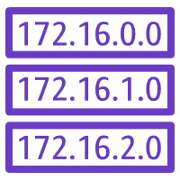

Security in VPC
Internet gateway
VPN gateway
Security Groups – Firewall for EC2 instances / RDS.
Network ACL – Firewall for Subnets
Key Pairs
Amazon VPC
Router
Route table
Route table
Network ACL
(Subnet 1)
Network ACL
(Subnet 2)
Subnet 1
Subnet 2
Security group
Security group
Security group
Instance
Instance
Instance
Instance

Slide 24
Course contents
Introduction
Overview of Cloud and AWS
Bank strategy on Cloud
AWS VPC
AWS EC2
AWS RDS
EC2 Hand-on
AWS RDS Hands-on
AWS Storage
AWS Auto scaling
AWS Security & IAM
Demo on AWS EBS
Auto Scaling Hands-on
Wrap-up
Day 2
Day 1

Slide 25
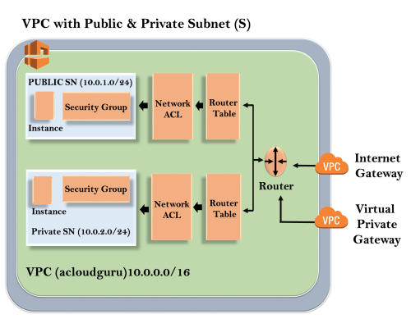

Slide 26
EC2 overview
Virtualized servers in Amazon data centers
Resizable compute capacity
Reduced time to provision and boot up new server instances
Pay as per capacity used
Option of Linux and Windows and MacOS
Deploy across regions and AZ
Uses Intel Xeon processors / AMD / Graviton(ARM)

Slide 27
EC2 instance families
General purpose (t): For balanced workloads
Compute Optimized (C,M) : For high performance computing, data lakes etc.
Memory Optimized (R): For high performance databases, in memory DB
Accelerated Computing (G,P) : For GPU intensive workloads like graphics, data pattern matching etc. (uses h/w accelerators or co-processers)
Storage Optimized (s) : For high IOPS at lower cost
https://aws.amazon.com/ec2/instance-types/
E.g. t2.micro :
t specifies the instance family (in this case typical / general purpose)
2 implies generation (new generations are most cost effective : better price to performance ratio)
Micro specifies the size
Notes:
Amazon burstable instances ( or T2 instances) are an instance family from Amazon Web Services which provide a guaranteed level of CPU performance with the ability to burst to high levels of CPU utilization for transient loads. Each instance has a “baseline” of CPU utilization which is governed using what Amazon calls CPU Credits. CPU Credits are burned down while the instance is active, and accumulate when the instance is operating below the CPU baseline.
E.g. if a t2.small instance has a baseline CPU util of 20 % …then credits are gained when operating below 20% and can be used to pay for util higher than 20% for a transient spike

Slide 28
Steps in creating an EC2 instance
Determine the AWS region in which the instance is to be launched
Select the AMI (Amazon Machine Image)
Choose the instance type based on workload
Configure N/W , IP address, security groups
Configure storage volumes, tags
Generate / re-use key pair for accessing the instance

Slide 29
AMI (Amazon Machine Image)
AMI is the template for the root volume of an EC2 instance (e.g. Operating system, Application server and applications)
Possible to create your own AMI by taking a public AMI and save the configurations as a custom AMI
Launch permissions that control which AWS accounts can use the AMI to launch instances.
AMIs can be shared with other AWS accounts or made public ; can be sold online
AWS provides its own Linux AMI called “Amazon Linux” – free, repo access to many useful software, packages to integrate with other AWS services
Notes:
All AMIs are categorized as either backed by Amazon EBS or backed by instance store. The former means that the root device for an instance launched from the AMI is an Amazon EBS volume created from an Amazon EBS snapshot. The latter means that the root device for an instance launched from the AMI is an instance store volume created from a template stored in Amazon S3.
https://docs.aws.amazon.com/AWSEC2/latest/UserGuide/ComponentsAMIs.html#storage-for-the-root-device

Slide 30

EC2 Instance life-cycle
Launch
Start
Pending
AMI
Reboot
Stop
Rebooting
Running
Stopping
Stopped
Terminate
Shutting down
Terminate
Terminated
Notes:
Running : Instance is billed whether idle or not
Rebooting : instance stays on the same host, IP is retained and so is instance data. Doesn’t start a new billing hour
Terminated : Cannot recover a terminated instance
Stopped : Stops the instance hourly billing (but still charged for storage volumes) , when started you will lose the instance data and instance moves to new host
Private IP , Elastic IP is retained but public IP is not.

Slide 31
Instance meta-data and user data
Instance meta-data is data about the instance. Obtained from following URL - http://169.254.169.254/latest/meta-data
User Data : Passed to the instance during launch to perform configuration tasks (bootstrap scripts such as installing HTTP server)
Can be specified in a file attachment
16 KB size limit
URL - http://169.254.169.254/latest/user-data
E.g.
#!/bin/sh
yum –y install httpd
chkconfig httpd on
/etc/init.d/httpd start

Slide 32
Break time !!!
Enjoy your break. We shall resume at 1:30 PM IST (4:00 PM SG time)
Upcoming session: AWS EC2 Hands-on lab

Slide 33
EC2 purchase options
Pay by hour – no commitments / contracts
Lowest upfront cost
Most flexible – for spiky , short term , unpredictable workloads
Purchase
Options
On Demand
Reserved
Scheduled
Spot
Dedicated instances
Dedicated host
Uses dedicated hardware . Usually required if software licensing is tied to physical hardware
Reserve capacity for 1-yr / 3 years
Significantly discounted rate
Always available
Good for consistent heavy use
Instance will be hosted on hardware which will not be shared with other AWS accounts
(Some regulations may dictate this)
Reserve capacity for on a schedule
Pay for scheduled duration
Good for scheduled workloads with finite time of completion
Based on bidding (on unused EC2 instances)
Price fluctuates based on supply and demand
Good if you are flexible about when to run and ok to be interrupted
Notes:
Reserved – Around 70% discount
Spot – 90%
Scheduled – 30 to 40% discount

Slide 34
AWS marketplace
Online store to discover, purchase and deploy IT S/W on top of AWS
Catalog of 4000+ Software solutions
Pre-configured for AWS and checked by AWS for security & operability
https://aws.amazon.com/marketplace

Slide 35
Course contents
Introduction
Overview of Cloud and AWS
Bank strategy on Cloud
AWS VPC
AWS EC2
AWS RDS
EC2 Hand-on
AWS RDS Hands-on
AWS Storage
AWS Auto scaling
AWS Security & IAM
Demo on AWS EBS
Auto Scaling Hands-on
Wrap-up
Day 2
Day 1

Slide 36
Lab 2: Introduction to Amazon EC2
Key takeaways from lab:
Launch your EC2 instance and install/configure web server during launch
Modify security group to make the server accessible from internet
Resize the server – instance type and EBS volume size

Slide 37
Course contents
Introduction
Overview of Cloud and AWS
Bank strategy on Cloud
AWS VPC
AWS EC2
AWS RDS
EC2 Hand-on
AWS RDS Hands-on
AWS Storage
AWS Auto scaling
AWS Security & IAM
Demo on AWS EBS
Auto Scaling Hands-on
Wrap-up
Day 2
Day 1

Slide 38








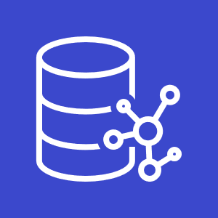



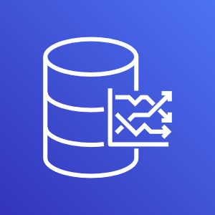
AWS Database options
Amazon RDS
Amazon Aurora
Amazon DynamoDB : NoSQL
Amazon Neptune : Graph DB
Amazon ElasticCache : In memory DB
Amazon Redshift : Warehouse
AWS Database migration service
Amazon Timestream : Time series DB

Slide 39
Amazon RDS (Relational Database Service)
Service for easy setup, operation and scaling of a relational database
Available for 6 databases (Oracle, SQL Server, MySQL, PostGre SQL, MariaDB and Aurora)
Simple and fast to deploy
Common DB admin tasks are managed by AWS (like patching, backups)
Fast, predictable performance
Simple and fast to scale
Cost effective
Multi AZ deployment possible
Read replicas to improve performance for read intensive workloads
Available on VMWare for use in on-premise / hybrid environment

Slide 40
Amazon RDS – Additional facts
Amazon Aurora is similar to MySQL and PostGre SQL but faster than both. Schema conversion tools available to migrate
RDS is a partially managed service
Multi AZ deployment uses strongly consistent replication (synchronous)
and provides one end point for seamless failover
Read replicas are based on eventual consistency
Aurora supports upto 50 read replicas , My SQL (5), PostGre(5), Maria (5) , none for SQL Server and Oracle
“DB instance” is the building block of RDS and represents an isolated DB environment on the cloud. One instance can contain multiple user databases
Notes:
Aurora is fully managed
Aurora has 5 times the throughput of MySQL and 3 times of PostGre SQL. Replicates data six ways across 3 AZs

Slide 41


Typical RDS deployment
Elastic Load Balancing
Security through :
IAM groups and policies
SSL / N/W encryption / TDE
Security groups
RDS encryption
Amazon EC2 application servers
AZ1
AZ2
Backup Options
Amazon RDS
Primary instance
Amazon RDS
Secondary instance
Automatic
Manual snapshot
Enabled by default
Full daily snapshot plus logs
Retention up to 35 days
Triggered manually
Stored in S3
Persists till user deletes
Allows recovery to that specific state

Slide 42
Course contents
Introduction
Overview of Cloud and AWS
Bank strategy on Cloud
AWS VPC
AWS EC2
AWS RDS
EC2 Hand-on
AWS RDS Hands-on
AWS Storage
AWS Auto scaling
AWS Security & IAM
Demo on AWS EBS
Auto Scaling Hands-on
Wrap-up
Day 2
Day 1

Slide 43
Lab 2: Introduction to Amazon RDS (Linux)
Key takeaways from lab:
Launch a MySQL RDS instance with an empty database
Connect to the EC2 server running in public subnet using SSH
Connect to the database from the EC2 instance and run SQL queries

Slide 44
Course contents
Introduction
Overview of Cloud and AWS
Bank strategy on Cloud
AWS VPC
AWS EC2
AWS RDS
EC2 Hand-on
AWS RDS Hands-on
AWS Storage
AWS Auto scaling
AWS Security & IAM
Demo on AWS EBS
Auto Scaling Hands-on
Wrap-up
Day 2
Day 1

Slide 45
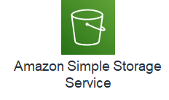
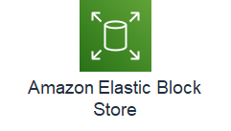
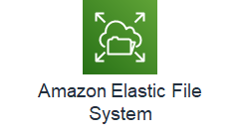
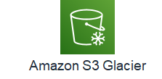
AWS Storage options
Object storage
Block storage
File storage

Slide 46
Amazon S3 (Simple Storage Service)
Storage for the internet
Object level storage (Max limit of 5 TB per object)
Designed for 11 nines durability: replicated to six copies across >= 3 Azs
Replication is consistent for reads and writes - synchronous (real time)
Data stored inside Buckets (soft limit of 100 buckets per account)
Very low cost (charged at per GB per month)
Ideal for Write Once, Read Many (WORM) kind of requirements
Supports Event triggers (e.g. when a file is uploaded)
Accessed through HTTP URL which should be DNS compliant
Private to the owner by default ; access can be controlled through policies
Supports versioning (delete does not remove the item, only puts a delete marker and enables a new version to be created. Possible to retrieve earlier version)
Notes:
Object level storage means there is no concept of update to a file – entire file needs to be re-uploaded
There is no restriction to amount of data inside a bucket
Pay for storage and transfer out to other regions and for the read and put/post requests
Not pay for transfer IN to S3 and for moving to EC2 instances in same region

Slide 47




S3 Concepts
S3 stored data as objects inside buckets
Bucket name is globally unique across accounts and regions
An object is composed of a file plus any meta-data that describes the file
You can have up to 100 buckets in an account
Maximum object size is 5 TB
Three states of a S3 bucket :
Un-versioned (default)
Versioning enabled
Versioning suspended
Amazon Simple Storage Service
Bucket with objects
Bucket
Object
An Object Key is the unique identifier for an object in a bucket
http://doc.s3.amazon.com/2006-03-01/AmazonS3.html
Bucket
Key / Object
Notes:
Cannot have buckets inside buckets

Slide 48
S3 Storage Classes
S3 Standard
99.99 % Availability
S3 Intelligent tiering
99.9 % Availability
COST
S3 standard - IA
99.9 % Availability
S3 1 Zone - IA
All replicas on same Zone
99.5 % Availability
Glacier
Ideal for Archival data.
Data encrypted and stored inside vaults
Retrieval time of minutes to hours
Deep Archival
For long term data retention (7 – 10 years)
Ideal alternative to tape libraries
Retrieval time within 12 hours
Lifecycle management rules dictate how objects are managed during their lifetime.
Can be used to dictate transitioning between the storage classes above
Notes:
Lifecycle policies to transition between storage classes
All storage classes support 11 nines durability
Refer - https://aws.amazon.com/s3/storage-classes/

Slide 49
Transferring files to S3 and typical use cases for S3
Transferring files to S3
Using console / SDK / API
Data Sync: For high speed transfer from on-premise to S3/EFS
AWS hosted full managed SFTP service
Multi part upload: Breaks down file into smaller chunks and uploads separately ; S3 combines the part to create the full object
Transfer acceleration : Uses edge location and backbone network
Use cases for S3
Storing and distributing static web content and media
( https://[bucketname].s3.amazon.com)
Data store for large computation and large scale analytics (clickstream analysis, financial transaction analysis) : Due to horizontal scaling
Data backup and archival – due to high durability, scalability and low cost. Can store copies to other regions
Storing AMIs and Snapshots

Slide 50

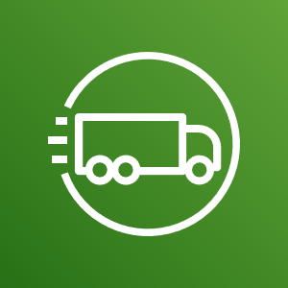
Transferring large data
Petabyte scale data transport
Appliance sent to premise for transferring data
Shipped back to Amazon facility and transferred to S3
AWS Snowball
Exabyte scale data transport
45 ft shipping container pulled by a semi-trailor
100 PB per snowmobile
High security – video surveillance, GPS, 256 bit encryption
AWS Snowmobile

Slide 51
Block storage
Instance store
Disks physically attached to host computer
Ephemeral storage - data stored is not persistent through instance stops, terminations, or hardware failures
Ideal for temporary data like buffer, cache, data replicated across load balanced servers
EBS (Elastic Block Storage)
Durable detachable, block storage for EC2
Consistent and Low latency performance
Stored data is automatically replicated within the AZ
Data persists through shut down
Recommended when data must be quickly accessible and requires long term persistence
OS root volumes
Database files
Enterprise applications
Notes:
Ephemeral -
Free, part of the instance
Block storage
No guarantee of performance
Ideal for Buffer, cache, replicated data, scratch
EBS
Supports incremental snapshots (on private area in S3)
Can be moved to other AZs

Slide 52
EBS Life-cycle
Create volume
Attach to EC2 instance
Format and Use
Snapshot to S3
Detach from EC2
Delete volume
Notes:
Can create a volume from an existing snapshot

Slide 53
EBS types
Type | General Purpose SSD | Provisioned IOPS SSD
SSD Backed | Balances price and performance for wide variety of workloads (1 GB to 16 TB) | High performance SSD for mission critical low latency / high throughput workloads (e.g. large databases) 4 GB to 16 TB)
Type | Throughput optimized HDD | Cold HDD
HDD Backed | Low cost HDD designed for frequently accessed throughput intensive workloads E.g. streaming, Big Data, log processing 500 GB to 16 TB) | Lowest cost HDD designed for less frequently accessed workloads E.g. large volume of data accessed infrequently 500 GB to 16 TB)
Notes:
Gp SSD – the IOPS scales linearly per GB with a minimum of 100 IOPS and a maximum of 16000 IOPS
Provisioned IOPS allows you to specify a target IOPS for your application so you will get the guaranteed IOPS
SSD backed is good for transactional workloads involving frequent read / write operations with small I/O size , where dominant performance attribute is IOPS
HDD backed is good for large streaming workloads where throughput is a better measure than IOPS

Slide 54
Amazon EFS (Elastic File System)
Network File System for Linux
Can be shared across EC2 instances in different AZ, regions, VPCs and accounts
Uses NFSv4 protocol
Mounted to an EC2 instance
Offers two storage classes (Standard and Infrequent access)
FSx is the equivalent option for Windows
Notes:
https://aws.amazon.com/efs/when-to-choose-efs/

Slide 55
Reboot vs Stop vs Terminate
Behavior | Reboot | Stop/Start | Terminate
Host computer | Instances stays on same computer | Instance runs on new computer
Public IP address | No change | New IP assigned
Elastic IP address | EIP remains associated with instance | EIP remains associated with instance | EIP disassociated from instance
Instance store volume | Preserved | Erased | Erased
EBS volume | Preserved | Preserved | Boot volume deleted by default
Billing | Instance billing hour doesn’t change | Stop incurring charges till Start | Stop incurring charges

Slide 56
Break time !!!
Enjoy your break. We shall resume at 11:00 AM IST (1:30 PM SG time)
Upcoming session: AWS EBS Demo

Slide 57
Course contents
Introduction
Overview of Cloud and AWS
Bank strategy on Cloud
AWS VPC
AWS EC2
AWS RDS
EC2 Hand-on
AWS RDS Hands-on
AWS Storage
AWS Auto scaling
AWS Security & IAM
Demo on AWS EBS
Auto Scaling Hands-on
Wrap-up
Day 2
Day 1

Slide 58



Triad of services
Elastic Load Balancing
Latency
Auto Scaling group
Utilization
Auto Scaling
Amazon CloudWatch
Execute scaling policy
Notes:
EC2 instances and ELB feed metrics to Cloud Watch
Auto scaling group defines a group with launch configurations and auto scale policies
Cloud watch alarms execute the policies to affect the size of the fleet

Slide 59
Elastic Load Balancer
Distributes traffic across multiple EC2 instances and across AZ
Supports health checks to detect unhealthy instances
Supports routing and balancing of HTTP, HTTPS, TCP traffic
Three variants:
Classic load balancer
Application load balancer
Network load balancer

Slide 60
Classic Load Balancer
Protocol
Port
Listener Config 1
Listener Config 2
Load Balancer
Health Checks
EC2
instances
EC2
instances
Target instances
Support for TCP, SSL, HTTP, HTTPS
By default evenly distributes load among AZ
Cross zone load balancing overrides the above
Mostly used for EC2 classic instances

Slide 61
Application Load Balancer
Load Balancer
Listener
Listener
Rule
Rule
Rule
Target Group
Target Group /api
Target Group /mobile
Target
Target
Target
Target
Target
Target
Target
Functions at the application layer of OSI stack. Makes routing decisions based on content of application traffic
Listeners checks connection request based on protocol and port
Rules are defined for each listener. Each rule specifies conditions, priority and target group
Each target group routes requests to one or more targets (EC2 instances / lambda function)
Health checks defined at target group level
One instance can belong to multiple target groups
Notes:
Benefits of Migrating from a Classic Load Balancer
Using an Application Load Balancer instead of a Classic Load Balancer has the following benefits:
Support for path-based routing. You can configure rules for your listener that forward requests based on the URL in the request. This enables you to structure your application as smaller services, and route requests to the correct service based on the content of the URL.
Support for host-based routing. You can configure rules for your listener that forward requests based on the host field in the HTTP header. This enables you to route requests to multiple domains using a single load balancer.
Support for routing based on fields in the request, such as standard and custom HTTP headers and methods, query parameters, and source IP addresses.
Support for routing requests to multiple applications on a single EC2 instance. You can register each instance or IP address with the same target group using multiple ports.
Support for redirecting requests from one URL to another.
Support for returning a custom HTTP response.
Support for registering targets by IP address, including targets outside the VPC for the load balancer.
Support for registering Lambda functions as targets.
Support for the load balancer to authenticate users of your applications through their corporate or social identities before routing requests.
Support for containerized applications. Amazon Elastic Container Service (Amazon ECS) can select an unused port when scheduling a task and register the task with a target group using this port. This enables you to make efficient use of your clusters.
Support for monitoring the health of each service independently, as health checks are defined at the target group level and many CloudWatch metrics are reported at the target group level. Attaching a target group to an Auto Scaling group enables you to scale each service dynamically based on demand.
Access logs contain additional information and are stored in compressed format.
Improved load balancer performance.

Slide 62
Network Load Balancer
Load Balancer
Listener
Rule
Target Group
Target
Target
Functions at the transport layer (TCP) of the OSI stack
Connection request received by listener. Target selected from target group configured and TCP connection opened on the specified port
Cross zone load balancing can be configured
Health checks at target group level

Slide 63
Load balancer comparison
Features | Classic LB | Application LB | Network LB
Protocols | TCP, SSL, HTTP, HTTPS | HTTP, HTTPS | TCP
Platforms | EC2 Classic, VPC | VPC | VPC
Cross zone LB | Yes | Yes | Yes
Logging | Yes | Yes | Yes
Path based routing | No | Yes | No
Sticky sessions | No | Yes | No
Static IP support | No | No | Yes
Notes:
Static IP support >> Normally ELB IP addresses change and only DNS name is provided to client ; but NW LB has option of providing a static IP
If you need flexible application management, use ALB
If you need extreme performance and static IP support, use Network LB
If you need compatibility with EC2 classic, use Classic LB
Sticky sessions :
In classic, sticky sessions can be used using the application cookies
In ALB, stick sessions can be defined at target group level and ELB generates a cookie called AWSELB to handle the same

Slide 64






Amazon CloudWatch
Amazon CloudWatch
Cloud watch metrics
Resources that use CloudWatch
CPU utilization
Status Check failed
CloudWatch Alarms
Email notification
Message
Custom Data
Hrs/week
Auto Scaling
Statistics
Statistics consumer / AWS console
Monitoring service for AWS cloud resources and applications being run
Visibility into resource utilization, operational performance and demand patterns
Can define custom metrics and can set alarms

Slide 65
Auto Scaling
Scales EC2 capacity automatically
Ideal for applications that have variability in usage
Benefits:
Fault tolerance :- unhealthy instances replaced by new ones. Can also launch in other AZ
Availability :- Ensures right capacity to handle load
Cost management :- Pay only for real capacity
Launch Configuration: Template used to launch EC2 instances. Specifies:-
AMI ID
Instance Type
Key pair
Security groups
User data
Block device mapping
Scaling policy using CloudWatch alarms
When to scale in and scale out
Auto Scale Group
Min Size
Scale out as needed
Desired Size
Max Size

Slide 66
Course contents
Introduction
Overview of Cloud and AWS
Bank strategy on Cloud
AWS VPC
AWS EC2
AWS RDS
EC2 Hand-on
AWS RDS Hands-on
AWS Storage
AWS Auto scaling
AWS Security & IAM
Demo on AWS EBS
Auto Scaling Hands-on
Wrap-up
Day 2
Day 1

Slide 67
Lab 3: Introduction to Amazon EC2 Auto Scaling
Key takeaways from lab:
Create launch configuration and auto scale group
Test auto scaling by terminating instance

Slide 68
Break time !!!
Enjoy your break. We shall resume at 1:30 PM IST (4:00 PM SG time)
Upcoming session: AWS Security & IAM

Slide 69
Course contents
Introduction
Overview of Cloud and AWS
Bank strategy on Cloud
AWS VPC
AWS EC2
AWS RDS
EC2 Hand-on
AWS RDS Hands-on
AWS Storage
AWS Auto scaling
AWS Security & IAM
Demo on AWS EBS
Auto Scaling Hands-on
Wrap-up
Day 2
Day 1

Slide 70
AWS Shared Responsibility Model
AWS is responsible for the security OF the cloud
Facilities – Regions, Azs, Edge locations
Platform hardware and software, Networking, Storage
For managed services, updates and patching of OS, Database etc.
Customers are responsible for security IN the cloud
Application identity and access management
Operating system security (updates and patches)
Network and Firewall configurations
Client and server side encryption
User activity logging

Slide 71
AWS Security
Physical Security
H/W, S/W and Network
Assurance
Data centers in nondescript and undisclosed facilities
24/7 trained security staff
Two factor authentication for authorized staff
Automated change control
Bastion servers that record all access attempts
Firewalls
Monitoring tools
Audits, attestations, certifications
ISO, SOC, HIPPA etc.
SSL Endpoints
Security Groups
VPC
Use SSL and TLS endpoints for secure communication with AWS services
Use security groups for configuring Firewall rules for instances
Use public and private subnets
Use NACL, NAT , route tables, VPN to manage networking constraints

Slide 72




IAM Core Concepts
IAM users and groups are created for managing access to AWS resources
Can use federated identities using corporate Directory servers
Role is similar to a user but has no credentials assigned. Role is assumed by a user or service and access keys dynamically created by AWS
Policies define set of permissions and can be attached to user/group/role
Assigned
Assigned
IAM User
IAM Group
IAM Policy
Assigned
Assumed
Assumed
IAM Role
AWS Resources
IAM User
Notes:
RoleAn IAM identity that you can create in your account that has specific permissions. An IAM role has some similarities to an IAM user. Roles and users are both AWS identities with permissions policies that determine what the identity can and cannot do in AWS. However, instead of being uniquely associated with one person, a role is intended to be assumable by anyone who needs it. Also, a role does not have standard long-term credentials such as a password or access keys associated with it. Instead, when you assume a role, it provides you with temporary security credentials for your role session.
Roles can be used by the following:
An IAM user in the same AWS account as the role
An IAM user in a different AWS account than the role
A web service offered by AWS such as Amazon Elastic Compute Cloud (Amazon EC2)
An external user authenticated by an external identity provider (IdP) service that is compatible with SAML 2.0 or OpenID Connect, or a custom-built identity broker.

Slide 73
IAM Policies
Documents created using JSON that describes a set of permissions
Are attached to identity / group / role
Evaluated at run time when request is made
Can be inline or Managed (AWS managed / Customer managed)
Usually define 3 aspects –
Action performed
Target resources
Conditions under which action is performed

Slide 74
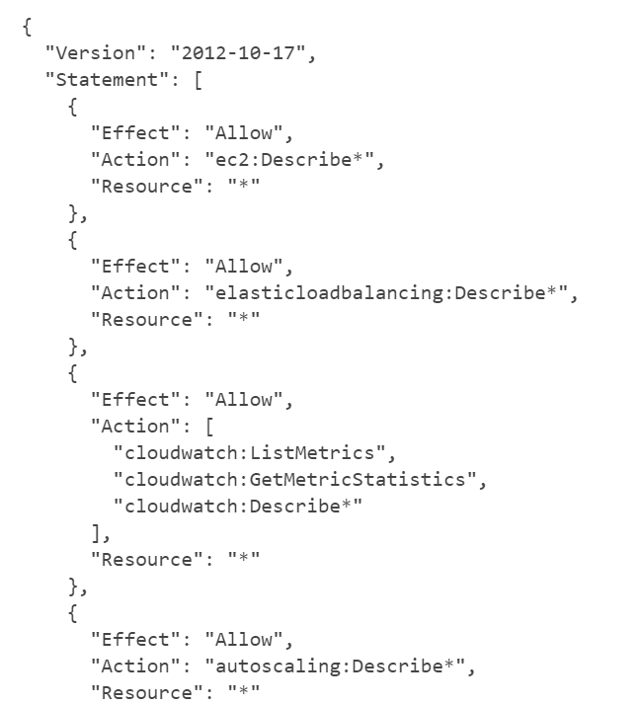
Policy example
This policy is granting permission to List and Describe information about EC2, ELB, Cloud Watch and Auto Scaling

Slide 75
Course contents
Introduction
Overview of Cloud and AWS
Bank strategy on Cloud
AWS VPC
AWS EC2
AWS RDS
EC2 Hand-on
AWS RDS Hands-on
AWS Storage
AWS Auto scaling
AWS Security & IAM
Demo on AWS EBS
Auto Scaling Hands-on
Wrap-up
Day 2
Day 1

Slide 76
Appendix A : Comparison of Cloud Providers

Slide 77
Comparison of Cloud providers
Vendor | Strengths | Weaknesses
AWS | • Dominant market position • Extensive, mature offerings • Support for large organizations • Extensive training • Global reach | • Difficult to use • Cost management • Overwhelming options
Azure | • Second largest provider • Integration with MS tools and software • Broad feature set • Hybrid cloud • Support for open source | • Issues with documentation • Incomplete mgmt tooling
Google Cloud | • Designed for cloud-native businesses • Commitment to open source and portability • Deep discounts and flexible contracts • DevOps expertise | • Late entrant to IaaS market • Fewer features and services • Historically not very enterprise focused

