Slide 1
Parallel Processing using Spark+Hadoop
Hadoop: Distributed file system that connects machines.
Mapreduce: parallel programming style built on a Hadoop cluster
Spark: Berkeley design of Mapreduce programming
Given a file treated as a big list
  A file may be divided into multiple parts (splits).
Each record (line) is processed by a Map function,
  produces a set of intermediate key/value pairs.
Reduce: combine a set of values for the same key

Slide 2
Python Examples and List Comprehension
>>> words = 'The quick brown fox jumps over the lazy dog'.split()
for i in [5, 4, 3, 2, 1] :
print i
print 'Blastoff!'
>>> lst = [3, 1, 4, 1, 5]
>>> lst.append(2)
>>> len(lst)
5
>>> lst.sort()
>>> lst.insert(4,"Hello")
>>> [1]+ [2] → [1,2]
>>> lst[0] ->3
Python tuples
>>> num=(1, 2, 3, 4)
>>> num +(5) → (1,2,3,4, 5)
>>>M = [x for x in S if x % 2 == 0]
>>> S = [x**2 for x in range(10)]
[0,1,4,9,16,…,81]
>>> words =‘hello lazy dog'.split()
>>> stuff = [(w.upper(), len(w)] for w in words]
→ [ (‘HELLO’, 5) (‘LAZY’, 4) , (‘DOG’, 4)]
>>>numset=set([1, 2, 3, 2])
Duplicated entries are deleted
>>>numset=frozenset([1, 2,3])
Such a set cannot be modified

Slide 3
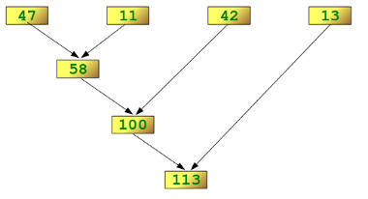
Python map/reduce
a = [1, 2, 3]
b = [4, 5, 6, 7]
c = [8, 9, 1, 2, 3]
f= lambda x: len(x)
L = map(f, [a, b, c])
[3, 4, 5]
g=lambda x,y: x+y
reduce(g, [47,11,42,13])
113

Slide 4
Mapreduce programming with SPAK: key concept
Write programs in terms of operations on implicitly distributed datasets (RDD)
RDD
RDD: Resilient Distributed Datasets
Like a big list:
  Collections of objects spread across a cluster, stored in RAM or on Disk
Built through parallel transformations
Automatically rebuilt on failure
RDD
RDD
RDD
Operations
Transformations
(e.g. map, filter, groupBy)
Make sure input/output match
Notes:
RDD ➔ Colloquially referred to as RDDs
(e.g. caching in RAM)
Lazy operations to build RDDs from other RDDs
Return a result or write it to storage

Slide 5
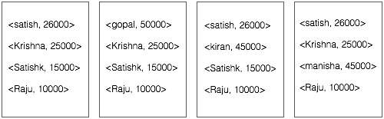
MapReduce vs Spark
RDD
RDD
RDD
RDD
Spark operates on RDD
Map and reduce
tasks operate on key-value
pairs
Notes:
RDD ➔ Colloquially referred to as RDDs
(e.g. caching in RAM)
Lazy operations to build RDDs from other RDDs
Return a result or write it to storage

Slide 6
Language Support
Python
lines = sc.textFile(...)
lines.filter(lambda s: “ERROR” in s).count()
Standalone Programs
Python, Scala, & Java
Interactive Shells
Python & Scala
Performance
Java & Scala are faster due to static typing
…but Python is often fine
Scala
val lines = sc.textFile(...)
lines.filter(x => x.contains(“ERROR”)).count()
Java
JavaRDD<String> lines = sc.textFile(...);
lines.filter(new Function<String, Boolean>() {
Boolean call(String s) {
return s.contains(“error”);
}
}).count();

Slide 7
Spark Context and Creating RDDs
#Start with sc – SparkContext as
Main entry point to Spark functionality
# Turn a Python collection into an RDD
sc.parallelize([1, 2, 3])
# Load text file from local FS, HDFS, or S3
sc.textFile(“file.txt”)
sc.textFile(“directory/*.txt”)
sc.textFile(“hdfs://namenode:9000/path/file”)

Slide 8
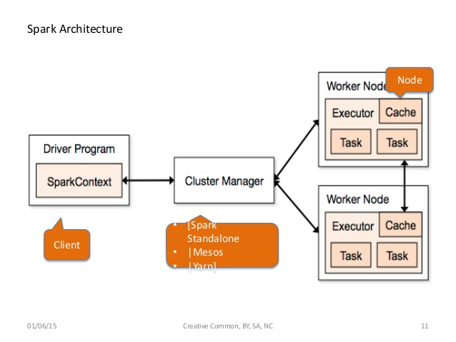
Spark Architecture
Notes:
NOT a modified version of Hadoop

Slide 9
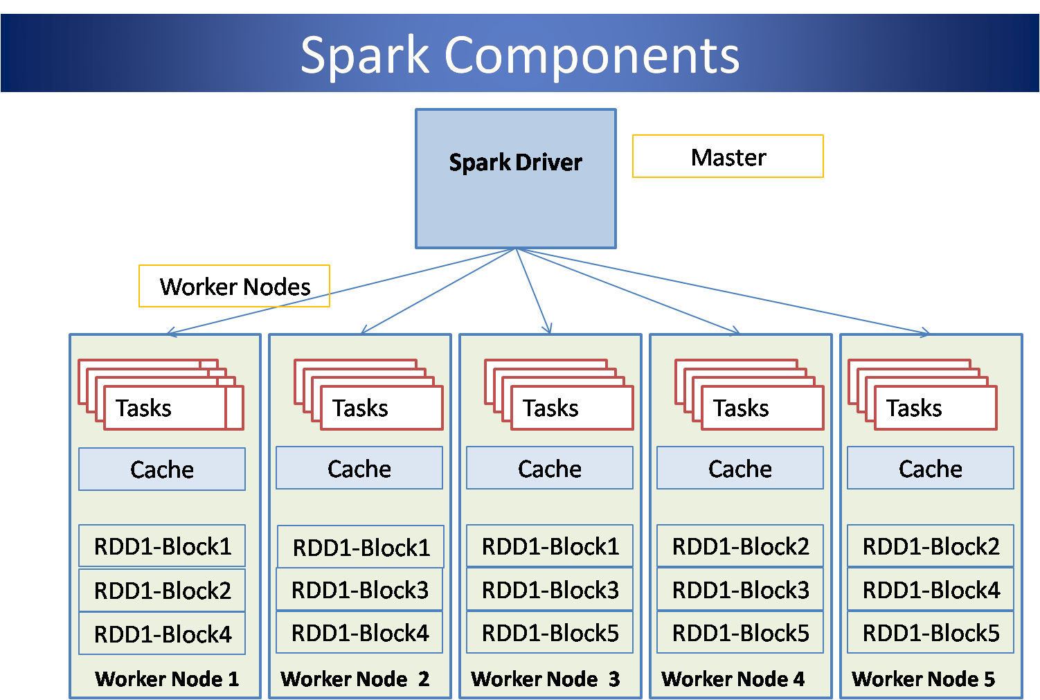
Spark Architecture
Notes:
NOT a modified version of Hadoop

Slide 10
Basic Transformations
nums = sc.parallelize([1, 2, 3])
# Pass each element through a function
squares = nums.map(lambda x: x*x) // {1, 4, 9}
# Keep elements passing a predicate
even = squares.filter(lambda x: x % 2 == 0) // {4}
#read a text file and count number of lines containing error
lines = sc.textFile(“file.log”)
lines.filter(lambda s: “ERROR” in s).count()
Notes:
All lazy

Slide 11
Basic Actions
nums = sc.parallelize([1, 2, 3])
# Retrieve RDD contents as a local collection
nums.collect() # => [1, 2, 3]
# Return first K elements
nums.take(2) # => [1, 2]
# Count number of elements
nums.count() # => 3
# Merge elements with an associative function
nums.reduce(lambda x, y: x + y) # => 6
# Write elements to a text file
nums.saveAsTextFile(“hdfs://file.txt”)
Notes:
Launch computations

Slide 12
Working with Key-Value Pairs
Spark’s “distributed reduce” transformations operate on RDDs of key-value pairs
Python: pair = (a, b)
pair[0] # => a
pair[1] # => b
Scala: val pair = (a, b)
pair._1 // => a
pair._2 // => b
Java: Tuple2 pair = new Tuple2(a, b);
pair._1 // => a
pair._2 // => b

Slide 13
Some Key-Value Operations
pets = sc.parallelize(
[(“cat”, 1), (“dog”, 1), (“cat”, 2)])
pets.reduceByKey(lambda x, y: x + y)
# => {(cat, 3), (dog, 1)}
pets.groupByKey() # => {(cat, [1, 2]), (dog, [1])}
pets.sortByKey() # => {(cat, 1), (cat, 2), (dog, 1)}
reduceByKey also automatically implements combiners on the map side

Slide 14
Example: Word Count
lines = sc.textFile(“hamlet.txt”)
counts = lines.flatMap(lambda line: line.split(“ ”))
.map(lambda word: (word, 1))
.reduceByKey(lambda x, y: x + y)
“to”
“be”
“or”
(to, 1)
(be, 1)
(or, 1)
(be, 1)(be,1)
(not, 1)
(be,2)
(not, 1)
“to be or”
“not”
“to”
“be”
(not, 1)
(to, 1)
(be, 1)
(or, 1)
(to, 2)
(or, 1)
(to, 1)(to,1)
“not to be”

Slide 15
Other Key-Value Operations
visits = sc.parallelize([ (“index.html”, “1.2.3.4”),
(“about.html”, “3.4.5.6”),
(“index.html”, “1.3.3.1”) ])
pageNames = sc.parallelize([ (“index.html”, “Home”),
(“about.html”, “About”) ])
visits.join(pageNames)
# (“index.html”, (“1.2.3.4”, “Home”))
# (“index.html”, (“1.3.3.1”, “Home”))
# (“about.html”, (“3.4.5.6”, “About”))
visits.cogroup(pageNames)
# (“index.html”, ([“1.2.3.4”, “1.3.3.1”], [“Home”]))
# (“about.html”, ([“3.4.5.6”], [“About”]))

Slide 16
Under The Hood: DAG Scheduler
General task graphs
Automatically pipelines functions
Data locality aware
Partitioning aware
to avoid shuffles
B:
A:
F:
Stage 1
groupBy
C:
D:
E:
join
Stage 2
map
filter
Stage 3
= RDD
= cached partition
Notes:
NOT a modified version of Hadoop

Slide 17
Setting the Level of Parallelism
All the pair RDD operations take an optional second parameter for number of tasks
  words.reduceByKey(lambda x, y: x + y, 5)
  words.groupByKey(5)
  visits.join(pageViews, 5)

Slide 18
More RDD Operators
map
filter
groupBy
sort
union
join
leftOuterJoin
rightOuterJoin
reduce
count
fold
reduceByKey
groupByKey
cogroup
cross
zip
sample
take
first
partitionBy
mapWith
pipe
save ...

Slide 19
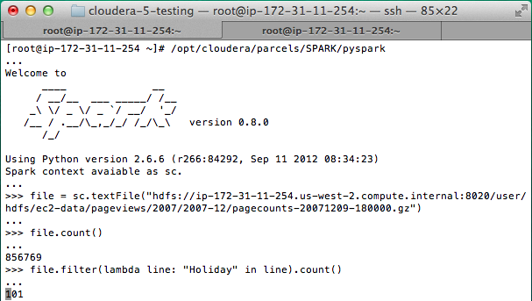
Interactive Shell
The Fastest Way to Learn Spark
Available in Python and Scala
Runs as an application on an existing Spark Cluster…
OR Can run locally
Notes:
The barrier to entry for working with the spark API is minimal

Slide 20
… or a Standalone Application
import sys
from pyspark import SparkContext
if __name__ == "__main__":
sc = SparkContext( “local”, “WordCount”, sys.argv[0], None)
lines = sc.textFile(sys.argv[1])
counts = lines.flatMap(lambda s: s.split(“ ”)) \
.map(lambda word: (word, 1)) \
.reduceByKey(lambda x, y: x + y)
counts.saveAsTextFile(sys.argv[2])

Slide 21
Create a SparkContext
import org.apache.spark.SparkContext
import org.apache.spark.SparkContext._
val sc = new SparkContext(“url”, “name”, “sparkHome”, Seq(“app.jar”))
Scala
Cluster URL, or local / local[N]
App name
Spark install path on cluster
List of JARs with app code (to ship)
import org.apache.spark.api.java.JavaSparkContext;
JavaSparkContext sc = new JavaSparkContext(
“masterUrl”, “name”, “sparkHome”, new String[] {“app.jar”}));
Java
from pyspark import SparkContext
sc = SparkContext(“masterUrl”, “name”, “sparkHome”, [“library.py”]))
Python
Notes:
Mention assembly JAR in Maven etc
Use the shell with your own JAR`

Slide 22
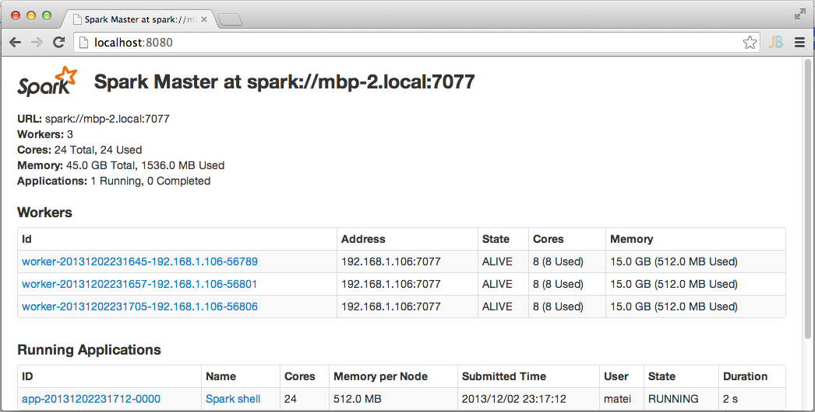
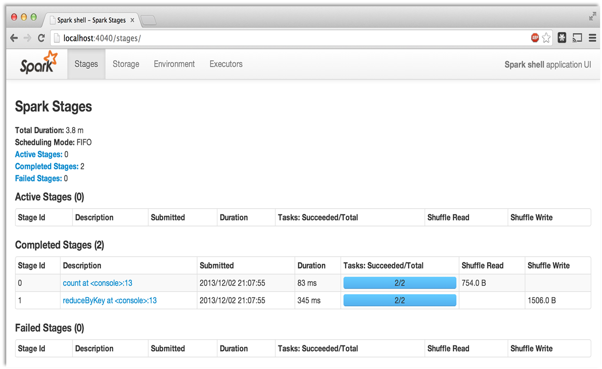
Administrative GUIs
http://<Standalone Master>:8080 (by default)

Slide 23
EXAMPLE APPLICATION: PAGERANK
Notes:
To Skip to the next section, go to slide 51

Slide 24
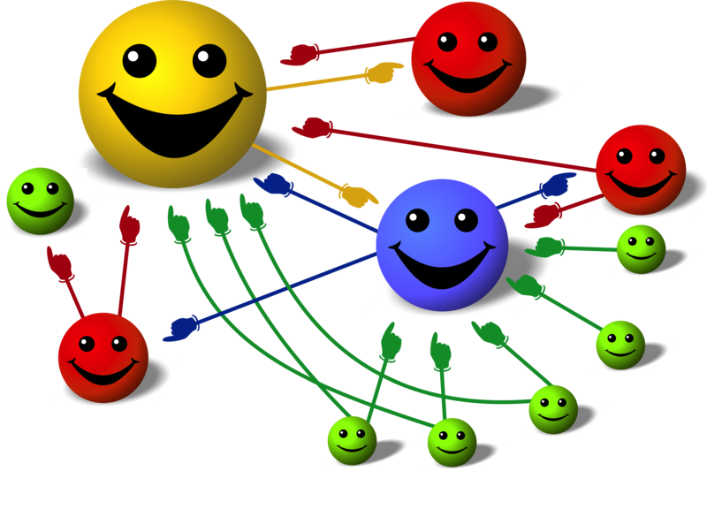
Google PageRank
Give pages ranks (scores) based on links to them
Links from many pages ➔ high rank
Link from a high-rank page ➔ high rank
Image: en.wikipedia.org/wiki/File:PageRank-hi-res-2.png

Slide 25
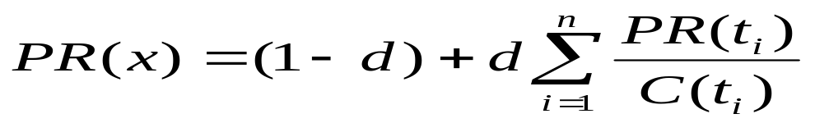
PageRank (one definition)
Model page reputation on the web
i=1,n lists all parents of page x.
PR(x) is the page rank of each page.
C(t) is the out-degree of t.
d is a damping factor .
0.4
0.2
0.2
0.2
0.2
0.4
0.4

Slide 26
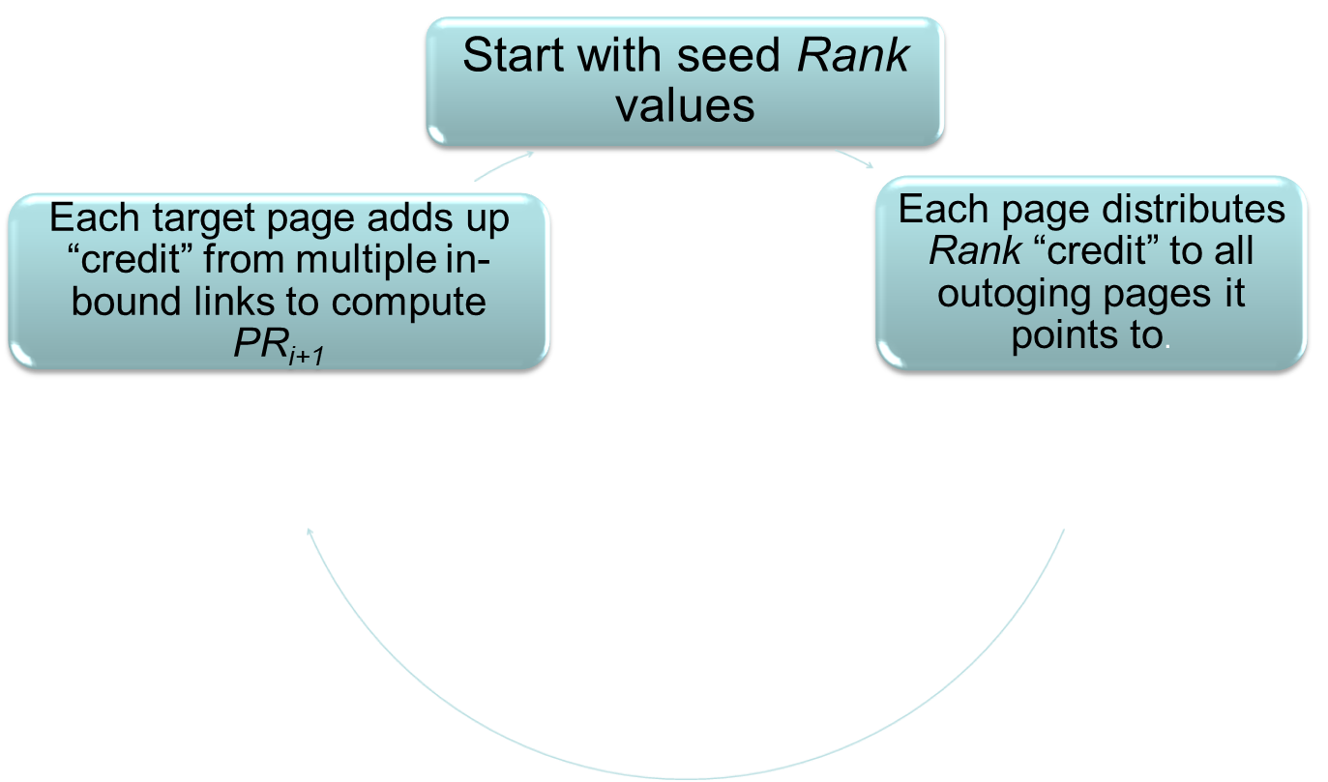
Computing PageRank Iteratively
  Effects at each iteration is local. i+1th iteration depends only on i^{th} iteration
  At iteration i, PageRank for individual nodes can be computed independently

Slide 27
PageRank using MapReduce
Map: distribute PageRank “credit” to link targets
Reduce: gather up PageRank “credit” from multiple sources to compute new PageRank value
Iterate until
convergence
Source of Image: Lin 2008

Slide 28
Algorithm demo
Start each page at a rank of 1
On each iteration, have page p contribute
rank_{p} / |outdegree_{p}| to its neighbors
Set each page’s rank to 0.15 + 0.85 × contribs
1.0
1.0
1.0
1.0

Slide 29
Algorithm
Start each page at a rank of 1
On each iteration, have page p contribute
rank_{p} / |outdegree_{p}| to its neighbors
Set each page’s rank to 0.15 + 0.85 × contribs
1.0
1
0.5
1
1.0
0.5
1.0
0.5
0.5
1.0

Slide 30
Algorithm
Start each page at a rank of 1
On each iteration, have page p contribute
rank_{p} / |outdegree_{p}| to its neighbors
Set each page’s rank to 0.15 + 0.85 × contribs
1.85
0.58
1.0
0.58

Slide 31
Algorithm
Start each page at a rank of 1
On each iteration, have page p contribute
rank_{p} / |outdegree_{p}| to its neighbors
Set each page’s rank to 0.15 + 0.85 × contribs
1.85
0.58
0.5
1.85
0.58
0.29
1.0
0.5
0.29
0.58

Slide 32
Algorithm
Start each page at a rank of 1
On each iteration, have page p contribute
rank_{p} / |outdegree_{p}| to its neighbors
Set each page’s rank to 0.15 + 0.85 × contribs
1.31
0.39
. . .
1.72
0.58

Slide 33
Algorithm
Start each page at a rank of 1
On each iteration, have page p contribute
rank_{p} / |outdegree_{p}| to its neighbors
Set each page’s rank to 0.15 + 0.85 × contribs
Final state:
1.44
0.46
1.37
0.73

Slide 34
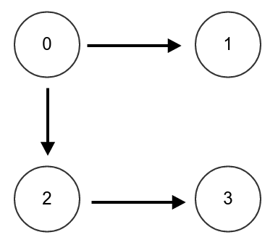
HW: SimplePageRank
Random surfer model to describe the algorithm
Stay on the page: 0.05 *weight
Randomly follow a link: 0.85/out-going-Degree to each child
  If no children, give that portion to other nodes evenly.
Randomly go to another page: 0.10
  Meaning: contribute 10% of its weight to others. Others will evenly get that weight. Repeat for everybody. Since the sum of all weights is num-nodes, 10%*num-nodes divided by num-nodes is 0.1
R(x) = 0.1+ 0.05 R(x) + incoming-contributions
Initial weight 1 for everybody
To/From | 0 | 1 | 2 | 3 | Random Factor | New Weight
0 | 0.05 | 0.283 | 0.0 | 0.283 | 0.10 | 0.716
1 | 0.425 | 0.05 | 0.0 | 0.283 | 0.10 | 0.858
2 | 0.425 | 0.283 | 0.05 | 0.283 | 0.10 | 1.141
3 | 0.00 | 0.283 | 0.85 | 0.05 | 0.10 | 1.283

Slide 35
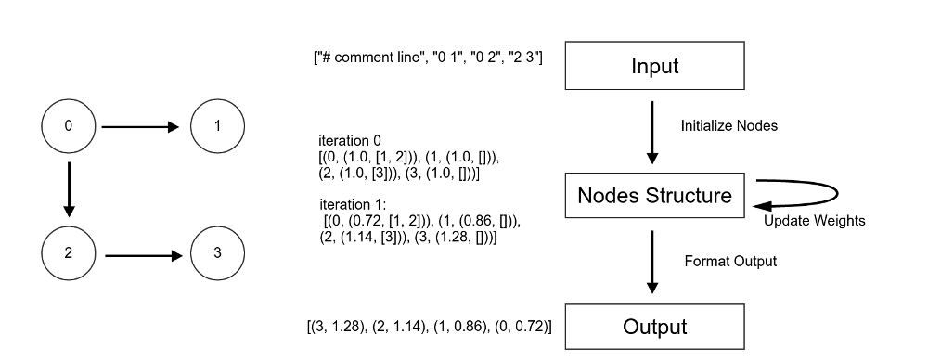
Data structure in SimplePageRank

