Slide 1
Structured Streaming with Apache Spark
Introduction • Real-Time Processing • Kafka Integration • Windowing & Watermarking

Slide 2
Introduction to Structured Streaming
• High-level API for stream processing
• Built on Spark SQL engine
• Supports event-time processing
• Output modes: Append, Update, Complete

Slide 3
Processing Real-Time Data Streams
• Read streams using DataFrames/Datasets
• Use same APIs for batch and streaming
• Sources: Kafka, file, socket, etc.
• Sinks: Console, file, Kafka, etc.

Slide 4
Integrating Kafka with Spark Streaming
• Use spark-sql-kafka package
• Options: bootstrap.servers, subscribe
• DataFrame has key, value, timestamp
• Read & write to Kafka using Structured Streaming

Slide 5
Window Operations and Watermarking
• Group events into time windows
• Tumbling and sliding windows
• Use withWatermark() to handle late data
• Supports event-time aggregations

Slide 6
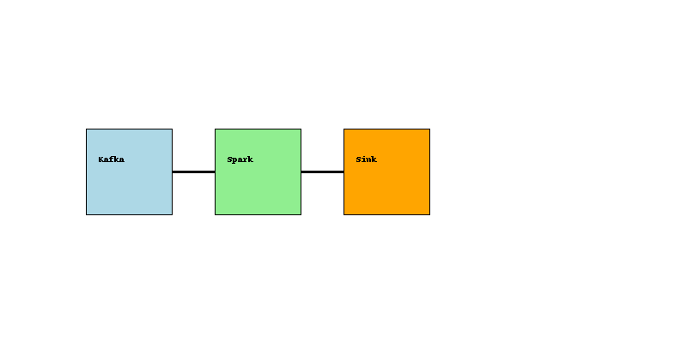
Structured Streaming Flow

