Slide 1
NAME:- patel vishva dharmendrakumar EN NO:-2302031000082 ROLL NO:-039 SUBJECT:-sem SEM:-5th asoit-it ASSIGNMENT 2

Slide 2
DFD DIAGRMAS

Slide 3
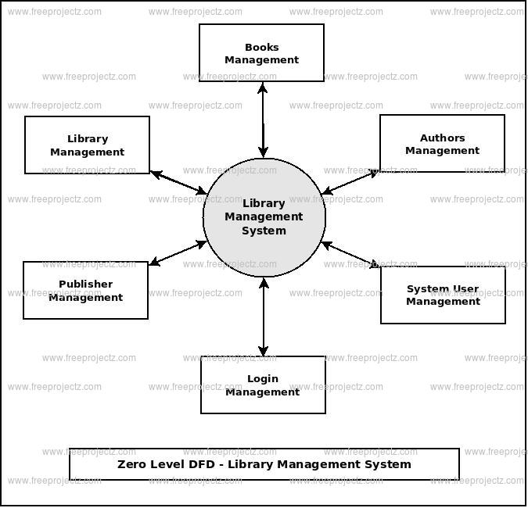

Slide 4
Level 1
Main Processes inside LMS:
User Authentication (Login/Register)
Manage Books (Add, Update, Search)
Manage Students
Issue Book
Return Book
Level 2 (Example – Issue Book)
Student requests book
System checks Book DB
If available → Record in Transaction DB
Update Book DB → Send confirmation to Student

Slide 5
ER -DIAGRAM

Slide 6
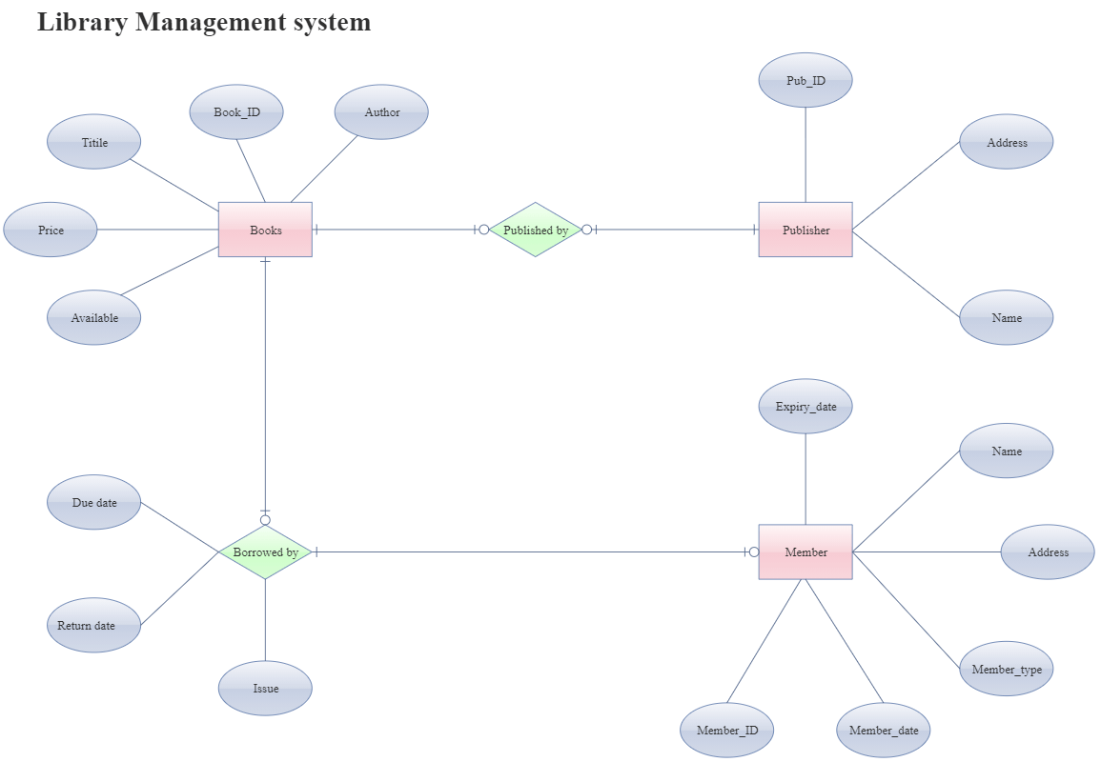

Slide 7
Entities (Tables)
Student
Student_ID (PK)
Name
Email
Phone
Password
Admin
Admin_ID (PK)
Name
Email
Password
Book
Book_ID (PK)
Title
Author
Publication
Quantity
Transaction
Transaction_ID (PK)
Issue_Date
Return_Date
Fine

Slide 8
UML DIAGRAMS

Slide 9
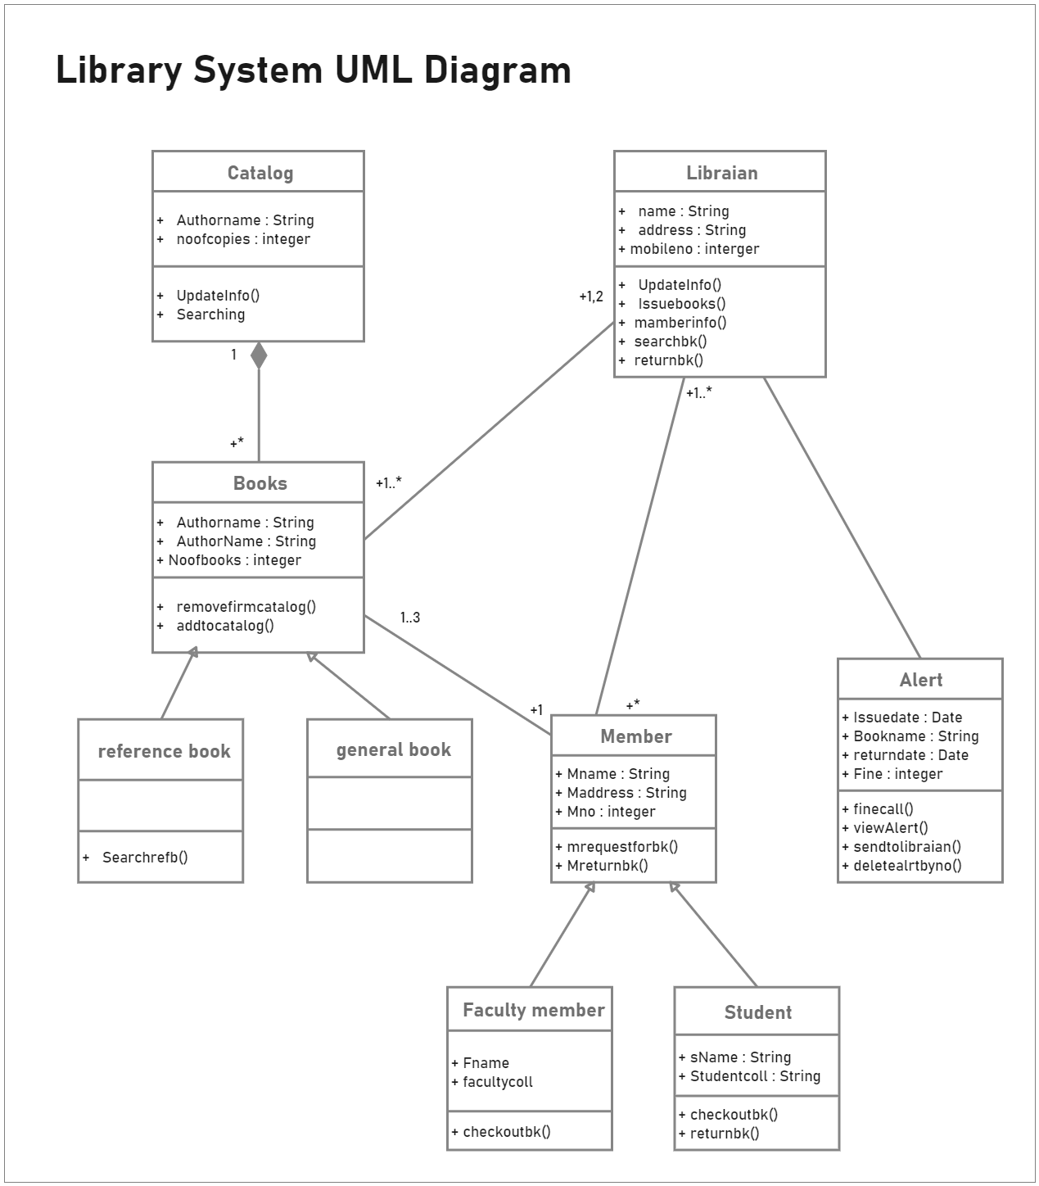

Slide 10
1. Use Case Diagram
👉 Shows what users (actors) can do in the system.
Actors:
Student
Admin
Use Cases:
Student → Register, Login, Search Book, Borrow Book, Return Book
Admin → Login, Add Book, Update Book, Delete Book, Manage Students, Generate Reports
2. Class Diagram
👉 Shows system classes, attributes, methods, and relationships.
Classes:
Student
Attributes: Student_ID, Name, Email, Password
Methods: register(), login(), searchBook()
Admin
Attributes: Admin_ID, Name, Email, Password
Methods: addBook(), updateBook(), manageStudents()
Book
Attributes: Book_ID, Title, Author, Publication, Quantity
Methods: isAvailable()
Transaction
Attributes: Transaction_ID, Issue_Date, Return_Date, Fine
Methods: issueBook(), returnBook()

Slide 11
3. Sequence Diagram (Book Issue)
👉 Shows step-by-step interaction between objects.
Student → Login → System → Student DB
Student → Search Book → System → Book DB
Student → Request Issue → Admin → System → Transaction DB
System → Confirmation → Student
4. Activity Diagram (Book Return)
👉 Shows workflow (step by step activity).
Start
Student returns book
System checks Book DB
System checks due date
If late → Calculate fine
Update Transaction DB
End

Slide 12
THANK YOU

