Slide 1
DATA ANALYTICS • PROJECT PRESENTATION
BIKE SHARING DATA ANALYSIS
Project By : Next Hikes IT Solutions
Presented By : Vishva kalariya
BIKE SHARING ANALYTICS • EXCEL PROJECT REVIEW
01

Slide 2
01 • EXECUTIVE SUMMARY
What the workbook tells us
TOTAL RENTALS
REGISTERED
CASUAL
AVG. PER RECORD
RECORDS
58,304
53,383
4,921
58.3
1,000
Sum of Count in 1,000 rows
Customer type
Customer type
Count / records
Analyzed
Registered riders contribute the clear majority of rentals.
Hourly, weather and temperature fields support demand segmentation.
The workbook includes cleaned data, summary statistics, pivot-style views, forecasting and anomaly detection.
02

Slide 3
03 • WORKBOOK WALKTHROUGH
A multi-stage Excel workflow
DATASETS
FINAL RESULT
01
02
Three source / combined dataset tabs
Consolidated hourly table
STATISTICS
PIVOTS & CHARTS
03
04
KPIs, summary measures, formulas
Weather, temperature and date views
DASHBOARD
FORECAST + ANOMALY
05
06
Visual summary workspace
Forward-looking and exception views
03

Slide 4
04 • DATA UNDERSTANDING
What each record captures
TIME
WEATHER
ENVIRONMENT
CUSTOMERS
Calendar
Conditions
Context
Demand
Date • Hour • Weekday • Holiday
Weather situation • Temperature • Feels-like temp
Humidity • Wind speed
Casual • Registered • Total Count
Data grain: one row represents an hourly observation. The supplied FINAL RESULT sheet contains 1,000 populated records.
04

Slide 5
05 • KEY PERFORMANCE INDICATORS
Demand Records
TOTAL RENTALS
REGISTERED SHARE
CASUAL SHARE
58,304
91.6%
8.4%
Count summed across records
Registered / total
Casual / total
Average demand per hourly record: 58.3 rentals • Maximum observed Count: 249
These are recalculated directly from the populated FINAL RESULT rows; some workbook summary labels may use different ranges or logic.
05

Slide 6
06 • CUSTOMER SEGMENTATION
Registered riders dominate the mix
Customer type is a major driver of the observed rental total.
REGISTERED
CASUAL
91.6%
8.4%
Registered riders account for most of the recorded demand.
Casual riders are a smaller but meaningful segment.
Retention and membership engagement are likely important levers.
06

Slide 7
07 • TIME PATTERNS
Demand changes by hour
Aggregate counts across the observed records by hour of day.
HIGHEST AGGREGATE HOUR
17:00
RENTALS IN THAT HOUR
6,169
Interpret peaks as patterns within the supplied 1,000-row slice, not necessarily a full-year profile.
07

Slide 8
08 • WEATHER ANALYSIS
Weather Analysis: Demand in Context
Weather fields help explain changes in bike rental activity beyond time and customer type.
01 Weather situation
Compare rental totals across the recorded weather categories.
Use category labels consistently when grouping the data.
02 Humidity & wind
Humidity and wind speed provide environmental context.
Check whether high or low values coincide with demand changes.
03 Business interpretation
Weather may influence comfort and willingness to ride.
Treat patterns as associations, not proof of causation.
ANALYSIS APPROACH
• Group records by weather situation and compare total or average Count.
• Review humidity and wind speed alongside temperature and hour of day.
• This presentation uses a 1,000-record sample; confirm the full dataset before making broad claims.
08

Slide 9
09 • TEMPERATURE
Temperature & Perceived Temperature
Temperature features help compare riding demand under different thermal conditions.
01 Temperature
Represents the recorded ambient temperature.
Compare rental levels across temperature ranges.
02 Feels-like temperature
Captures perceived thermal conditions in the dataset.
Compare it with actual temperature to add context.
03 Demand relationship
Look for ranges where rental activity rises or falls.
Check hourly and weather differences before interpreting.
HOW TO USE THIS INSIGHT
• Compare average Count by temperature band rather than relying on individual rows.
• Use the same method for temperature and feels-like temperature to make the comparison fair.
• The current sample supports exploratory analysis; it does not establish a causal relationship.
09

Slide 10
10 • CALENDAR PATTERNS
Daily totals provide a trend lens
Date-based aggregation can expose spikes, dips and changing demand.
HIGHEST DAILY TOTAL
1,985
25 Jan 2011
Use a complete date range for seasonality conclusions.
10

Slide 11
11 • STATISTICAL SUMMARY
Descriptive statistics & spreadsheet functions
The workbook demonstrates core summary measures and conditional calculations.
MEAN
MINIMUM / MAXIMUM
STANDARD DEVIATION
AVERAGE
MIN / MAX
STDEV
Average demand
Observed range
Demand variability
COUNTIF
SUMIF
CORREL
COUNTIF
SUMIF
CORREL
Count records meeting a threshold
Sum values meeting a condition
Linear relationship between two variables
11

Slide 12
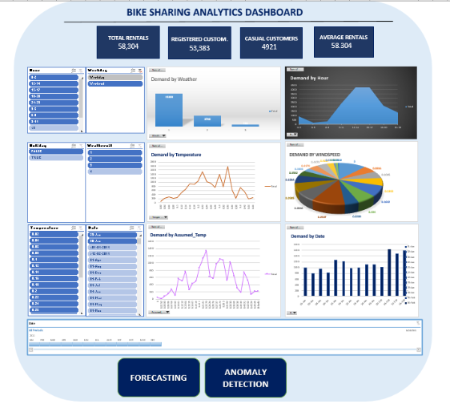
12 • DASHBOARD
DASBOARD AND FUNCTION
12

Slide 13
13 • DASHBOARD OVERVIEW
One View of Bike-Sharing Performance
The dashboard brings the project’s key measures and demand drivers into a single monitoring view.
KEY METRICS
Total rentals: 58,304
Registered: 53,383 • Casual: 4,921
DEMAND BREAKDOWNS
Weather and temperature views
Hourly, date-based and feels-like patterns
INTERACTIVE FILTERS
Filters help narrow the view by selected fields.
Use them to compare relevant subsets.
HOW TO READ THE DASHBOARD
• Start with the KPI cards to understand the overall rental volume and customer mix.
• Use the charts to compare demand across hour, date, weather and temperature fields.
• Forecasting and anomaly detection are supporting analysis tabs; validate their outputs before using them for decisions.
13

Slide 14
14 • FORECASTING
Forecasting: useful, but validate first
The workbook contains a FORECASTING sheet with date and observed Count fields.
The forecast and confidence-bound columns appear blank in the supplied workbook.
Treat this tab as a setup / placeholder rather than a validated predictive result.
Next step: fit a time-series model, reserve a test period and report forecast error.
14

Slide 15
15 • ANOMALY DETECTION
Flag unusual demand for review
The anomaly sheet includes a status field and a Z-score example.
NORMAL FLAGGED ROWS
ANOMALY FLAGGED ROWS
EXAMPLE Z-SCORE
1
0
-0.83
Status values present
Status values present
First populated row
Use Z-scores or rolling baselines to identify unusually high / low counts.
Verify flagged points against weather, holidays and data quality.
A robust rule should define the threshold and handle time-of-day differences.
15

Slide 16
16 • CLOSING
Key takeaways & next steps
Customer mix: registered riders are the largest source of rentals.
Time matters: hourly and daily aggregation is essential for operational planning.
Context matters: evaluate weather and temperature alongside time patterns.
Strengthen the workbook: verify formulas, fill forecast outputs and document anomaly thresholds.
Before final reporting, reconcile summary KPIs with the exact analysis range.
16

Slide 17
THANK YOU
Thank you for your time and attention.
Data Analytics | Excel Project
17

