Slide 1
INJECTION MOULDING COMPANY
DEVLOPED BY: PARIKH VISHVA
ENROLLMENT NO.:CS01
SYBJECT: ESFP-1

Slide 2
INDEX
Mainpage
Login
Menu
-Injection Moulding Company.
> The fastest machine for plastic caps and closures
> The compact machine for near-standard applications
> The high-perpormance machine
> The compact tie bar less machine
> The special machine for rubber injection moulding
-Automation
-Digital solution in injection moulding
> The basis of digitisation strategy
> Mould sampling
> Production
> Maintenace & Services
> Design
-Injection mouldimh process
-Service
Exit

Slide 3
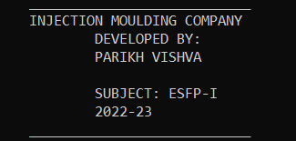
MAIN PAGE

Slide 4
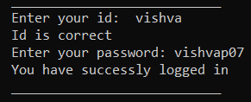
LOGIN

Slide 5
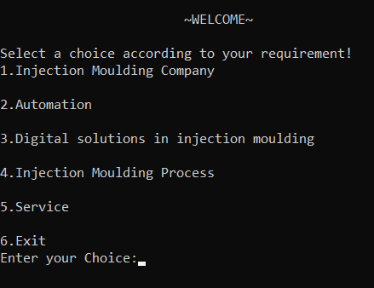
MENU

Slide 6
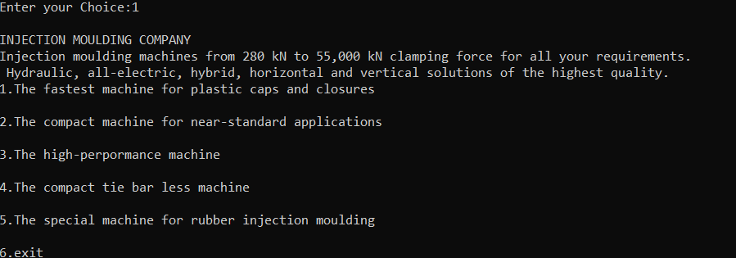
INJECTION MOULDING COMPANY

Slide 7
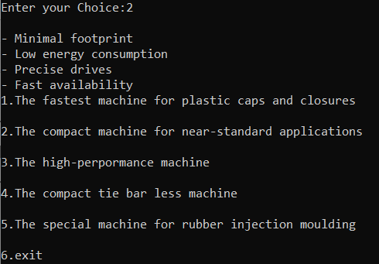
AUTOMATION

Slide 8
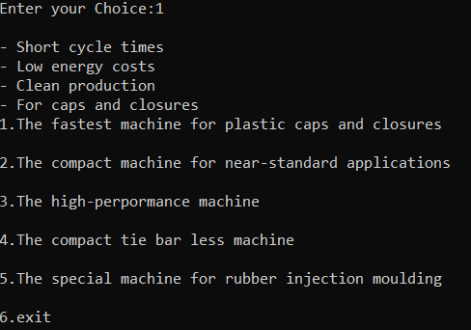
AUTOMATION:1

Slide 9
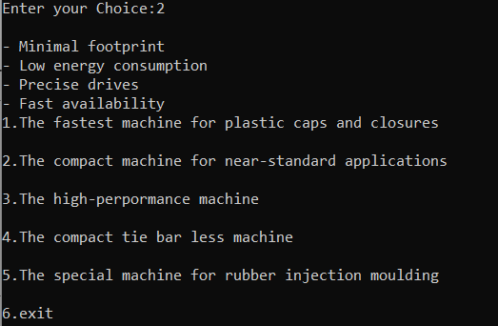
AUTOMATION: 2

Slide 10
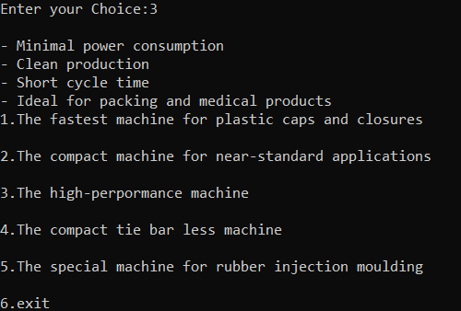
AUTOMATION:3

Slide 11
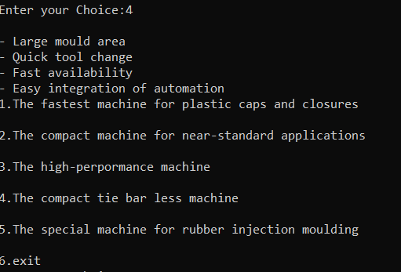
AUTOMATION: 4

Slide 12
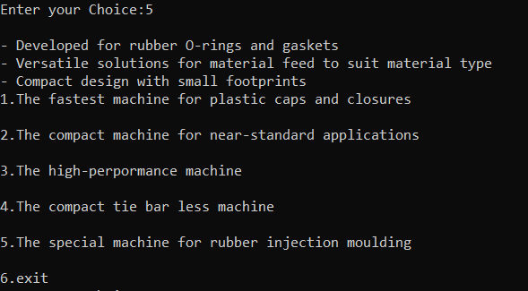
AUTOMATION:5

Slide 13
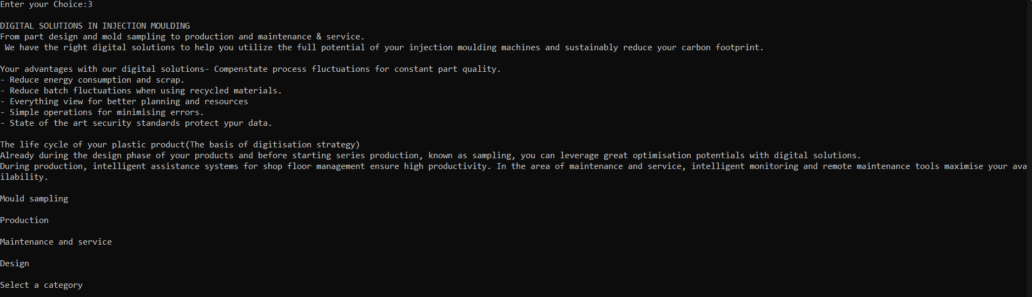
DIGITAL SOLUTION IN INJECTION MOULDING

Slide 14
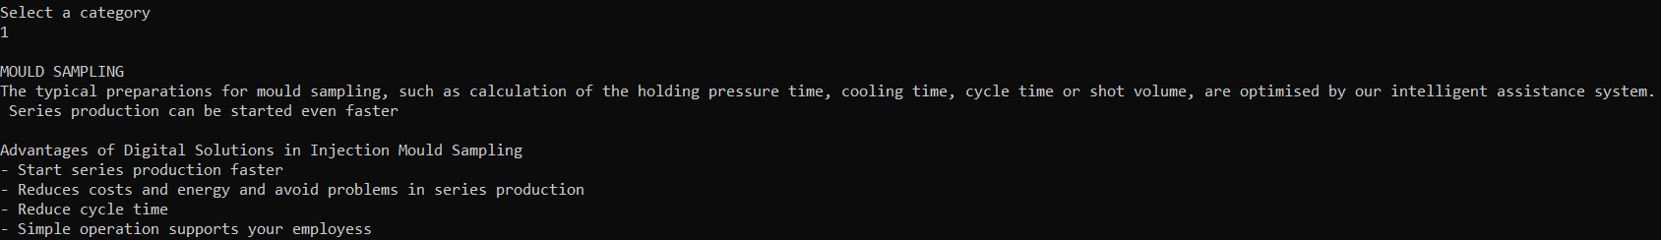
CATEGORY:1

Slide 15
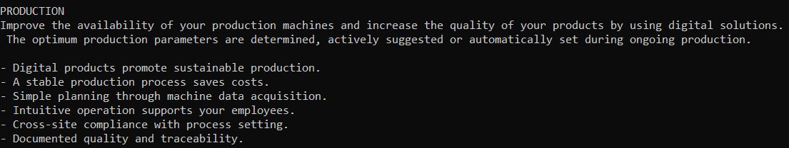
CATEGORY:2

Slide 16
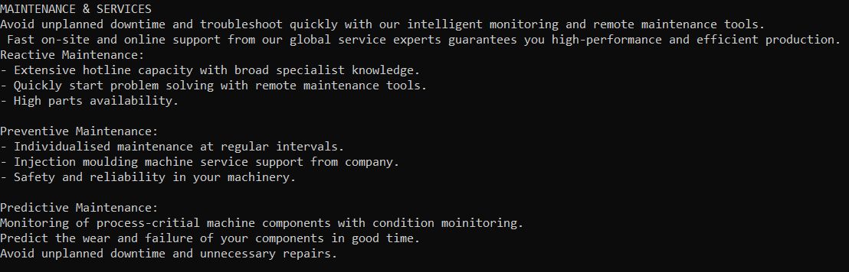
CATEGORY:3

Slide 17
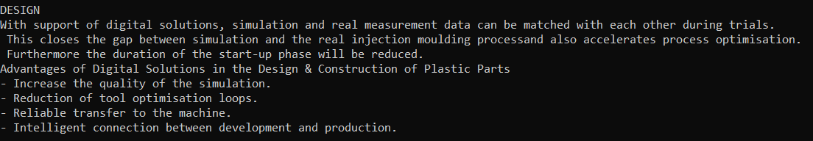
CATEGORY:4

Slide 18
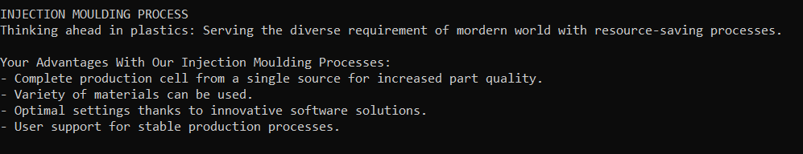
INJECTION MOULDING PROCESS

Slide 19
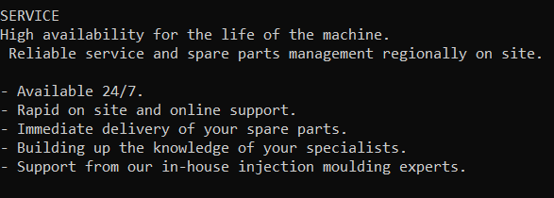
SERVICE

Slide 20
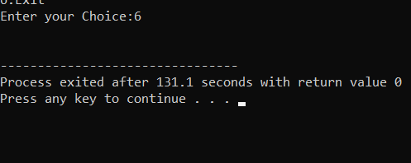
EXIT

Slide 21
THANK YOU!

