Slide 1
Track Bus
(Rajasthan Hackathon 4.0)

Slide 2
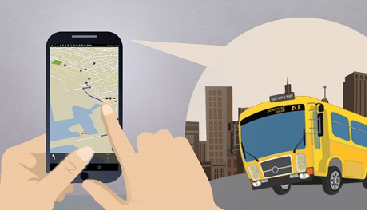
Bus Tracking System
- Vishva patel
- Saurav Agrawal
- Kush Goswami
- Krunal Bhimani

Slide 3
Contents
Problem Statement
Introduction
Aims and Objective
System Analysis
Methodology
Advantage

Slide 4
Problem Statement
In our Country having the facility of public transport like Bus, people are not using public transport instead they prefer to use their personal vehicles to travel from one place to another which uses much more fuel and contribute in increasing pollution and traffic.
So the Question Arises :
How can we increase use of public Transport ?
How public transport can help in reducing traffic and pollution ?

Slide 5
Introduction
There are Buses made available for passengers travelling distance ,but not many passengers have complete information about the buses.
Complete information about number of buses that go to the required destination, bus number, bus timings, the routes through which the bus will pass, time taken for the journey, maps that would guide the passenger with his/her route and the most importantly , track the current location of the bus and give the correct time for the bus to reach its bus stop.
The problem statement deals with the problem stated above.
The system is Android Application which give necessary information about all the buses running in the city.
The platform chosen for this kind of system is android, reason being Android operating system has come up on a very large scale and is owned by almost every second person.

Slide 6
Aims and Objectives
The main aim of the proposed work is to improve the Bus system by adding the necessary additional features into the application, like accurate bus timings, correct bus numbers and moreover adding GPS tracker into it.
Another objective of this application will be that to make it a user friendly application so that people can easily find things which will boost public transport.

Slide 7
System Analysis
To design and build a GPS tracking system for fleet based vehicles that will provide two way communication with drivers . It uses following environment and tools for the development of the application.
Android
Android Tools and Android SDK
FireBase Database
GPS Tracking Unit
GPS Tracking Unit Architecture

Slide 8
Methodology
Project is designed in parts where each part is responsible for different aspects.
Essentially, main activity handles instantiate methods and pre-configuration process for Location Manager class such as manage the previous location , current location distance between two location and status check wether GPS is on or off.
Location based Bus tracking system will auto start on boot up or installation.
Then it will find current latitude and longitude value with previous latitude and longitude value and stores it to the server Database.
The user will check for the bus and get the information from the database for that particular location.

Slide 9
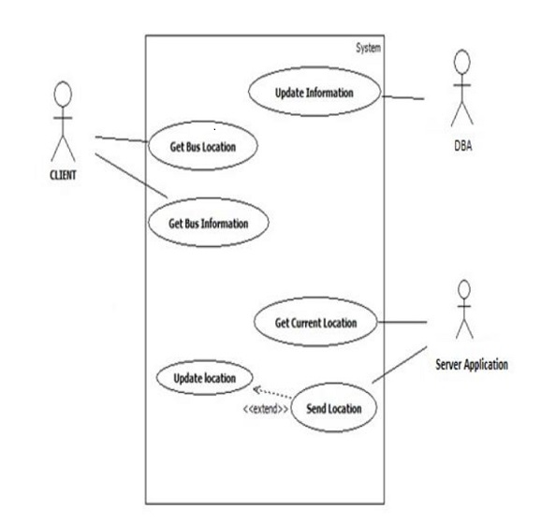
Use Case Diagram

Slide 10
Advantage
The passenger can easily select bus and their stop from the list of buses and know where the bus is and how long it will take to reach their stop.
They will also know the exact location of the us on Google Map which gives them a better idea on the whereabouts of the bus .
This will also help in boosting up the use of public transport and contribute in reducing the traffic by not using private vehicles and using bus.
The government will be benefited too as it will generate more revenue by boosting up the use of public transport.

Slide 11
What We Have Made?
We have build two android applications one for the driver (Which is in the driver folder of demo in github) ,what it will do is that it will track and update the drivers location to the firebase database constantly (In Real Time).
Secondly we have build the client side application which we have kept simple and we have added only one bus for now ,we can add data of multiple buses .
we can even edit the details on the client side. For just the prototype and verifying that everything works fine we have created this two applications,hope that this will be beneficial to the citizens of country.

Slide 12
THANK YOU

