Slide 1
Capstone Project Presentation
NAME :- VISHVARAJSINH.PARMAR
EN.NO:- 92200133007
SUB:--CP
TOPIC :- Jay Khodiyar Control System
3-Phase Electrical Equipments

Slide 2
Introduction
This project presents a digital platform for industrial and commercial electrical equipment.
- Offers MCBs, MCCBs, meters, lugs, and related components.
- Ensures quality assurance and competitive pricing.
- Deployed live using Vercel for global accessibility.

Slide 3
Problem Statement & Objectives
Problem Statement:
- Traditional methods of procuring electrical equipment lack efficiency, scalability, and digital access.
Objectives:
- Build an online platform to streamline product access.
- Enable smooth navigation, shopping cart, and checkout.
- Improve efficiency and transparency in procurement.

Slide 4
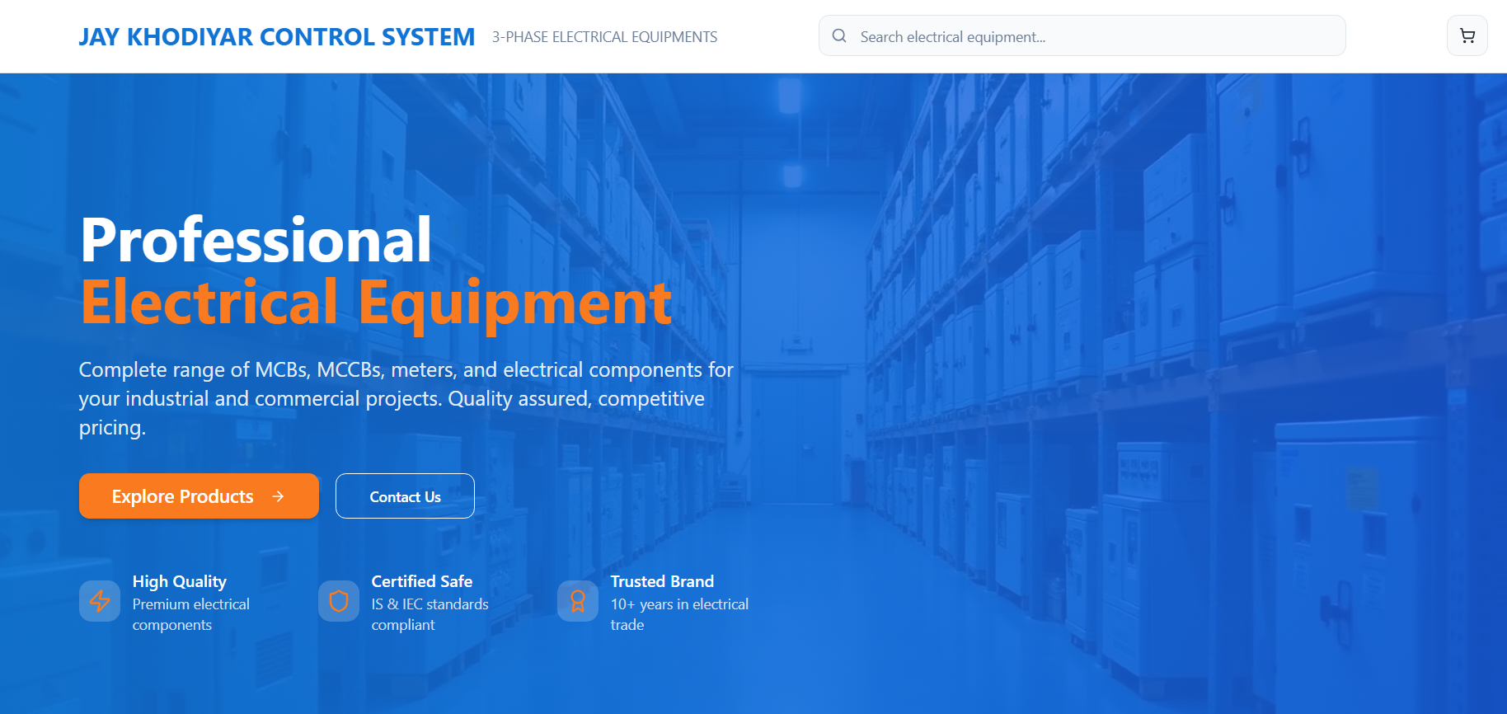
System Architecture (Figure 1)

Slide 5
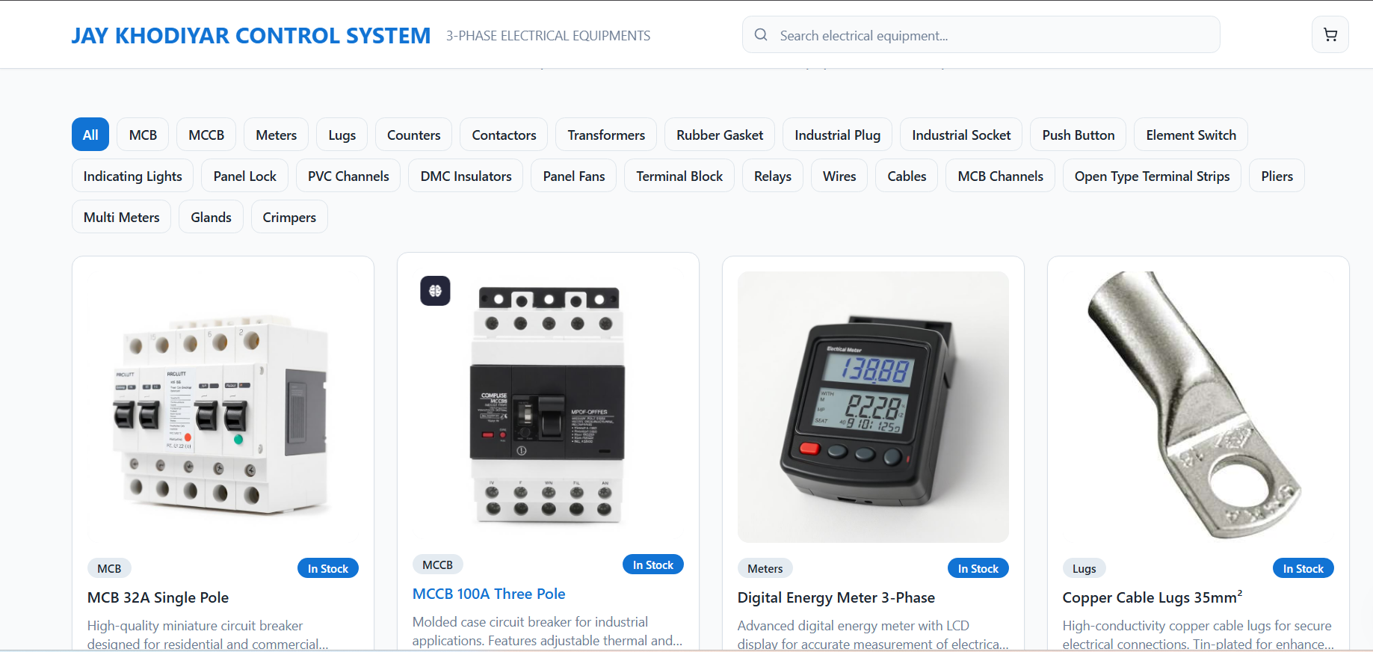
Scalability & Deployment

Slide 6
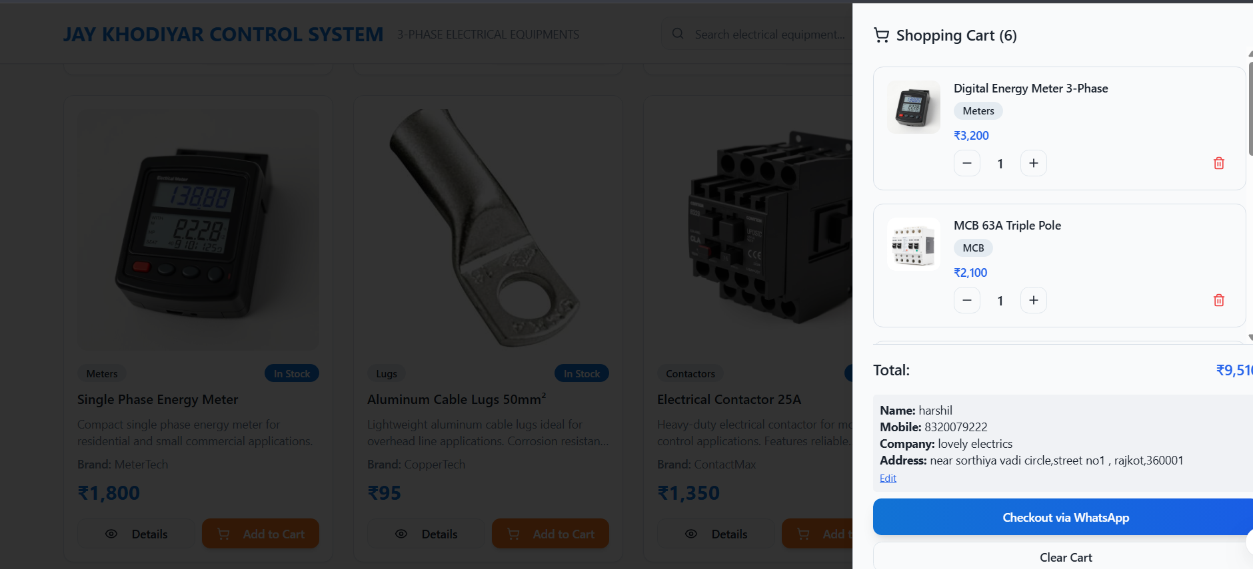
Live Demo Screenshots

Slide 7
Key Features
- Online catalog of 3-phase electrical equipment.
- Product search and filtering.
- Shopping cart and checkout via WhatsApp.
- Deployed on Vercel with live accessibility.

Slide 8
Monitoring & Maintenance
- Live monitoring using Vercel analytics.
- KPIs: Uptime, response time, and API error tracking.
- Maintenance plan includes weekly backups, bug fixes, and security updates.

Slide 9
Innovation & Impact
- Unique integration of traditional trade with modern ICT tools.
- Improved procurement efficiency for industrial users.
- Scalable design allows expansion to other product domains.
- Contribution to ICT field: Promotes digital transformation in electrical trade.

Slide 10
Conclusion & Q/A
Conclusion:
- Developed a fully functional digital platform for electrical equipment.
- Successfully deployed and tested scalability.
- Demonstrated innovation and ICT contribution

