Slide 1


Health AI
6th Semester
PROJECT (CEDE)
Department of Computer Engineering
Group No: 2
Internal Guide:
Prof. Amit Modi
VSITR
Prepared By:
Student Name - (Enrollment No)
Urvish Patel -20BECE54049
Kewal Patel-19BECE54028
Om Patel-20BECE54038

Slide 2
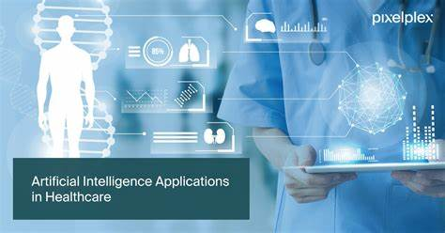
Artificial Intelligence base HealthCare System

Slide 3
Abstract
An AI-based healthcare system is a cutting-edge technological advancement that utilizes artificial intelligence to optimize healthcare processes, improve patient outcomes, and reduce costs. This system incorporates machine learning algorithms and predictive analytics to interpret vast amounts of patient data, including medical records, laboratory results, and imaging studies, to generate insights that can support clinical decision-making. Additionally, AI-based healthcare systems can assist with disease detection and diagnosis, personalized treatment plans, and patient monitoring. With the ability to process information at a speed and accuracy that far surpasses human capabilities, AI-based healthcare systems have the potential to revolutionize the way healthcare is delivered, improving quality of care and reducing healthcare costs

Slide 4
Outlines(SAVED)
Problem Statement
Introduction
Technology Stack
Objective
Key Feature
Possible Outcomes
Proposed system Architecture
Diagrams(Flowchart, E R Diagram, Class, DFD etc)
Final Prototype
References

Slide 5
1.Problem Statement
The problem statement is to develop an AI-based system that can accurately predict the likelihood of a patient developing diabetes, kidney disease, liver disease, cancer, and heart disease. These conditions are major health concerns worldwide and early detection is crucial for effective treatment and management.The system should be able to analyze a patient's medical history, lifestyle, and other relevant data to provide a comprehensive risk assessment for each of these conditions. It should be able to handle large amounts of data and use advanced machine learning algorithms to continuously learn and improve its predictions.The goal of this system is to help healthcare providers identify patients at high risk for these conditions, provide early interventions and personalized treatments, and ultimately improve patient outcomes. This would not only benefit individual patients but also have a positive impact on public health by reducing the burden of these chronic diseases on healthcare systems.

Slide 6
2.INTRODUCTION
The healthcare industry is currently undergoing a significant transformation, with the integration of advanced technologies such as artificial intelligence (AI) and machine learning (ML) becoming increasingly prevalent. AI-based healthcare systems are among the most promising and innovative applications of these technologies, offering a vast array of benefits for patients, healthcare providers, and healthcare organizations alike.
AI-based healthcare systems leverage the vast amounts of data generated by the healthcare industry, including electronic health records, medical imaging, and wearable devices, to generate insights that can support clinical decision-making. These systems have the potential to improve the accuracy and speed of diagnosis, reduce the likelihood of medical errors, and enable more personalized treatment plans. Additionally, they can help healthcare providers manage resources more efficiently, resulting in cost savings and better allocation of healthcare resources.
In this context, the adoption of AI-based healthcare systems is expected to increase significantly in the coming years. This paper will explore the key features and benefits of AI-based healthcare systems, as well as the challenges associated with their implementation and integration into existing healthcare systems.

Slide 7
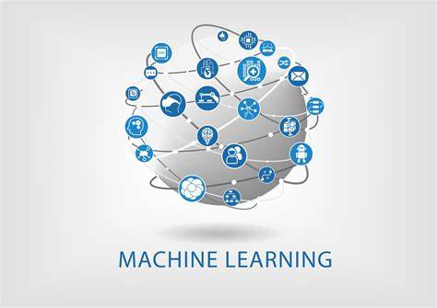




Technology Stack
Technology Stack
Technology: Machine learning, Deep Learning
Front-End: Streamlit , CSS3, Bootstrap,Plotly
Back-end: Flask-Rest, streamlit

Slide 8



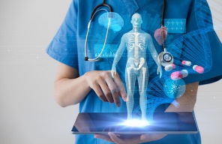


1.Objective
Personalized Treatment
Predictive Analytics
Health-AI
Early Detection and Diagnosis
Improved Clinical Decision-making
Sugession Accordind to MedicalReport

Slide 9




1. Key Feature
Data Integration
1
AI-based healthcare systems require large amounts of diverse data to train their algorithms. These systems can integrate data from various sources such as electronic health records, medical imaging, and patient-generated data from wearable devices.
Decision Support Tools
2
AI-based healthcare systems can provide decision support tools that can assist healthcare providers in making diagnoses and treatment decisions. For example, these systems can provide recommendations for medication dosage or suggest potential treatment options based on patient data.
3
AI-based healthcare systems can use patient data to generate personalized treatment recommendations. For example, these systems can analyze genetic data to identify patients who are likely to benefit from a particular medication or treatment.
Personalized Medicine
4
AI-based healthcare systems can use predictive analytics to identify patients who are at high risk of developing certain diseases or conditions. These systems can analyze patient data and generate risk scores, which can help healthcare providers make more informed decisions about treatment and preventive measures.
Predictive Analytics

Slide 10
1. Possible Outcomes
Early Detection: One of the most significant outcomes of an AI-based healthcare system is the ability to detect diseases early, even before symptoms appear. Early detection can help healthcare providers intervene before the disease progresses to a more severe stage, resulting in better treatment outcomes and potentially saving lives.
Cost Savings: AI-based healthcare systems can help reduce healthcare costs by enabling more efficient resource allocation, reducing the need for hospital readmissions, and minimizing the likelihood of medical errors. This can lead to significant cost savings for both patients and healthcare providers
Reduced Medical Errors: AI-based healthcare systems can help healthcare providers reduce medical errors by providing accurate and timely information. This can improve the quality of care provided to patients and reduce the likelihood of adverse events.
Improved Patient Experience: An AI-based healthcare system can help improve the patient experience by providing personalized care plans, reducing wait times, and enabling remote consultations. This can result in better patient satisfaction and higher levels of patient engagement.

Slide 11
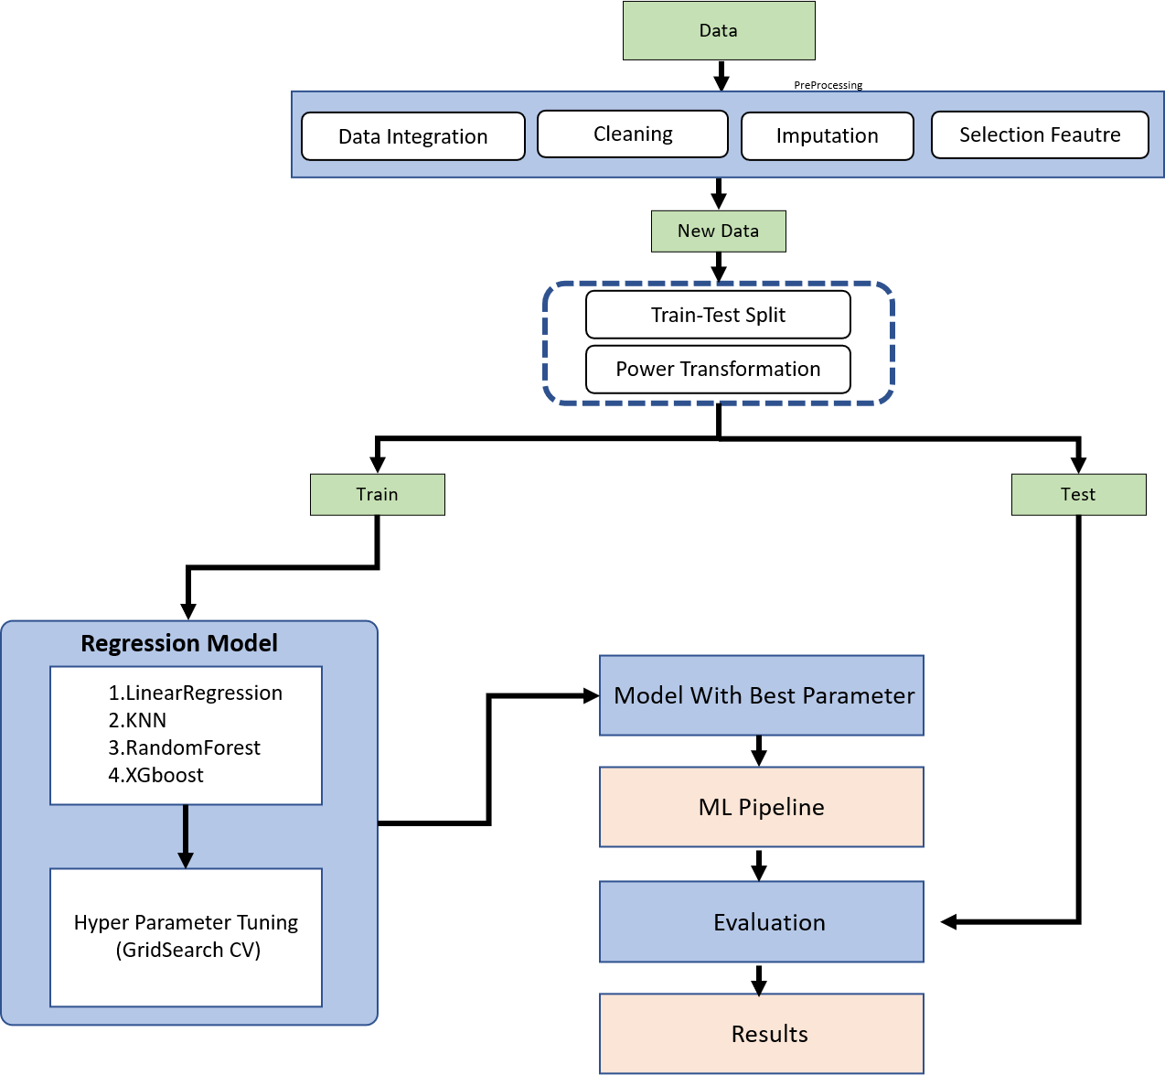
1.Proposed system Architecture

Slide 12
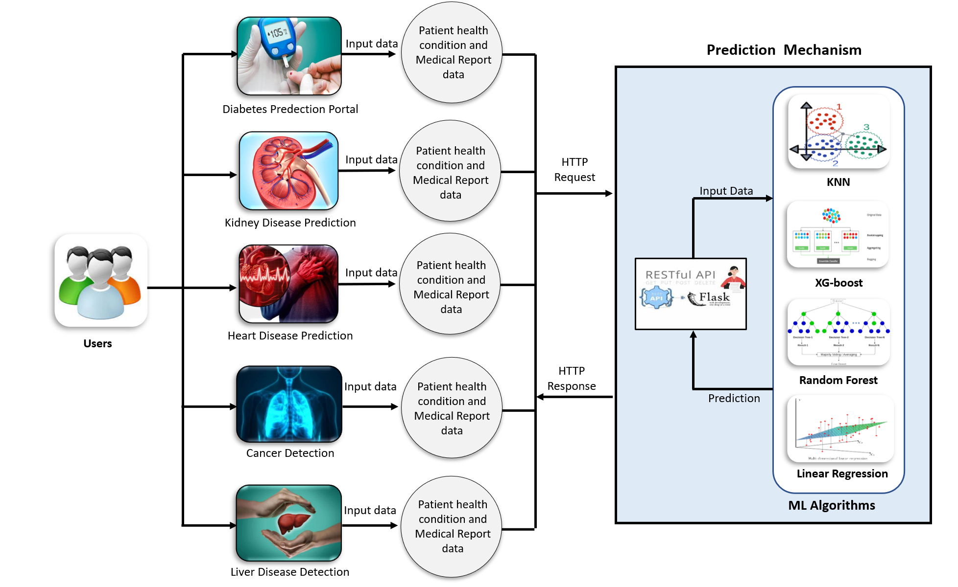
1. Diagrams

Slide 13
1.Secquence Diagram
User
Front-end UI
Rest-API
Prediction Mechanism
Database
Input Data
Get Data
Send Input Data
Request(if Patient Disease Effected )
Response(Disease effected or not)
Response(Send Suggestions)
Response To User

Slide 14
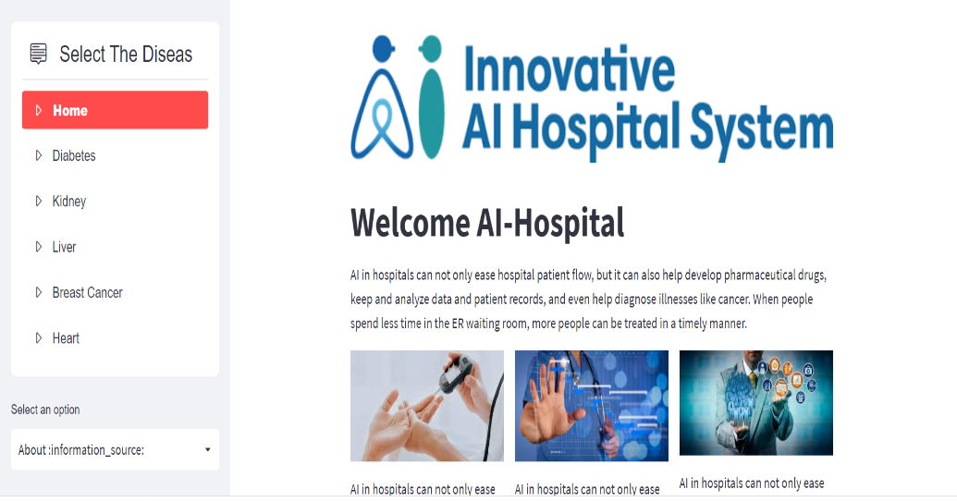
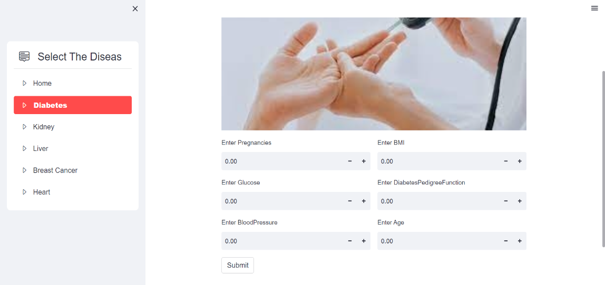
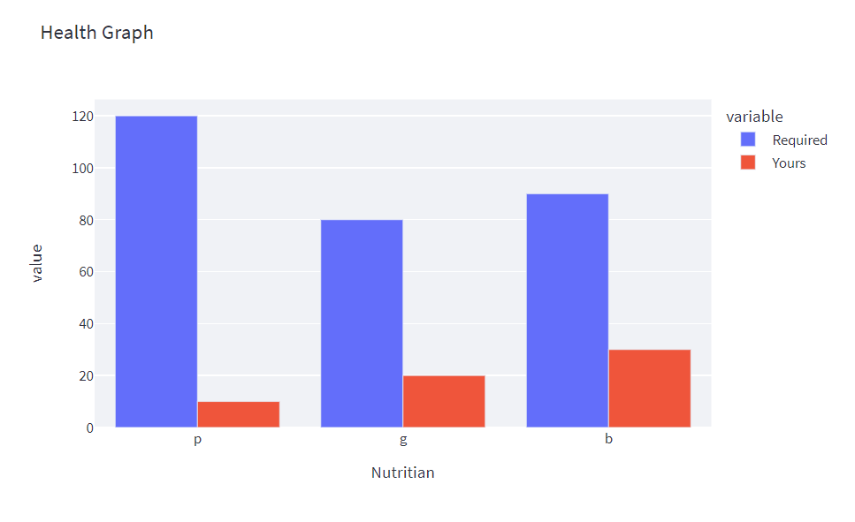
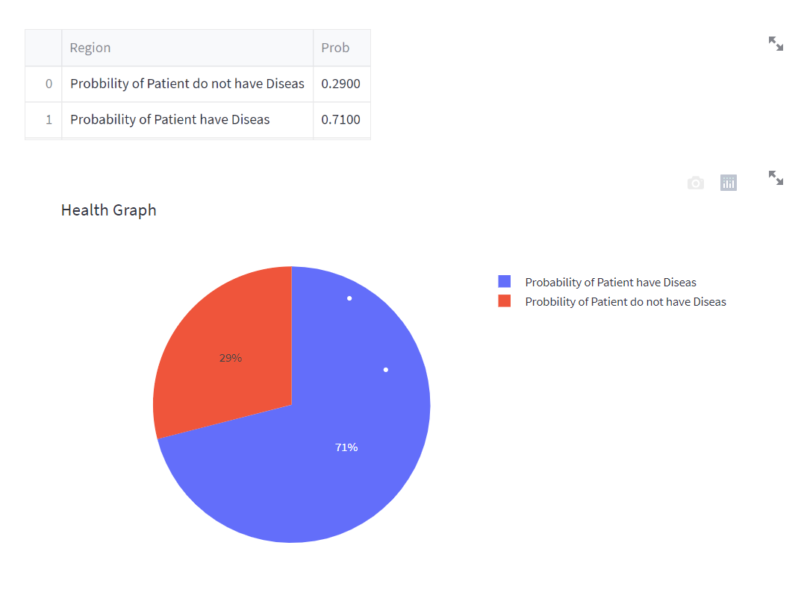
1. Implementation

Slide 20
No | Topics | Page no
1 | Abstract | 4
2 | Problem Statement | 5
3 | Cloud Architecture 3.1 Cloud Types | 7
4 | Component 4.1Virtualizat 4.2 Ion Users | 9
5 | Working | 10
6 | Merits and Demerits | 11
7 | Conclusion | 12
8 | References | 13

Slide 31
1. Objective

Slide 32

1.INTRODUCTION
1
2
3

Slide 33
Outlines
Introduction
Problem Statement
Objective
Scope
Possible Outcomes
Prior Art Search (Literature review)
Survey(if any)
Any Diagrams(Flowchart, E R Diagram, Class, DFD etc)
Final Prototype
Implementation(if any)
Videos( if any)
Conclusion & Future Works(if any)
References

