Slide 1
Confidence-Driven Adaptive Multi-Sensor Fusion Framework for Robust Autonomous Vehicle Localization
Presented by:
K. Vishwa
Roll No : 23261A0590
Under the Guidance of:
Dr. P. Poornima
Department of Computer Science and Engineering
Mahatma Gandhi Institute of Technology (MGIT)
Hyderabad, Telangana, India

Slide 2
Introduction
Autonomous vehicles require accurate and reliable localization for navigation, trajectory planning, obstacle avoidance, and motion control.
Modern vehicles use heterogeneous sensors such as:
  Camera — provides rich visual information.
  GPS — provides absolute positioning.
  IMU — provides high-frequency motion measurements.
Sensor performance is not constant during real-world driving.
Camera, GPS, and IMU can independently degrade because of:
  Poor illumination and motion blur
  GPS signal degradation and outages
  IMU noise, vibration, and drift
Conventional fusion techniques commonly rely on fixed sensor weights or predefined covariance models.

Slide 3
Problem Statement & Research Gap
Problem Statement
  Conventional multi-sensor localization methods may perform poorly when one or more sensors become temporarily unreliable because they generally use fixed weights or fixed uncertainty models.
Research Gap
  Existing approaches often:
  Do not explicitly assess the quality of camera, GPS, and IMU simultaneously before fusion.
  Use predefined sensor weights that cannot respond effectively to changing sensor reliability.
  Adapt uncertainty mainly within the filtering stage rather than through a unified sensor-confidence framework.
  Provide a position estimate without explicitly predicting how reliable that localization estimate is.
Proposed Solution
  Sensor Quality Assessment → SCI → Adaptive Weighting → Confidence-Driven Fusion → AEKF → Localization Reliability Prediction

Slide 4
Objectives
Develop a unified Sensor Confidence Index (SCI) to quantify the reliability of Camera, GPS, and IMU measurements.
Develop adaptive sensor weighting so that reliable sensors receive greater influence while degraded sensors are automatically down-weighted.
Develop a confidence-aware Adaptive Extended Kalman Filter (AEKF) to improve localization robustness under changing sensing conditions and GPS degradation.
Develop a machine-learning-based localization reliability prediction module to predict localization error using confidence-aware features.

Slide 5
Base Paper
Paper Title
  Mitigating GPS Spoofing in AVS: SHA and RSA Algorithms with Proteus Simulation for Real-Time Detection
Authors & Year
  B. Poornima — 2025
Base Paper URL
  https://doi.org/10.1007/s13198-025-02864-8
Key Idea / Contribution
  Proposes a GPS spoofing detection and mitigation framework for Autonomous Vehicular Systems.
  Uses PDOP, HDOP, and VDOP GPS features for spoofing detection.
  Employs Extra Trees Regressor for machine-learning-based analysis.
  Uses an MPU6050 accelerometer–gyroscope to cross-verify GPS information.
  Applies SHA-256 hashing and RSA encryption to protect GPS data integrity and security.
  Provides real-time alerts through LED and GSM when spoofing is detected.

Slide 6
Dataset
Dataset Name: KITTI Raw Dataset
Source: Karlsruhe Institute of Technology (KIT) & Toyota Technological Institute at Chicago (TTIC)
Size: 2,472 synchronized frames from 9 driving sequences
Features / Input: Camera images, GPS, IMU, and OXTS navigation measurements
Type of Data: Synchronized multimodal autonomous-driving sensor data
Dataset URL: KITTI Raw Data

Slide 7
References
[1] B. Poornima and L. S. Kumari, “Mitigating GPS spoofing in AVS: SHA and RSA algorithms with Proteus simulation for real-time detection,” International Journal of System Assurance Engineering and Management, 2025, doi: 10.1007/s13198-025-02864-8.
[2] M. Jiang, Z. Chu, Y. Pan, H. Yuan, Q. Han, J. Zou, Y. Zhang, X. Zhu, C. Zhang, X. Zhou, W. Lou, and Z. Wang, “Multi-sensor fusion on autonomous driving perception: A comprehensive survey,” Multimodal Transportation, vol. 5, Art. no. 100325, 2026, doi: 10.1016/j.multra.2026.100325.
[3] H. Qian, M. Wang, M. Zhu, and H. Wang, “A review of multi-sensor fusion in autonomous driving,” Sensors, vol. 25, no. 19, Art. no. 6033, 2025, doi: 10.3390/s25196033.
[4] C. Wei, Z. Qin, Z. Zhang, G. Wu, and M. J. Barth, “Integrating multi-modal sensors: A review of fusion techniques for intelligent vehicles,” IEEE Open Journal of Intelligent Transportation Systems, 2025.
[5] D. Kumar and N. Muhammad, “A survey on localization for autonomous vehicles,” IEEE Access, vol. 11, pp. 122276–122294, 2023, doi: 10.1109/ACCESS.2023.3326069.
[6] Z. Wang, Y. Wu, and Q. Niu, “Multi-sensor fusion in automated driving: A survey,” IEEE Access, vol. 8, pp. 2847–2868, 2020, doi: 10.1109/ACCESS.2019.2962554.
[7] S. Wang, J. Wang, C. Wang, X. Lv, and X. Wang, “Robust GNSS/INS hybrid integration based on multi-state validation of GNSS measurements,” IEEE Transactions on Intelligent Transportation Systems, 2025.
[8] Y. Hou, L. Cheng, Y. Ke, et al., “The INS/GPS integrated navigation based on autonomous underwater vehicle using modified extended Kalman filter,” Transactions of the Institute of Measurement and Control, vol. 48, no. 3, 2024, doi: 10.1177/01423312241288643.
[9] U. C. Onyema and S. Mahmoud, “Enhancing GPS/IMU localization accuracy in autonomous vehicles through deep learning-based error correction models,” IEEE, 2024.

Slide 8
[10] V. Cánepa, P. Servidia, and J. Giribet, “Adaptive extended Kalman filter for integrated navigation in a satellite launch vehicle,” IEEE, 2024.
[11] I. Khairullin, “Adaptive EKF SLAM with semantic landmark typing for robust navigation of highly automated vehicles,” IEEE, 2024.
[12] N. Kalakunnath, A. Varghese, A. P. Anuradha, and D. K. Girish, “Advances in deep learning for autonomous vehicle perception: A comprehensive review,” 2025.
[13] X. Zhang, Y. Li, et al., “Image-guided outdoor LiDAR perception quality assessment for autonomous driving,” IEEE Transactions on Intelligent Vehicles, vol. 10, no. 9, pp. 4455–4466, 2024, doi: 10.1109/TIV.2024.3485004.
[14] K. Rajeswari, S. R. Vispute, J. Gupta, K. Dhadwad, R. Ghuge, and M. Ashwin, “Image quality analysis and verification for vehicle photos using deep learning,” IEEE, 2024.
[15] P. Geneva, K. Eckenhoff, W. Lee, Y. Yang, and G. Huang, “OpenVINS: A research platform for visual-inertial estimation,” in Proc. IEEE Int. Conf. Robotics and Automation (ICRA), 2020, doi: 10.1109/ICRA40945.2020.9196524.
[16] S. Park and S. Han, “ROFT-VINS: Robust feature tracking-based visual-inertial state estimation for harsh environment,” arXiv preprint, 2026.
[17] C. Jiang, M. Zhang, Y. Wang, and A. Zhang, “AHMOT: Adaptive Kalman filtering and hierarchical data association for 3-D multiobject tracking in IoT-enabled autonomous vehicles,” IEEE, 2025.
[18] R. Sun, Y. Dai, and Q. Cheng, “Adaptive sensor weighting in multi-sensor navigation,” IEEE, 2023.
[19] I. K. Nti, E. Nyarko-Boateng, E. Ayidzoe, and E. N. Osae, “An optimized ensemble model for predicting average localization error of wireless sensor networks,” Scientific African, vol. 27, Art. no. e02561, 2024, doi: 10.1016/j.sciaf.2024.e02561.
[20] K. Matsumoto, E. Javanmardi, J. Nakazato, and M. Tsukada, “Localizability estimation for autonomous driving: A deep learning-based place recognition approach,” in Proc. 2023 Seventh IEEE International Conference on Robotic Computing (IRC), Laguna Hills, CA, USA, 2023, pp. 280–283, doi: 10.1109/IRC59093.2023.00052.

Slide 9
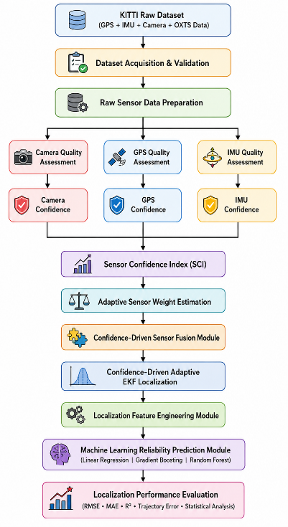
Methodology Overview & Architecture
Data Ingestion & Synchronization: Timestamp validation of Camera, GPS, and IMU.
Sensor Quality Assessment (SQA): Real-time extraction of sensory health indicators.
Sensor Confidence Index (SCI): Unified scalar quantification of sensing environment quality.
Adaptive Weight Estimation (AWE): Dynamic weight redistribution based on reliability.
Adaptive Extended Kalman Filter (AEKF): Confidence-scaled measurement covariance update.
Reliability Prediction: Machine learning regression to predict localization uncertainty.

Slide 10
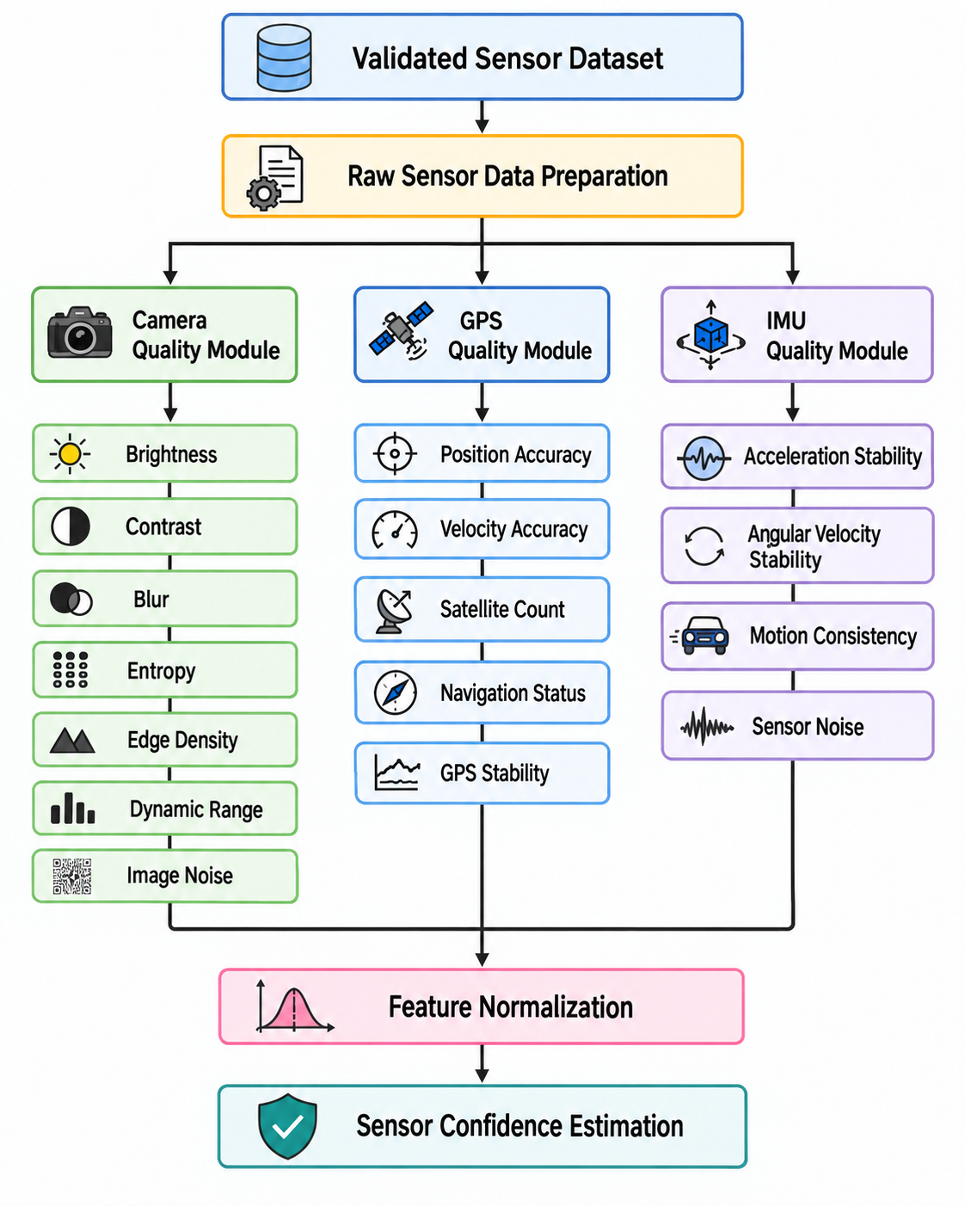
Sensor Quality Assessment (SQA)
Camera Quality Assessment (CQA) (7 Metrics):
  Brightness, Contrast, Blur Level (Laplacian variance), Image Entropy, Edge Density (Canny), Dynamic Range, and Image Noise.
GPS Quality Assessment (GQA) (5 Indicators):
  Number of Satellites, Position Dilution of Precision (PDOP / HDOP / VDOP), and GPS Position Variance.
IMU Quality Assessment (IQA) (4 Indicators):
  Accelerometer Noise/Variance, Gyroscope Drift, Motion Consistency, and High-Frequency Vibration.
Normalization: All metrics are normalized to $[0, 1]$ to ensure uniform scaling across heterogeneous sensor dimensions.

Slide 11
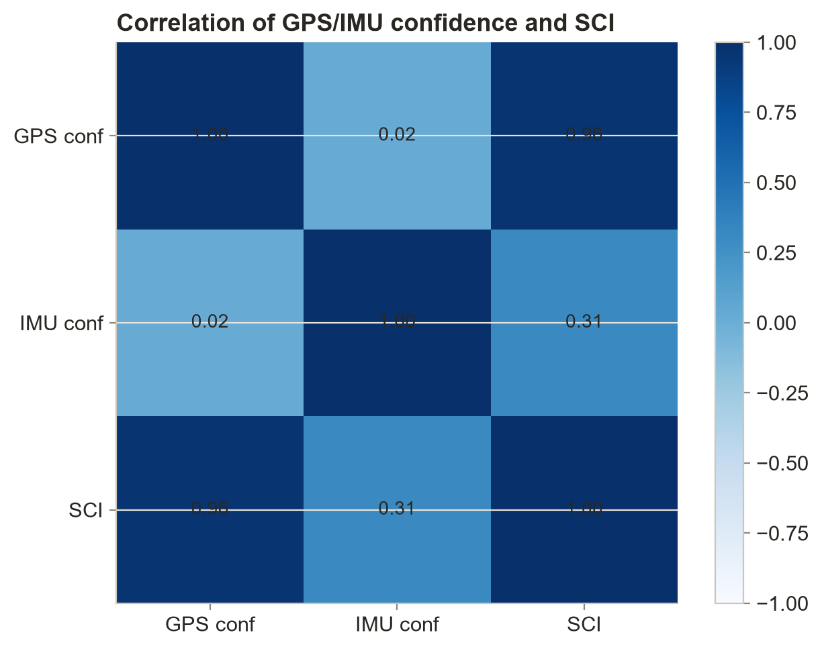
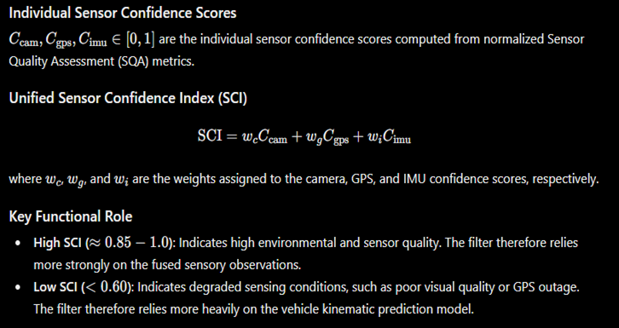
Sensor Confidence Index (SCI)

Slide 12
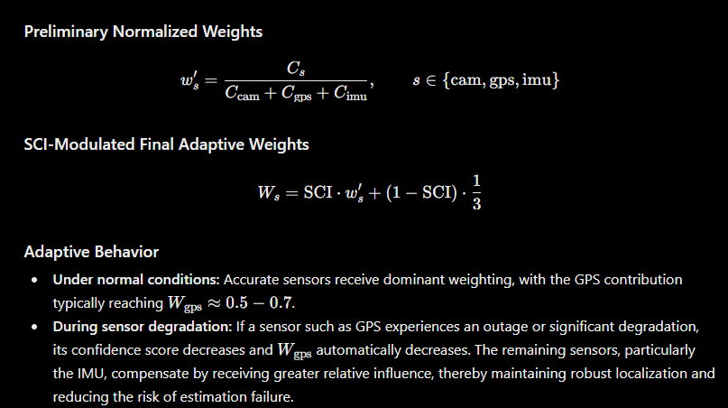
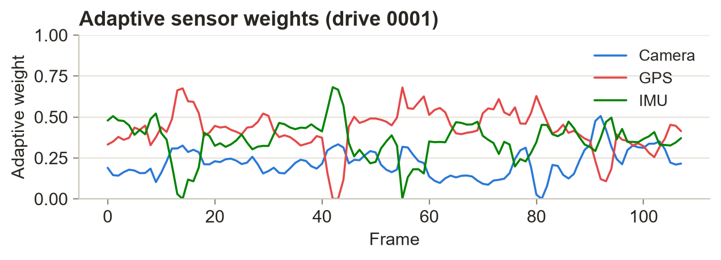
Adaptive Weight Estimation (AWE)

Slide 13
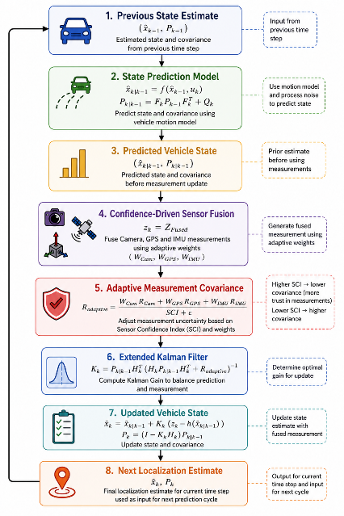
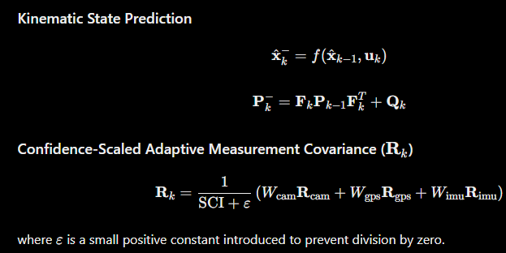
Confidence-Aware AEKF

Slide 14
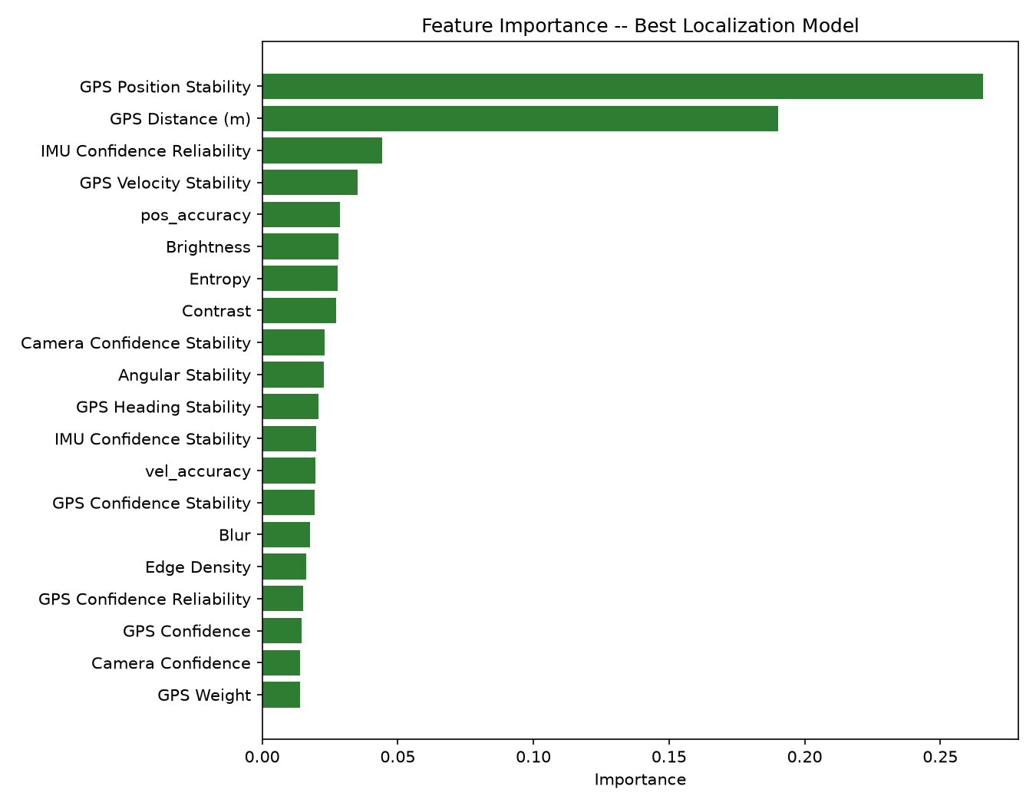
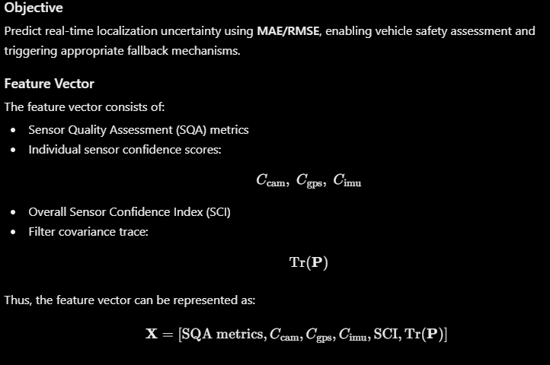
ML-Based Reliability Prediction
ML Regressor Models
Three regression models are evaluated for predicting localization uncertainty:
Extra Trees Regressor
Random Forest Regressor
Gradient Boosting Regressor
Cross-Validation
Leave-One-Drive-Out (LODO) cross-validation is performed across all 9 KITTI sequences, comprising 2,472 frames. In each iteration, one complete drive sequence is held out for testing while the remaining sequences are used for training.

Slide 15
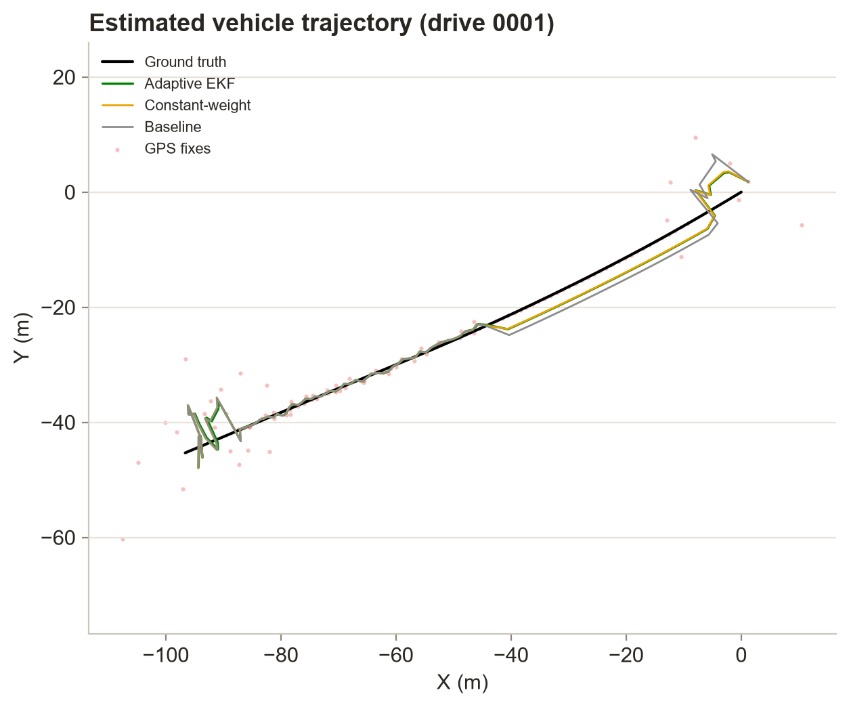
Trajectory & Localization Accuracy
Quantitative Performance on KITTI Benchmark:
  CAMSF (Proposed): RMSE = 2.48 m | MAE = 1.88 m
  Fixed-Weight Baseline: RMSE = 2.95 m | MAE = 2.19 m
  Error Reduction: 15.8% improvement in localization accuracy.
GPS Outage Resilience: Maintained a smooth, continuous trajectory even during severe 33-frame GPS dropouts.

