Slide 1



BANK LOAN OF CUSTOMERS
DATA ANALYSIS PROJECT
P- 414P | Group 2 | Mentor: Gunda Bharat

Slide 2


C O N T E N T S
Introduction
Meet the team
KPI-1 : Year wise loan amount Stats
KPI-2 : Grade and sub grade wise revol bal
KPI-3 : Total Payment for Verified Status Vs Total Payment
for Non Verified Status
KPI-4 : State wise and Month wise Loan status
KPI-5 : Home ownership vs Last payment date stats
Dashboards & Queries : Excel, SQL, Power BI & Tableau

Slide 3


Introduction
The project aim to analyze the finance dataset of bank loan of customers, through a report get insights from it by using different software tools such as Excel, MySQL, Tableau and Power Bi.
we used for analyzing, cleaning and removing duplicates from datasets and prepared dashboards and insights accurate business decisions are made.

Slide 4
DATA S E T
Data Set | Finance_1 | Finance_2
No. of Rows | 39k | 39k
No. of Columns | 24 | 25
File Format | .csv | .xlsx
Datatype Set | Excel Data | Excel Data

Slide 5
TO O L S U S E D I N T H E P RO J E C T
MySQL
Tableau
Excel
Power-BI
Data Exploration
Retrieving Relevant Data according to KPIs
Joining multiple
Files
Visualization
Data Exploration
Data Cleaning
Visualization
Joining multiple
Files
Data Exploration
Data Cleaning in Power Query
Visualization

Slide 6







DATA A N A LY S I S P RO C E S S
Step 1
Define the Question
Step 2
Collect the data
Step 3
Clean the data
Step 4
Analyze the data
Step 5
Visualize and Share the Insights

Slide 7
M E E T O U R T E A M
Mr. Sumit Rajaram Pujare
Ms. Digdarshini Das
Ahir Vishwa Bhadreshbhai
Ms. Shruti Shivprasad Pardeshi
Mrs. Anjana C
Mr. Bhukya Praveen
Mr. Sagar Nathu Jedhe

Slide 8


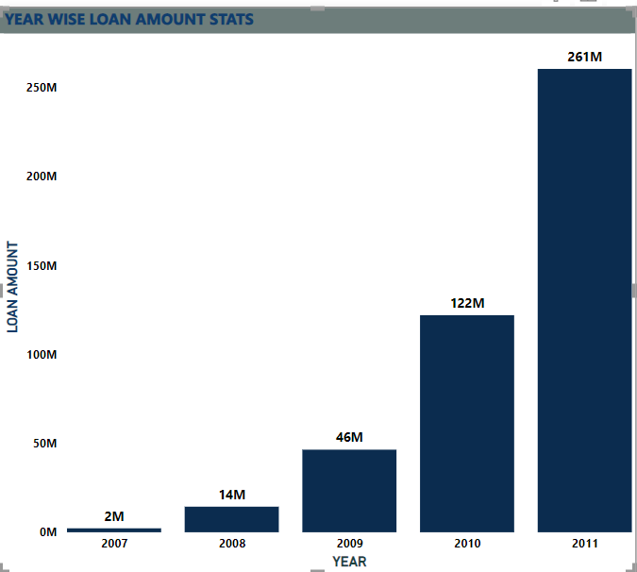
KPI-1 : YEAR WISE LOAN AMOUNT STATS
By observing this chart we can see how loan amount is increasing by year.
It is continuously increasing by each year as you see it‘s varies from 2 M to 261 M between the years 2007 to 2011.
From the year 2009, The changes in loan amount is suddenly increased with a higher rate that is around 5 times for next 2 years as compared to pervious years.

Slide 9
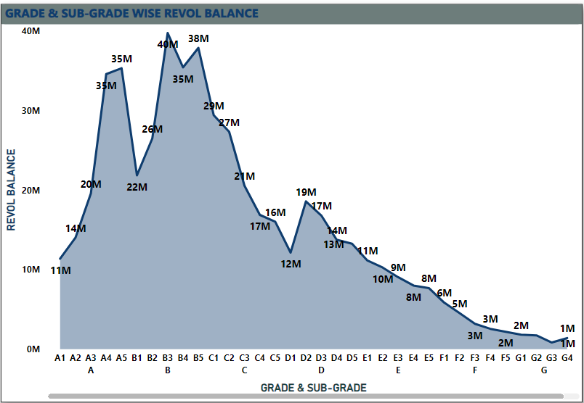
KPI-2 : GRADE AND SUB GRADE WISE REVOL_BAL
In this Grade and subgrade wise revol balance we can notice Grade B have more revol balance then any other grades & Grade G have very low revol balance.
The average revolving balance is higher in the ‘grade B’ its around 29M and the maximum reaches in the ‘sub-grade B1’ that is 39M, Same like the average lower revolving balance is in ‘grade G’ its around 1200K and the minimum reaches in the ‘sub-grade G5’ that is 701k.

Slide 10
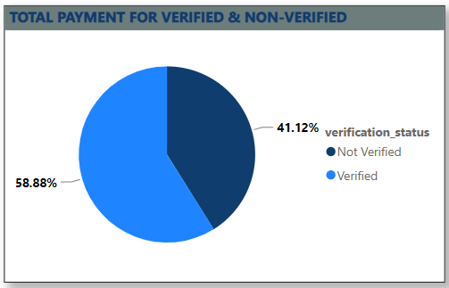
KPI-3 : TOTAL PAYMENT FOR VERIFIED VS NON VERIFIED STATUS
As we Can see in the Donut Chart that Out of $373 Million only 59% are verified i.e.
$220million
41% of $373 Million are not verified i.e. $ 154 Million. Which might be a threat to company, Should inform the verification team to take required action regarding that.

Slide 11
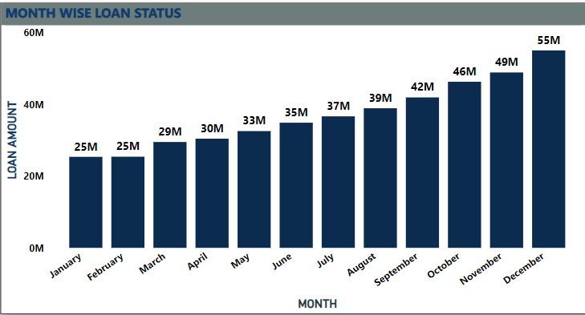
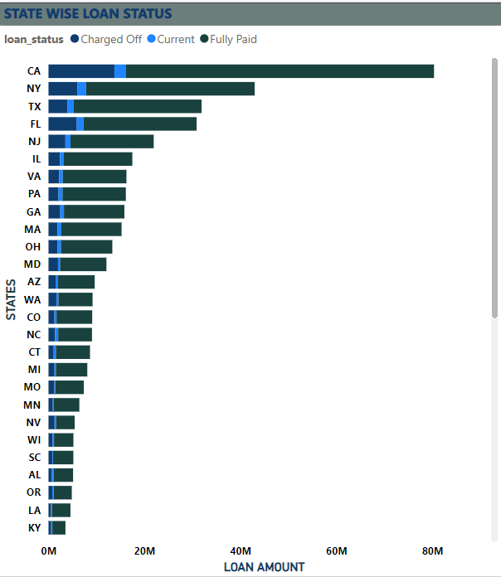
KPI-4 : STATE WISE AND MONTH WISE LOAN STATUS
In the data set we have different states and the months along with the 3 types of loan status.
In the state wise loan status we can observe that CA,NY,TX,FL & NJ are the top states to fully paid amount.
In the month wise loan status we can observe that Dec, Nov and oct are the fully paid amount.

Slide 12
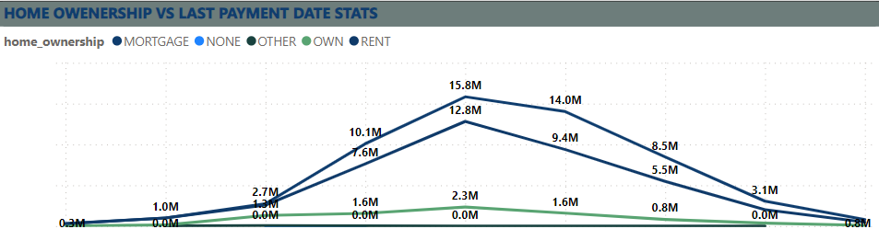
KPI-5 : HOME OWNERSHIP VS LAST PAYMENT DATE STATS
In this chart is shown by the types of home ownerships varies from 2008 to 2016.
In maximum amount reaches in the year 2012 who Rent and Mortgage house owners has paid their last Payment is 12 million and 15 million. And the minimum amount reaches in year 2008 and payment is 0.29 million and 0.31million.

Slide 13

DASH B OARD
Power-BI

Slide 14


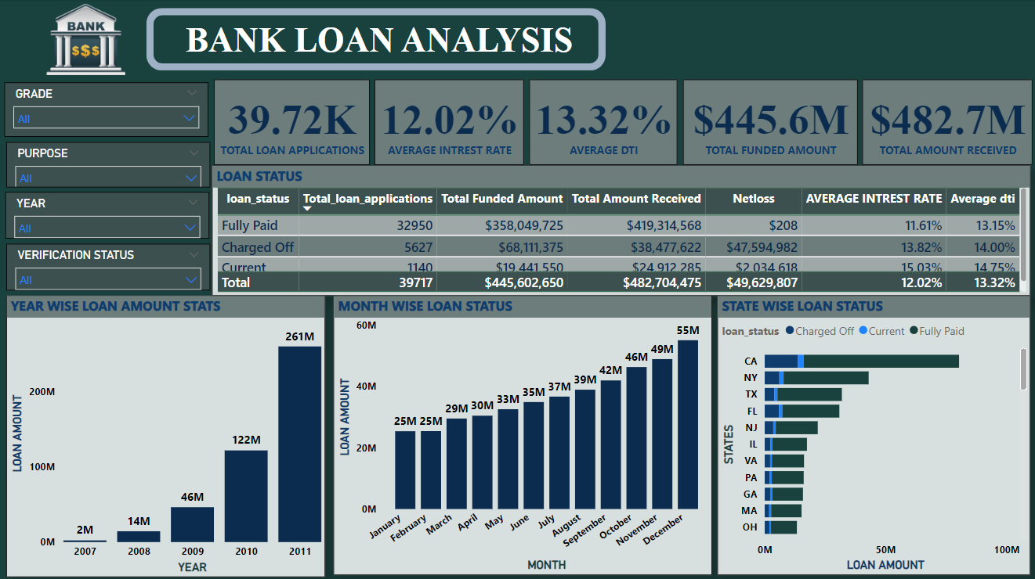
P O W E R B I DA S H B OA R D

Slide 15
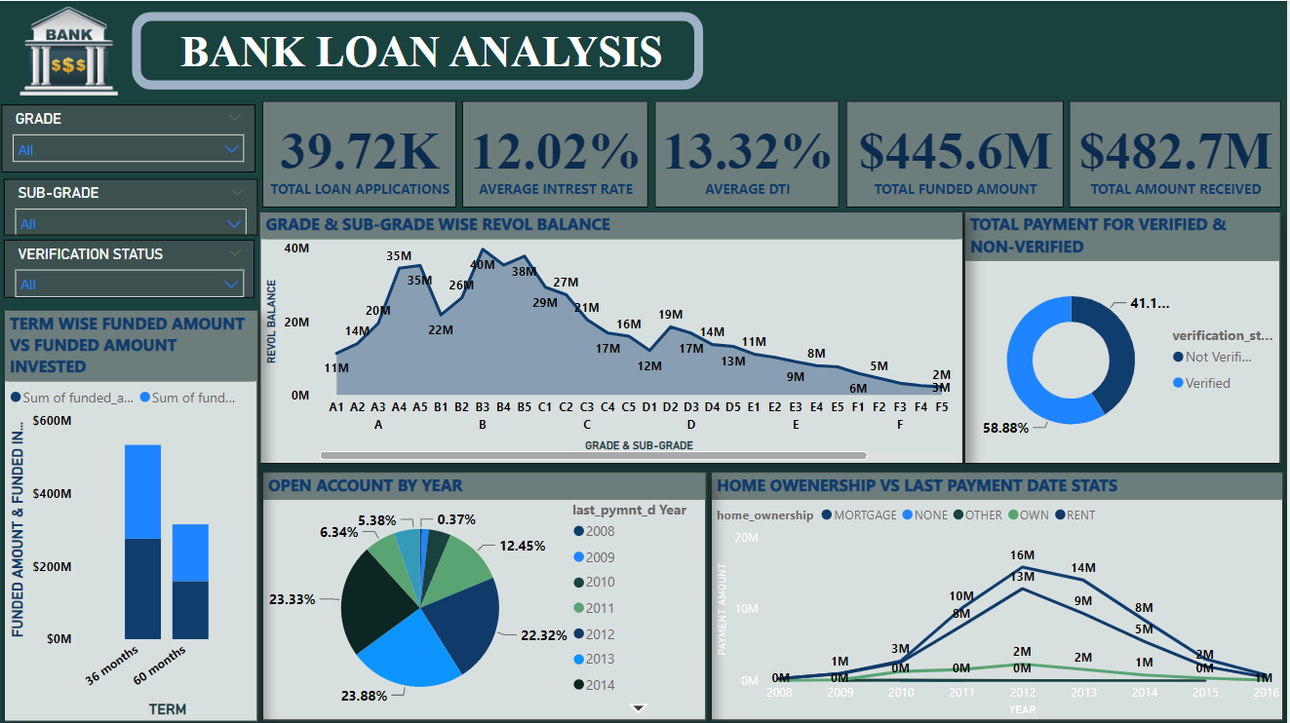
P O W E R B I DA S H B OA R D

Slide 16




CONCLUSION
Banking holds a crucial role in our day to day life. From the analysis of above dashboards and reports we can draw hidden insights. With the use of gained insights from the finance datasets and KPI’S. Accurate Business decisions are made and can track the business state. It enables a holistic view of the business, supporting long term growth and competitiveness in the banking industry.

Slide 17


T H ANK YOU

