Slide 1

Olist Store Analysis
A Brazilian E-commerce Company

Slide 2
Agenda
Domain : E-Commerce
Project Name : P352(Olist Store E-commerce Analytics )
Background :
1) Client Scenario
2) ETL Process
3) Problem Solving
4) Visualizing Analytical Insides
5) Dashboard Preparation

Slide 3
Project Group Details
Project Group No: 02
Mr. Akshay Kumar
Abhinandan Kumar
Mr. sumit rajaram pujare
Mr Kondakari Lakshmi ganesh
Mrs. Anjana C
Ms. Digdarshini Das
Ahir Vishwa Bhadreshbhai

Slide 4
Problems To Solve
Weekday Vs Weekend (order_purchase_timestamp) Payment Statistics.
Number of Orders with review score 5 and payment type as credit card.
Average number of days taken for order_delivered_customer_date for pet_shop.
Average price and payment values from customers of sao paulo city.
Relationship between shipping days (order_delivered_customer_date - order_purchase_timestamp) Vs review scores.

Slide 5
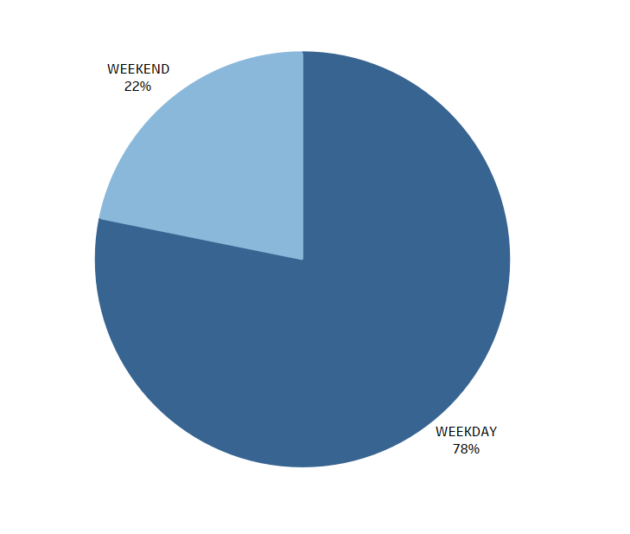
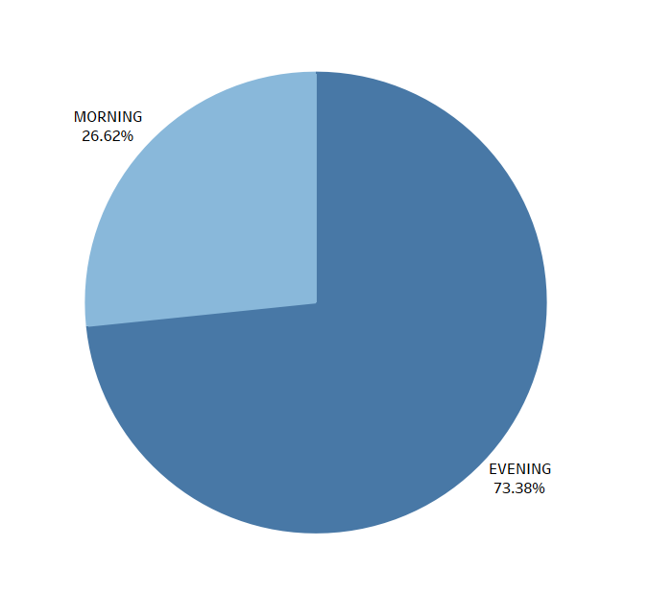
Payment Statistics weekday vs weekend
Here, we can see that the majority of the payment was made throughout the workweek.
Nearly 22% of payments are received on the weekends, while 78% happen during the workweek.
The percentage of transactions made in the evening on weekdays is 73.38% compared to 26.62% in the morning.
This leads us to the conclusion that olist stores must employ their full staff throughout weekday evening hours.
On weekday evenings, the Olist store must check the product availability.

Slide 6
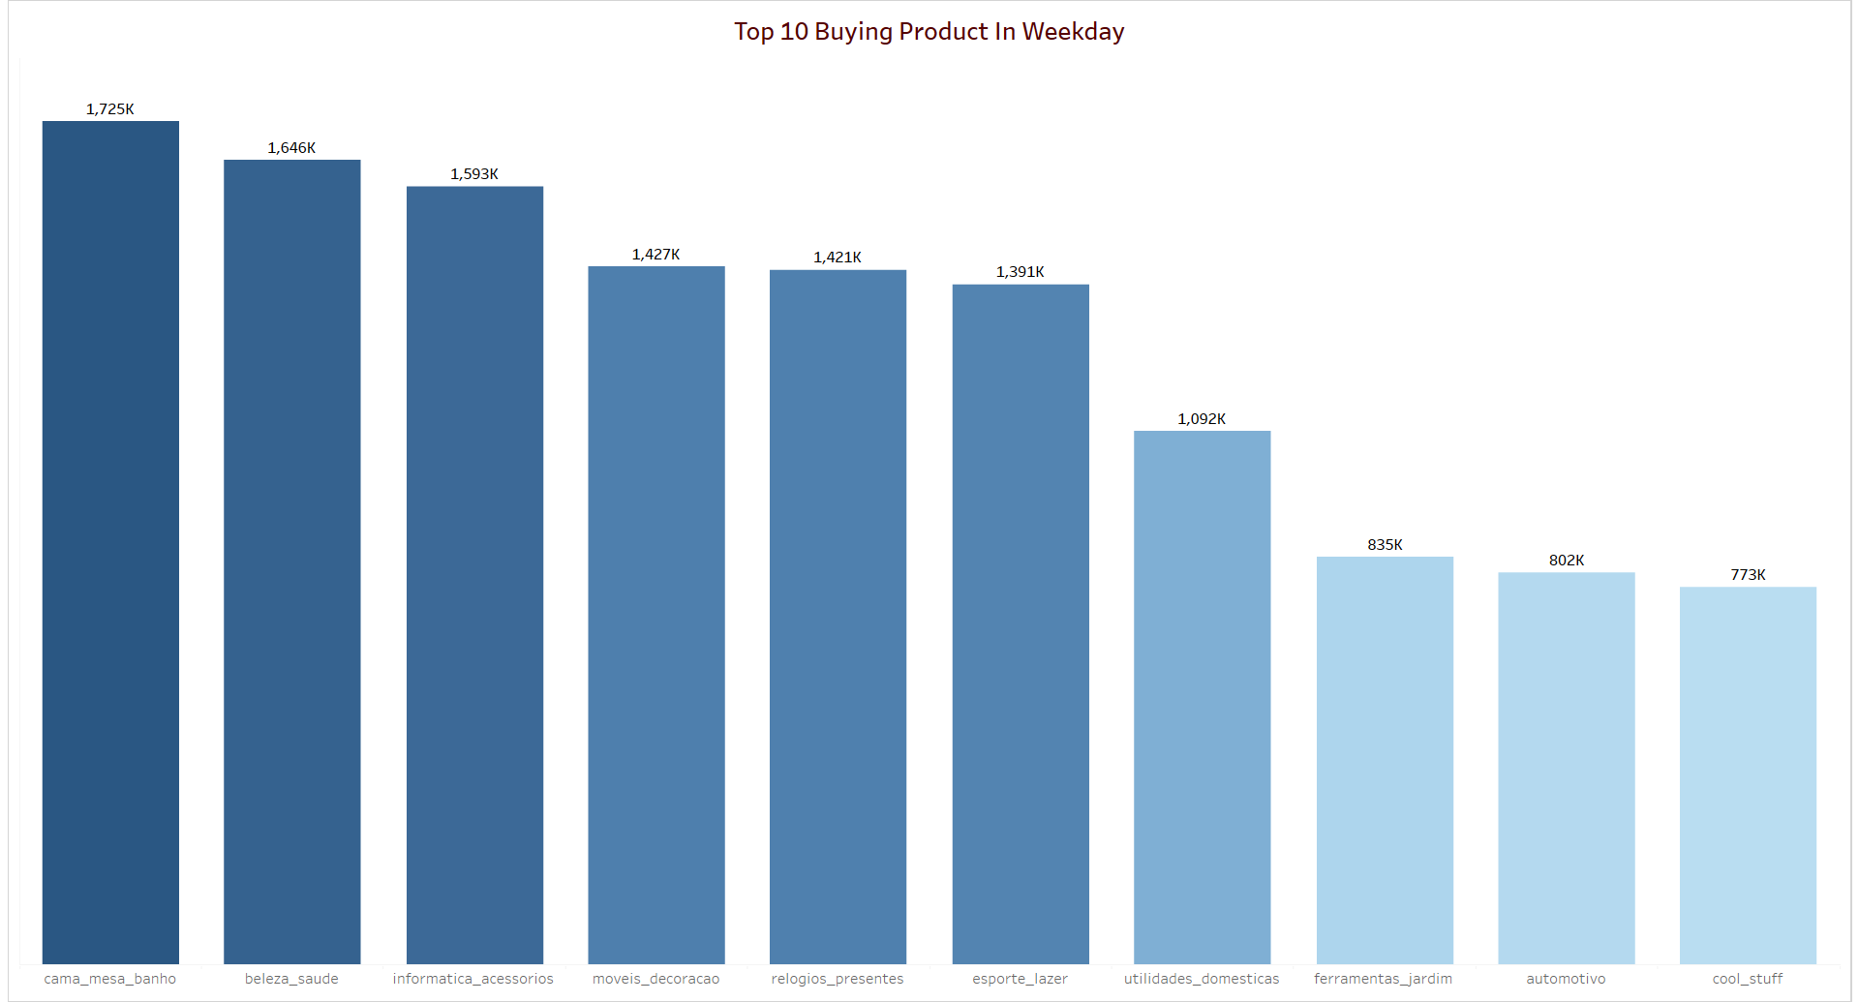
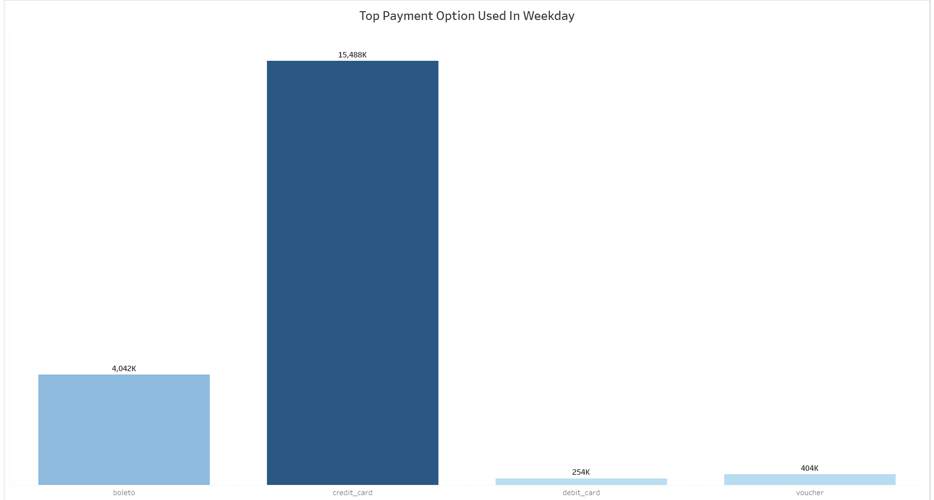
Payment Statistics weekday vs weekend
The top-selling goods include Cama Mesa Bano, Bleza Saude, Informetica Accessories, Moveis Decoracao, and Relogios Decoracao.
Boleto and credit cards were used for the majority of the payments.
This leads us to the conclusion that online retailers should confirm the availability of their best-selling items.
Olist stores must provide customers a secure, convenient method of payment with a credit card and Boleto.
Customers at Olist stores may receive discounts and coupons for using debit cards as a form of payment, increasing their share of the market.

Slide 7
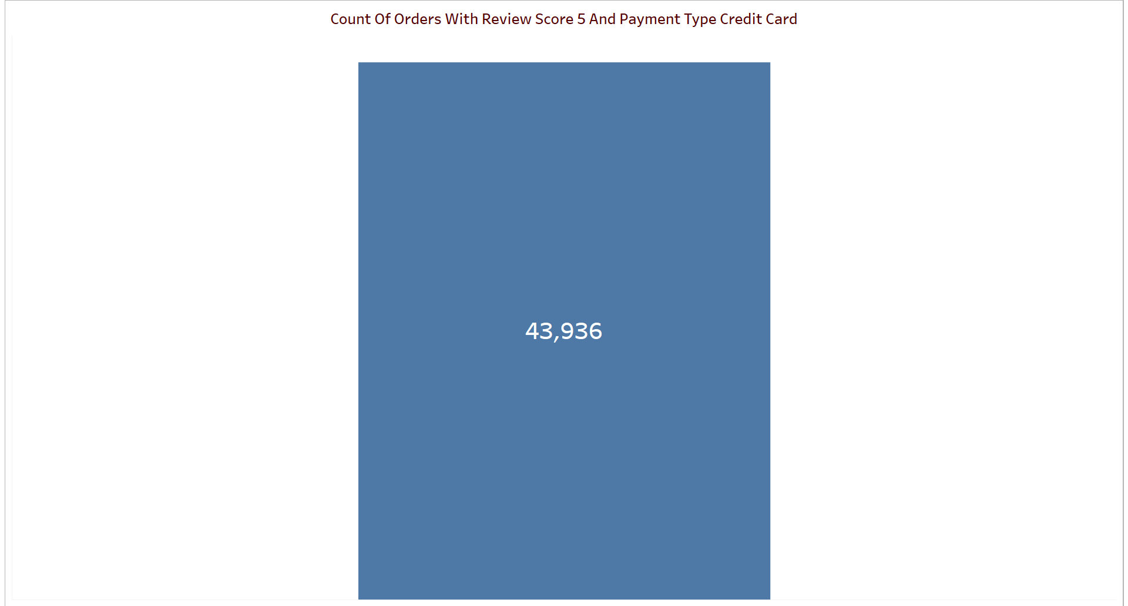
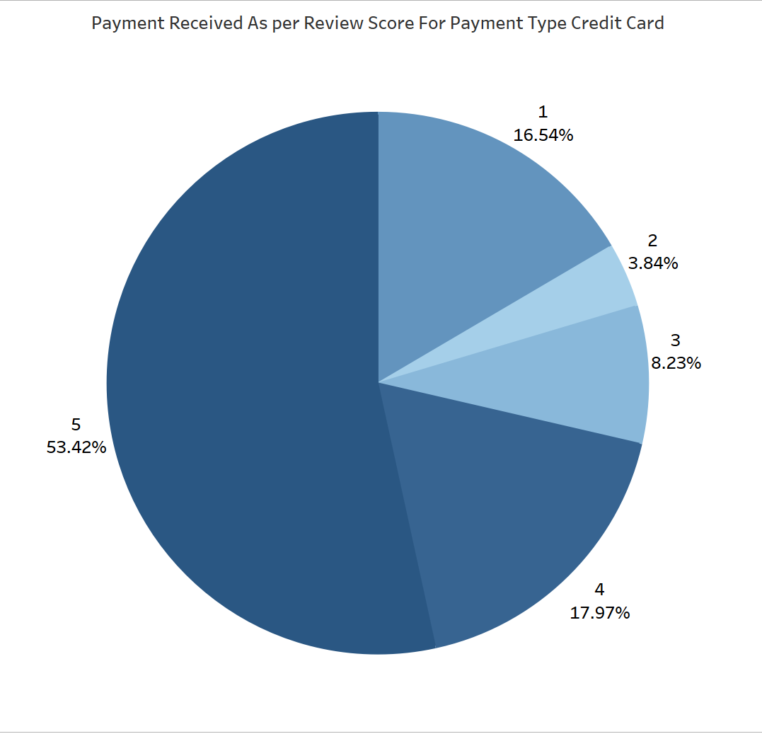
Count Of Orders With Review Score 5 And Payment Type Credit Card
Customers who made credit card payments for these orders gave them an average rating of five stars out around 44k.
When using a credit card, 53.42% and 17.97% of the payment are received, with ratings of 5 and 4, respectively.
The money collected by the 5 and 4 review score is around 71.39%.
Olist Store obtained the highest payout for reviews with a high rating, although Review Score 1 only received 16.54% of the total amount.
Olist must improve the areas where they received a 1 on the review scale. They should focus on the quickest delivery and a flawless client experience if they want to increase ratings.

Slide 8
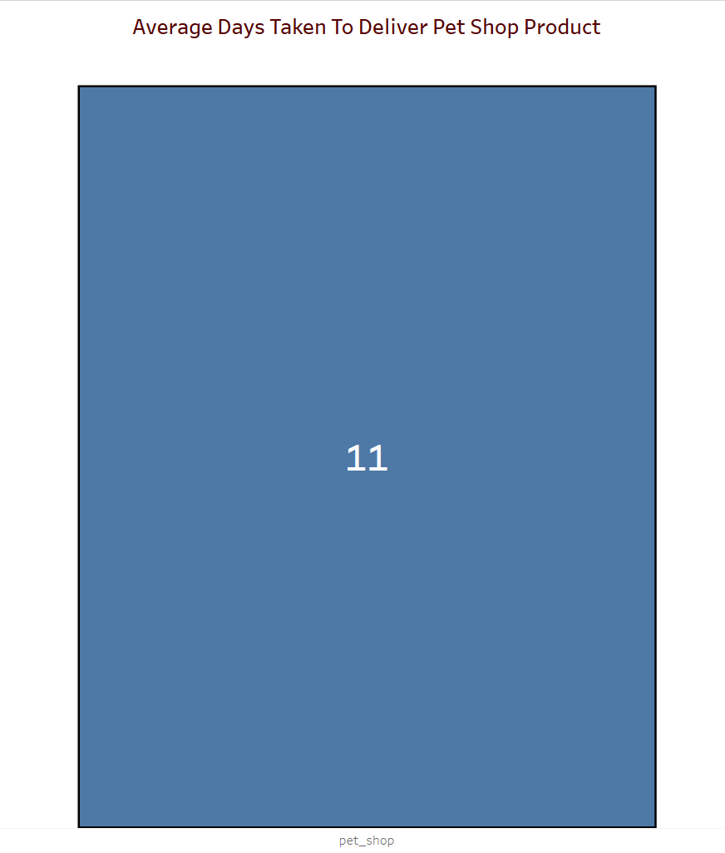
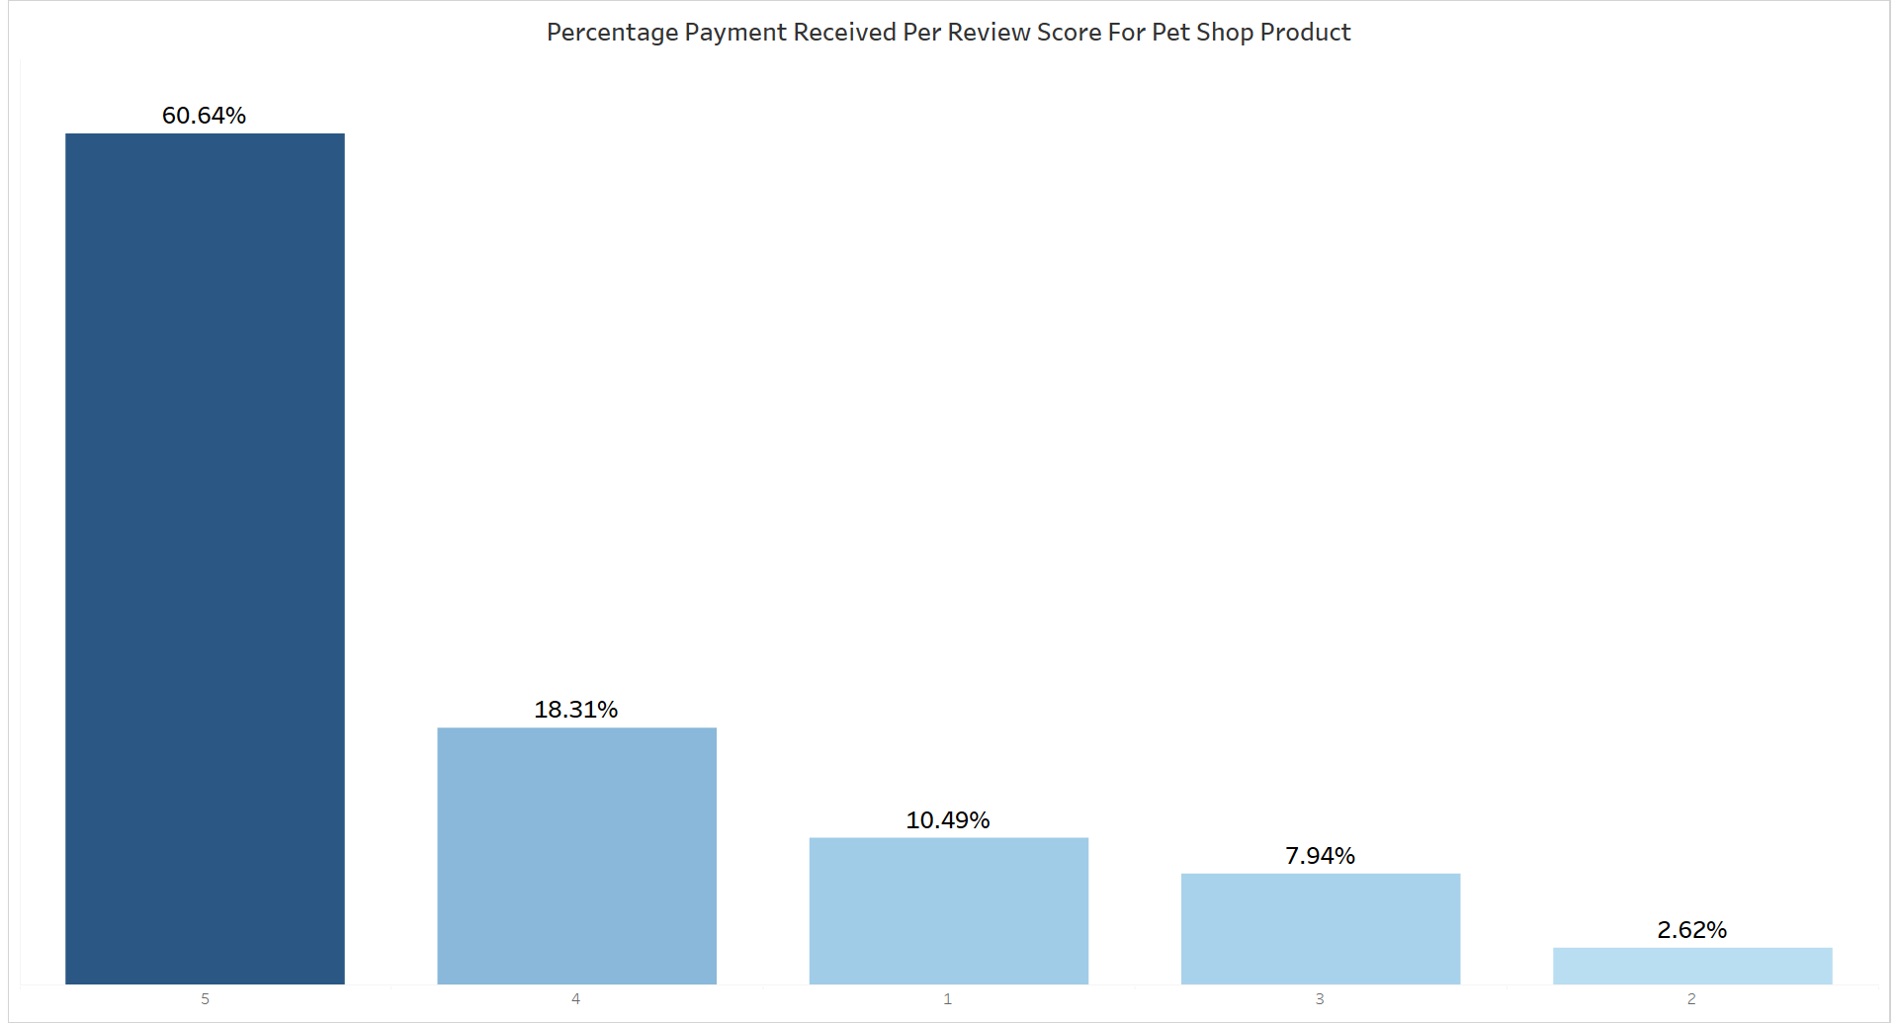
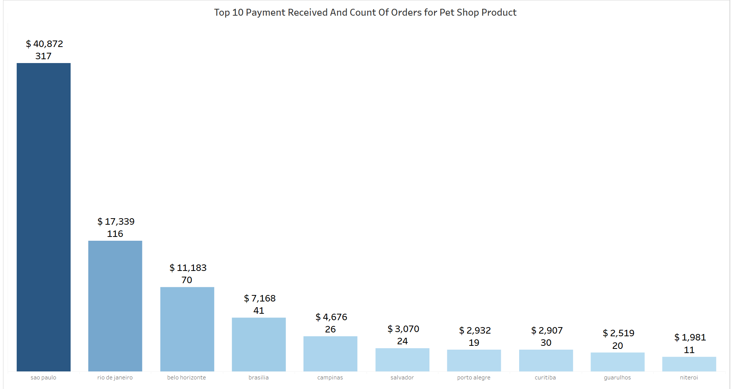
Average Days Taken To Deliver Pet Shop Product
The average time for OLIST to deliver pet shop products is 11 days.
The most often ordered goods with a rating of five and credit card payment are Cama Mesa Bano, Bleza Saude, Isporte Lazer, Moveis Decoracao, and Informetica Accessories.
The money collected by the 5 and 4 review score is around 71.39%.
We must improve our delivery service since longer delivery times have an adverse effect on our company's reputation and customer service.

Slide 9
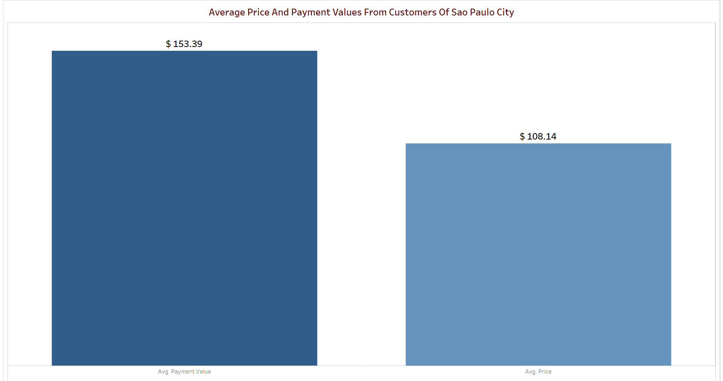
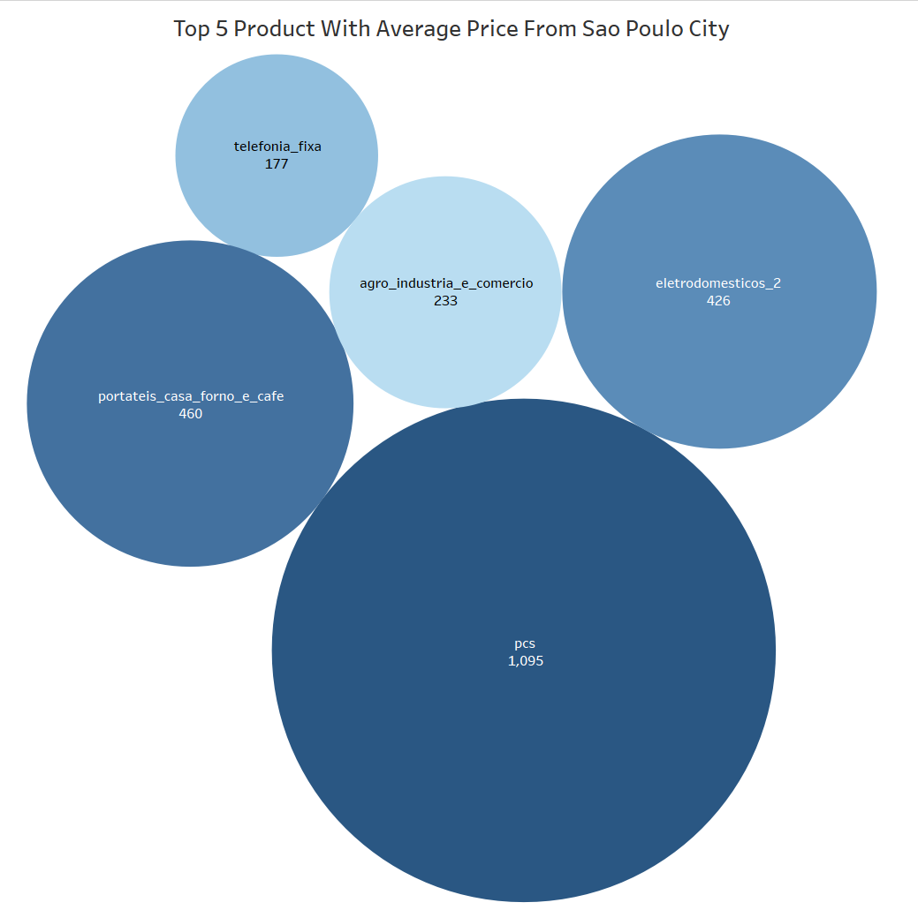
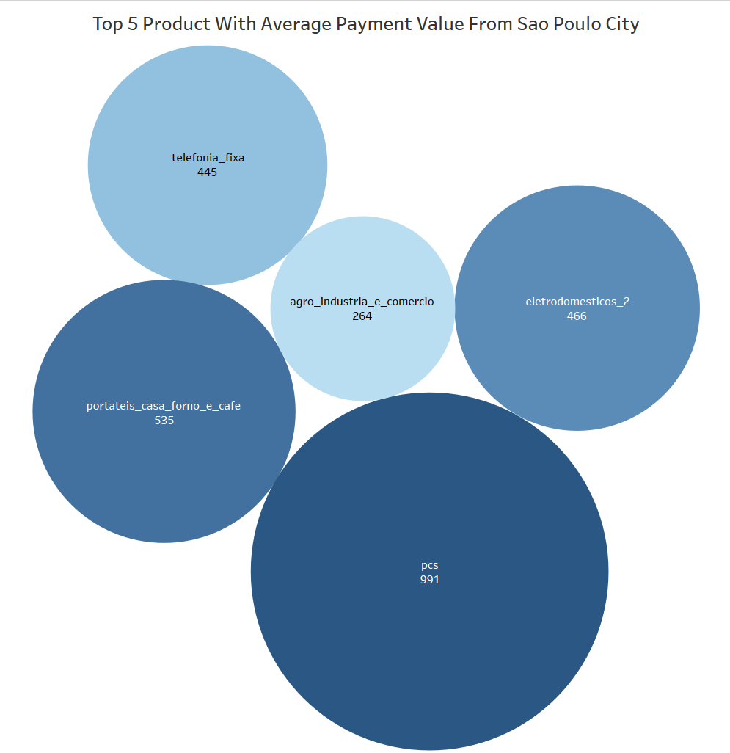
Average Price And Payment Values From Customers Of Sao Paulo City
Average pricing and payment value from Sao Paulo City are 108 and 153.39 respectively.
The top 5 items with the highest average price and payment value are agro_industria_e_comercio, pcs, telefonia_fixa, electrodomesticos, and portateis_casa_forno_e_cafe.
The only city that is making a decent profit and above the target line, according to the research on cities, is Sao Paulo. As a result, we need to examine the other cities that are having an influence on the industry and strive to improve them.

Slide 10
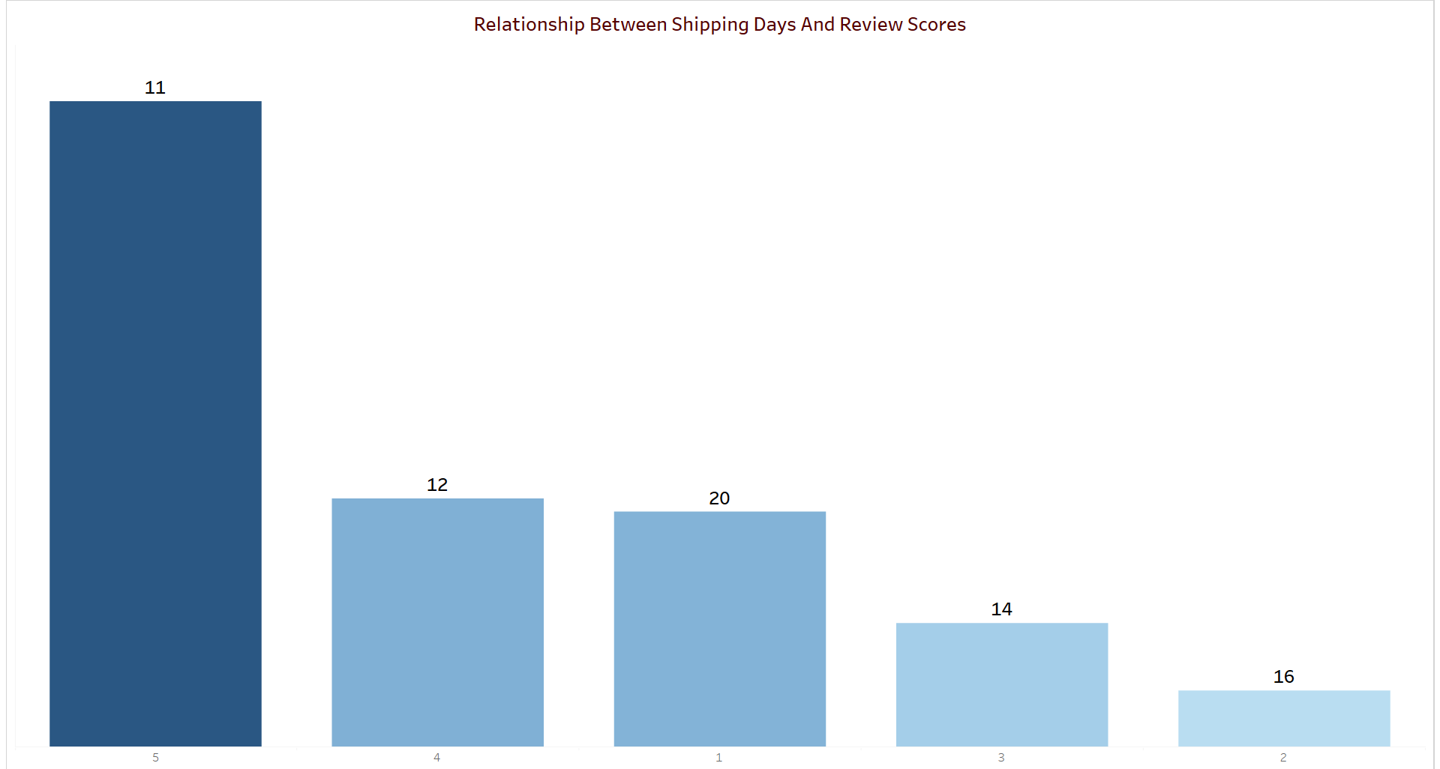
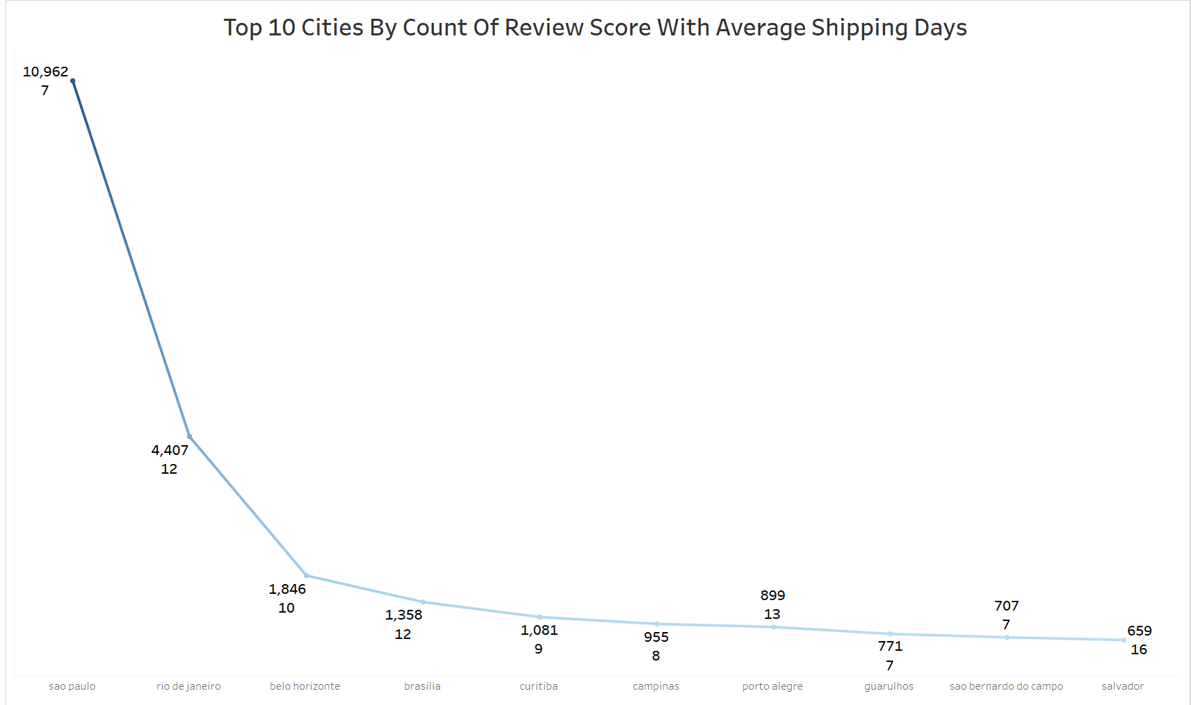
Relationship Between Shipping Days And Review Scores
When comparing delivery days to review scores, the review score always comes first. One review score worth 21 days, two are worth 18, three are worth 14, four are worth 12, and five are worth 11.
Sao Paulo is the top city, with a highest review score of 5 and an average shipment time of 7 days.
According to the visualization, we can see that if we increase the shipment force and reduce the number of days it takes to deliver the goods, our review score would go up. We must improve the delivery and service times in a few cities with lower review scores.

Slide 11
Conclusion
According to the conclusion, we can provide discounts in the morning to raise sales at least 10% to 15% more than they are presently.
We may work on delivery days so that the review score will rise in a positive way, and we can give fantastic deals for various forms of payment so that they rise in comparison to credit card payments.
Given that the average delivery time for items from pet shops is now 11 days, we must reduce this time and may do so by entering into a contract with additional local vendors. This will result in a shorter delivery time and higher customer satisfaction.
Sao Paulo City has higher average costs and payment values than other cities, the survey claims. It is essential to evaluate price and payment values between cities in order to identify potential development locations and encourage industrial expansion.
According to studies, delivery days and review scores are correlated, thus we must focus on shipping days in order to improve our review scores.

Slide 12
Thank You

