Slide 1
UNSUPERVISED TEST PLATFORM
GOV-TECH-THON

Slide 2

PROBLEM STATEMENT
The virtual world is becoming a huge barrier for students to take their examinations. This problem is presently faced by all the educational institutions and students around the world. People face a lot of issues to completely virtualize this process, automatic invigilation even though simple is not well implemented anywhere, so if we solve this problem, it would be super useful for students' education.

Slide 3
PROBLEM SOLUTION
The web application which we create would completely turn as an invigilator while examination and it would monitor the students and would detect any kind of malpractice. And this application would provide a good user-friendly interface which would make the students feel interesting to take their examinations.
1) Monitors the candidate on camera using OpenCV.js and validates for plagiarism.
2) Warn candidate on the attempt of plagiarism with camera appearance and restrict user interface interaction other than the test console.
3) Disable the candidate to perform right-click or copy operation on the test console.
4) Validate whether the location of the Candidate remains static until the assessment ends and submit the Test Report for validation.

Slide 4
SYNOPSIS
Student Credentials.
Video Supervision.
Validate for plagiarism through the camera.
Monitor Interface interaction.
Restrict text copy.
Disable right-click operation.
Location Validators.
Generate Test Report.

Slide 5
OUTCOMES
Students are strictly monitored well during their examinations. Any kind of malpractice would automatically log them out of the website and would report the problem to the university.
The application would make them feel easier and secure, it would completely control the system.
The website would ensure necessary authentication, control, fraud detection and compliance.
The software is a package of remote-supervision, webcam and invigilation control.
The website will have the required profiles and would act according to the institution instructions to conduct the examination.

Slide 6



TECHNOLOGY STACK
OpenCV
Node js
MongoDB
React Js
React-webcam
VS Code
React Js

Slide 7
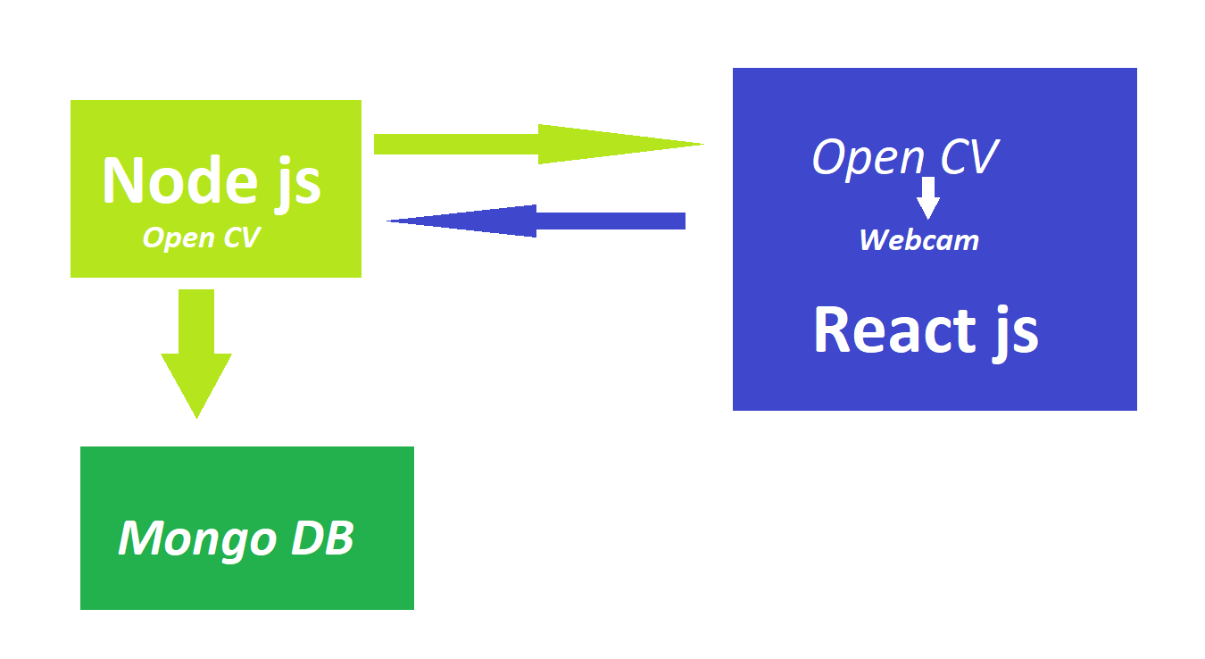
WORKFLOW ARCHITECTURE

Slide 8
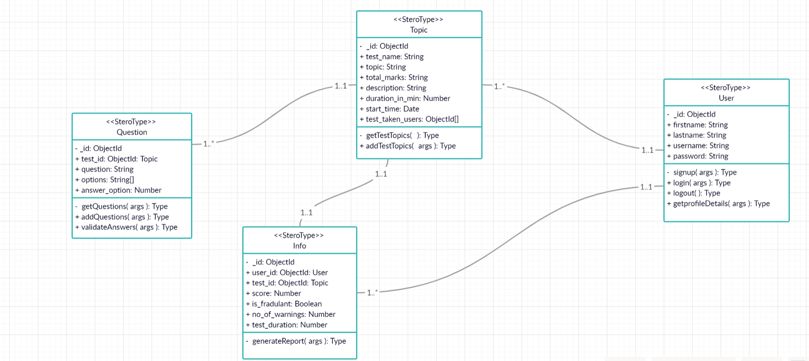
CLASS DIAGRAM - DB ARCHITECTURE

