Slide 1
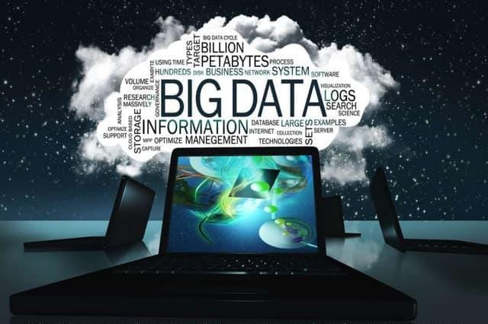

Slide 2

PRESENTED BY
N.MANIKANDAN
L.JACOP ANTONY
S.VISHWA
S.S. JEEVANANTHAM
S.SARAVANAPERUMALERUMAL

Slide 3
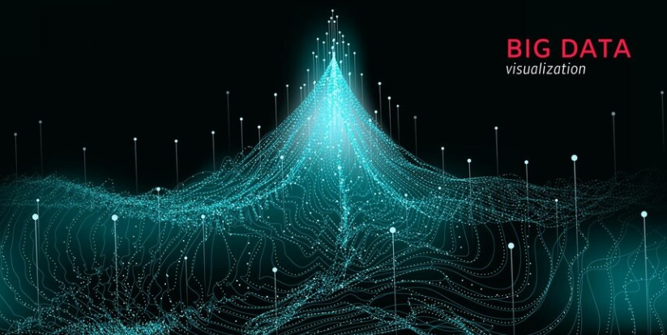
INTRODUCTION
Big Data may well be the Next Big Thing in the IT world.
Big data burst upon the scene in the first decade of the 21st century.
The first organizations to embrace it were online and startup firms. Firms like Google, eBay, LinkedIn, and Facebook were built around big data from the beginning.
Like many new information technologies, big data can bring about dramatic cost reductions, substantial improvements in the time required to perform a
computing task, or new product and service offerings.

Slide 4
WHAT IS BIG DATA?
‘Big Data’ is similar to ‘small data’, but bigger in size
but having data bigger it requires different
approaches:
Techniques, tools and architecture
An aim to solve new problems or old problems in a better way
Big Data generates value from the storage and processing of very large quantities of digital information that cannot be analyzed with
traditional computing techniques.

Slide 5
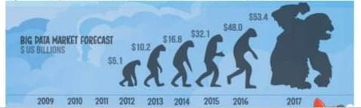
What is big data
Walmart handles more than 1 million customer transactions every hour
Facebook handles 40 million photos from its user base
Decoding the human genome originally took 10 years to process;now it can be achieved in one week .

Slide 6
1st Character of Big Data Volume
A typical PC might have had 10 gigabytes of storage in 2000.
Today, Facebook ingests 500 terabytes of new data every day.
Boeing 737 will generate 240 terabytes of flight data during a single flight across the US.
The smart phones, the data they create and consume; sensors
embedded into everyday objects will soon result in billions of new, constantly-updated data feeds containing environmental, location, and other information, including video.

Slide 7
2nd Character of Big Data Velocity
Clickstreams and ad impressions capture user behavior at millions of events per second
high-frequency stock trading algorithms reflect market changes within microseconds
machine to machine processes exchange data between billions of devices
infrastructure and sensors generate massive log data in real- time
on-line gaming systems support millions of concurrent users, each producing multiple inputs per second.

Slide 8
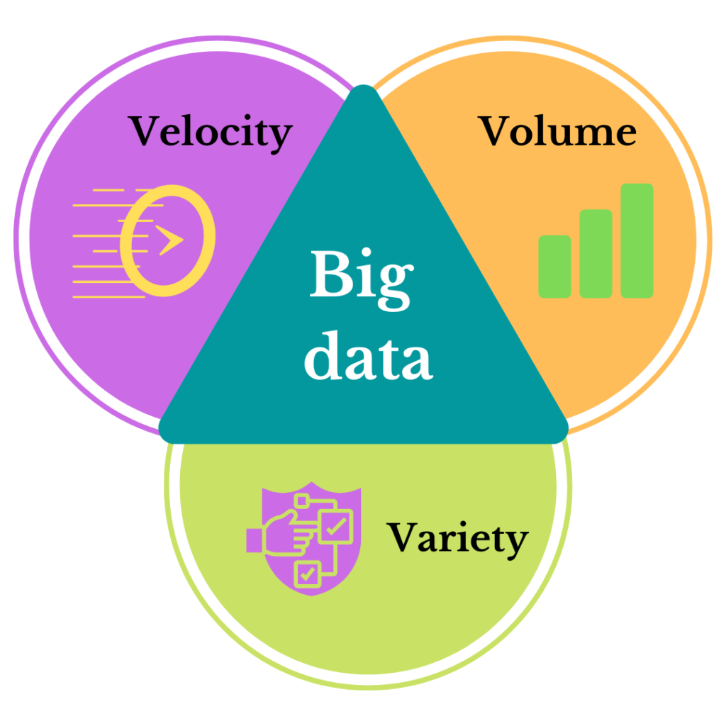
THREE CHARACTERISTICS OF BIG DATA V3s

Slide 9
3rd Character of Big Data Variety
Big Data isn't just numbers, dates, and strings. Big Data is also geospatial data, 3D data, audio and video, and unstructured text, including log files and social media.
Traditional database systems were designed to address smaller volumes of structured data, fewer updates or a predictable, consistent data structure.
•

Slide 10
Storing Big Data
Analyzing your data characteristics
Selecting data sources for analysis
Eliminating redundant data
Establishing the role of NoSQL

Slide 11
Selecting Big Data stores
Choosing the correct data stores based on your data characteristics
Moving code to data
Implementing polyglot data store solutions
Aligning business goals to the appropriate data store

Slide 12
Processing Big Data
Integrating disparate data stores
Mapping data to the programming framework Connecting and extracting data from storage Transforming data for processing
Subdividing data in preparation for Hadoop MapReduce
Employing Hadoop MapReduce

Slide 13
Why Big Data
Growth of Big Data is needed
Increase of storage capacities
Increase of processing power
Availability of data(different data types)
Every day we create 2.5 quintillion bytes of data; 90% of the data in the world today has been created in the last two years alone

Slide 14
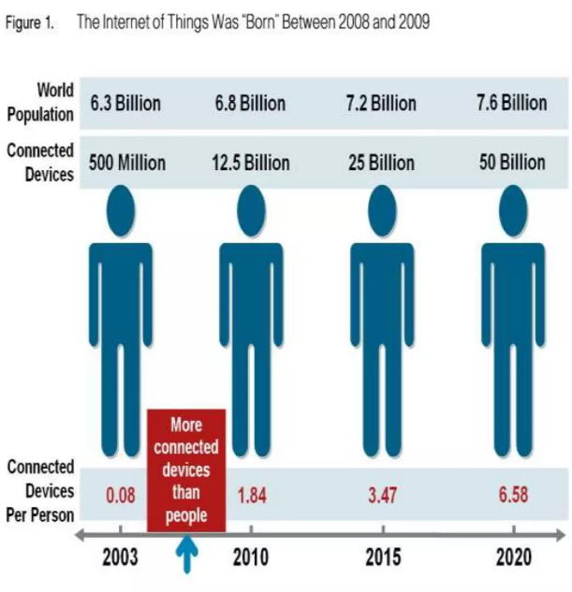
Why Big Data
FB generates 10TB daily
IBM claims 90% oftoday's
stored data was generated
in just the last two years.

Slide 15
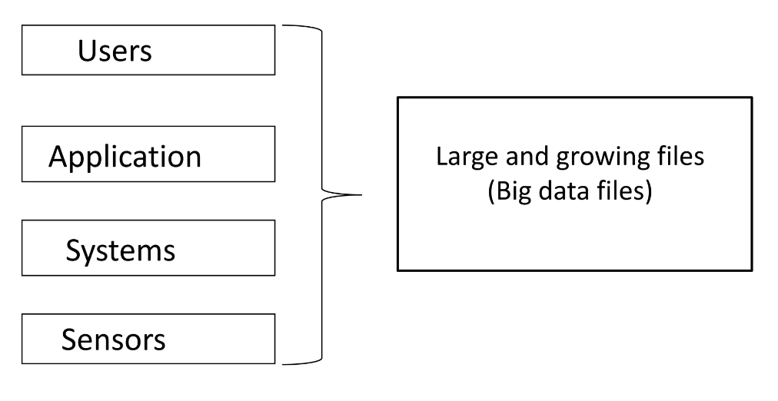
BIG DATA SOURCES

Slide 16


How Is Big Data Different?
1) Automatically generated by a machine (e.g. Sensor embedded in an engine)
2) Typically an entirely new source of data (e.g. Use of the internet)
3) Not designed to be friendly (e.g. Text streams)
4) May not have much values
Need to focus on the important part

Slide 17
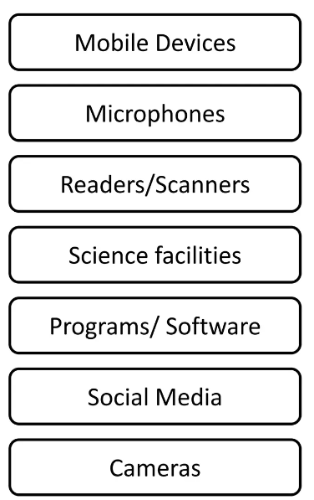
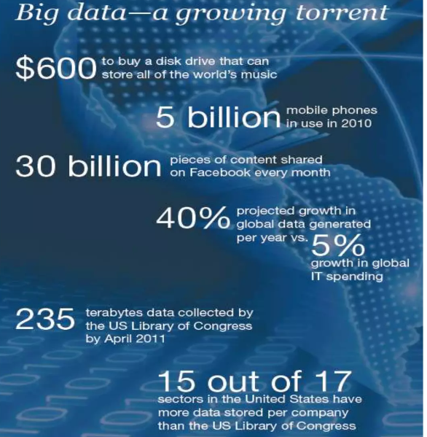
Data generation points Examples

Slide 18
Big Data Analytics
Examining large amount of data
Appropriate information
Identification of hidden patterns, unknowncorrelations
Competitive advantage
Better business decisions: strategic and operational

Slide 19






Application of Big Data analytics
Homeland
Security
Multi channel
sales
Telecom
Manufacturing
Smarter
Healthcare
Traffic Control

Slide 20
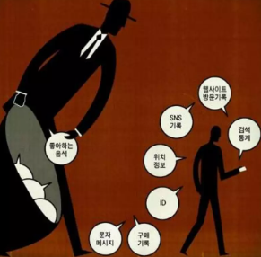
Risk of Big data
will be so overwhelmed
Need the right people and solve the right problem
costs escalate too fast
isn't necessary to capture 100%
Many sources of big data is privacy

