Slide 1

HTML & CSS

Slide 2
What You Can Do with HTML
You can publish documents online with text, images, lists, tables, etc.
You can access web resources such as images, videos or other HTML document via hyperlinks.
You can create forms to collect user inputs like name, e-mail address, comments, etc.
You can include images, videos, sound clips, flash movies, applications and other HTML documents directly inside an HTML document.
You can create offline version of your website that work without internet.
The list does not end here, there are many other interesting things that you can do with HTML in your development....

Slide 3
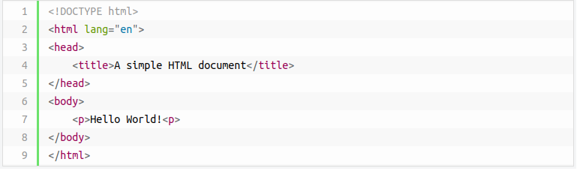
Type some HTML code
It is important that the extension .html is specified when you save html file — some text editors, such as Notepad, will automatically save it as .txt otherwise.
To open the file in a browser. Navigate to your file then double click on it. It will open in your default Web browser. If it does not, open your browser and drag the file to it.

Slide 4
Understanding the HTML5 Doctype
The doctype declaration refers to a Document Type Definition (DTD). It is an instruction to the web browser about what version of the markup language the page is written in. The World Wide Web Consortium (W3C) provides DTDs for all HTML versions.
A DOCTYPE declaration appears at the top of a web page before all other elements. According to the HTML specification or standards, every HTML document requires a valid document type declaration to insure that your web pages are displayed the way they are intended to be displayed.
The DOCTYPE for HTML5 is very short, concise, and case-insensitive.
<!DOCTYPE html>

Slide 5
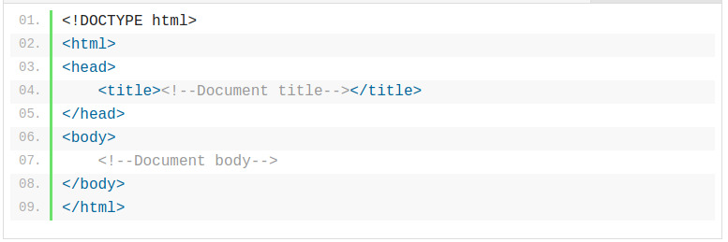
HTML <html> Tag
The <html> element defines the root of HTML documents. It is the outer container for everything that appears in an HTML document except <!DOCTYPE>.
The basic syntax of the <html> tag is given with:
HTML : <html> ... </html>

Slide 6
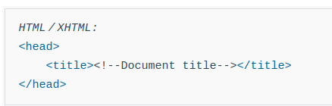
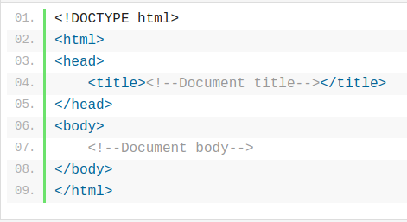
HTML <head> Tag
The <head> tag defines the head portion of the document that contains information about the document. The <head> element acts as a container for all other head elements such as <title>, <meta>, <link>, <style> etc..
The basic syntax of the <head> tag is given with:

Slide 7
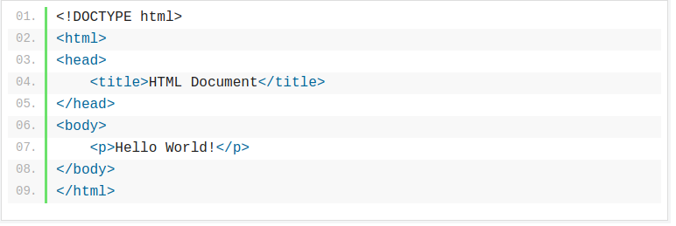
HTML <body> Tag
The <body> element represents the main content of the document. It typically wraps around all of the content that will be displayed on screen, such as headings, paragraphs, hyperlinks, images, forms, tables, lists, videos and so on.
The basic syntax of the <body> tag is given with:
HTML : <body> ... </body>

Slide 8
Styling HTML elements
With CSS, it becomes very easy to specify the things like, size and typeface for the fonts, colors for the text and backgrounds, alignment of the text and images, amount of space between the elements, border and outlines for the elements, and lots of other styling properties.
Style information can either be attached as a separate document or embedded in the HTML document itself. These are the three methods of implementing styling information to an HTML document.
Inline styles — Using the style attribute in the HTML start tag.
Embedded style — Using the <style> element in the head section of the document.
External style sheet — Using the <link> element, pointing to an external CSS files.

Slide 9

Inline styles
Inline styles are used to apply the unique style rules to an element, by putting the CSS rules directly into the start tag. It can be attached to an element using the style attribute.
The style attribute includes a series of CSS property and value pairs. Each property: value pair is separated by a semicolon (;)
Using the inline styles are generally considered as a bad practice. Because style rules are embedded directly inside the html tag, it causes the presentation to become mixed with the content of the document, which makes updating or maintaining a website very difficult.

Slide 10
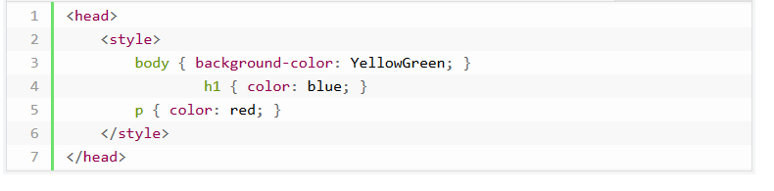
Embedded Style Sheets
Embedded style sheets are defined in the <head> section of an HTML document using the <style> tag. You can define any number of <style> elements inside the <head> section.
Embedded or internal style sheets only affect the document they are embedded in.

Slide 11
External Style Sheets
An external style sheet is ideal when the style is applied to many pages.
An external style sheet holds all the style rules in a separate document that you can link from any HTML document on your site. External style sheets are the most flexible because with an external style sheet, you can change the look of an entire website by updating just one file.
You can attach external style sheets in two ways — linking and importing:

Slide 12

Linking External Style Sheets
An external style sheet can be linked to an HTML document using the <link> tag.
The <link> tag goes inside the <head> section, as shown here:

Slide 13
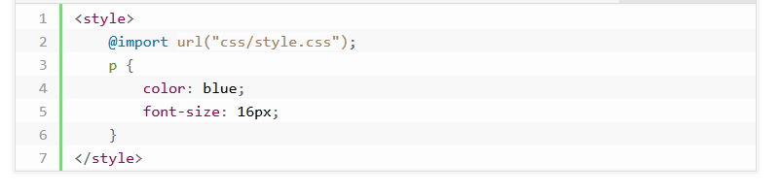
Importing External Style Sheets
The @import rule is another way of loading an external style sheet. The @import statement instructs the browser to load an external style sheet and use its styles.
You can use it in two ways. The simplest way is to use it within the <style> element in your <head> section. Note that, other CSS rules may still be included in the <style> element.

Slide 14
HTML Script
Working with Client-side Script
Client-side scripting refers to the type of computer programs that are executed by the user's web browser. JavaScript (JS) is the most popular client-side scripting language on the web.
Adding JavaScript to HTML Pages
JavaScript can either be embedded directly inside the HTML page or placed in an external script file and referenced inside the HTML page. Both methods use the <script> element.

Slide 15
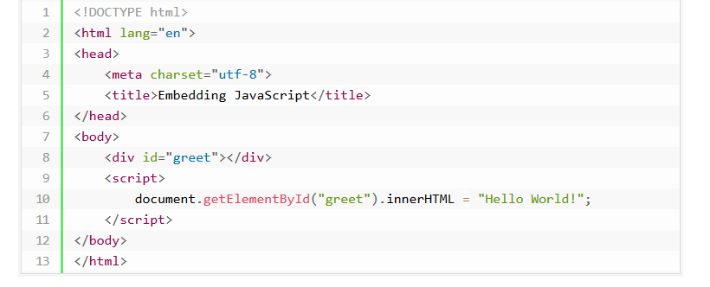
Embedding JavaScript
To embed JavaScript in an HTML file, just add the code as the content of a <script> element.

Slide 16
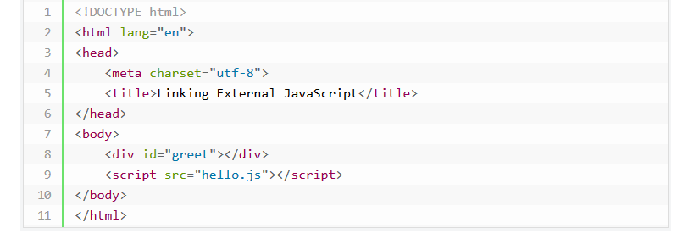
Calling External JavaScript File
You can also place your JavaScript code into a separate file (with a .js extension), and call that file in your HTML document through the src attribute of the <script> tag.
This is useful if you want the same script available to multiple documents. It saves you from repeating the same task over and over again and makes your website much easier to maintain.

Slide 17
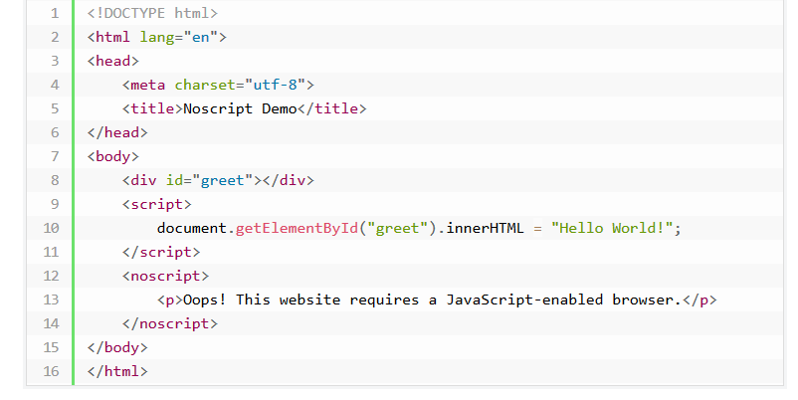
The HTML noscript Element
The <noscript> element is used to provide an alternate content for users that have either disabled JavaScript in their browser or have a browser that doesn't support client-side scripting.
This element can contain any HTML elements, aside from <script>, that can be included in the <body> element of a normal HTML page.

