Slide 1

Developing Solutions for Employee Retention Management
Bhargava Vidiyala WT1976
Sai Vishwa Gaddam BF6887
Vigneshwaran Anandan BX6811

Slide 2
Introduction Employee attrition in IT Industry
Attrition is a major problem that the IT industry is facing. Attrition refers to the rate at which employees leave a company or organization. In the IT industry, attrition is a significant concern, as it can lead to a loss of talent and expertise, decreased productivity, and increased costs associated with recruitment, training, and onboarding new employees.
To address the problem of attrition, companies in the IT industry need to focus on creating a positive work culture that fosters employee engagement, well-being, and growth. This can involve providing competitive compensation packages, offering flexible work arrangements.

Slide 3
Use-Case
Employee attrition implies a reduction in employment caused by employees who willingly quit or resign from a company. Employee turnover is defined as the number of existing employees who are replaced by new employees during a specific time period. Using past data stored in human resources (HR) departments, analysts can build and design a machine learning model that can predict which employees will leave the company.
The reasons for employees leaving the job should be known so that appropriate corrections can be made. The advanced knowledge regarding when employees may leave the job can equip HR to plan their activities with respect to
(I) solving the problem on hand so that retention can be stopped.
(ii) possible new hiring.
The solution is expected to address the problem so that employee retention can be encouraged and attrition can be kept at a very minimum. So that HR can use the information to provide ambiance and ensure high motivational levels in the organization.

Slide 4
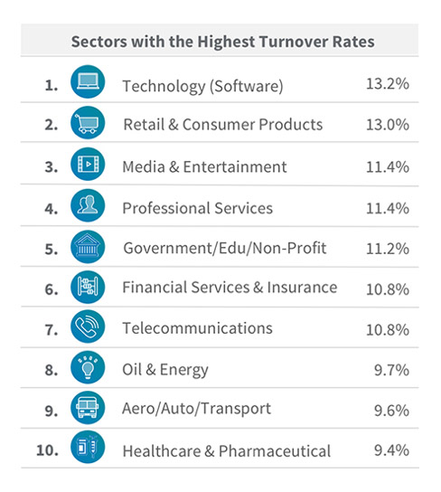

Slide 5
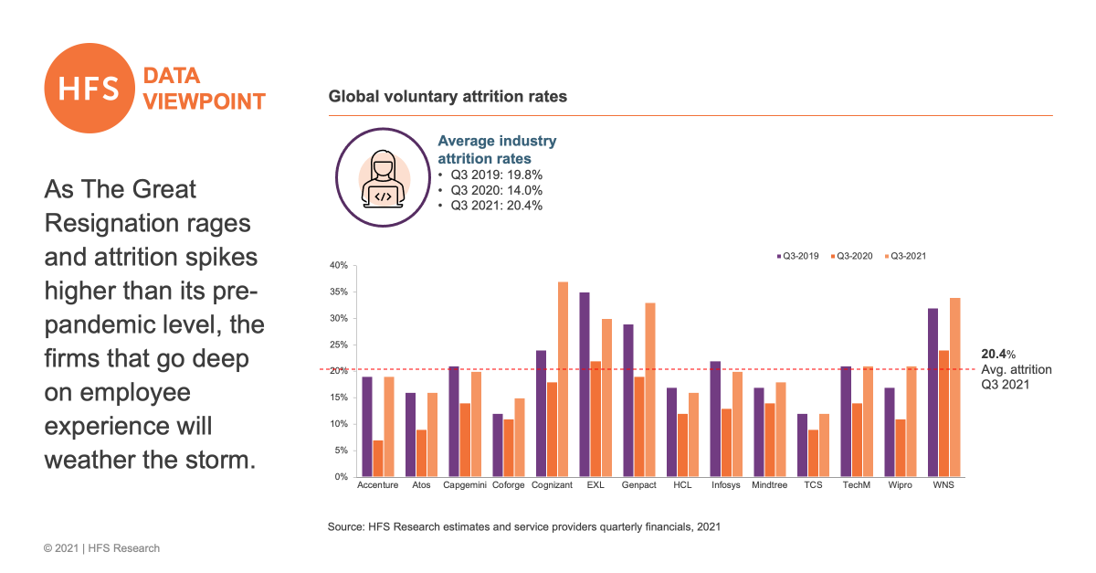

Slide 6
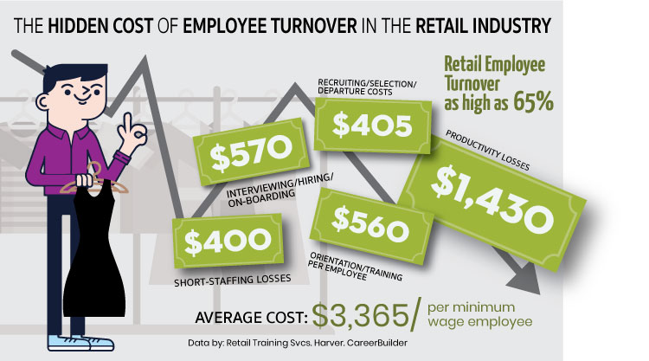
Cost to Company for replacing an Employee.

Slide 7
Variables
Satisfaction_Level: This variable measures the employee's satisfaction with their job, on a scale of 0 to 1.
Last_Evaluation: This variable measures the employee's most recent performance evaluation, on a scale of 0 to 1.
Number_of_Projects: This variable measures the number of projects the employee has worked on during their time with the organization.
Average_Monthly_Hours: This variable measures the average number of hours the employee worked per month.
Time_Spent_at_the_Company: This variable measures the number of years the employee has been with the organization.
Work_Accident: This variable indicates whether the employee has had a work accident during their time with the organization.
Promotion_Last_5_Years: This variable indicates whether the employee has been promoted in the last 5 years.(0 or 1).
Department: This variable indicates the department in which the employee works.
Salary: This variable indicates the employee's salary level, categorized as low, medium, or high.

Slide 8
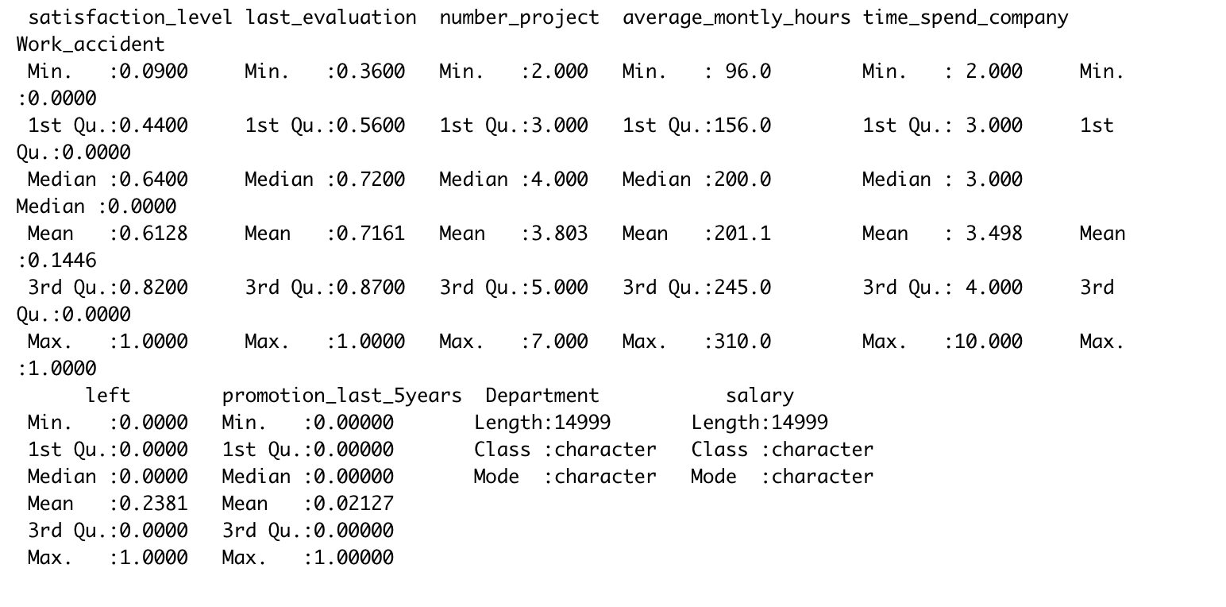
Summary Statistics

Slide 9
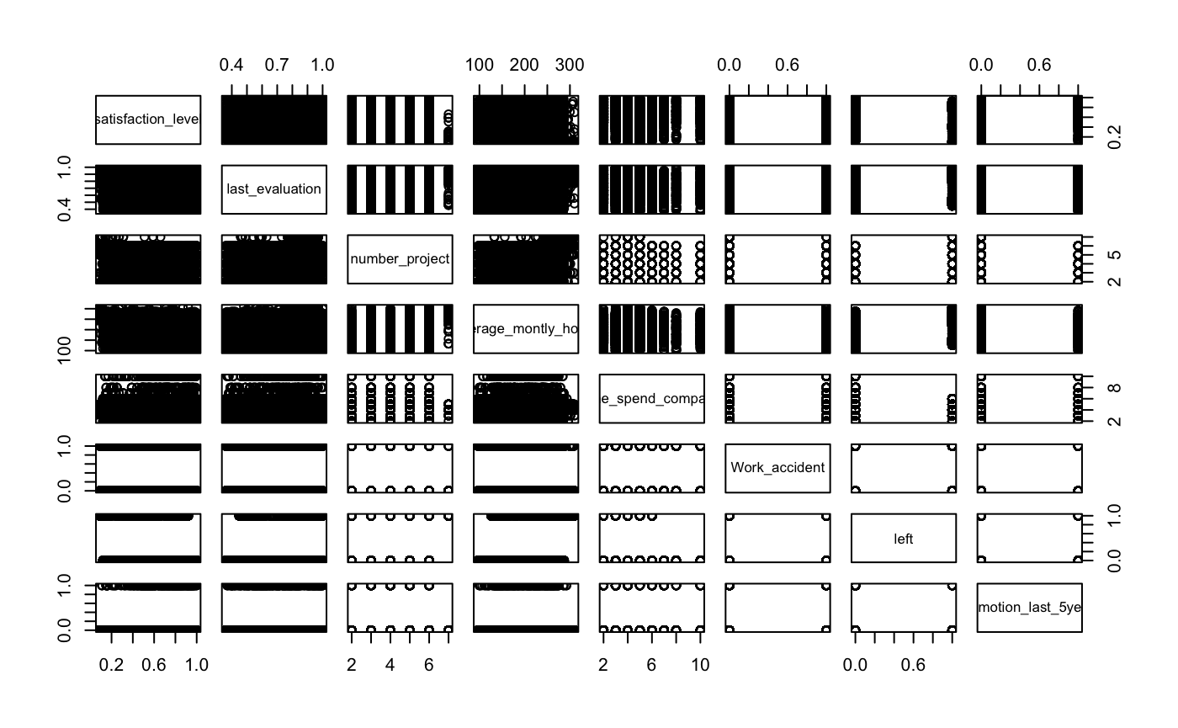
Scatterplot Matrix

Slide 10
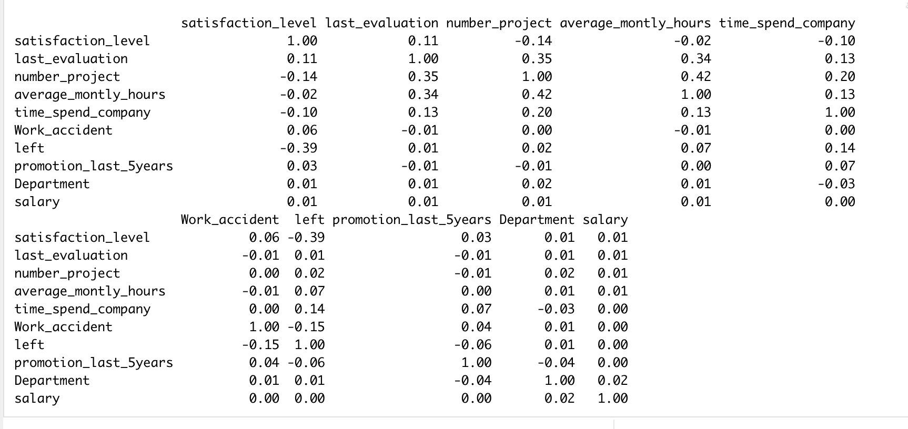
Correlation Matrix

Slide 11
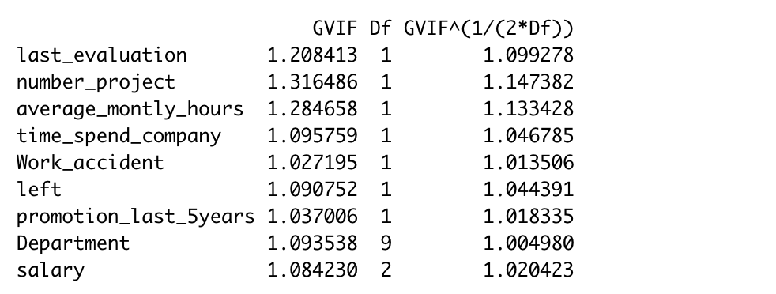
Checking Multicollinearity

Slide 12
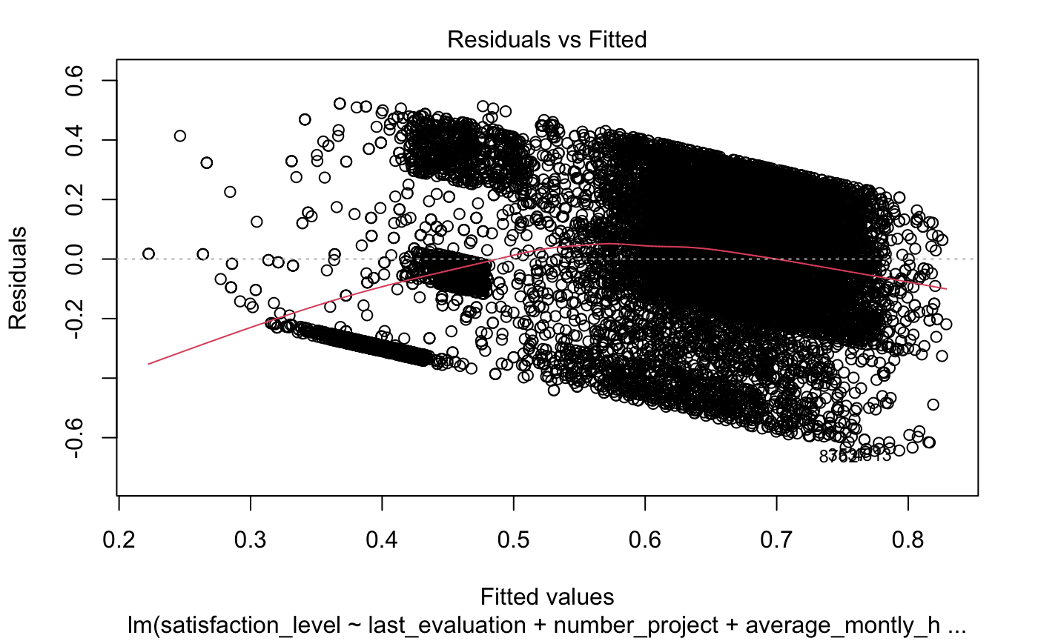

Slide 13
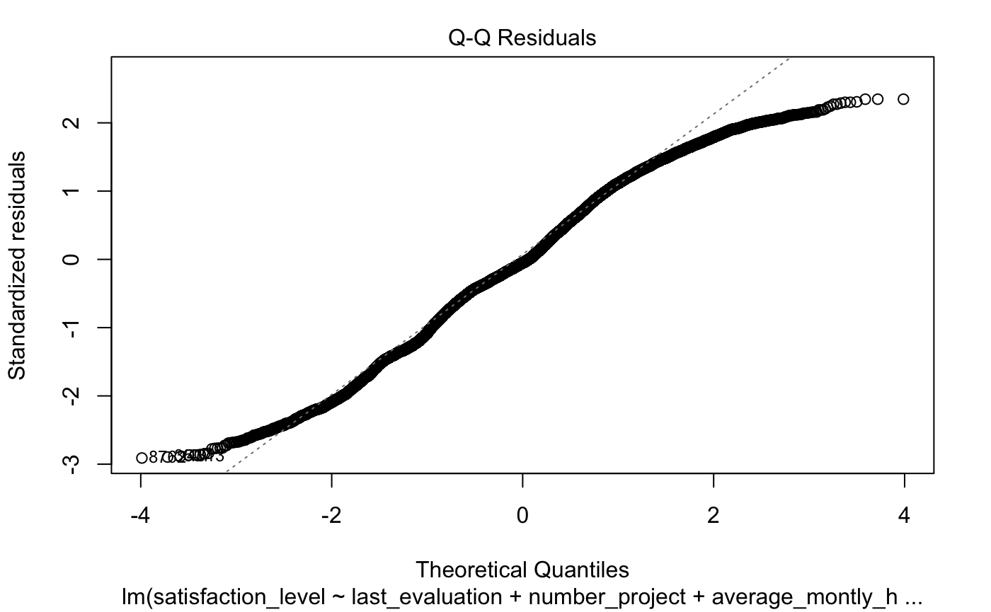
Q-Q Plot

Slide 14
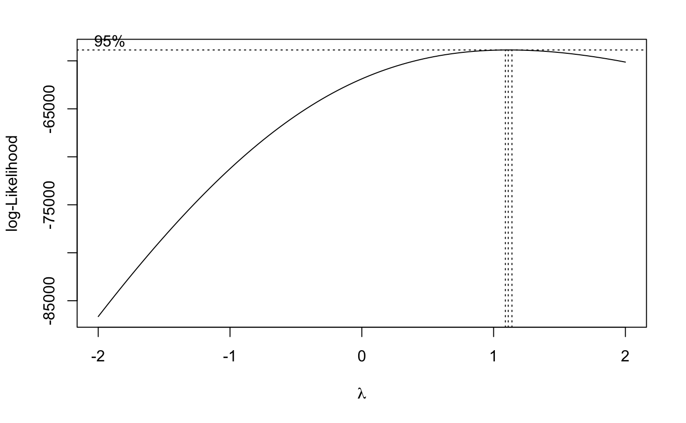
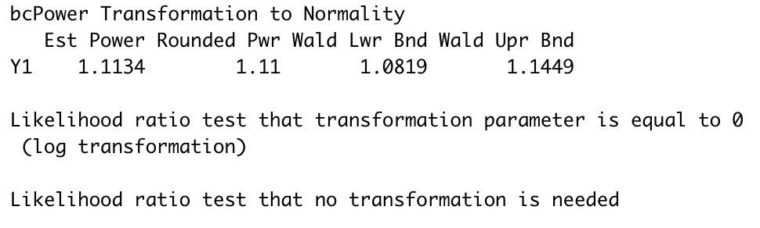
Boxcox Plot

Slide 15
Regression
Response Variable: Satisfaction level (Continuous data).
Satisfaction level ranges from 0-1.
Accuracy is measured in terms of RMSE.
Lower the RMSE, the better is the model.

Slide 16
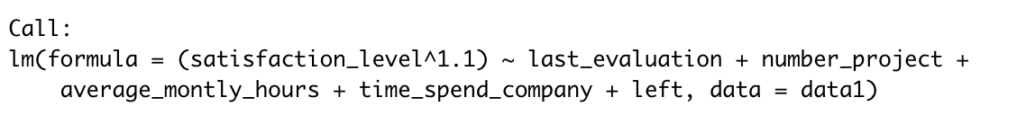
Mulitple Linear Regression Model

Slide 17
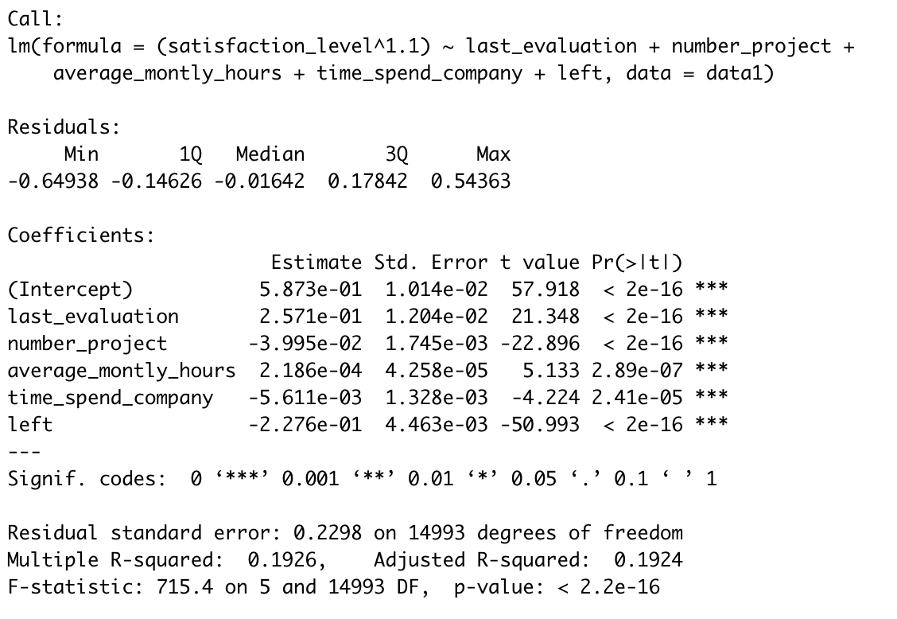

Slide 18

RMSE
RMSE is calculated by taking the square root of the mean of the squared differences between the predicted values and the actual values. It is a commonly used metric in machine learning, particularly in regression tasks, to evaluate the accuracy of a model.
RMSE = sqrt(1/n * sum((actual_i - predicted_i)^2))

Slide 19

Comparing RMSE with other Algorithms
MLR 0.1926
Random Forest 0.1875
Xg_boost 0.1753

Slide 20
Random Forest
Random Forest is a popular machine learning algorithm used for classification and regression tasks. It is an ensemble method that combines multiple decision trees to make predictions.
The Random Forest algorithm works by building a set of decision trees, each trained on a random subset of the training data and a random subset of features. This results in a diverse set of trees that can capture different aspects of the data.

Slide 21
XG_Boost
XGBoost is a popular machine learning algorithm used for classification and regression tasks. It stands for Extreme Gradient Boosting and is based on the gradient boosting framework.
XGBoost is designed to handle large datasets and is known for its speed and accuracy. It works by iteratively adding decision trees to the model, where each tree corrects the errors made by the previous tree.
Parallel processing: XGBoost is designed to be highly parallelizable and can take advantage of multi-core CPUs and distributed computing platforms to speed up training.
Built-in cross-validation: XGBoost includes built-in cross-validation to help optimize hyperparameters and prevent overfitting.
Handling missing values: XGBoost can handle missing values by assigning them to the most common value or by learning the best imputation value from the data.
Feature importance: XGBoost can calculate feature importance scores to help identify the most important features in the data for making predictions.

Slide 22
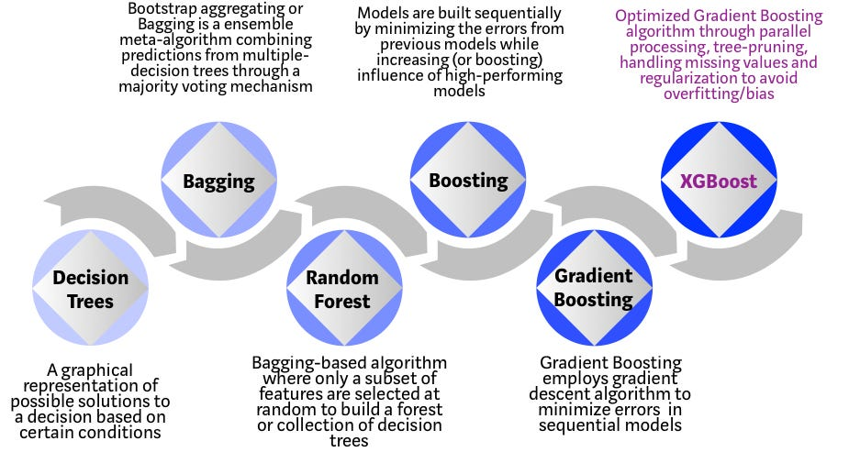
XG Boost

Slide 23


Slide 24
Thank You

