Slide 1
Visual Language Models
A Comparison of 5 Lightweight VLMs for Food Ingredient Recognition
BLIP · GIT · SmolVLM · nanoVLM · TinyVLM
15 Images · Fruits · Vegetables · Spices · Dry Fruits · Pulses
Vishwa Keerthi

Slide 2
The 5 Models Used
BLIP
GIT
SmolVLM
nanoVLM
TinyVLM
Bootstrap Language
Image Pretraining
Generative Image-to-
Text Transformer
SmolVLM-256M
Instruct
nanoVLM-222M
TinyVLM /
MiniGPT-4 family
by Salesforce
by Microsoft
by HuggingFace
by Community
by Academic
~450 MB
~500 MB–1.2 GB
~256 MB
~222 MB
~0.6–1 GB
Classic captioning model. Direct, precise — rarely wrong. Best for clear ingredient naming.
Descriptive captions but sometimes hallucinates extra objects not in the image.
Chat-style prompts. Very compact yet accurate — highest total score in our tests.
Smallest model tested. Outputs often vague, cut off, or unrelated to the image.
Tested separately. Includes MiniGPT-4 Lite, LLaVA-Lite, Shikra. ~60–70% accuracy.

Slide 3
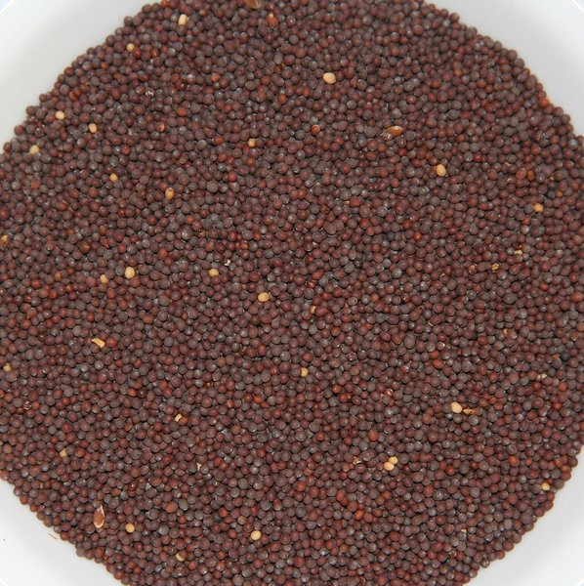
Spice
1. Brown Mustard Seeds
BLIP
❌
"a bowl of black beans on a white background"
GIT
⚠️
"a bowl of small brown seeds on a white background"
SmolVLM
✅
"Brown mustard seeds"
nanoVLM
❌
"seeds in a bowl it is a"
TinyVLM
✅
"mustard seeds / small dark seeds in a bowl"
✅ Correct ⚠️ Partial ❌ Wrong

Slide 4
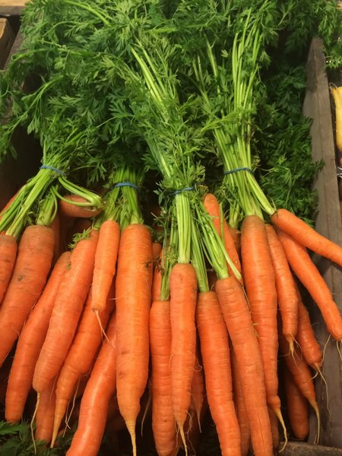
Vegetable
2. Carrots (Whole)
BLIP
✅
"a bunch of carrots with green stems"
GIT
✅
"a bunch of carrots are sitting in a wooden box"
SmolVLM
✅
"Carrots"
nanoVLM
✅
"carrots orange vegetable green"
TinyVLM
✅
"carrots / bunch of fresh carrots"
✅ Correct ⚠️ Partial ❌ Wrong

Slide 5
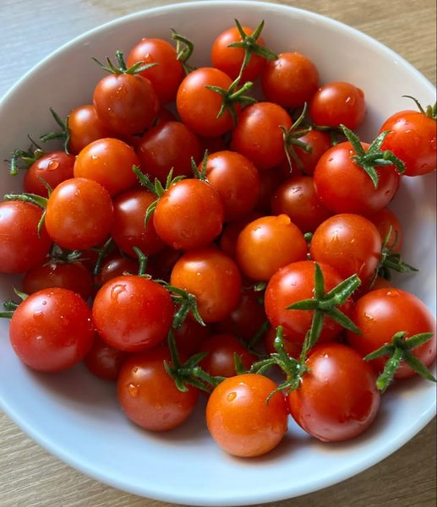
Vegetable
3. Cherry Tomatoes
BLIP
✅
"a bowl of cherry tomatoes on a wooden table"
GIT
⚠️
"a bowl of tomatoes on a table"
SmolVLM
✅
"Cherry tomatoes"
nanoVLM
⚠️
"tomatoes red bowl small it"
TinyVLM
✅
"cherry tomatoes / small red tomatoes in a bowl"
✅ Correct ⚠️ Partial ❌ Wrong

Slide 6
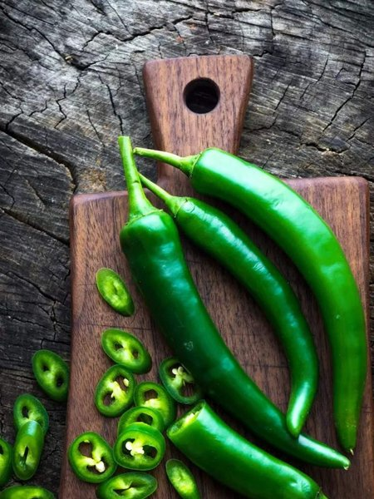
Vegetable
4. Chilli & Chilli Cuts
BLIP
✅
"green peppers on a wooden cutting board"
GIT
✅
"a group of green peppers on a cutting board with a knife"
SmolVLM
✅
"Green chillies"
nanoVLM
⚠️
"green pepper vegetable cut"
TinyVLM
✅
"green chillies / green peppers on a cutting board"
✅ Correct ⚠️ Partial ❌ Wrong

Slide 7
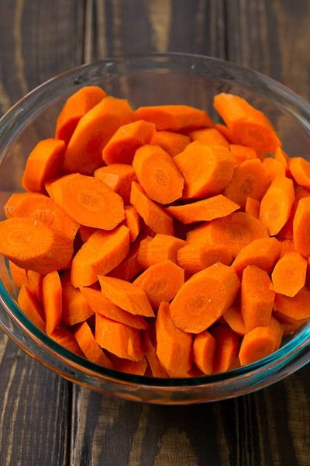
Vegetable
5. Chopped Carrots
BLIP
✅
"a bowl of sliced carrots on a table"
GIT
✅
"a glass bowl full of sliced carrots"
SmolVLM
✅
"Chopped carrots"
nanoVLM
✅
"carrots orange sliced bowl"
TinyVLM
✅
"carrots / sliced orange carrots in a glass bowl"
✅ Correct ⚠️ Partial ❌ Wrong

Slide 8
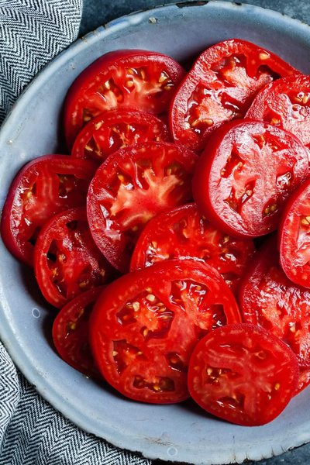
Vegetable
6. Chopped Tomatoes
BLIP
✅
"sliced tomatoes in a blue bowl"
GIT
⚠️
"a bowl of sliced tomatoes on a table with a cloth"
SmolVLM
✅
"Sliced tomatoes"
nanoVLM
⚠️
"tomatoes red sliced bowl"
TinyVLM
✅
"tomatoes / sliced red tomatoes in a bowl"
✅ Correct ⚠️ Partial ❌ Wrong

Slide 9
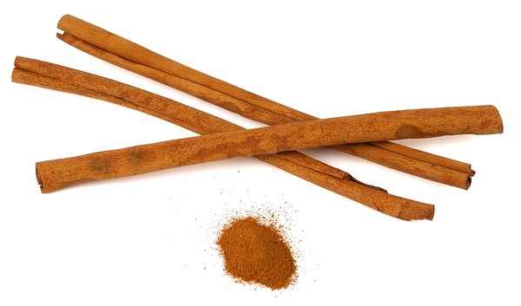
Spice
7. Cinnamon
BLIP
✅
"a group of cinnamon sticks on a white background"
GIT
✅
"cinnamon sticks and cinnamon powder on a white background"
SmolVLM
✅
"Cinnamon sticks and powder"
nanoVLM
❌
"sticks brown spice powder"
TinyVLM
✅
"cinnamon / cinnamon sticks with ground powder"
✅ Correct ⚠️ Partial ❌ Wrong

Slide 10
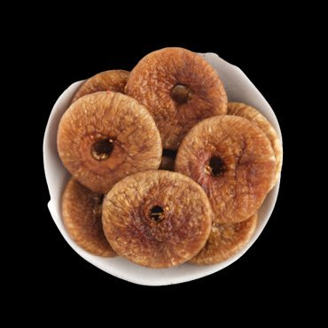
Dry Fruit
8. Dry Fig
BLIP
✅
"a bowl of dried figs on a black background"
GIT
⚠️
"a white bowl filled with dried fruit on a black background"
SmolVLM
✅
"Dried figs"
nanoVLM
⚠️
"figs dried bowl round"
TinyVLM
✅
"dried figs / dry figs in a white bowl"
✅ Correct ⚠️ Partial ❌ Wrong

Slide 11
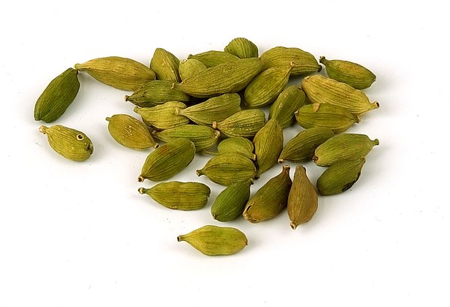
Spice
9. Green Cardamom
BLIP
❌
"a group of green seeds on a white background"
GIT
❌
"a pile of green seeds on a white background"
SmolVLM
✅
"Green cardamom pods"
nanoVLM
❌
"seeds green spice pods"
TinyVLM
✅
"cardamom / green cardamom pods"
✅ Correct ⚠️ Partial ❌ Wrong

Slide 12
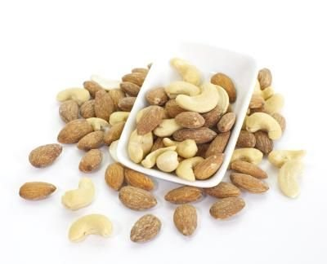
Dry Fruit
10. Mixed Almonds & Cashews
BLIP
✅
"a bowl of mixed nuts on a white background"
GIT
✅
"a bowl of almonds and cashews on a white background"
SmolVLM
✅
"Mixed almonds and cashews"
nanoVLM
✅
"nuts mixed almonds cashews"
TinyVLM
✅
"mixed nuts / almonds and cashews in a bowl"
✅ Correct ⚠️ Partial ❌ Wrong

Slide 13
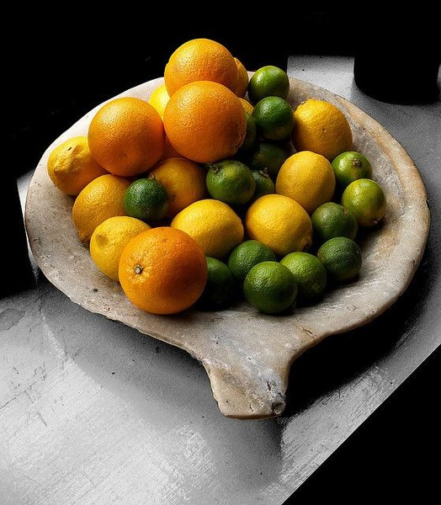
Fruit
11. Mixed Citrus Fruits
BLIP
✅
"a bowl of oranges and limes on a table"
GIT
✅
"a wooden bowl filled with oranges lemons and limes"
SmolVLM
✅
"Mixed citrus fruits — oranges, lemons, and limes"
nanoVLM
✅
"fruits orange green citrus"
TinyVLM
✅
"citrus fruits / oranges lemons and limes in a bowl"
✅ Correct ⚠️ Partial ❌ Wrong

Slide 14
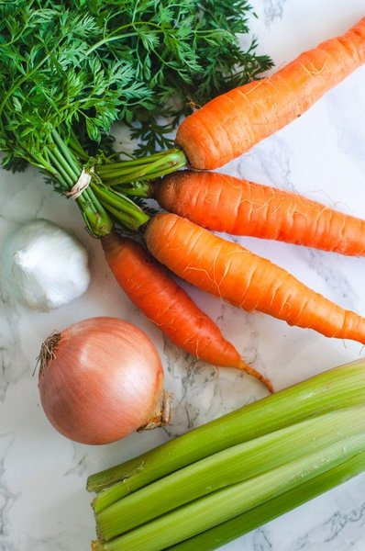
Vegetable
12. Mixed Vegetables
BLIP
✅
"a bunch of fresh vegetables on a marble surface"
GIT
✅
"a variety of fresh vegetables on a white background including carrots onion garlic"
SmolVLM
✅
"Mixed vegetables: carrots, onion, garlic, and celery"
nanoVLM
⚠️
"vegetables mixed carrots onion"
TinyVLM
✅
"mixed vegetables / assorted vegetables on a marble table"
✅ Correct ⚠️ Partial ❌ Wrong

Slide 15
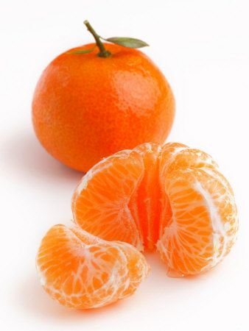
Fruit
13. Orange (Mandarin)
BLIP
✅
"an orange and a peeled orange on a white background"
GIT
✅
"an orange and orange slices on a white background"
SmolVLM
✅
"Mandarin orange / tangerine"
nanoVLM
✅
"orange fruit peeled segments"
TinyVLM
✅
"orange / mandarin orange peeled and whole"
✅ Correct ⚠️ Partial ❌ Wrong

Slide 16
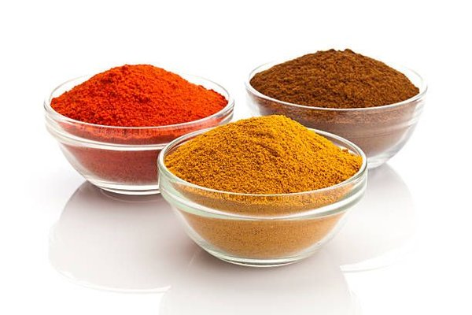
Spice
14. Spice Powders
BLIP
⚠️
"three bowls of spices on a white background"
GIT
⚠️
"three glass bowls of spices on a white background"
SmolVLM
✅
"Spice powders — chilli, turmeric, and cumin/coriander"
nanoVLM
❌
"powder spices bowls three"
TinyVLM
⚠️
"spice powders / three bowls of ground spices"
✅ Correct ⚠️ Partial ❌ Wrong

Slide 17
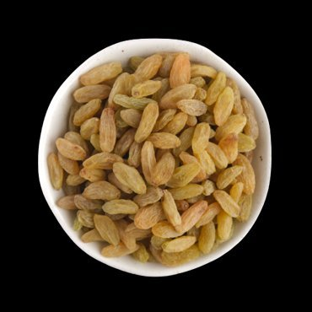
Dry Fruit
15. Raisins
BLIP
✅
"a bowl of raisins on a black background"
GIT
✅
"a white bowl filled with golden raisins on a black background"
SmolVLM
✅
"Raisins / dried grapes"
nanoVLM
✅
"raisins dried fruit bowl"
TinyVLM
✅
"raisins / golden raisins in a white bowl"
✅ Correct ⚠️ Partial ❌ Wrong

Slide 18
Correct Identifications by Category
From VLM_types.xlsx — number of correct identifications per food category
Model
Fruits
Vegetables
Pulses
Dry Fruits
Spices
Total
BLIP
8
6
3
3
2
22
GIT
8
5
0
3
1
17
SmolVLM
10
9
3
1
3
26
nanoVLM
8
5
3
2
2
20
⚠️ TinyVLM (MiniGPT-4 Lite, LLaVA-Lite, Shikra) was tested separately in tinyvlm.ipynb on a different image set. Overall accuracy ~60–70%.
Qualitative Ranking — Ingredient Identification
🥇 BLIP
🥈 SmolVLM
🥉 nanoVLM
4th GIT
5th TinyVLM
Best — direct and precise, rarely wrong
Good — accurate but sometimes adds extra context
Decent score but outputs vague or cut off
Descriptive but hallucinates extra objects
Variable quality (~65%), tested separately

Slide 19
Conclusion
🥇 1st
SmolVLM
26/37
Best overall — follows instructions, very compact (256 MB), rarely adds extra objects
🥈 2nd
BLIP
22/37
Most precise per-image — no hallucination, direct ingredient naming
🥉 3rd
nanoVLM
20/37
Decent numbers but outputs are vague, often cut off mid-sentence
4th
GIT
17/37
Descriptive but hallucinates — adds tables, napkins, bowls that aren't there
5th
TinyVLM
~65%
Tested separately on different images; quality varies a lot by variant
Key Takeaway: For compact food ingredient recognition, SmolVLM and BLIP offer the best accuracy-to-size ratio among sub-1 GB models.

