Slide 1




Home-Credit-Default-Risk
Dexlab (21): Kumar Saurabh, Shubham Thakur, Ameya Dalvi, Vishwa Shrirame

Slide 2
Outline
Project Summary
EDA Summary
Modeling Pipeline
Results
Conclusion and Next steps

Slide 3
Project Summary
The main goal of this project is to evaluate credit worthiness of a loan borrower.
Previously we trained a model using Logistic Regression with test accuracy 91.93%.
Now, we have done feature engineering, feature selection and hyperparameter tuning to further improve and get insights on the model.
We analysed the selected features using Feature importances to get a visual representation of their contributions to our work.

Slide 4
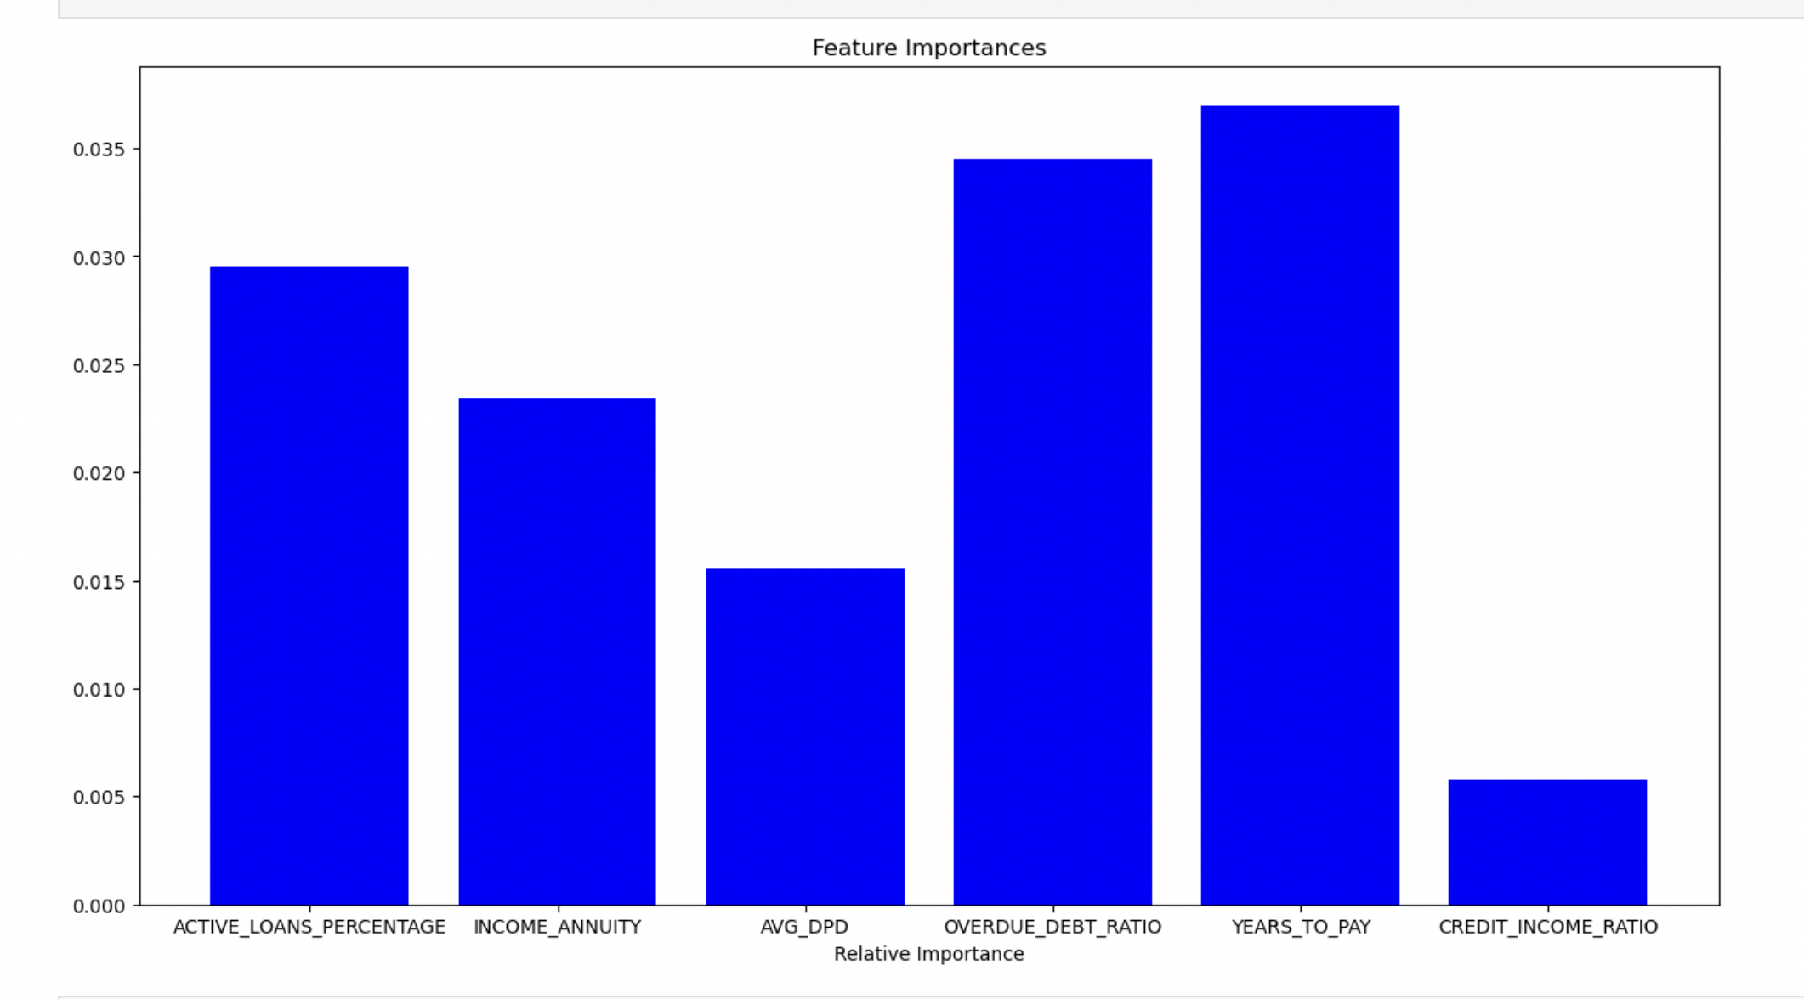
EDA Summary
We identified 6 features and analyzed them using Feature Importances to visualize their importance over our work. Credit to Annuity Ratio of the Application is found to be the most important feature.

Slide 5
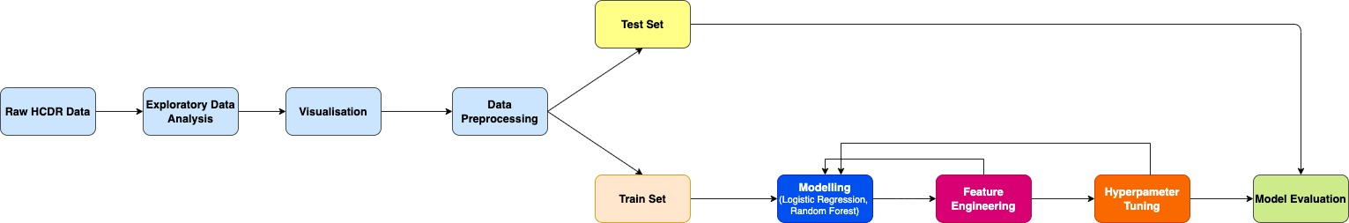
Modelling Pipeline
We performed EDA and sent the processed data to our pipeline.
We received an improved result after Feature Engineering and Feature Selection from our baseline model.
Furthermore, we performed hyperparameter tuning and identified the best parameters that would aid our model performance.
We sent our results from our tuned model to Kaggle.

Slide 6
Results
After feature engineering, we achieved the test accuracy of 92.13% with Logistic Regression.
In hyperparameter tuning, we implemented GridSearchCV to identify best parameters for logistic regression and got an improved test accuracy of 92.47%.
We got a score of 0.6491 for our Kaggle submission.

Slide 7
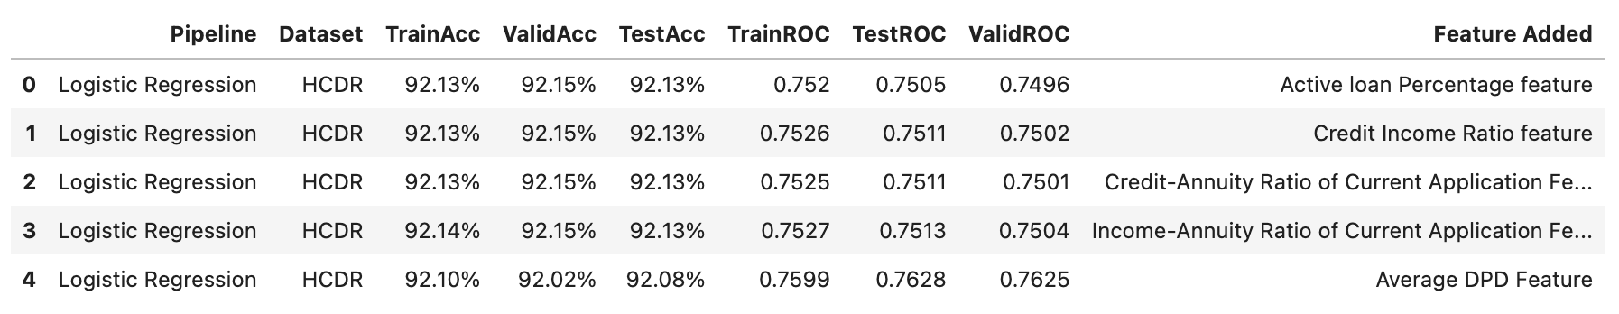
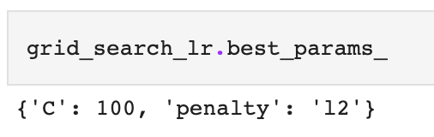
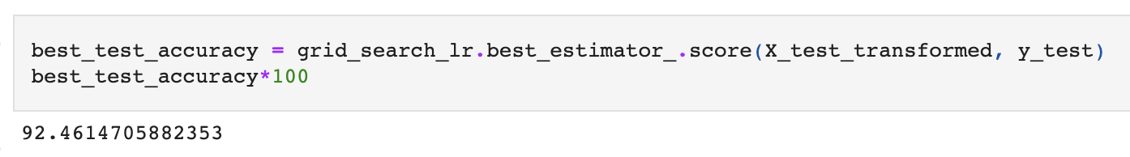
Result after Feature Engineering
Result after Hyperparameter Tuning

Slide 8
Conclusion and further steps
As per our analysis, the best results were observed using Logistic Regression.
After feature engineering and hyperparameter tuning we have seen an improvement in test accuracy by 0.54% from our baseline model.
We think that the decrease in our submission score on Kaggle would be because of inaccurate feature selections.
In the next phase we will implement a deep learning algorithm to build a MLP model in Pytorch for loan default classification.

