Slide 1




Home-Credit-Default-Risk
Dexlab (21): Kumar Saurabh, Shubham Thakur, Ameya Dalvi, Vishwa Shrirame

Slide 2
Outline
Project Summary
EDA Summary
Modeling Pipeline
Results
Conclusion and Next steps

Slide 3
Project Summary
The main goal of this project is to evaluate credit worthiness of a loan borrower.
Previously we performed feature engineering and hyper-parameter tuning in Phase 2.
Now, we have improved our results from Phase 2 and implemented deep learning algorithm in this Phase 3.
We constructed a neural network - Multi-layer Perceptron and visualized the trained model on TensorBoard.

Slide 4
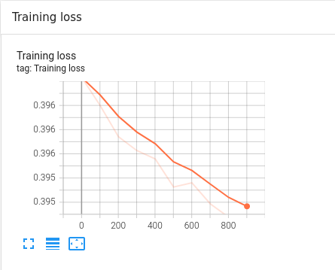
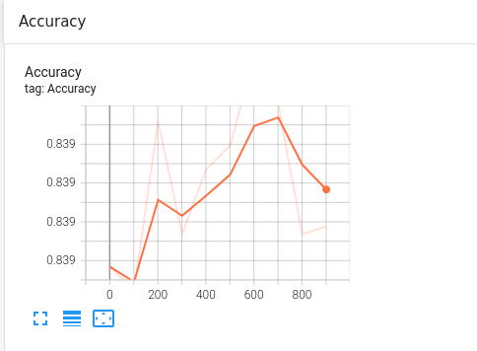
Visualization
We visualized our training model in real-time on TensorBoard and plotted the Accuracy and Loss function of the data.

Slide 5
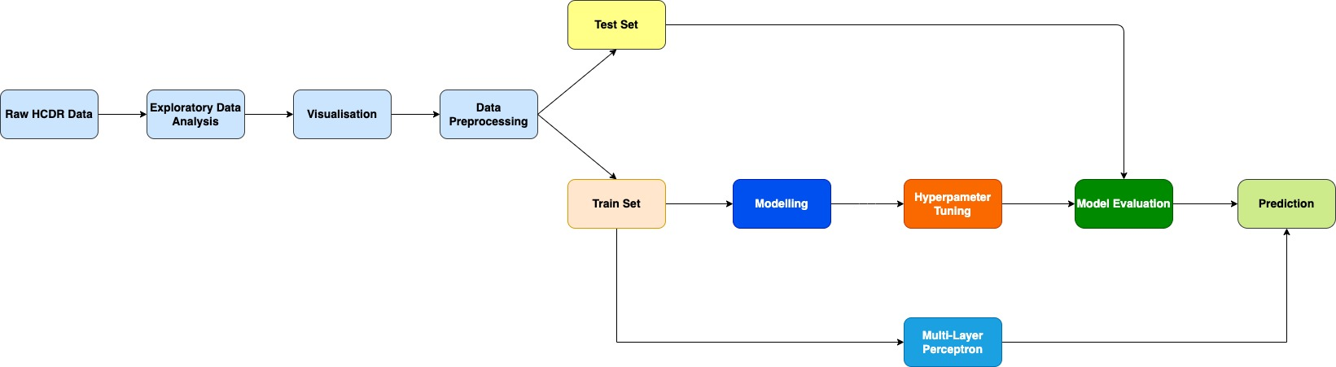
Modelling Pipeline
We did some data preprocessing and sent the processed data to our neural network.
We made use of 14 input features, 2 hidden layers and 2 output features and used Leaky-Relu as the activation function.
We evaluated our model using Cross Entropy Loss Function.
Furthermore we visualized the training model on TensorBoard in real-time.
We submitted our scores to Kaggle.

Slide 6
Results
We improved our Phase 2 Kaggle submission from 0.6491 to 0.7313 which is a 12% improvement.
We achieved a train accuracy of 83.91% and test accuracy of 83.53% on our neural network.
We also achieved a loss score of 0.3944 on 1000 epochs.
We got a score of 0.7202 for our Phase 3 Kaggle submission.

Slide 7
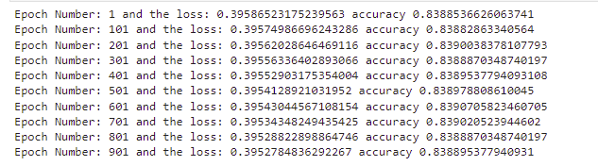

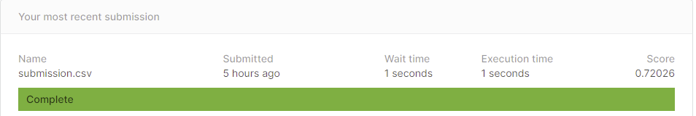
Train Accuracy of Multi layer perceptron
Test Accuracy of Multi layer perceptron

Slide 8
Conclusion
We found that by removing redundant features and balancing the data, we are getting better results.
Multi layer Perceptron performs better than Single layer Perceptron.
Improved the Kaggle submission score from the last phase by modifying features and balancing data.
Learnings - The reason of overfitting of our model in the last phase, worked with TensorBoard, and learnt neural networks in a theoretical and practical ways.

