Slide 1
Query craft: Revolutionizing query processing
By Team Query Quashers
(Apoorv, Daksh, Kashi)
Notes:
Welcome to our presentation on QueryCraft, a groundbreaking solution in dynamic query processing.
Team: Apoorv, Daksh, Kashi – the minds behind QueryCraft.
Today, we'll unveil how QueryCraft addresses complex querying challenges with unmatched efficiency.
In today’s world the technology is moving towards analytics and future prediction. Data plays a vital role in making such decisions. We tend to create Ad-hoc OLAP queries to retrieve various kinds of data from the Database. Although Ad – hoc OLAP is significantly used but it becomes an overhead to validate and maintain such huge queries. To solve this problem we introduce Query Craft which provides a succinct way to represent these queries for efficient evaluation. Unlike traditional SQL optimizer, Query Craft focuses on the semantics and the bigger picture of the query.

Slide 2
Navigating Through Query Craft's Journey
Introduction to Query Craft
Project Overview
  Problem
  Solution
Team Contributions
High-Level Architecture
Query Craft's Input Format
Technology Stack
Current Limitations
Live Demonstration
Synopsis and Road Ahead

Slide 3



Query craft: at the forefront of query innovation
Query Craft introduces a custom PHI ($∅$) operator, grouping variables, multi-feature queries, and extended multi-feature queries, transforming the way complex queries are handled.
Designed for dynamic and efficient query processing, it's a leap forward in database querying technology.
Key Features: Advanced query handling, dynamic code generation, and efficient processing.
Notes:
Introducing Query Craft! We used the concept of grouping variables to reduce the confusion of the query optimizer while it processes the traditional SQl queries.
Grouping variable are used to categorize the data into several groups to make the analysis much easier and faster.
So here comes the concept of Multi-feature Queries and Extended-multifeatured queries, using this syntax we overcome the tedious process of writing multiple with statements and views.
So the MF EMF queries are very effective as their syntax supports the concept of grouping variable where in MF query, the scope of the grouping variable is limited to the grouping attributes in EMF
the scope of the grouping variables extends outside the group.

Slide 4
PROBLEM
MARKET GAP
Traditional SQL struggles with complex multi-layered data aggregation and advanced multi-feature analysis.
CUSTOMERS
DB Admins using standard SQL spend most of their time joining multiple instances of the same table that only partially resolves their issue
Inefficiency
Standard SQL queries using Pivoting or Hierarchical queries tend to come with overhead when it comes to validating and maintaining such huge queries
COSTS
Increased compute time, leading to loss of productivity of DB Admins costing organizations millions of dollars

Slide 5
SOLUTION
CLOSE THE GAP
TARGET AUDIENCE
Introduces a custom PHI operator and advanced grouping variables, filling a critical gap in complex data analysis and processing efficiency.
Our target audience is Data Analysts, Database Administrators, Business Intelligence Professionals seeking advanced querying capabilities.
COST SAVINGS
EFFICIENT
Increase in productivity thereby reducing expenses of the organization
Optimized for handling large datasets with complex query requirements, reducing processing time and resource usage.

Slide 6
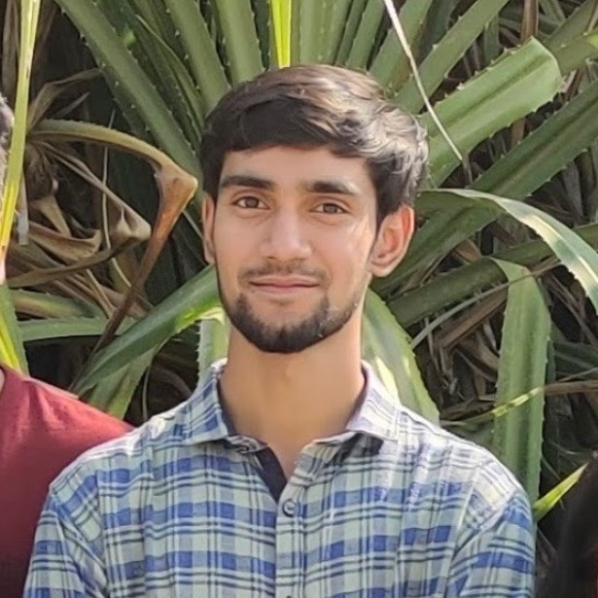


The Brains Behind Query Craft
APOORV
Focused on input parsing, SELECT clause, and test case development
DAKSH
Spearheaded ‘HAVING’ clause, ‘AVERAGE', ‘SUM’, ‘COUNT’, and other aggregate functions, and associated test cases
KASHI
Developed the base code, aggregate loops, MF struct, and error handling mechanisms

Slide 7
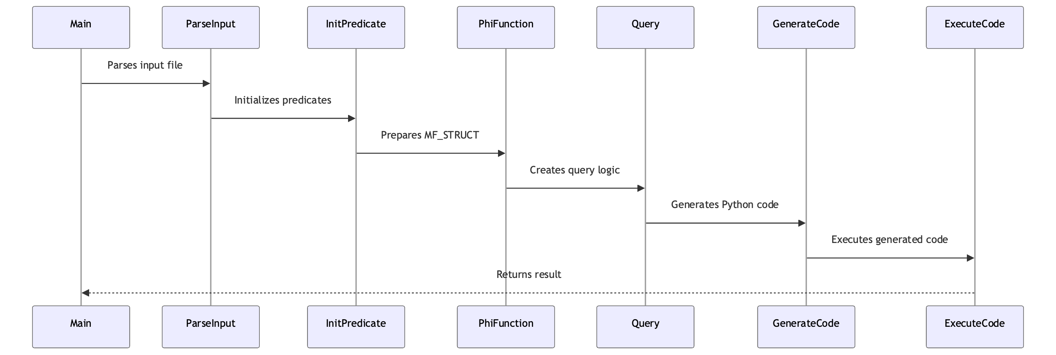
ARCHITECTURE

Slide 8
Query structure
For each customer find all the aggregates in "NY", find all the aggregates in "CT"
EMF
STANDARD SQL
s:
cust, sum_1_quant, avg_1_quant, max_1_quant, min_1_quant, count_1_quant, cust, sum_2_quant, avg_2_quant, max_2_quant, min_2_quant, count_2_quant
n:
1
v:
cust
f:
sum_1_quant, avg_1_quant, max_1_quant, min_1_quant, count_1_quant, sum_2_quant, avg_2_quant, max_2_quant, min_2_quant, count_2_quant
p:
1.state=='NY' and 1.cust==cust
2.state=='CT' and 2.cust==cust
g:
WITH t1 as (
SELECT cust, sum(quant), avg(quant), max(quant), min(quant), count(quant)
FROM sales
WHERE state = 'NY'
GROUP BY cust
), t2 as (
SELECT cust, sum(quant), avg(quant), max(quant), min(quant), count(quant)
FROM sales
WHERE state = 'CT'
GROUP BY cust
) select * from t1 inner join t2 on t1.cust = t2.cust;
Notes:
S: Defines projected attributes for output (Comma-separated values).
n: Specifies the number of grouping variables (Single integer).
V: Lists grouping attributes (Comma-separated values).
[F]: Sets of aggregate functions for each grouping variable (Comma-separated values).
[σ]: Predicates defining the range for each grouping variable (Line-separated values).
G: Predicate for the having clause (Single string).

Slide 9
Powering Query Craft
language
Python 3
DBMS
PostgreSQL
Packages
subprocess, sys, re, psycopg2, PrettyTable, dotenv
Notes:
Engineered with Python for its flexibility and robustness.
Employs PostgreSQL for database management, ensuring reliability.
Incorporates libraries like psycopg2, PrettyTable, and dotenv for extended functionalities.

Slide 10
Query Craft's Current Boundaries
Alias
CODE DUPLICATION
COUNT(*)
No Support for "AS" Alias in SELECT. The inability to use the "AS" keyword for aliasing in SELECT queries limits the flexibility in naming conventions and readability of the query results.
The lack of aliasing support has led to some code duplication in the _generated.py file, impacting the maintainability and scalability of the code.
QueryCraft does not support the use of the asterisk (*) as a wildcard in the COUNT aggregate function, a common practice in standard SQL for counting all records.
Notes:
No Support for "AS" Alias in SELECT:
Impact: The inability to use the "AS" keyword for aliasing in SELECT queries limits the flexibility in naming conventions and readability of the query results.
Technical Context: This limitation can lead to less intuitive query outputs, especially when dealing with complex queries involving multiple columns or calculations.
Code Duplication in _generated.py:
Consequence: The lack of aliasing support has led to some code duplication in the _generated.py file, impacting the maintainability and scalability of the code.
Developer Perspective: Code duplication can increase the risk of errors and make the codebase more challenging to manage and update.
"*" Not Supported in COUNT Aggregate Function:
Limitation: QueryCraft does not support the use of the asterisk (*) as a wildcard in the COUNT aggregate function, a common practice in standard SQL for counting all records.
Effect on Users: This restricts users from quickly writing queries to count all entries in a table, requiring them to specify individual columns, which can be less efficient and more time-consuming.
Apart from these : No support for minimal scanning, only EMF Query with the specified formatting structure will work

Slide 11
Synopsis & The Road Ahead for Query Craft
Query Craft Today:
Revolution in Data Analysis: Custom PHI operator and advanced grouping for complex queries.
Industry Impact: Significant strides in finance, healthcare, e-commerce with intricate data analysis capabilities.
Current Limitations: Needs enhancement in SELECT aliasing, reduction of code duplication, and support for "*" in COUNT.
Tomorrow's Query Craft:
Enhance SELECT aliasing and optimize codebase.
Improve user interface for complex queries.
Expand SQL-standard features and analytical functions.
Explore AI and ML integrations for predictive analytics.
Broaden market reach, including emerging data-reliant sectors.
Commitment:
Continuous Improvement: Addressing limitations and setting new standards in query processing.
Growth Partner: Evolving as a tool for data-driven decision-making across various industries.

