Slide 1
Scrabble Player Rating Competition Project - Biryani ML Scholars (#9)
Syed Raza
Kashi Bondugula
Gaurav Kumar
Venkata Sumanth Nagabhairu
CS 559 Fall 2022 Final Project

Slide 2
Agenda
Exploratory Data Analysis
Preprocessing
Modeling
Non-parametric
Parametric
Stacking
Conclusion and Future Work

Slide 3
Exploratory Data Analysis and Preprocessing

Slide 4
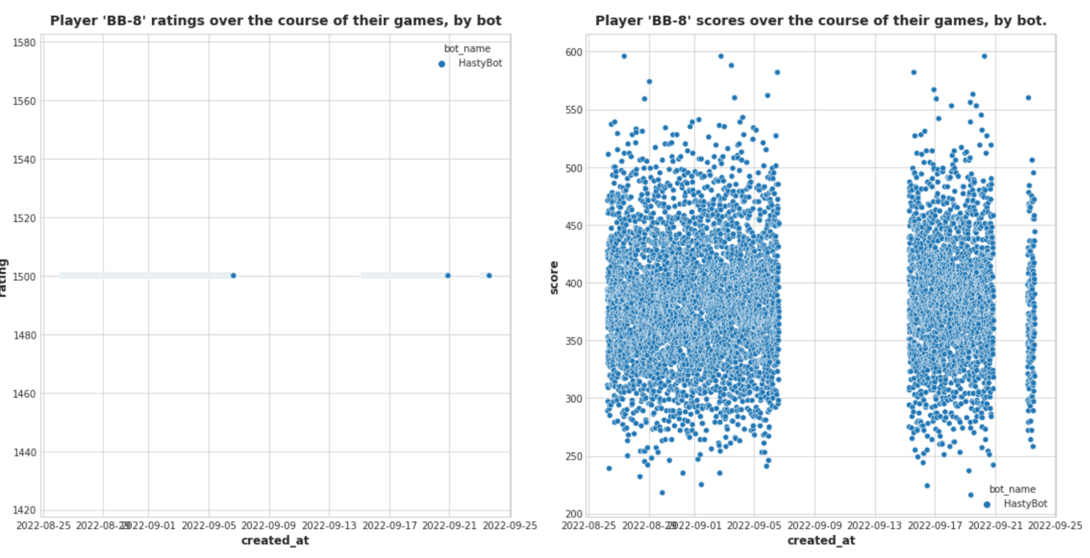
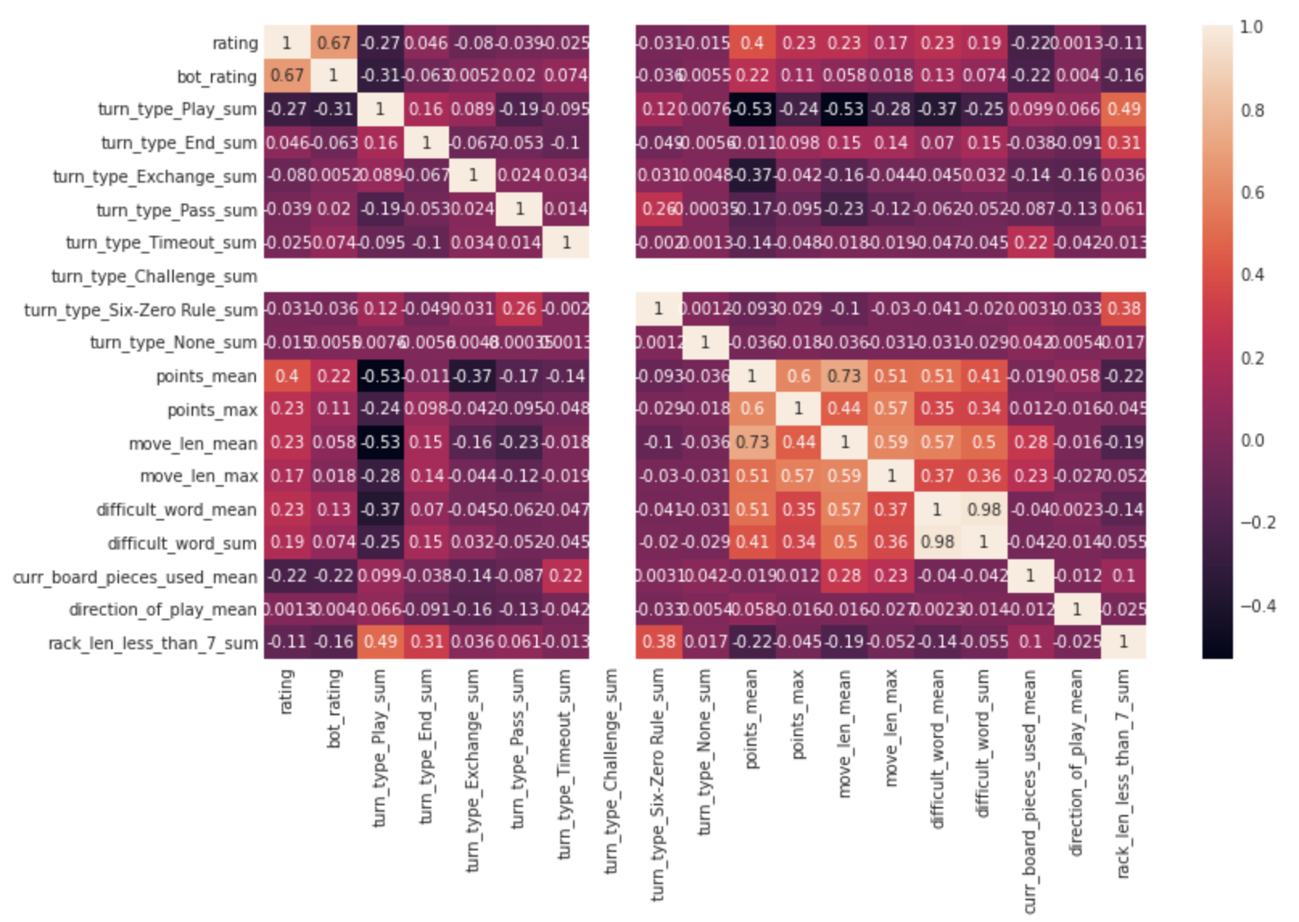
Our analysis inspired decisions for which players – and which features – to include in our model
Agg. features correlated the highest to the target
Outliers - no rating variation
Notes:
heatmap,
to just 5 categorical features, in
encoded categorical columns using one-hot vectors.
engineered features representing metrics for each game
(e.g. “difficult_word_sum”, or “max_overtime_minutes”).
standardized the numerical columns using Z-scores,

Slide 5
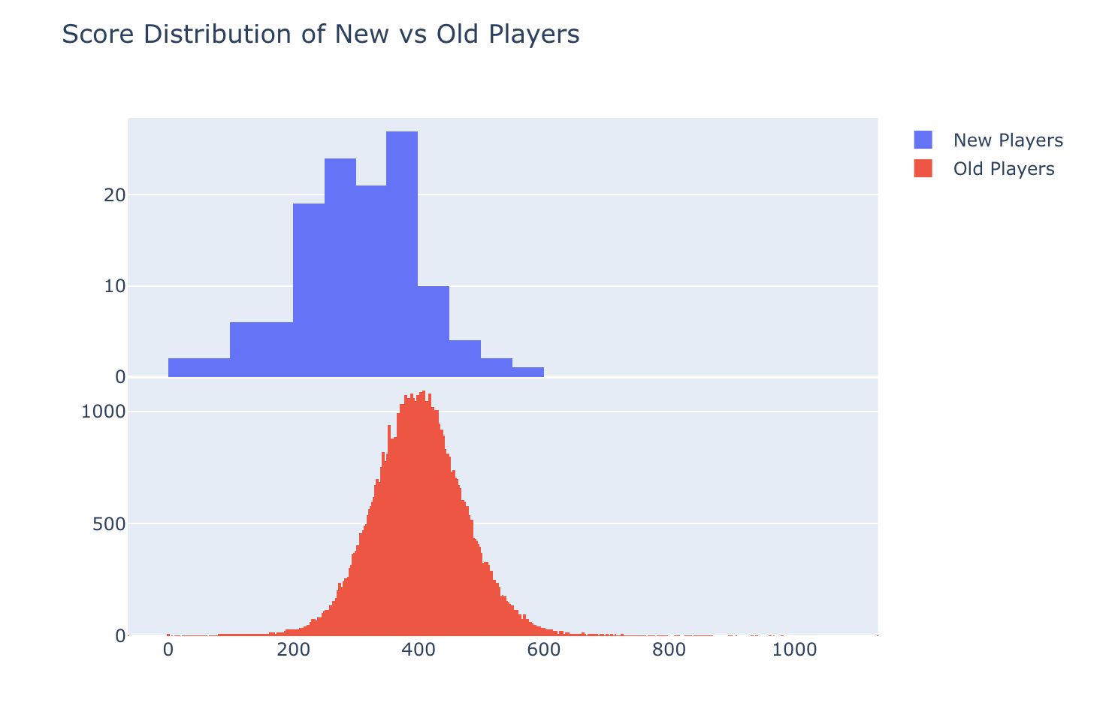
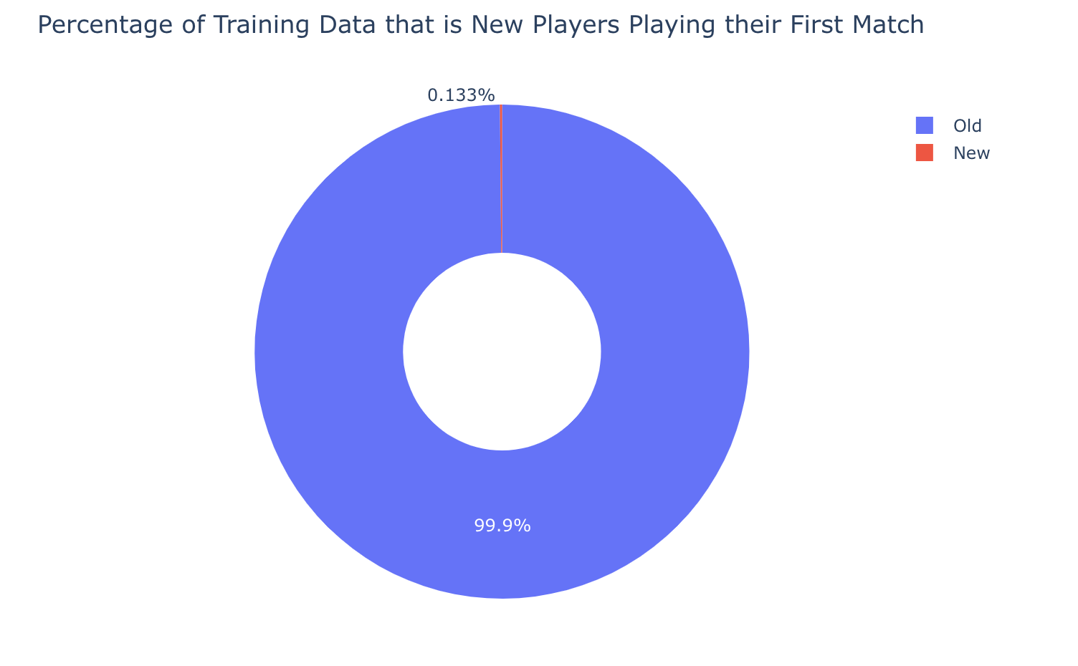
As the below plot shows, the training data is mostly represented by players who have played before. However, the distributions of scores between both new and old players are roughly Gaussian, with the same range of values

Slide 6
Modeling and Evaluation

Slide 7
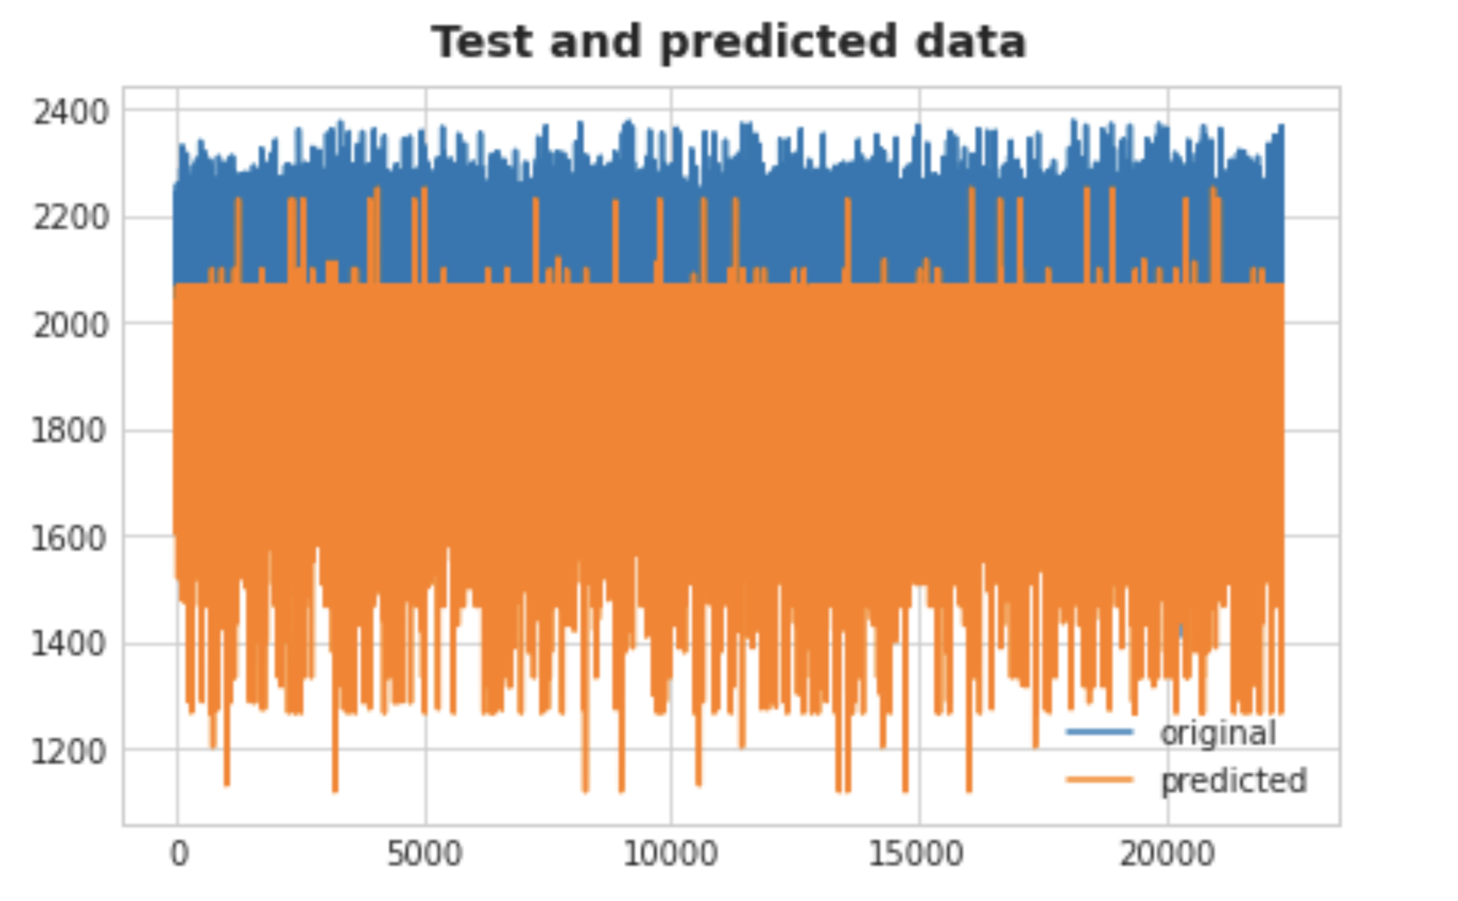
Non-Parametric Model using Decision Tree
Base:
DecisionTreeRegressor
Model Parameters:
Max_depth
Mean RMSE
Train (players): 156
Test (bots): 170

Slide 8
Non Parametric model using KNN
Initial Hyper Parameters
n_neighbours = 5
weights = { “uniform” }
algorithm = { “auto” }
leaf_size = 30
p = 2
metric = minkowski
Initial RMSE: 162.0879491561218
Optimized Hyper Parameters using Grid Search CV
n_neighbours = 7
algorithm = brute
metric = minkowski
weights = uniform
leaf_size = 30
p = 2
Even the parameters haven’t changed that much
Best Score of GridSearchCV: 139.51366016328168 (train)
Final RMSE: 162.0189491561218
Final Conclusion: Not much of a difference, even with tuning hyper parameters.

Slide 9
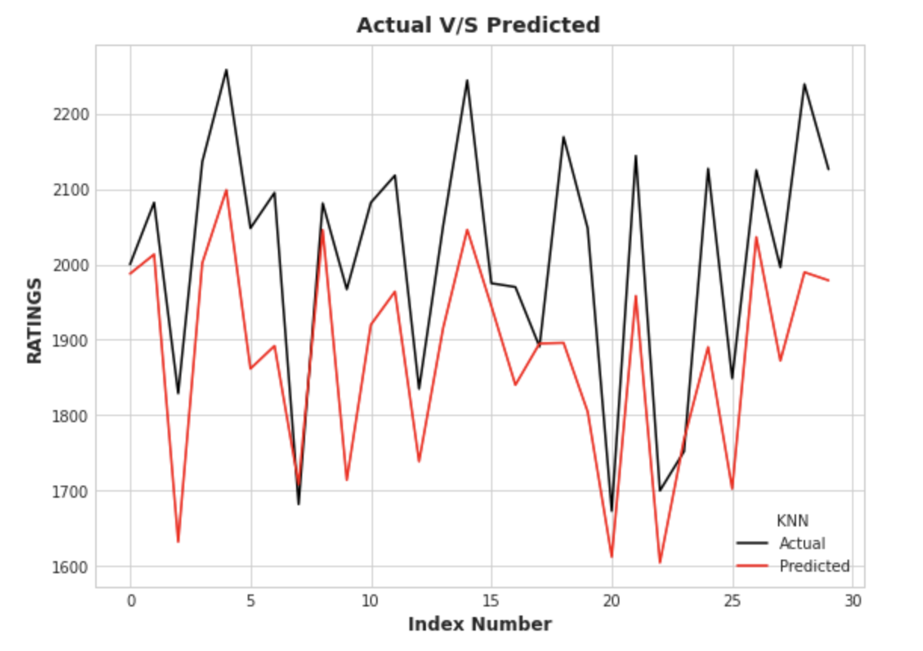
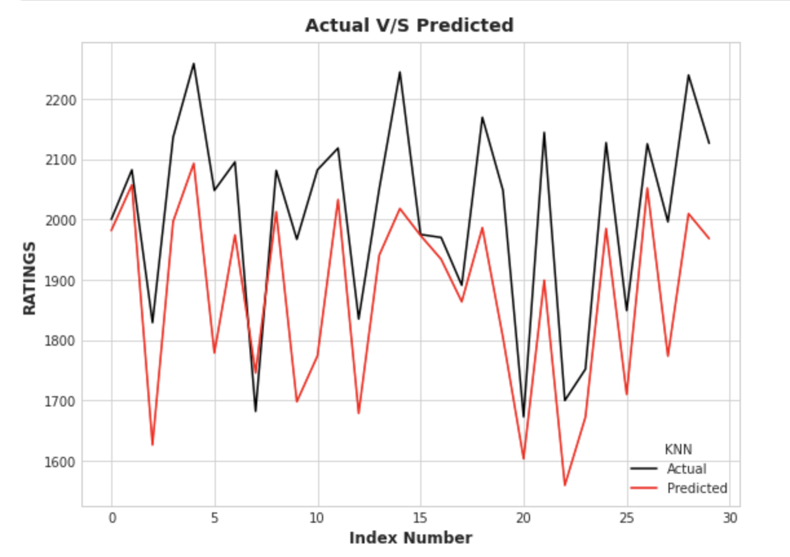
Non Parametric model using KNN
Actual v/s Predicted
Without Hyperparameter Tuning (RMSE : 162.08)
)
After Hyperparameter Tuning (RMSE : 162.01)

Slide 10
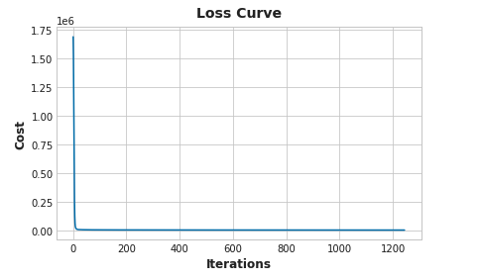
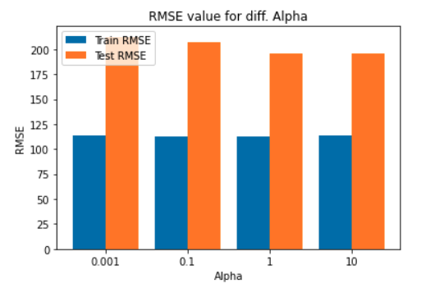



Parametric Model using Neural Network
Neural Network using scikit Learn MLPRegressor
Scrabble data and Neural Network
Large data set ~73000
MLP Regressor
Model Parameters
Parameter Selection -
Activation function - RELU
Solver for Weight optimization - ADAM
Epocs - 1000, 1500, 2000
Alpha - [ 0.0001 - 10 ]
Learning Rate - Constant/ Adaptive
GridSearchCV
Initial model outcome - Overfitting

Slide 11
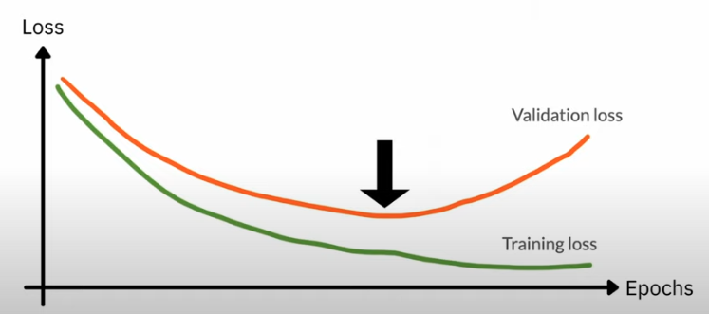
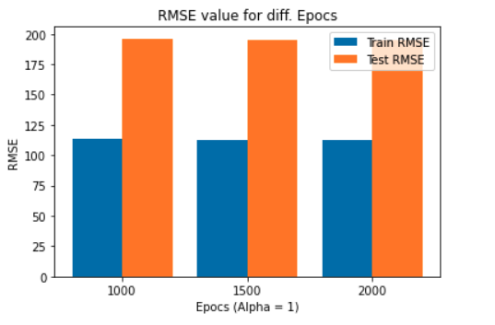
Parametric Model using Neural Network
Neural Network using scikit Learn MLPRegressor
Overfitting in Neural Network
A lot of flexibility in the model causes high variance
Penalizing Alpha
Best Result with Alpha=1
Early Stopping
To get optimum balance between training loss vs validation loss
Epocs=1500
Predicted RMSE - ~154 (Kaggle)
Further Optimization
Adding More Hidden Layers
Dropout

Slide 12
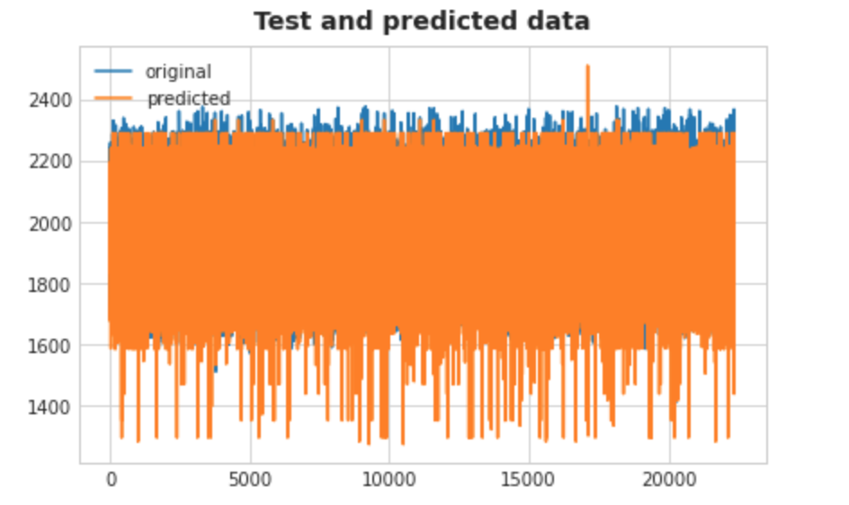
Parametric Model using LinearSVM
Base:
LinearSVM
Model Parameters:
C value
Mean RMSE
Train (players): 128
Test (bots): 156

Slide 13
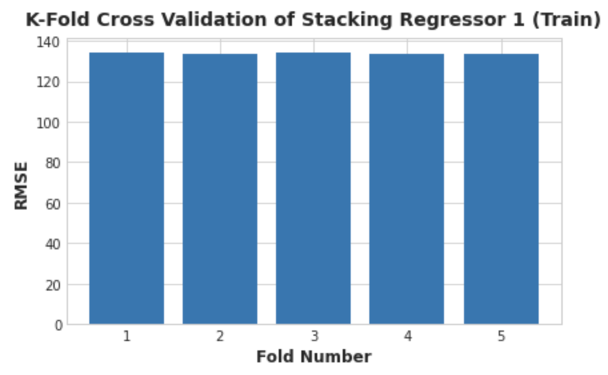
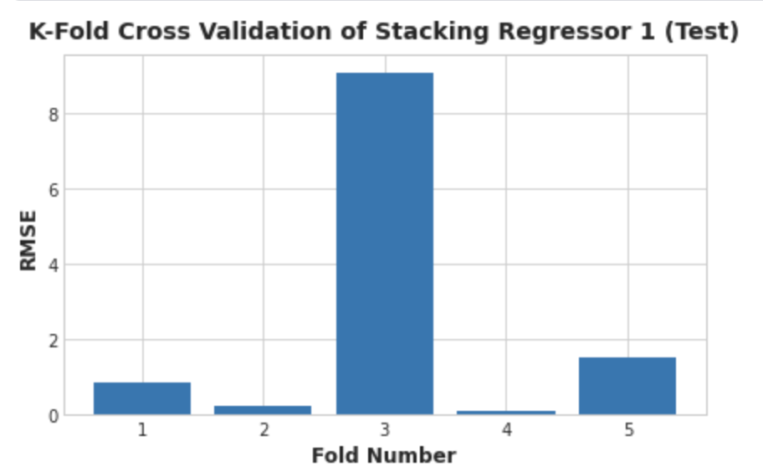
Stacking Model
Base:
SGDRegressor
DecisionTreeRegressor
Meta-regressor
Ridge Regressor
Mean RMSE
Train (players): 133.768
Test (bots): ~2.4
Notes:
We also tried a Lasso for the Meta-regressor, bu that wasn’t as good

Slide 14
Conclusions and Future Work

Slide 15
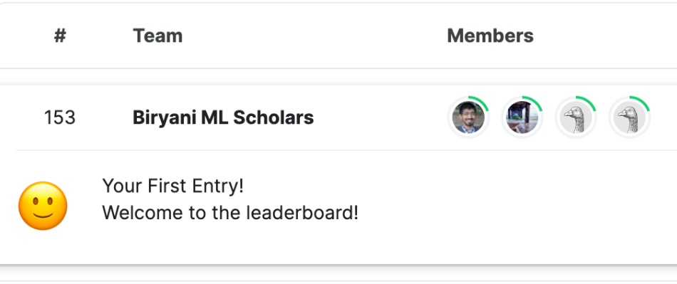
Our model achieves low test error, and shows interesting directions for future generalization work
Results
Mean Test RMSE (bots): ~2.4
Mean Test RMSE (players): ~152.876
Future Work
Reproducibility challenges
Cross validation to reduce overfitting between players/bot populations
Notes:
Cross val - be sure to mention GridSearchCV!
refer to this slide: https://sit.instructure.com/courses/61585

