Slide 1

A CAPSTONE PROJECT
ON
CSA0402-OPERATING SYSTEM
OSentinel – Autonomous OS Process Anomaly Detection, Isolation & Self-Recovery System
Presented By: Harish Kumar G {192521340}
Vishwa U {192511192}
Mohamed Haroon P {192511313}
Jaisurya Devendiran {192511051}
Sakthi K R {192521303}
Guided by
Dr. PRISKILLA ANGEL RANI J

Slide 2


Introduction
Modern operating systems run hundreds of processes simultaneously.
Some processes may become abnormal due to excessive resource usage or failures.
Traditional Task Managers mainly provide monitoring without automatic recovery.
OSentinel continuously monitors, detects, isolates, and recovers abnormal processes.

Slide 3
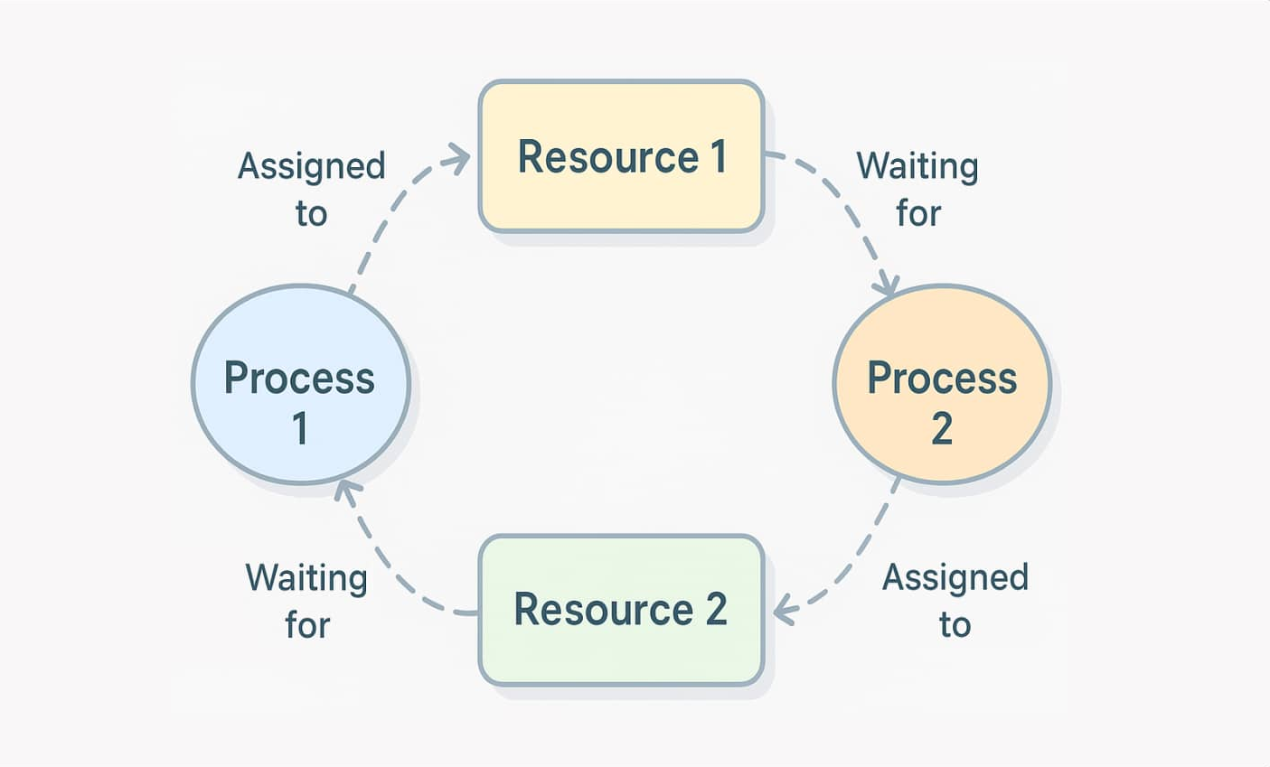

Problem Statement
Traditional process monitoring faces problems such as:
Runaway CPU-consuming processes.
Memory leak behavior.
Zombie and orphan processes.
Fork bomb process explosions.
Resource deadlocks.
Manual intervention is required for recovery.

Slide 4
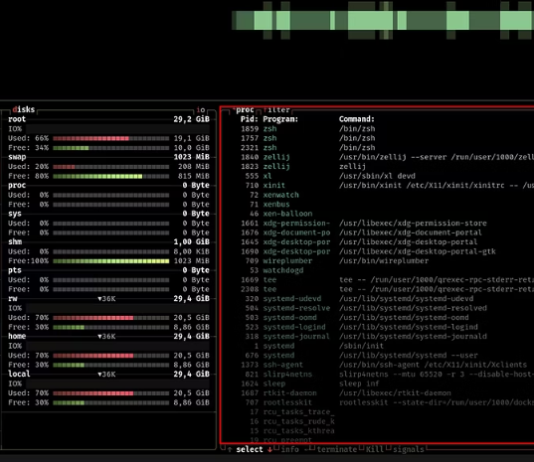
Objectives of the System
Monitor live OS process telemetry.
Discover parent-child process relationships.
Detect multiple types of process anomalies.
Identify resource deadlocks using Wait-For Graphs.
Calculate process risk levels.
Automatically quarantine and recover problematic processes.

Slide 5
Module 1: Process Telemetry & Lineage Discovery
Purpose: Collect and analyze live process information.
Functions:
Collect PID, PPID, process name and status.
Monitor CPU and memory usage.
Track thread count and creation time.
Build parent-child process hierarchy.
Maintain historical telemetry for trend analysis.
Technique: Bulk process iteration + Process Tree + Rolling History Buffer.

Slide 6
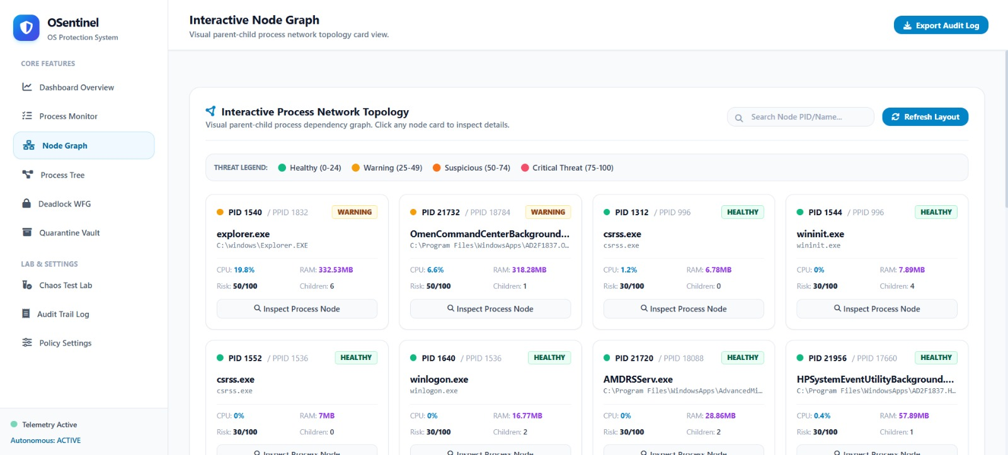
Module 1: Process Telemetry & Lineage Discovery

Slide 7
Module 2: Multi-Signature Anomaly Detection Engine
Purpose: Detect abnormal process behavior.
Detects:
Zombie Processes
Orphan Processes
Runaway CPU Processes
Memory Leak Patterns
Fork Bomb Explosions
The engine evaluates multiple behavioral signatures instead of relying on a single threshold.

Slide 8
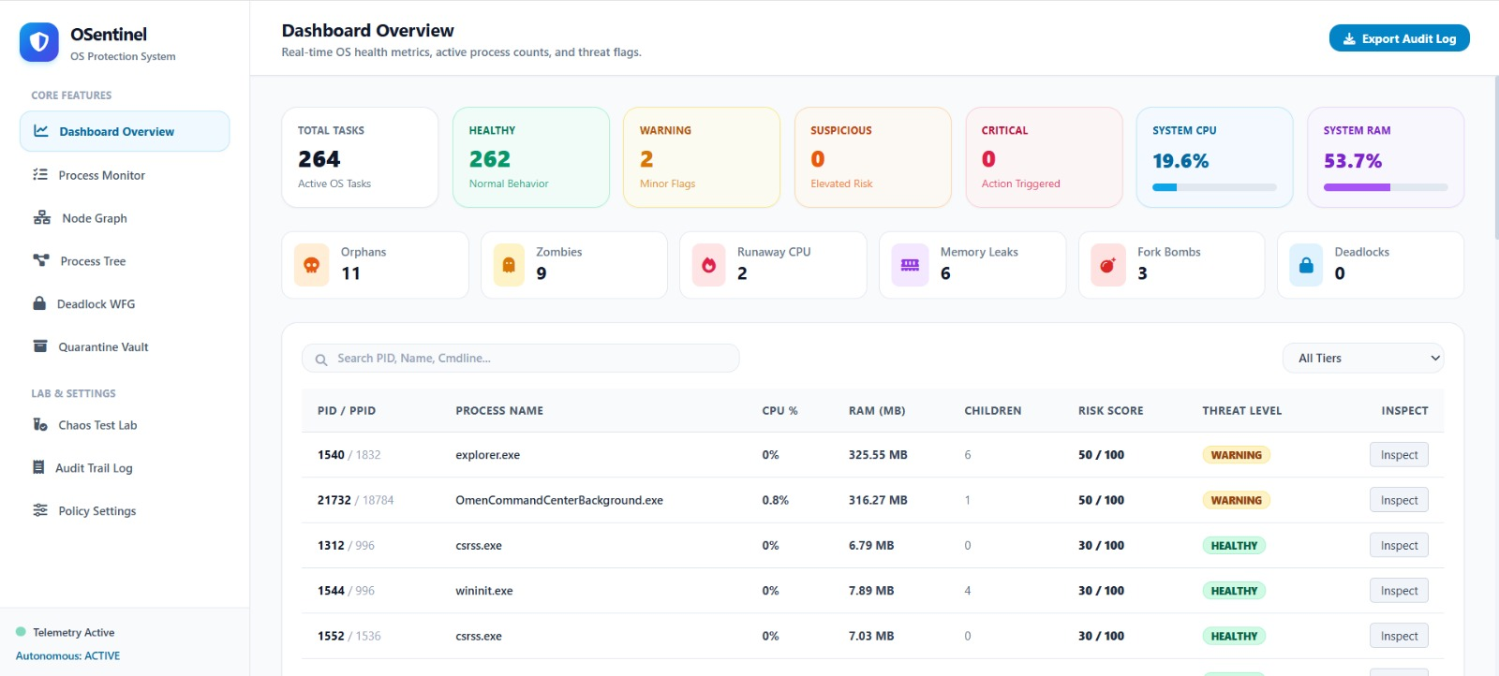
Module 2: Multi-Signature Anomaly Detection Engine

Slide 9
Module 3: Wait-For Graph Deadlock Analyzer
Purpose: Detect resource-related process deadlocks.
Functions:
Represent processes as graph vertices.
Represent waiting relationships as directed edges.
Detect circular dependencies.
Identify active deadlock cycles.
Determine processes that can be terminated to break the deadlock.
Techniques: Wait-For Graph + DFS + Tarjan's Strongly Connected Components (SCC).

Slide 10
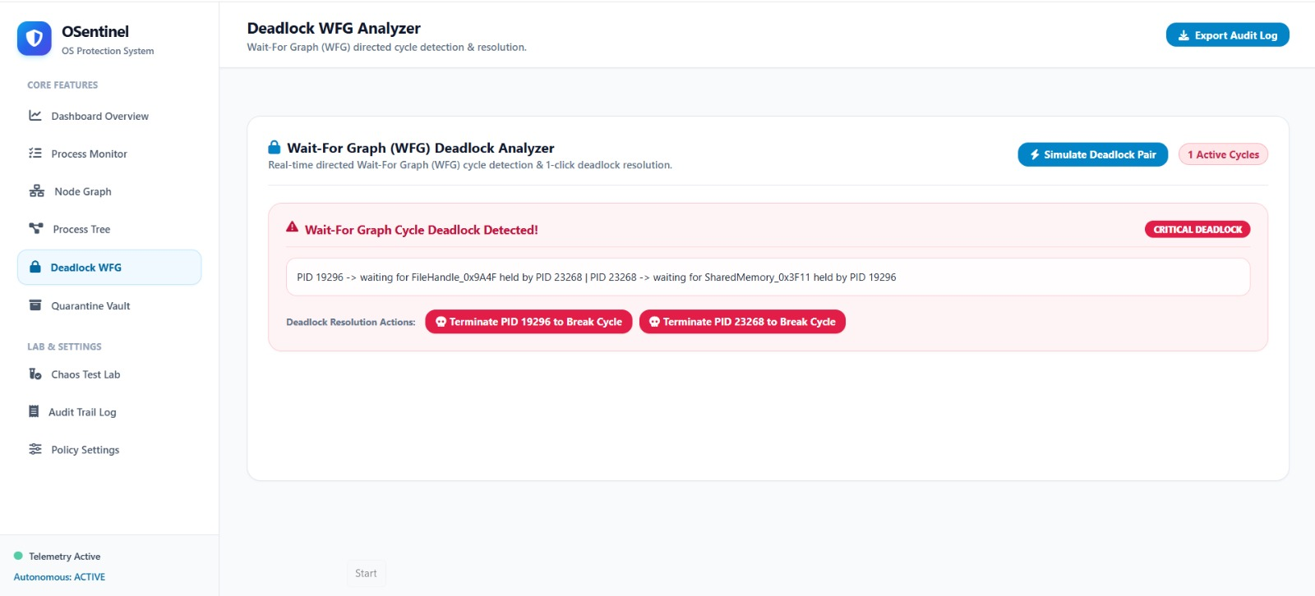
Module 3: Wait-For Graph Deadlock Analyzer

Slide 11
Module 4: Risk Scoring & Quarantine Isolation Vault
Purpose: Evaluate process threat level and isolate dangerous processes.
Risk Levels:
0–24: Healthy
25–49: Warning
50–74: Suspicious
75–100: Critical
Risk Formula: R = min(100, Σ Wi × Ai)
Isolation Actions:
Reduce process priority.
Restrict CPU affinity.
Suspend process threads.
Maintain isolation records.

Slide 12
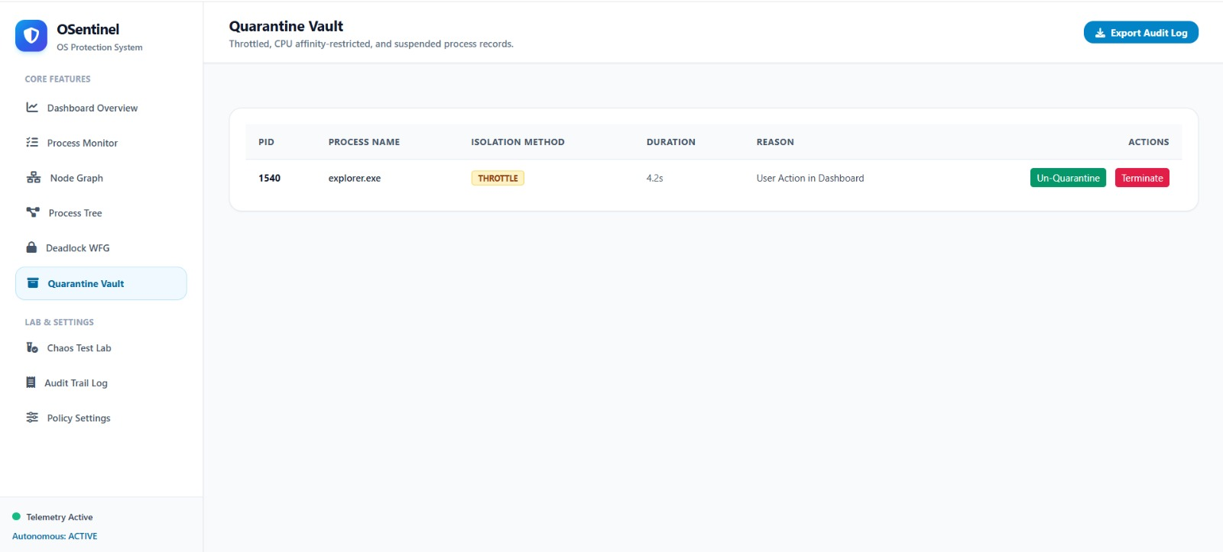
Module 4: Risk Scoring & Quarantine Isolation Vault

Slide 13
Module 5: Autonomous Self-Recovery & Chaos Lab
Purpose: Automatically recover abnormal processes and test system response.
Recovery Cycle:
Detect → Analyze → Decide → Recover → Verify
Chaos Lab:
Simulates orphan processes.
Generates CPU load.
Simulates memory leaks.
Creates fork bomb scenarios. a
Generates deadlock pairs.
This allows the system to demonstrate real-time detection and recovery.

Slide 14
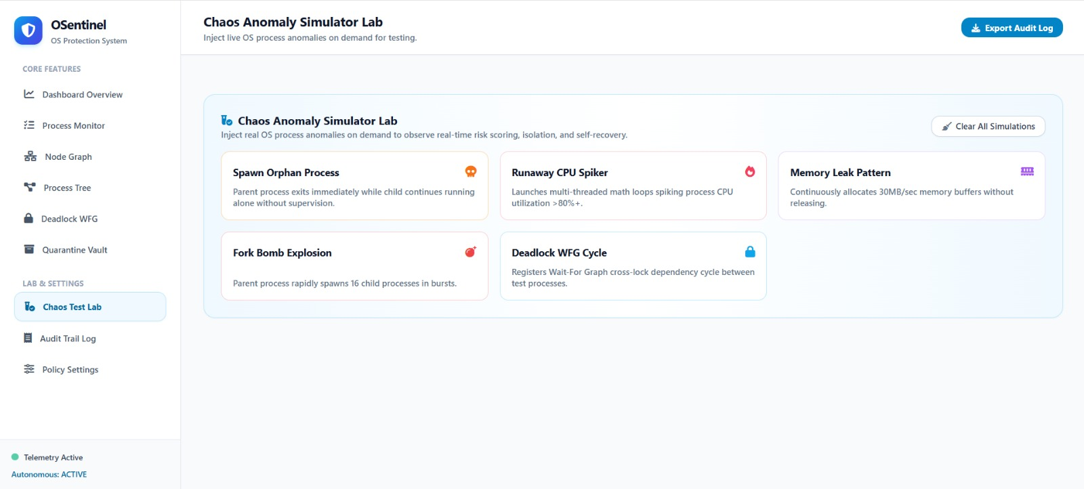
Module 5: Autonomous Self-Recovery & Chaos Lab

Slide 15
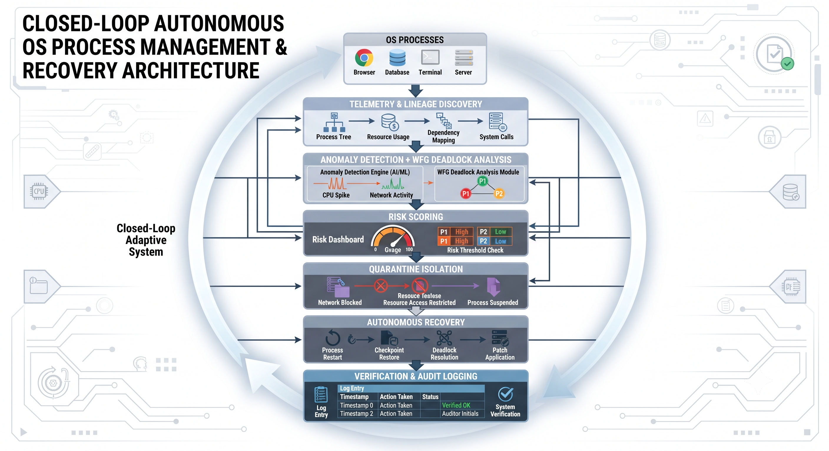
System Architecture
OSentinel forms a closed-loop from telemetry capture through verification:
OS Processes → Telemetry & Lineage Discovery
Anomaly Detection → WFG Deadlock Analysis
Risk Scoring → Quarantine Isolation
Autonomous Recovery → Verification & Audit Logging

Slide 16
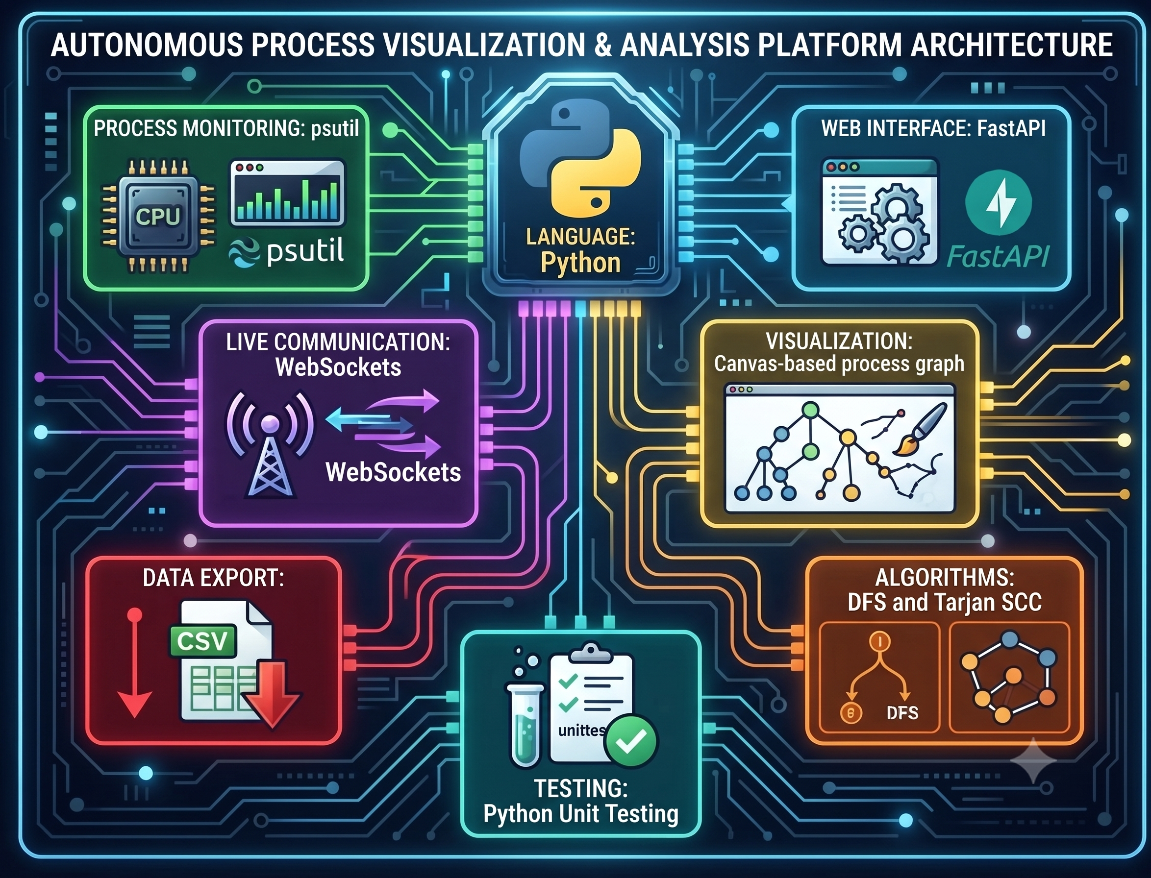
Technologies Used
Language: Python
Process Monitoring: psutil
Web Interface: FastAPI
Live Communication: WebSockets
Visualization: Canvas-based process graph
Data Export: CSV
Algorithms: DFS and Tarjan SCC
Testing: Python Unit Testing

Slide 17
Traditional Method vs OSentinel
Traditional Monitoring | OSentinel
Manual observation | Autonomous monitoring
Static process information | Live telemetry
Basic process visibility | Behavioral anomaly detection
Manual deadlock analysis | Automatic WFG analysis
Manual process termination | Automated quarantine

Slide 18

Expected Output
The system will display:
Live process telemetry.
Process hierarchy visualization.
Detected anomaly types.
Deadlock cycle identification.
Risk score and threat tier.
Quarantine status.
Recovery actions.
Audit history.

Slide 19
Future Enhancements
Machine-learning-based anomaly prediction.
Advanced malware behavior detection.
Adaptive risk scoring.
Cross-system process monitoring.
Advanced sandbox-based isolation.
Cloud-based monitoring and analytics.

Slide 20
Conclusion
OSentinel provides an autonomous approach to OS process protection.
It combines telemetry, anomaly detection, deadlock analysis, risk scoring, isolation, and recovery.
The closed-loop architecture enables automatic response to abnormal process behavior.
The system improves process visibility, system stability, and recovery automation.

Slide 21

THANK YOU

