Slide 1

Compressive spectral anomaly detection
Vishwanath Saragadam , Jian Wang,
Xin Li, Aswin Sankaranarayanan
Notes:
Hello everyone. I will be giving a talk on compressive spectral anomaly detection
Hyperspectral images are used for identifying material composition of a scene and one of the applications is anomaly detection.
In this talk, I will be presenting a compressive imager to efficiently and directly detect anomalies, thus reducing the measurement load

Slide 2
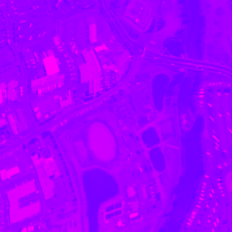
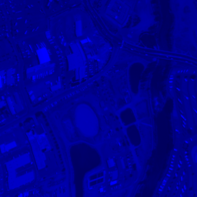
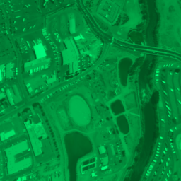
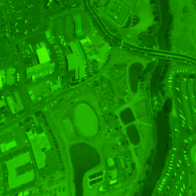

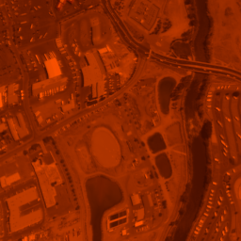
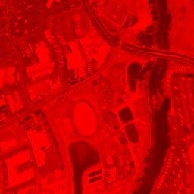


Hyperspectral images
Information as a function of space and wavelength
Wavelength
400nm
$$λ$$
2400nm
Space
$$H(x,y,λ)$$
Data from SpecTIR
Notes:
Alright, so let’s look at an ubiquitous modality of imaging, the hyperspectral data
Hyperspectral images capture information as a function of space and wavelength,
What it means is that each pixel in the image captures variations across wavelength

Slide 3
Applications of spectral data
material classification
target/anomaly detection
object recognition
Data from SpecTIR
Notes:
The availability of spectral information at each pixel enables numerous applications, including, but not limited to
Material classification
Object recognition
Target/anomaly detection
Of these methods, Anomaly detection is of interest in this presentation

Slide 4


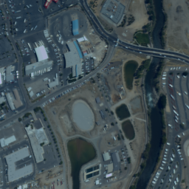


Anomaly detection
Spectrum of anomalies significantly different from background
Far fewer than signal dimension
Background
400nm
$$λ$$
2400nm
Anomaly
Data from SpecTIR
400nm
$$λ$$
2400nm
Notes:
An anomaly is defined as anything which seems out of place
In case of hyperspectral images, this means that anomalous pixels have spectrum significantly different from the background
By definition, such anomalous pixels are far fewer than the signal dimension itself.

Slide 5


Acquisition & detection wasteful
Traditional method
Acquire the complete hyperspectral image, then detect
Inefficient as it throws away most of the data
Hyperspectral cameras costly and time consuming
Limited data bandwidth of ADC
Splitting of light into wavelengths
Anomalies occupy only 4% of spatial data
256X256X356
266 outliers
Data from SpecTIR
Notes:
So if we want to detect anomalies, the natural task is to completely measure the data cube and then detect anomalies
However, this means 99% of the data is thrown away
This matters even more, as hyperspectral cameras are quite costly and need a long time to acquire.
So clearly we need an efficient technique, since we only interested in less than 1% of the data.

Slide 6
Hyperspectal image signal model
Can be decomposed as low rank and sparse signals
Low rank
Sparse
Background
Anomalies
Data from SpecTIR
Notes:
Fortunately, hyperspectral images aren’t too random
In fact, they have a very concise signal model, of a decomposition of low rank and sparse signals
In this case, the low rank contribution comes from background, since only few materials will contribute to background
On the other hand, anomalies are far fewer in number, contributing to the sparse part.

Slide 7
Anomaly detection & sparse signals
Anomaly detection = sparse signal estimation
Provided we remove the background
Remove the background
Sparse signal
How do we efficiently separate the two?
Data from SpecTIR
Notes:
Immediately, we can see that anomaly detection is a very sparse signal acquisition problem,
Provided the background is removed
My contribution is in the form of a two state imager which does exactly this
By removing background spectra, we show that anomaly detection nicely boils down to a sparse signal sensing problem

Slide 8




Spatially-coded spectrometer
Camera performs spatial coding $y_{i}\left(λ\right)=〈φ_{i}\left(x, y\right), H\left(x, y, λ\right)〉$
Obtains spectral measurements $y_{i,k}=y_{i}\left(λ_{k}\right)$
$$〈 , 〉=$$
400nm
$$λ$$
2400nm
Spatial coding – Inner product over space
Spectral measurement
Data from SpecTIR
Notes:
Okay so time to talk about what kind of measurement system we have at hand
We have a camera which does spatial coding
Essentially, our camera takes an inner product between a certain pattern and our hyperspectral camera, giving spectral measurements

Slide 9
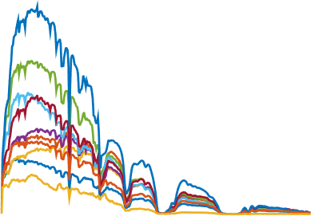
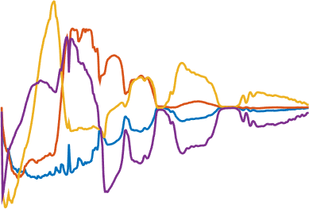
A two-stage imager
Stage 1 (Subspace estimation):
Step 1: Estimating background spectrum
Need knowledge of the background
Estimate it from a few samples
400nm
$$λ$$
2400nm
400nm
$$λ$$
2400nm
Pick random spatial locations
Measure spectrum
Estimate subspace
Data from SpecTIR
Notes:
So, if we want to remove the contribution of background, we need to know what the background means
If we randomly sample points in a scene, we will get spectrum that very likely represents most of the background points
So we go ahead and find a subspace for the background spectrum
Cosmetics, text alignment, small letters
No full stops in any sentence

Slide 10


A two-stage imager
Stage 1 (Subspace estimation):
Step 1: Estimating background spectrum
Need knowledge of the background
Estimate it from a few samples
Stage 2 (Anomaly detection):
Step 1: Obtain spatially-coded measurements
$$〈 , 〉$$
$$Y=ΦX$$
400nm
$$λ$$
2400nm
Data from SpecTIR
Notes:
So, if we want to remove the contribution of background, we need to know what the background means
If we randomly sample points in a scene, we will get spectrum that very likely represents most of the background points
So we go ahead and find a subspace for the background spectrum
Cosmetics, text alignment, small letters
No full stops in any sentence

Slide 11
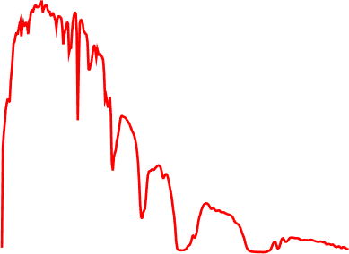
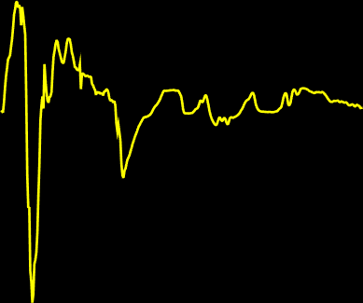


A two-stage imager
Stage 1 (Subspace estimation):
Step 1: Estimating background spectrum
Need knowledge of the background
Estimate it from a few samples
Stage 2 (Anomaly detection):
Step 1: Obtain spatially-coded measurements
$$〈 , 〉$$
$$Y=Φ\left(L+S\right)$$
400nm
$$λ$$
2400nm
400nm
$$λ$$
2400nm
Data from SpecTIR
Notes:
So, if we want to remove the contribution of background, we need to know what the background means
If we randomly sample points in a scene, we will get spectrum that very likely represents most of the background points
So we go ahead and find a subspace for the background spectrum
Cosmetics, text alignment, small letters
No full stops in any sentence

Slide 12

A two-stage imager
Stage 1 (Subspace estimation):
Step 1: Estimating background spectrum
Need knowledge of the background
Estimate it from a few samples
Stage 2 (Anomaly detection):
Step 1: Obtain spatially-coded measurements
Step 2: Projection
On to complementary subspace of background
$$〈 , 〉$$
$$Y=Φ\left(L+S\right)U_{⊥}$$
400nm
$$λ$$
2400nm
400nm
$$λ$$
2400nm
Data from SpecTIR
Notes:
So, if we want to remove the contribution of background, we need to know what the background means
If we randomly sample points in a scene, we will get spectrum that very likely represents most of the background points
So we go ahead and find a subspace for the background spectrum
Cosmetics, text alignment, small letters
No full stops in any sentence

Slide 13


A two-stage imager
Stage 1 (Subspace estimation):
Step 1: Estimating background spectrum
Need knowledge of the background
Estimate it from a few samples
Stage 2 (Anomaly detection):
Step 1: Obtain spatially-coded measurements
Step 2: Projection
On to complementary subspace of background
Step 3: Solve as sparse approximation problem
$$〈 , 〉$$
$$Y=Φ\tilde{S}$$
400nm
$$λ$$
2400nm
Data from SpecTIR
Notes:
So, if we want to remove the contribution of background, we need to know what the background means
If we randomly sample points in a scene, we will get spectrum that very likely represents most of the background points
So we go ahead and find a subspace for the background spectrum
Cosmetics, text alignment, small letters
No full stops in any sentence

Slide 14
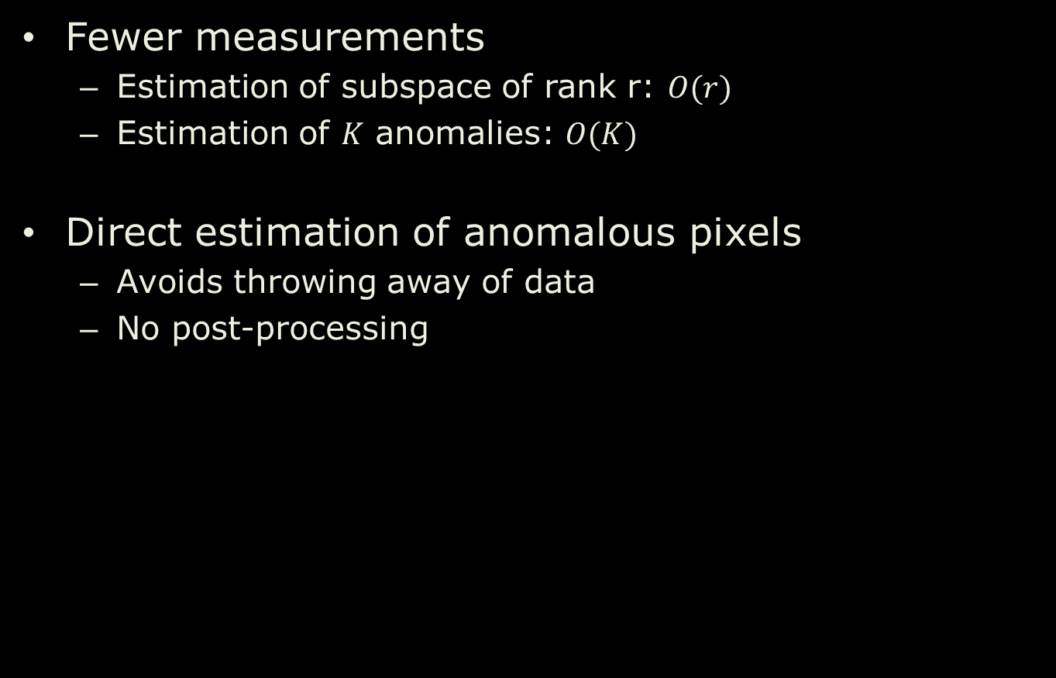
Advantages
Fewer measurements
Estimation of subspace of rank r: $O(r)$
Estimation of $K$ anomalies: $O(K)$
Direct estimation of anomalous pixels
Avoids throwing away of data
No post-processing
Notes:
There is a visible reduction in the number of measurements
For estimating the subspace, we need measurements proportional to the subspace
For estimating K outliers, we need measurements proportional to K
This is far less than dimension of the hyperspectral image.
Make sure your O(K) is correct.

Slide 15


Simulation experiments
256x256x356 HSI of Deepwater horizon oil spill
200 Detected anomalies with 500 measurements for subspace and 5000 measurements for anomalies
Data from SpecTIR

Slide 16
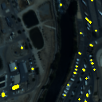
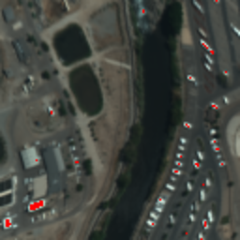
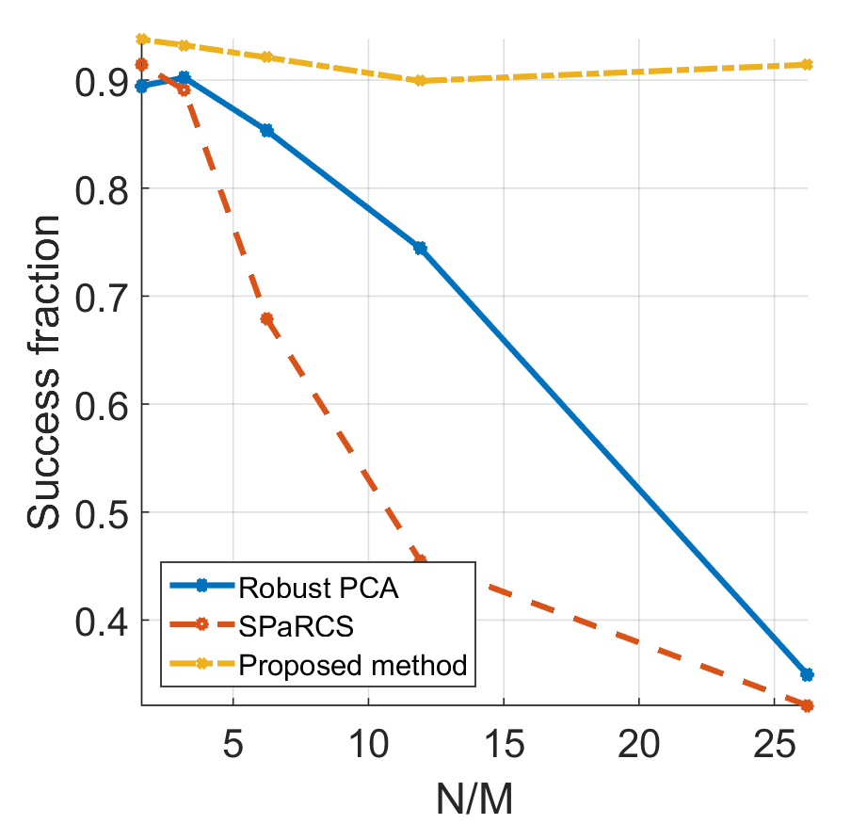
Performance metrics
128x128x360 image with 79 added outliers marked in yellow
Fraction of correctly detected outliers with various methods with 60dB added noise
Data from SpecTIR
Notes:
Our method also outperforms other compressive sensing techniques which jointly recover a low rank and sparse matrix such as SPaRCS and Robust PCA
Image on the left shows the test image we used for characterizing the performance of various algorithm. We created the image by forcing the image to be low rank and sparse with 483 anomalous pixels

Slide 17

Prototype
objective lens
DMD
spatial coding
scene
spectrometer
condenser lens
collimator
slit
spectral meas.
diffraction grating
focusing lens
line sensor
Notes:
So coming back to what our imager looks like
As I mentioned, we need an optical setup that measure spectral with spatial coding
Very simple solution – have a DMD for spatial coding
And a spectrometer for spectral measurements
We also built our own spectrometer.

Slide 18
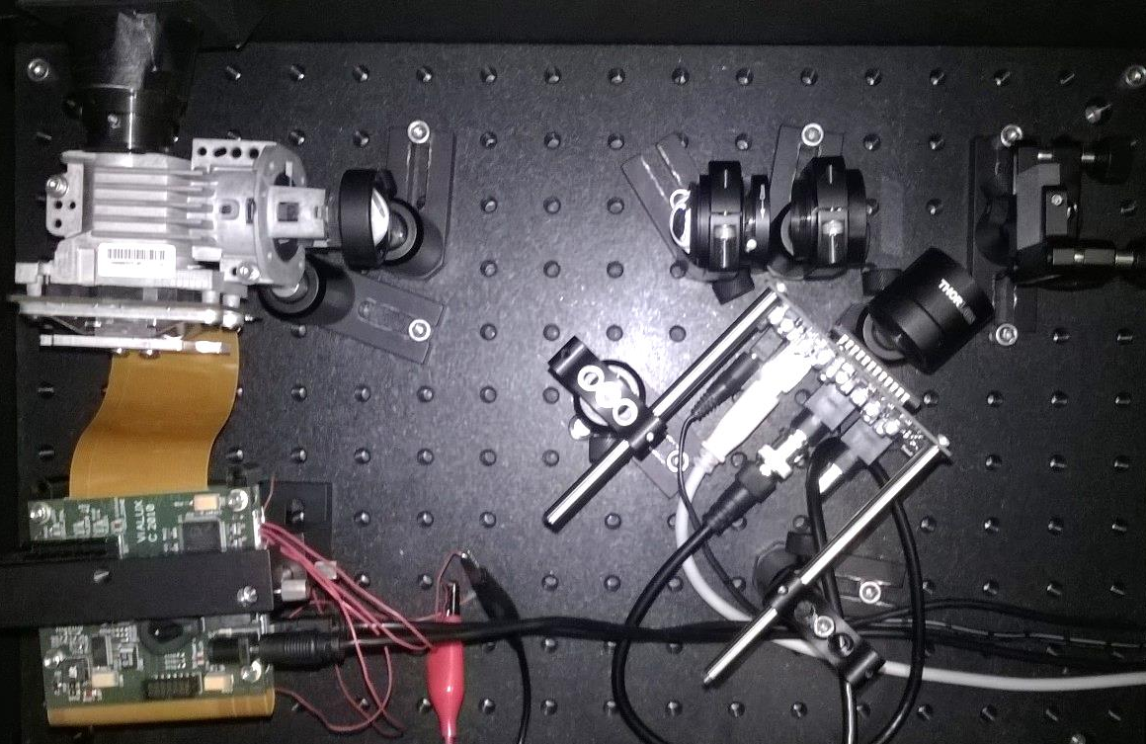
Hardware setup
objective
collimating lens
grating
DMD
focusing lens
pinhole
focusing lens
line sensor

Slide 19


Experiments
64x64x51 image. Anomalies in red circle
64 measurements for subspace, 250 for anomalies, 10 anomalies detected
Notes:
We performed anomaly detection with data obtained by the imager we built
The image on the left shows the scene we used for anomaly detection, which consists of printed text on paper. The gray pixels in the red circle consist of anomalies formed by placing a white LED light behind a diffuser
The image on the right shows 10 anomalies marked in red estimated by obtaining 64 measurements for subspace estimate and 250 spatially multiplexed measurements for estimating the outlier
Again, our algorithm very well estimates the anomalous pixels

Slide 20
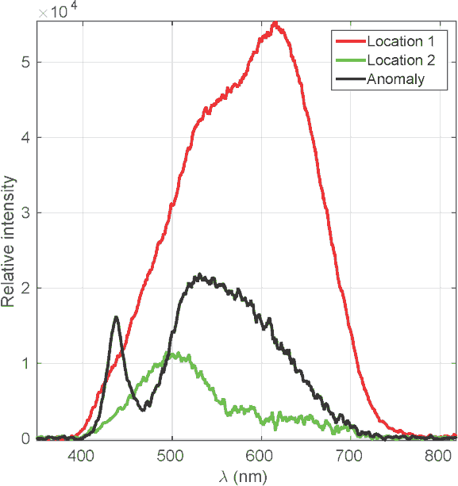

Experiments
Image of scene
Spectral signatures at some representative locations
Notes:
We show spectral signatures at three different locations
Notice that the anomalous pixel has a distinct peak in blue wavelength region, which makes it an anomaly in the scene
DMD grating issues, have a backup slide.
Change bright line to a darker shade?
Photon noise from BG will kill the results, what do we do?
Adaptive measurements is the answer.

Slide 21
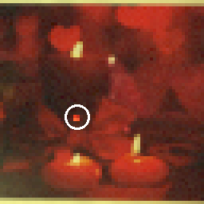
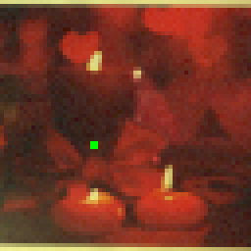
Experiments
64x64x51 image. Anomalies in red circle
64 measurements for subspace, 250 for anomalies, 10 anomalies detected
Notes:
Our second experiment consisted of a scene printed on paper which is predominantly red.
Four pixels within the white circle were illuminated by a red laser. The red laser is indistinguishable from the background
The image on the right shows 4 anomalies marked in green estimated by obtaining 64 measurements for subspace estimate and 100 spatially multiplexed measurements for estimating the outlier
Again, our algorithm very well estimates the anomalous pixels
Why is it challenging?
Mention that a RGB camera can’t do a good job, and hence this scene is hard

Slide 22
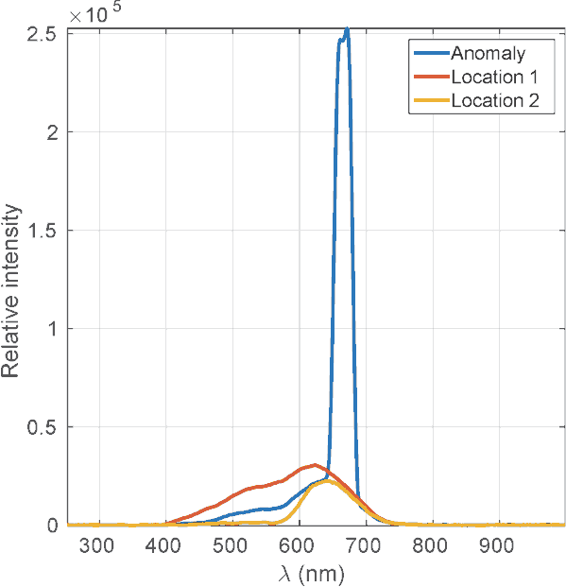

Experiments
Image of scene
Spectral signatures at some representative locations
Notes:
We show spectral signatures at three different locations
Notice that the anomalous pixel has a strong peak in the red region, corresponding to the narrow band laser light
Get rid of top, bottom edges and add a bright frame to differentiate if from the slide background.

Slide 23
Conclusion
Stage 1:
Estimate subspace for background
Stage 2:
Obtain spatially multiplexed measurements of scene
Take projection onto complementary subspace and solve as sparse approximation problem
Our method outperforms many other detection methods
Flowchart of proposed algorithm
Notes:
In conclusion, we proposed a two stage sensing mechanism to estimate anomalies in hyperspectral images
Simulations and real experiments show the superiority of our algorithm in terms of number of measurements needed and estimation accuracy.
Thank you.

Slide 24
Thank you

Slide 25
Extra slides

Slide 26
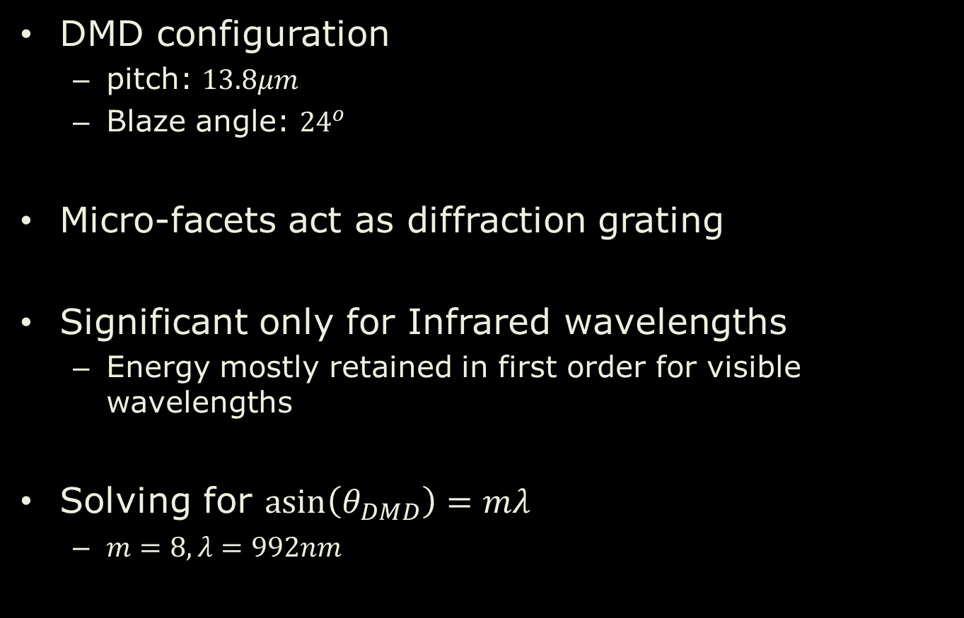
Effects of DMD as a grating
DMD configuration
pitch: $13.8μm$
Blaze angle: ${24}^{o}$
Micro-facets act as diffraction grating
Significant only for Infrared wavelengths
Energy mostly retained in first order for visible wavelengths
Solving for $\operatorname{asin}\left(θ_{DMD}\right)=mλ$
$m=8, λ=992nm$

Slide 27

Noise due to background removal
Energy of background much greater than anomalies
Photon noise of background comparable to anomalies
May reduce performance
This paper models $Y=ΦH+E, E∼N(0,σ^{2})$
Correct model to use $Y=ΦX+E, X∼𝒳,E∼𝒩(0, σ^{2})$
$𝒳\left(x,y,λ\right)∼poisson(H\left(x,y,λ\right))$

Slide 28
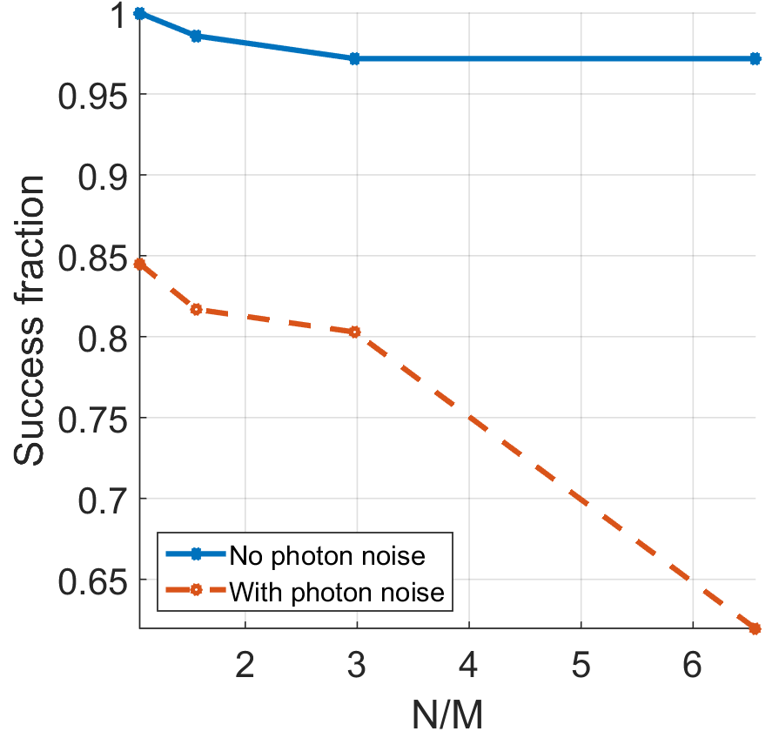
Noise due to background removal
Comparison of our method without and photon noise and 60 dB measurement noise

Slide 29
Adaptive extension
Problem with direct sensing
Photon noise from background overwhelms anomalies
Solution: Don’t detect in background area
Step 1: Estimate background as before
Step 2: Take a few spatiall-coded measurements to get an approximate area of background pixels
Step 3: Sense anomalies in non-background pixels
Planned for future work

Slide 30
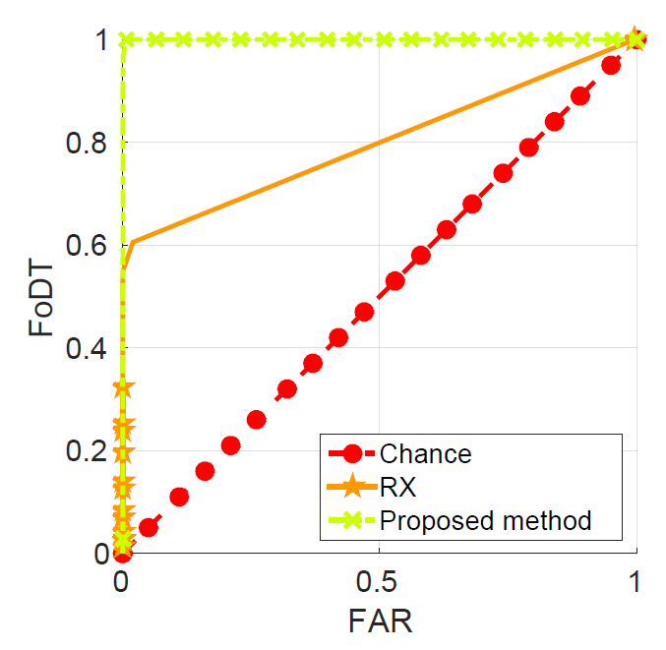
Performance metrics
Receiver operating characteristic on a 128x128x360 image with 71 artificially added anomalous spectra.
Notes:
Finally, our algorithm outperforms the Reed Xiaoli detector in detecting anomalies
We artificially inserted 71 anomalous targets in a hyperspectral image and performed anomaly detection with our proposed algorithm and
The Receiver operating characteristic curve plots true positives vs false positive
From the plot, it is evident that our method has a larger area under the curve than the RX detector

Slide 31
Reed-Xiaoli detector
Constant False Alarm Rate detector
Gaussian Log-likelihood Ratio Test
Background assumed to follow Gaussian distribution
Anomalies have low likelihood
Vanilla version a local anomaly detecto
Local patch of hyperspectral image.
Covariance computed over this area
Mean computed over this red area
Guard area. No outliers assumed in this yellow area
Point under test to classify as anomaly

