Slide 1



SMART INDIA HACKATHON 2026
  Problem Statement ID - 26135
  Problem Statement Title -
  Theme - Miscellaneous
  PS Category - Software
  Team ID -
  Team Name - Code Society
Difficulties in tracking employment outcomes,
skill gaps, and the impact of skilling initiatives

Slide 2





CONTINUUM
Longitudinal Livelihood Outcomes Intelligence Platform
Code Society
Problem:
Current skilling portals lose visibility after certification because fragmented student identities, frequent contact changes, and disconnected databases make long-term tracking impossible. Additionally, low employer response rates leave diverse outcomes—like self-employment, apprenticeships, and gig work—completely unmonitored. Without verifiable data on multi-year retention and wage progression, policymakers cannot identify real-world skill gaps or hold underperforming training providers accountable.
Our Idea:
Continuum is a longitudinal skilling-outcomes platform that connects training with real-world livelihood outcomes. It creates a consent-based, low-burden and privacy-conscious outcome record to track, verify and understand what happens after certification.
Proposed Solution:
Multi-Anchor Ledger: Unifies disconnected profiles via permanent digital anchors (Aadhaar, DigiLocker), maintaining contact even through phone updates and trainee migration.
Passive Verification: Eliminates reliance on manual employer reporting by pulling status signals directly from public registries like EPFO, NAPS, and Udyam.
Longitudinal Analytics: Tracks multi-year wage progression and records specific attrition causes to pinpoint real-world skill gaps and enforce provider accountability.
Innovation/Uniqueness:
Moves beyond certification and one-time placement to measure longitudinal livelihood outcomes.
Maintains identity and outcome continuity across changing trainee details, employers, locations and job roles.
Transforms fragmented outcome signals into actionable intelligence for programme improvement, provider accountability, resource allocation and policy.
2
Notes:
2

Slide 3










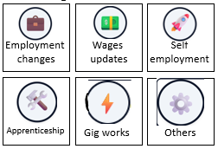





User Ecosystem
User Logs for self updations
Role Based access control(Admin/Trainer/student)
Profile Management
Multi-factor authentication
Identity and Access Management
Core Modules
Training and Learning Management
Progress and Performance Tracking
Placement and Internship Management
Alerts and Notifications
Data Sources
Student/Trainee
( View Progress/access resources)
Government authorized
sources
Dynamic Skill
Identity Graph
Identity continuity
Identity evolution
Identity recovery
Identity relationships
Trainer/Mentor
(add training, assess)
Employer/
Enterprises
sources
Placement Officer
( track placement, reports)
Trainee
evidence
Admin
Manages data , users, system
Longitudinal outcome Timeline
Outcome Analysis
Provider
Performance
Programme/Policy Actions
Provider improvement
Skill Gap interventions
Training adjustments
Funding recommendations
Verification and Confidence Scoring
Source identity
Evidence corroboration
Verification rules
Confidence score
Integrity/Signature
AI - Based Anomaly Detection
Identity match
Evidence intelligence
Outcome classification
Skill/role relevance
Anomaly detection
Temporal consistency
3M 6M 12M 24M
Skill Gap Intervention
Employmenttransitions
Wage
progression
Unknown/
Unemployment states
Skill/Role
relevance
Outcome Event Ledger
Economic Analysis
Attrition Patterns
Next Training Cohort
Continuous Feedback
Tracks longitudinal livelihood events
Multi anchor identity recovery
Verified
E-mail check
Training
Record verify
Digi Locker / e-KYC
verification
Additional anchors
Cross verify
Identity recovered
Update active anchor

Slide 4


FEASIBILITY AND VIABILITY
Code Society
OVERALL FEASIBILITY
ECONOMIC FEASIBILITY
PRACTICAL VIABILITY
Unified Profile Ledger: Consent-based trainee records successfully map across diverse training timelines.
Multi-Source Evidence: Merges government, employer, and user data signals to ensure high credential credibility.
Unified Metrics: Standardizes diverse career tracks into uniform cohort, provider, and district analytics.
Low-Burden Collection: Automated notifications drastically minimize manual calling costs and human resources.
Zero Infrastructure Waste: Operates through API connectors on top of existing platforms without replacing current infrastructure.
Phased Rollout: Begins with core outcome tracking before expanding to advanced verification algorithms.
Passive-First Tracking: Pulls authorized public infrastructure data signals first, using active follow-ups only as a backup.
Confidence Scoring: Cross-corroborates input data to assign reliability levels before updating the dashboard.
Insight-Driven Policy: Seamlessly translates identity continuity into automated, actionable course adjustments.
CHALLENGE → MITIGATION
Risk: Identity ambiguity
Mitigation: Multi-anchor identity recovery + confidence thresholds + human review.
Risk: Incomplete Outcome Evidence
Mitigation: Evidence hierarchy + Source corroboration + UNKNOWN state preservation.
Risk: External System Dependency
Mitigation: Connector abstraction layer + independent core platform.
Risk: Privacy and Consent
Mitigation: Consent-based collection + internal identifiers + minimum necessary data.
4
Notes:
4

Slide 5
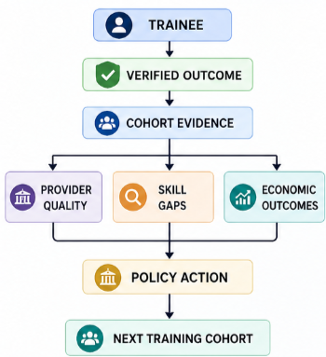
IMPACTS AND BENEFITS
Code Society
From One Trainee's Journey To Better Training Decisions
Direct Impact
on Target Users
Trainees
Continuous visibility into employment, retention, wages and livelihood progression after training.
Training Providers
Evidence to identify non-placement, attrition and skill mismatches and improve training outcomes.
Employers & Ecosystem
Better visibility into skill availability, job-role relevance and workforce outcomes.
Economic & Strategic Benefits
Smarter Resource Allocation
Direct funding and interventions towards programmes, providers and skills demonstrating stronger outcomes.
Lower Tracking Cost & Burden
Automated, assisted and evidence-based follow-ups reduce repetitive manual outcome collection.
Measurable Public Value
Longitudinal employment, wage, retention and livelihood evidence demonstrates the impact of skilling investments.
Strategic Impact
Outcome-Based Accountability
Enables objective comparison of courses, providers, programmes and regions.
Skill-Gap Intelligence
Reveals recurring gaps between training delivered and real-world job requirements.
Evidence-Based Policy
Transforms longitudinal outcomes into actionable intelligence for programme design, investment and policy.
5
Notes:
5

Slide 6
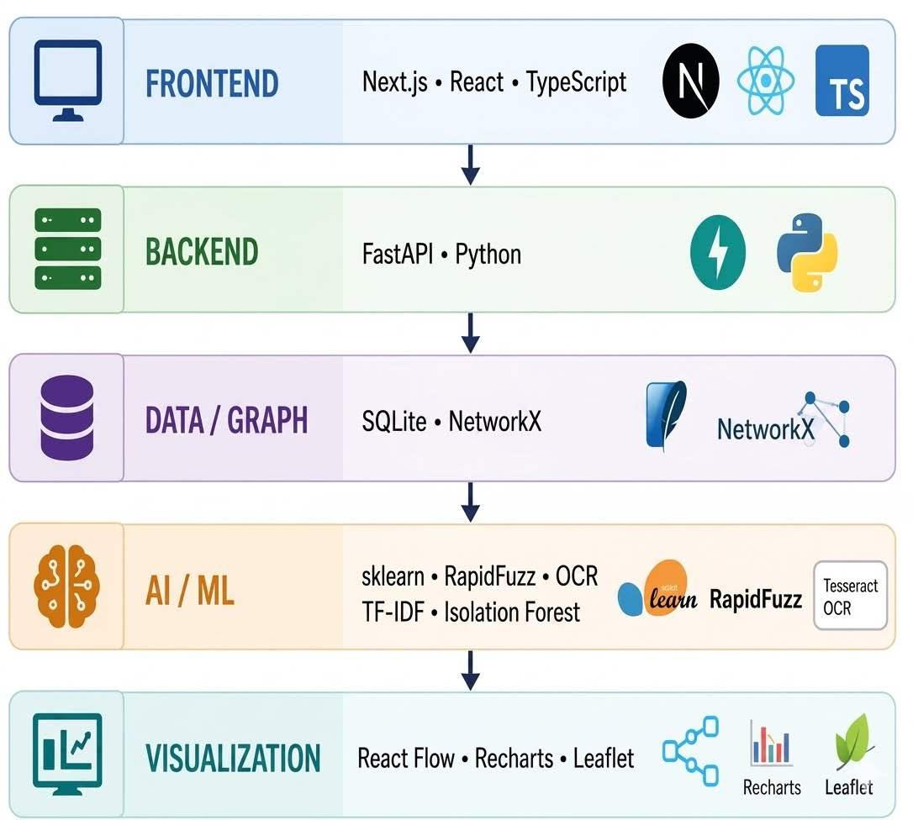
Code Society
RESEARCH-GROUNDED. TECHNOLOGY-READY.
Research & References
Technology architecture
Problem & Policy Context
  Government skilling & employment outcome documentation-https://www.niti.gov.in/node/2397
  PMKVY / Skill India Digital ecosystem documentation-https://www.skillindiadigital.gov.in/
Identity / Digital Infrastructure
  UIDAI — Aadhaar & Digital Identity Documentation
  Digi Locker — Digital Document Infrastructure https://www.digilocker.gov.in/
  API Setup - Government API Integration Platform -https://apisetu.gov.in/
  Udyam — MSME Registration & Enterprise Identity
Technology / Standards
  W3C — Verifiable Credentials Data Model-https://www.w3.org/TR/vc-data-model-2.0/
  Graph-based Identity & Entity Resolution Research
  Longitudinal Employment Outcome Research
  Explainable & Evidence-Aware Machine Learning Literature-https://arxiv.org/list/cs.AI/recent
The Identity Changes
The Training History shouldn’t
6
Notes:
6

