Slide 1
Installation and Site Live Snap

Slide 2
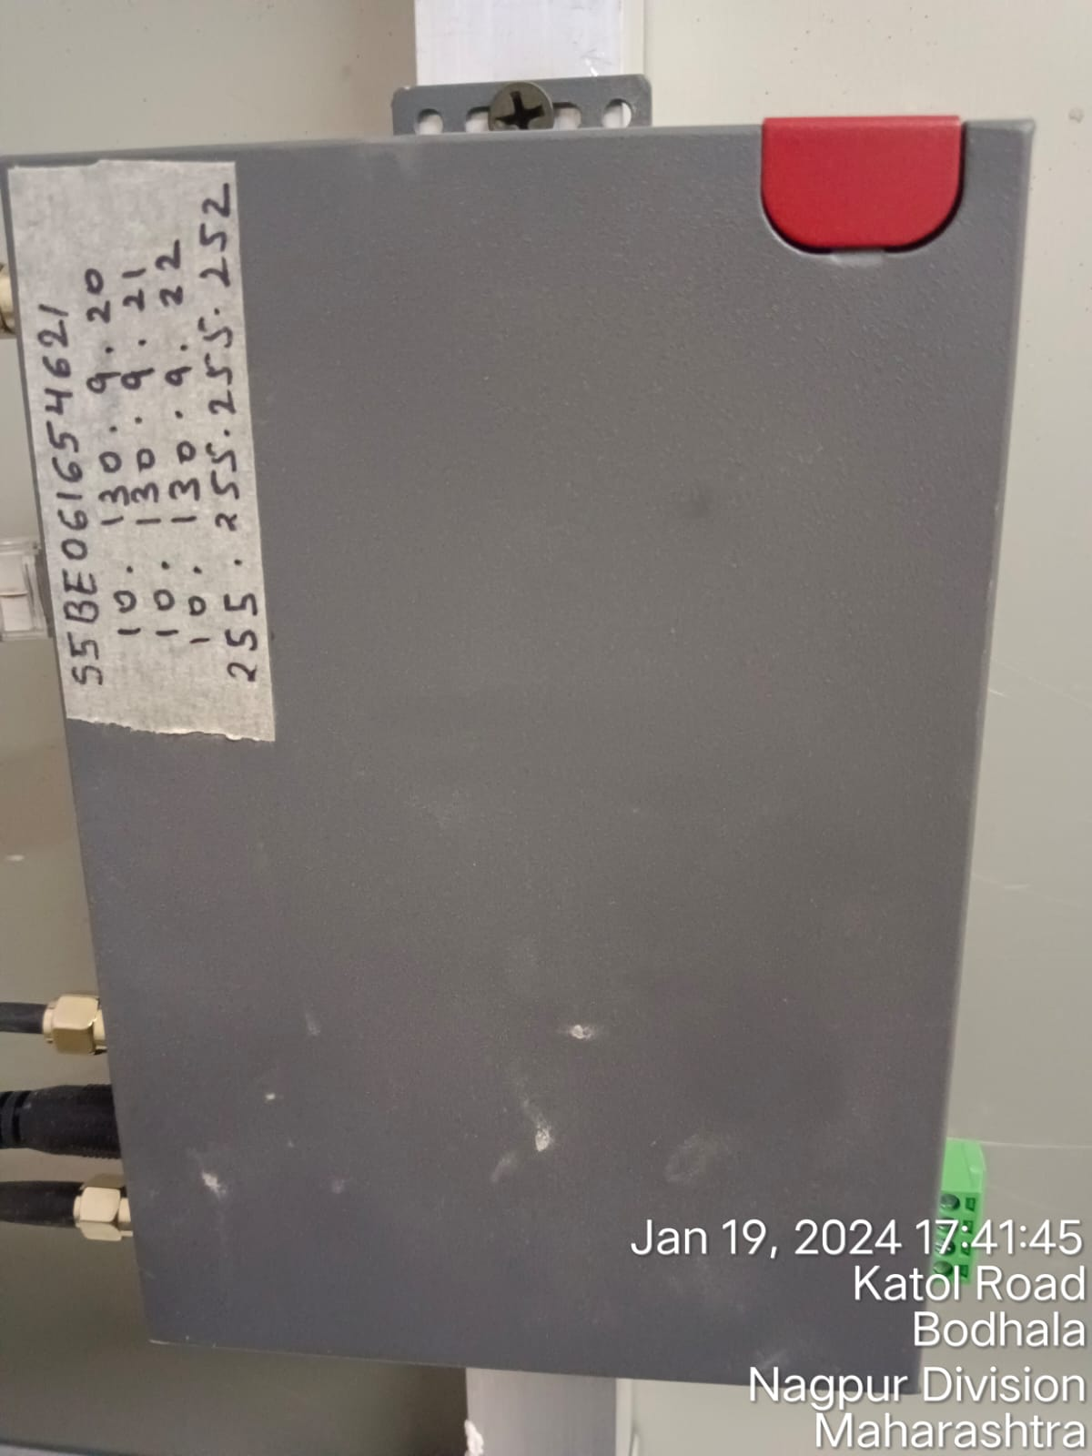
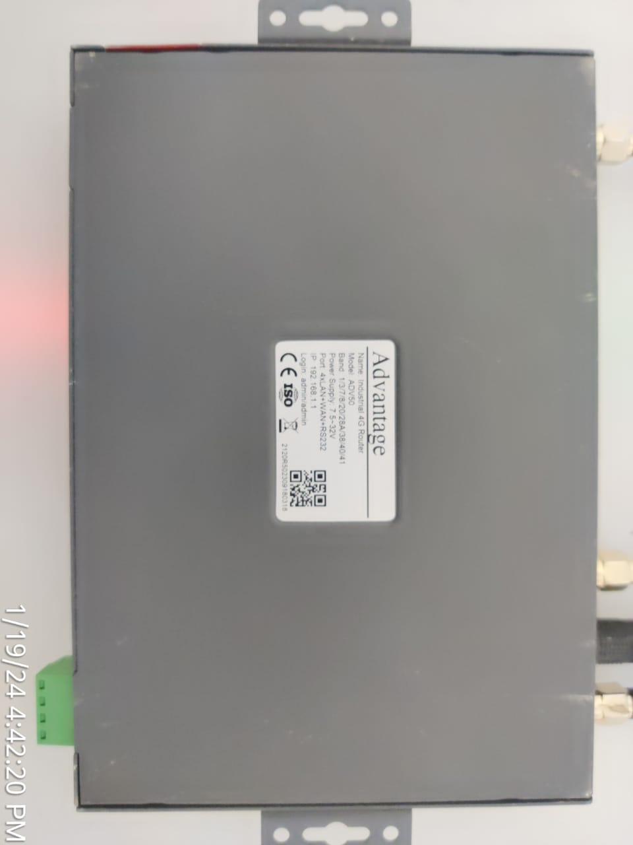
1. Router Front & Back Side Snap

Slide 3
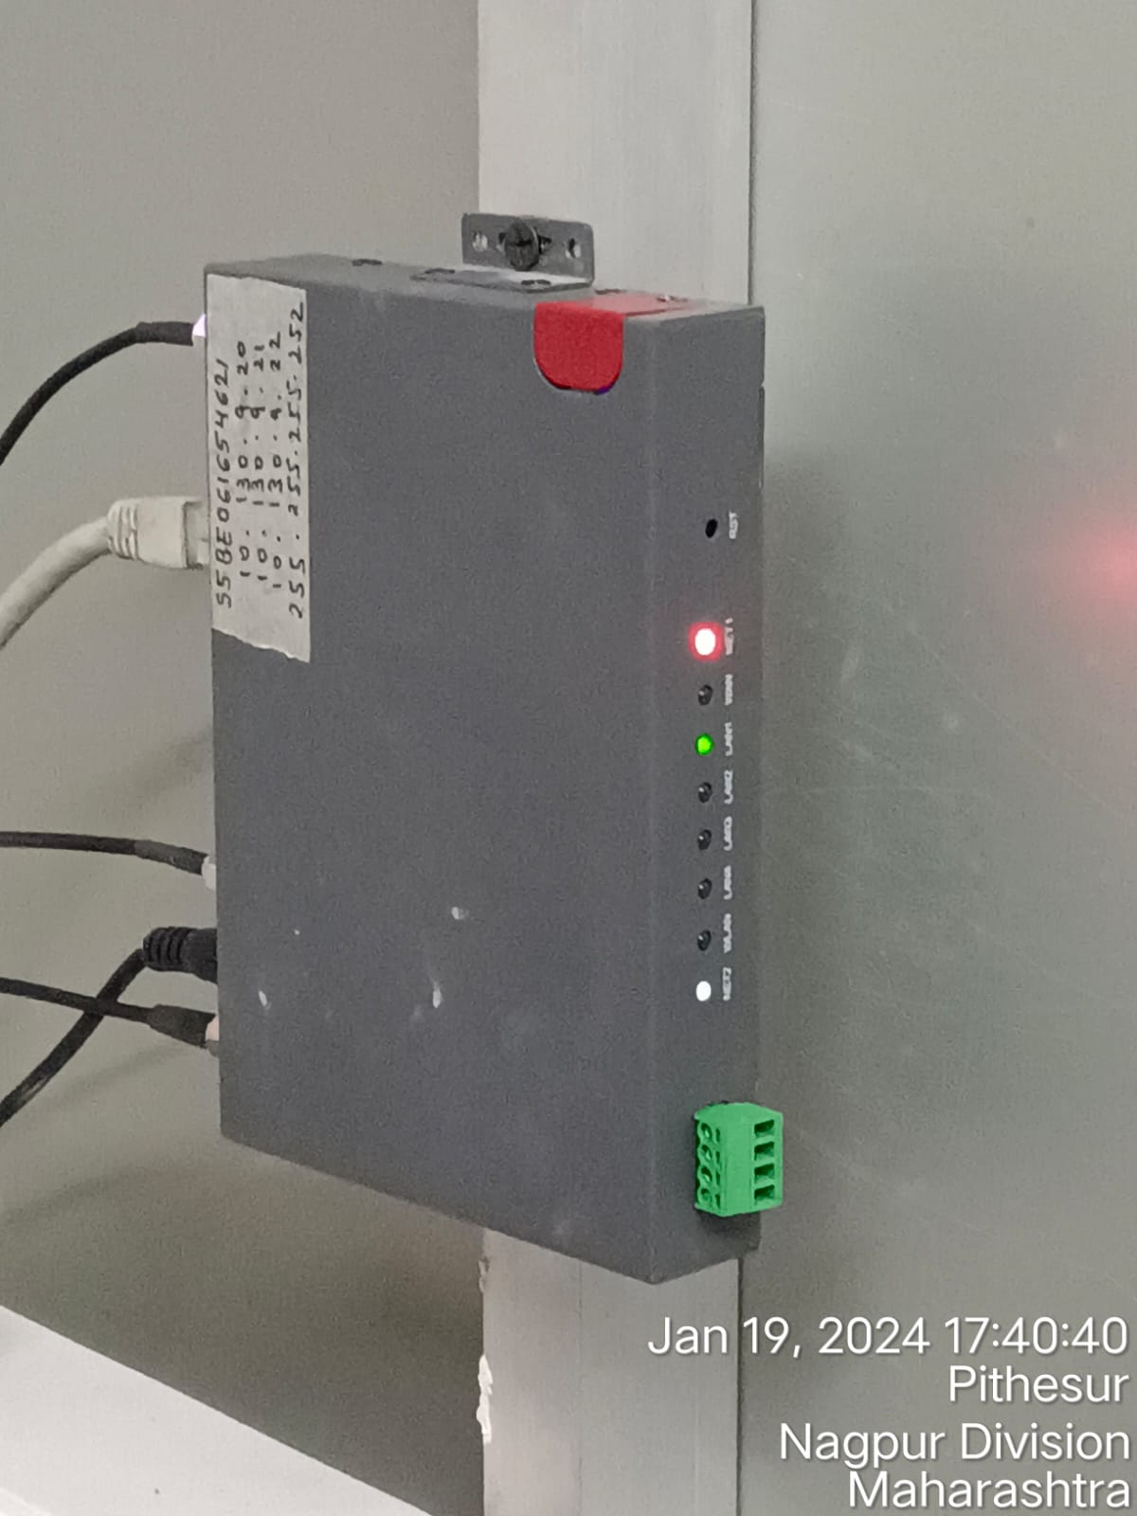
2. Router Installation Place Snap

Slide 4
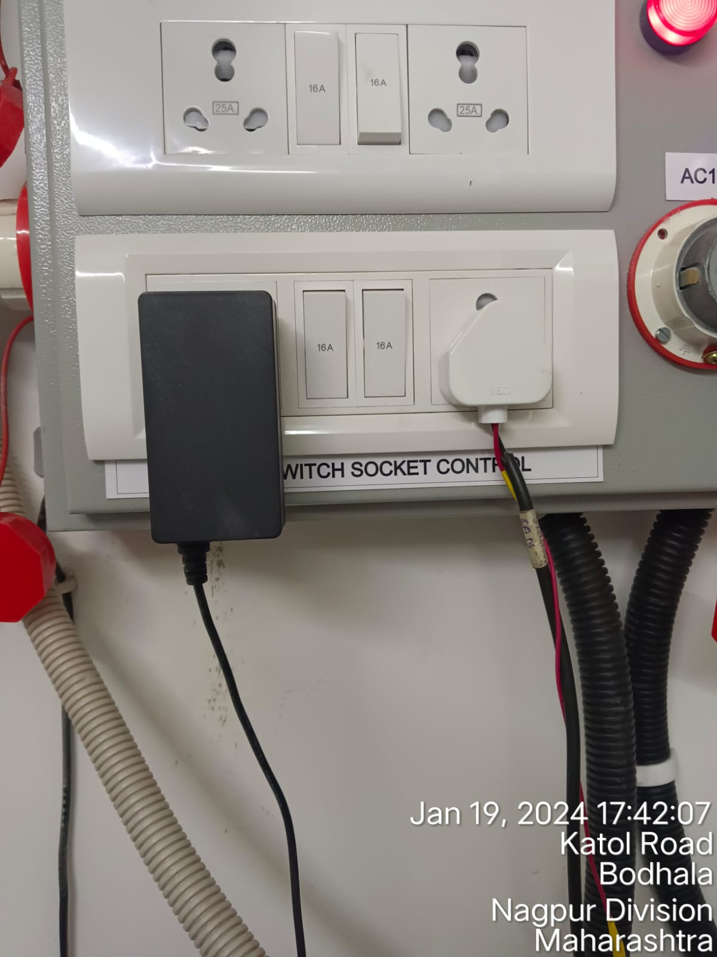
3. Adaptor Installation Place Snap

Slide 5
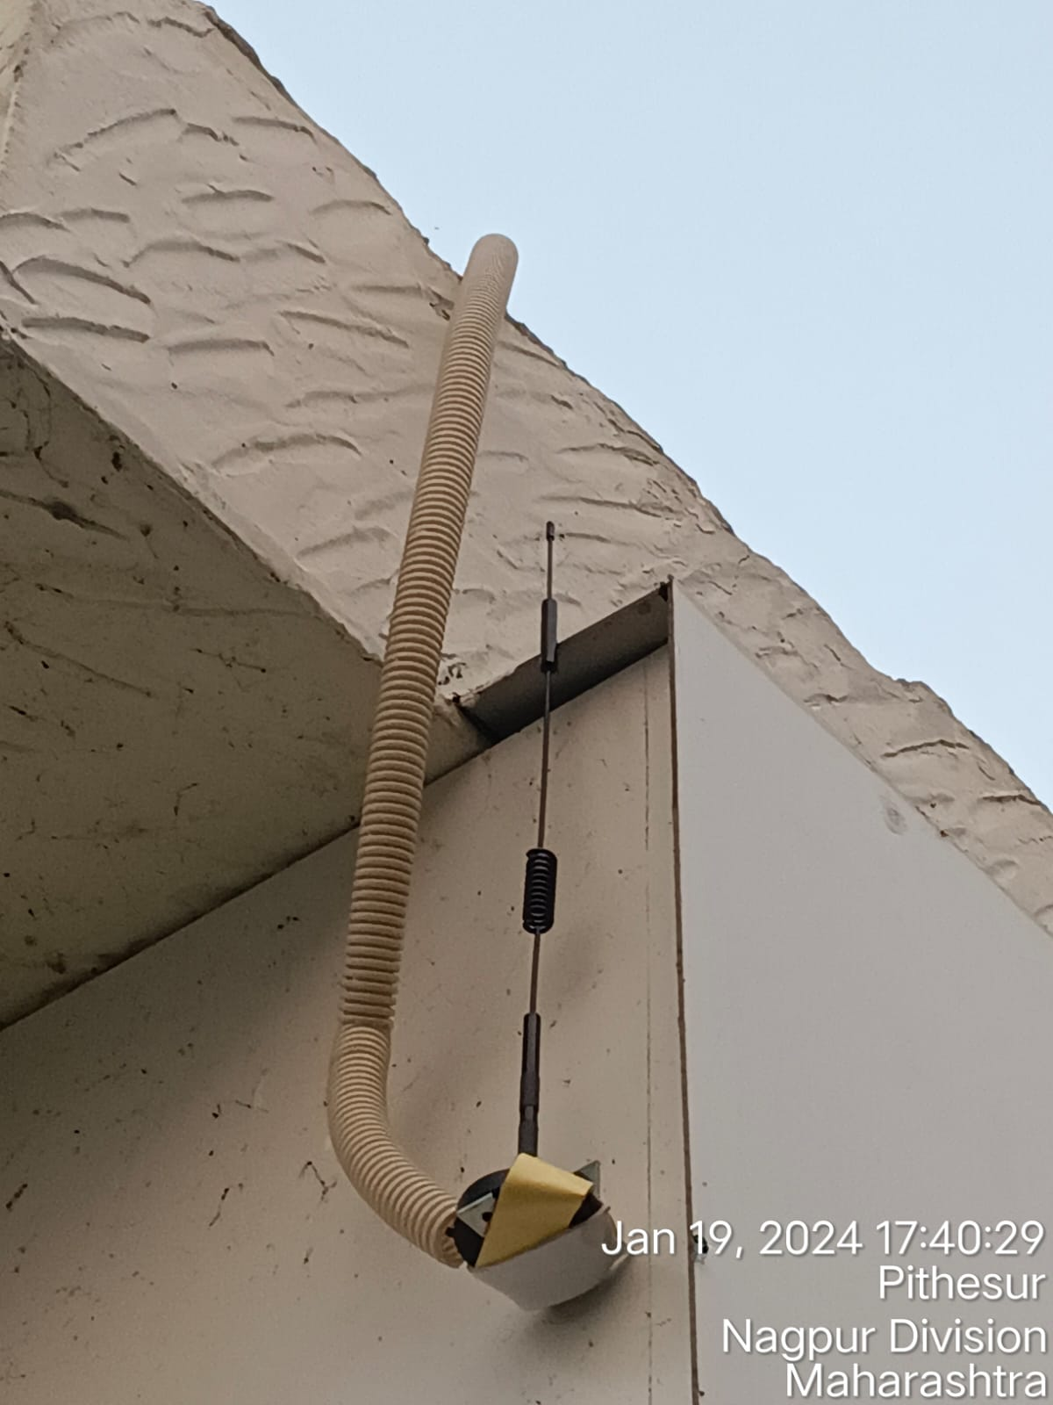
4. 1st Antenna Installation Snap

Slide 6
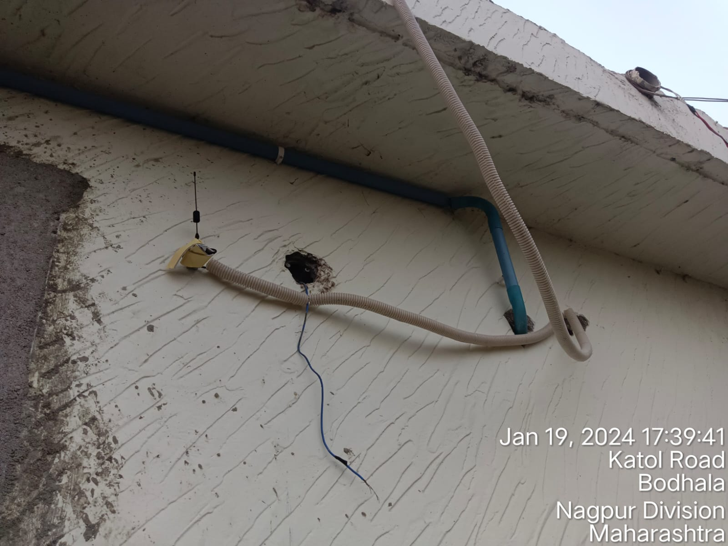
5. 2nd Antenna Installation Snap

Slide 7
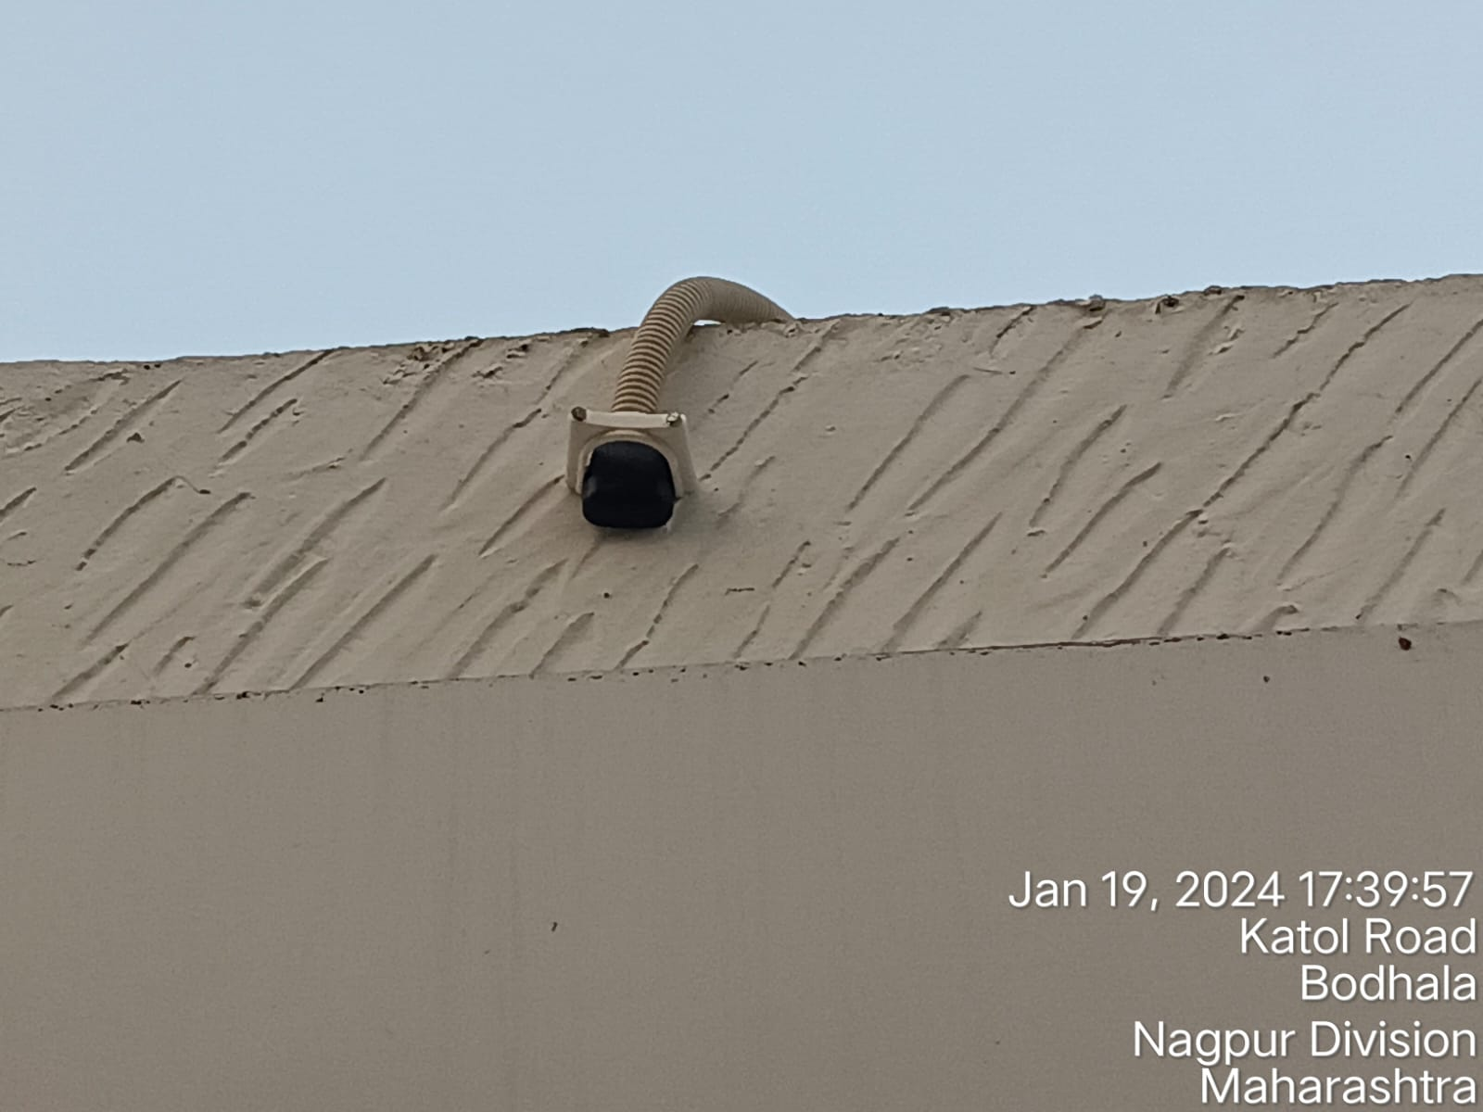
6. GPS Installation Place

Slide 8
7. Router Power On Snap

Slide 9
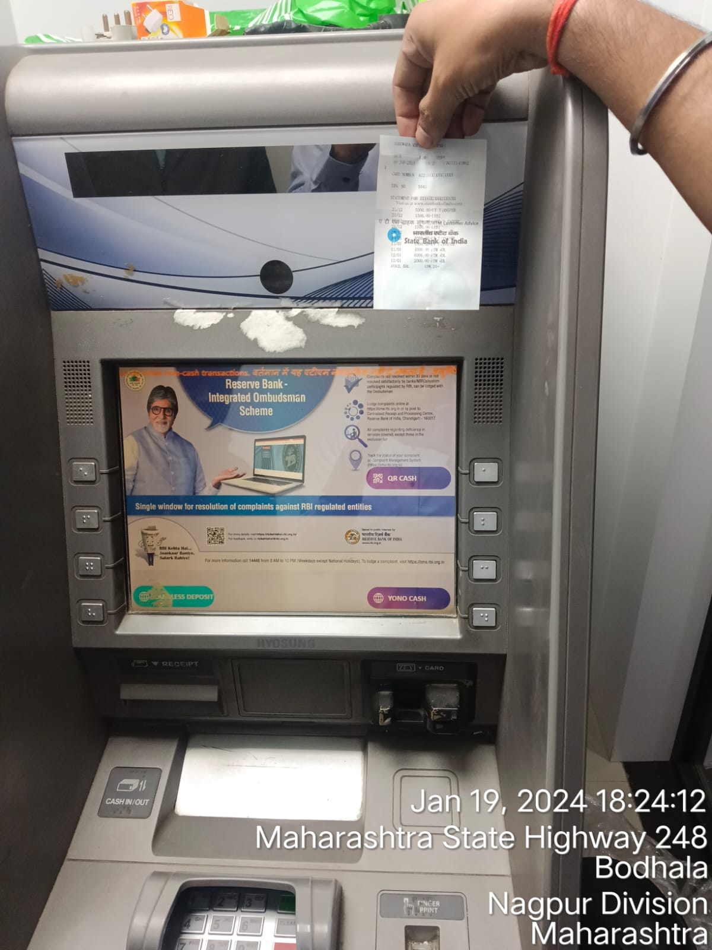
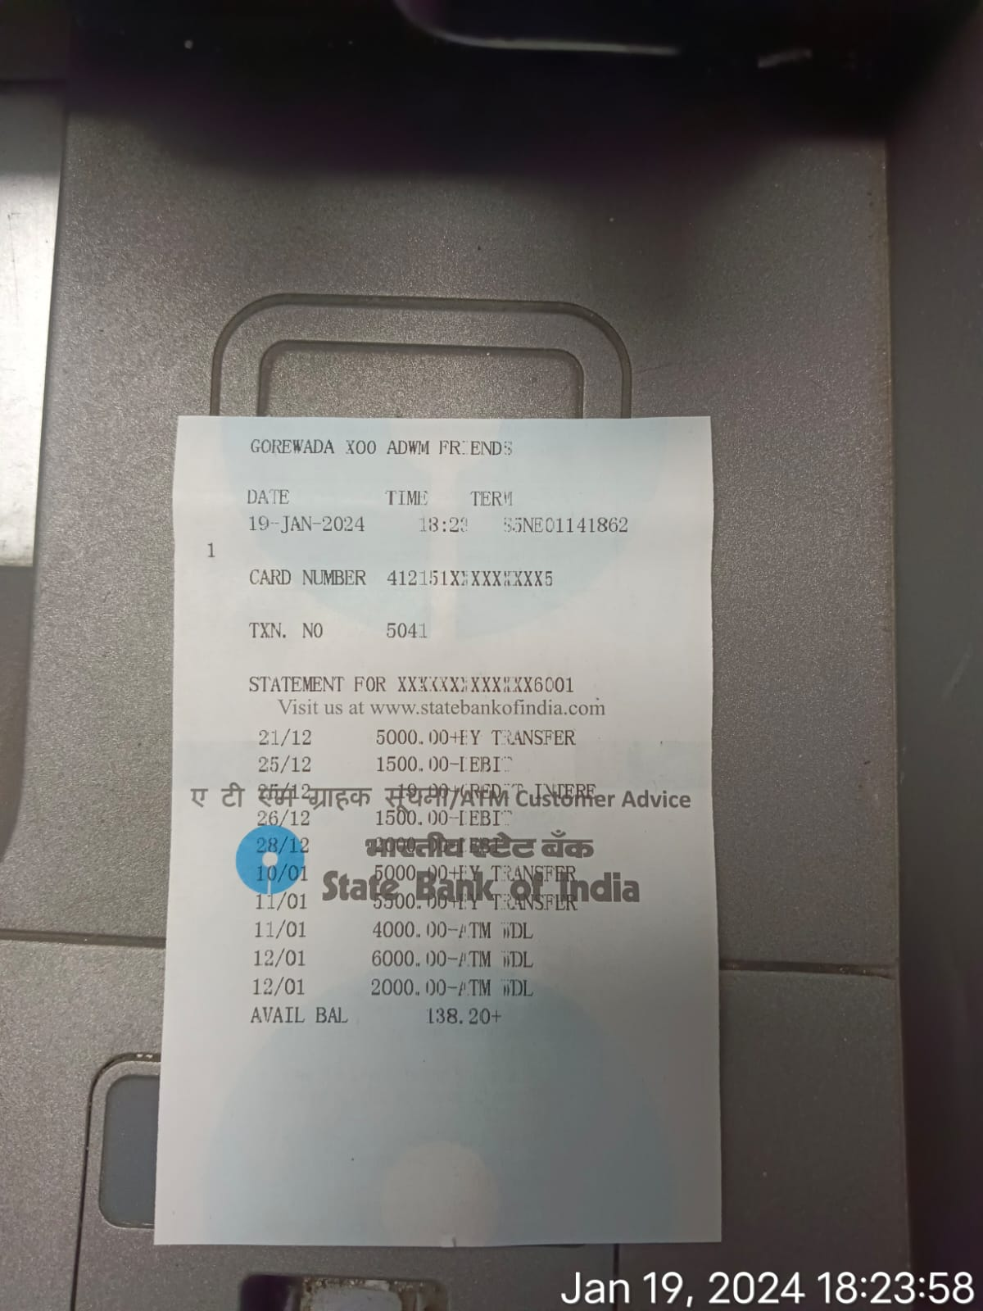
8. ATM Live Snap (ATM Machine and ATM Slip)

