Slide 1
Problem Statement Code: 002
Company Name: compliance-automated.io
Presented By :
Team Runtime Terror
Ashish Vishwakarma 6117059
Hozefa Lightwala 6117027
Fahad Patel 6117035
Mohammed Maknojiya 6117028

Slide 2

Problem Statement
Numerous customer service scenarios can occur through multiple channels such as web applications. typically these interactive sessions involve data input from one or more parties/customer. Employee can generate a form dynamically with multiple fields containing various information and need to verify this information from customer if there is a change required. Employee can select specific fields which he feels may require a change and shares a QR-code or link which will contain only the specific fields shortlisted. The customer can then check the fields and update if changes are required.

Slide 3
Approach/Solution
We have created a web application which allow employees to create forms dynamically with multiple fields along with validations and then share a link to the customer.
For each user a separate form will be generated once the Employee creates the form which has a unique QR code.
The Employee can select specific fields for which he needs approval from customer and then the link can be shared to the customers for verification.
Customers can then edit the form if they find something wrong. Customers can edit only those fields which are set Enabled by Employee. After update the Employee would receive the necessary changes. All the changes would be automatically saved in the database.

Slide 4
Technology Stack
HTML/CSS
Boostrap
Javascript
PHP
MySQL

Slide 5
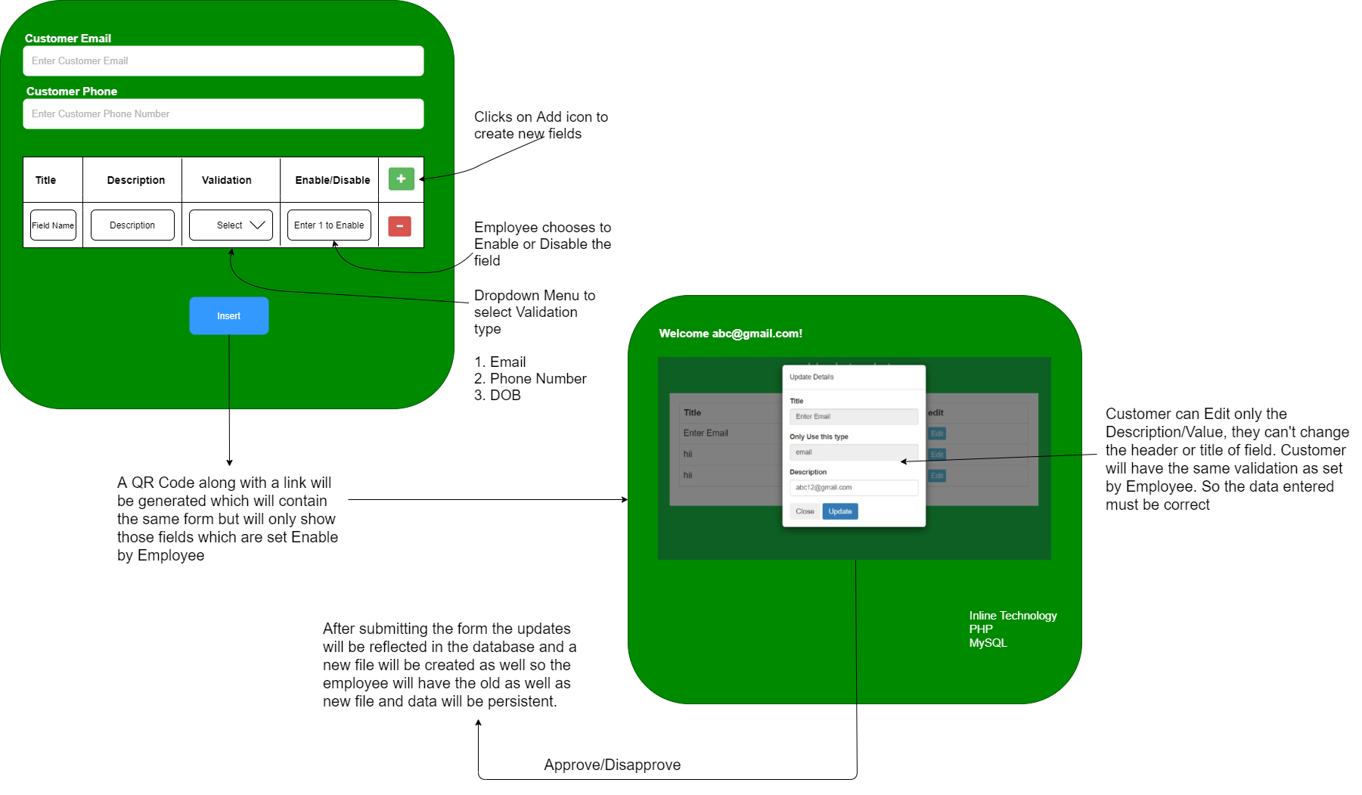
Flow Diagram

Slide 6


Slide 7


Slide 8
Future Scope
Custom Validations as per Employee needs
Auto Suggestion feature for filling quick responses

