Slide 1
A Brief Overview of Neural Networks
By
Rohit Dua, Samuel A. Mulder, Steve E. Watkins, and Donald C. Wunsch

Slide 2
Overview
Relation to Biological Brain: Biological Neural Network
The Artificial Neuron
Types of Networks and Learning Techniques
Supervised Learning & Backpropagation Training Algorithm
Learning by Example
Applications
Questions

Slide 3
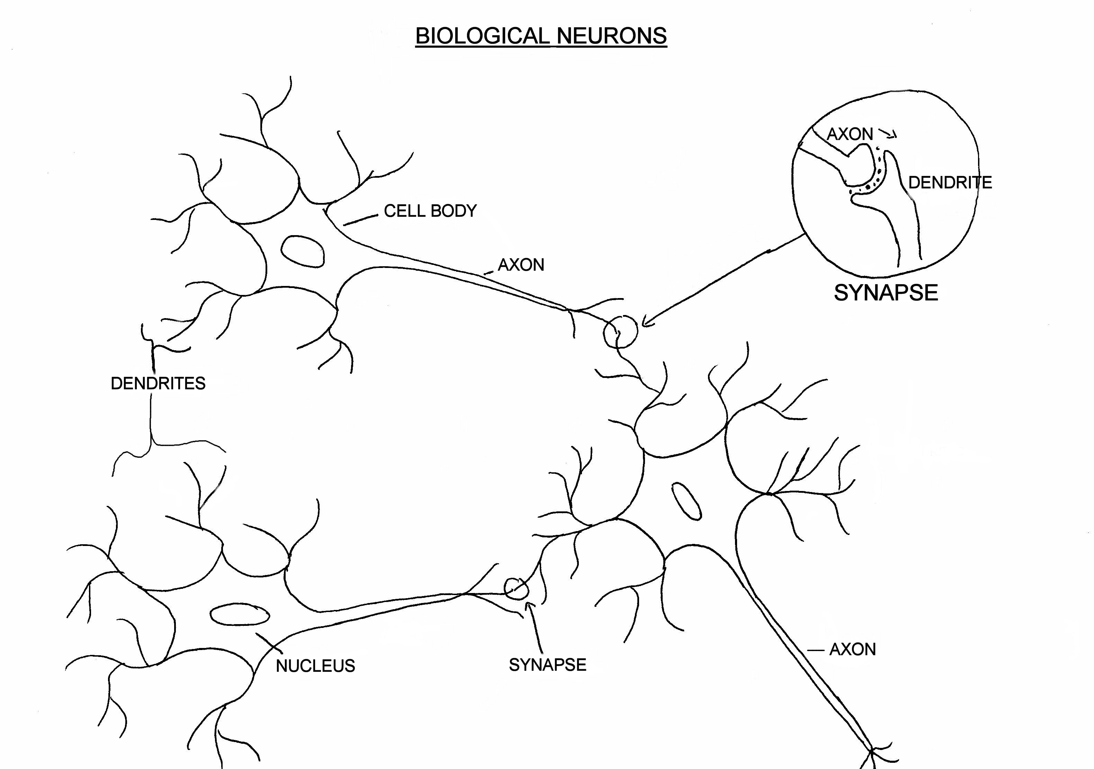
Biological Neuron

Slide 4
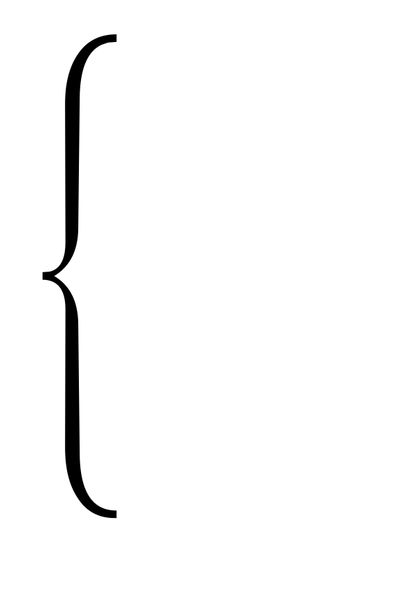
Artificial Neuron
W
Neuron
INPUTS
W
Σ
f(n)
Outputs
W
Activation
Function
W
W=Weight

Slide 5
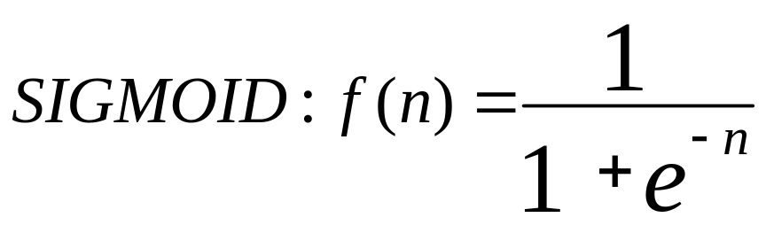
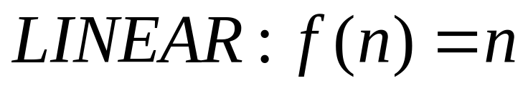
Transfer Functions
1
Output
0
Input

Slide 6
Types of networks
Multiple Inputs and Single Layer
Multiple Inputs and layers

Slide 7
Types of Networks – Contd.
Feedback
Recurrent Networks

Slide 8
Learning Techniques
Supervised Learning:
Expected Output
Inputs from the environment
Actual System
Actual Output
+
Neural Network
Σ
-
Training
Error

Slide 9
Multilayer Perceptron
Output Layer
Inputs
First Hidden layer
Second Hidden Layer

Slide 10
Signal Flow
Backpropagation of Errors
Function Signals
Error Signals

Slide 11
Learning by Example
Hidden layer transfer function: Sigmoid function = F(n)= 1/(1+exp(-n)), where n is the net input to the neuron.
Derivative= F’(n) = (output of the neuron)(1-output of the neuron) : Slope of the transfer function.
Output layer transfer function: Linear function= F(n)=n; Output=Input to the neuron
Derivative= F’(n)= 1

Slide 12
Learning by Example
Training Algorithm: backpropagation of errors using gradient descent training.
Colors:
  Red: Current weights
  Orange: Updated weights
  Black boxes: Inputs and outputs to a neuron
  Blue: Sensitivities at each layer

Slide 13
First Pass
G1= (0.6225)(1-0.6225)(0.0397)(0.5)(2)=0.0093
G2= (0.6508)(1-0.6508)(0.3492)(0.5)=0.0397
0.6225
0.6225
0.6508
0.5
0.5
0.5
0.6508
0.5
1
0.5
0.5
0.5
0.5
0.6508
0.5
0.6225
0.5
0.6225
0.6508
Gradient of the neuron= G =slope of the transfer function×[Σ{(weight of the neuron to the next neuron) × (output of the neuron)}]
Gradient of the output neuron = slope of the transfer function × error
G3=(1)(0.3492)=0.3492
Error=1-0.6508=0.3492

Slide 14
Weight Update 1
New Weight=Old Weight + {(learning rate)(gradient)(prior output)}
0.5+(0.5)(0.0397)(0.6225)
0.5+(0.5)(0.3492)(0.6508)
0.5+(0.5)(0.0093)(1)
0.5124
0.5047
0.6136
0.5124
0.5124
0.5047
0.6136
0.5124

Slide 15
Second Pass
G1= (0.6236)(1-0.6236)(0.5124)(0.0273)(2)=0.0066
G2= (0.6545)(1-0.6545)(0.1967)(0.6136)=0.0273
0.6236
0.6391
0.6545
0.5047
0.5124
0.6136
0.8033
0.5047
1
0.5124
0.5124
0.5047
0.6136
0.8033
0.5047
0.5124
0.6236
0.6391
0.6545
G3=(1)(0.1967)=0.1967
Error=1-0.8033=0.1967

Slide 16
Weight Update 2
New Weight=Old Weight + {(learning rate)(gradient)(prior output)}
0.5124+(0.5)(0.0273)(0.6236)
0.6136+(0.5)(0.1967)(0.6545)
0.5047+(0.5)(0.0066)(1)
0.5209
0.508
0.6779
0.5209
0.5209
0.508
0.6779
0.5209

Slide 17
Third Pass
0.6243
0.6504
0.508
0.6571
0.5209
0.6779
0.8909
0.508
1
0.5209
0.5209
0.508
0.6779
0.508
0.5209
0.6571
0.8909
0.6243
0.6504

Slide 18
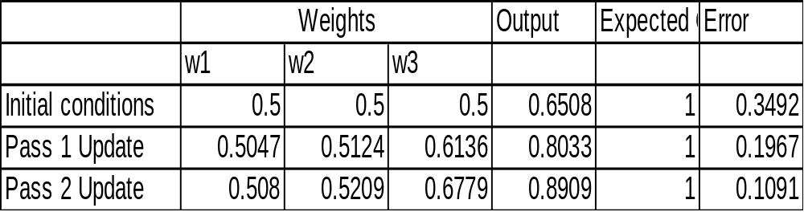
Weight Update Summary
W1: Weights from the input to the input layer
W2: Weights from the input layer to the hidden layer
W3: Weights from the hidden layer to the output layer

Slide 19
Training Algorithm
The process of feedforward and backpropagation continues until the required mean squared error has been reached.
Typical mse: 1e-5
Other complicated backpropagation training algorithms also available.

Slide 20
Why Gradient?
O1
Output
1
W1
O3 = 1/[1+exp(-N)]
W2
N = (O1×W1)+(O2×W2)
Error = Actual Output – O3
O2
O = Output of the neuron
W = Weight
N = Net input to the neuron
0
Input
To reduce error: Change in weights:
  Learning rate
  Rate of change of error w.r.t rate of change of weight
    Gradient: rate of change of error w.r.t rate of change of ‘N’
    Prior output (O1 and O2)

Slide 21
Gradient in Detail
Gradient : Rate of change of error w.r.t rate of change in net input to neuron
  For output neurons
    Slope of the transfer function × error
  For hidden neurons : A bit complicated ! : error fed back in terms of gradient of successive neurons
    Slope of the transfer function × [Σ (gradient of next neuron × weight connecting the neuron to the next neuron)]
    Why summation? Share the responsibility!!
  Therefore: Credit Assignment Problem

Slide 22
An Example
G1=0.66×(1-0.66)×(0.34)= 0.0763
1
0.731
0.6645
0.66
1
0.5
Error = 1-0.66 = 0.34
0.5
0.5
0.4
0.5
0.6645
0.66
0
0.598
Error = 0-0.66 = -0.66
Reduce more
G1=0.66×(1-0.66)×(-0.66)= -0.148
Increase less

Slide 23
Improving performance
Changing the number of layers and number of neurons in each layer.
Variation in Transfer functions.
Changing the learning rate.
Training for longer times.
Type of pre-processing and post-processing.

Slide 24
Applications
Used in complex function approximations, feature extraction & classification, and optimization & control problems
Applicability in all areas of science and technology.

