Slide 1
World Cup Player Analysis
Shreyas MD
Vishwajeet Shivaji Hogale
Sharika Vallambatla

Slide 2
Introduction
Our project has 3 data sets
Batsman_Data.csv
Bowler_Data.csv
Ground_average.csv
Total number of rows and columns
Batsman_Data.csv 11150 rows * 13 columns
Bowler_Data.csv 11150 rows * 14 columns
Ground_average.csv 107 rows * 11 columns

Slide 3
BATSMAN:

Slide 4
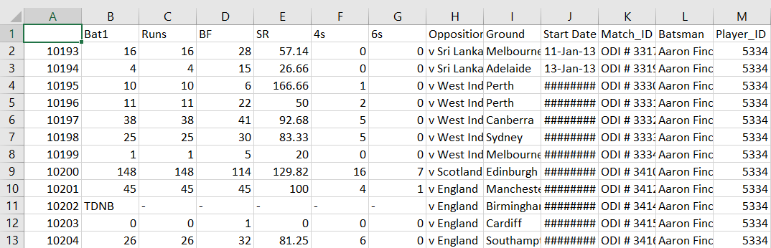
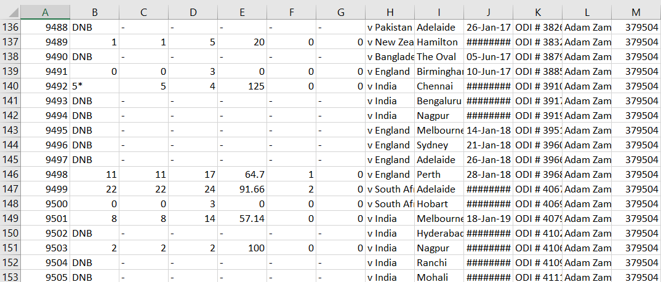
Before Cleaning

Slide 5
BOWLERS:

Slide 6
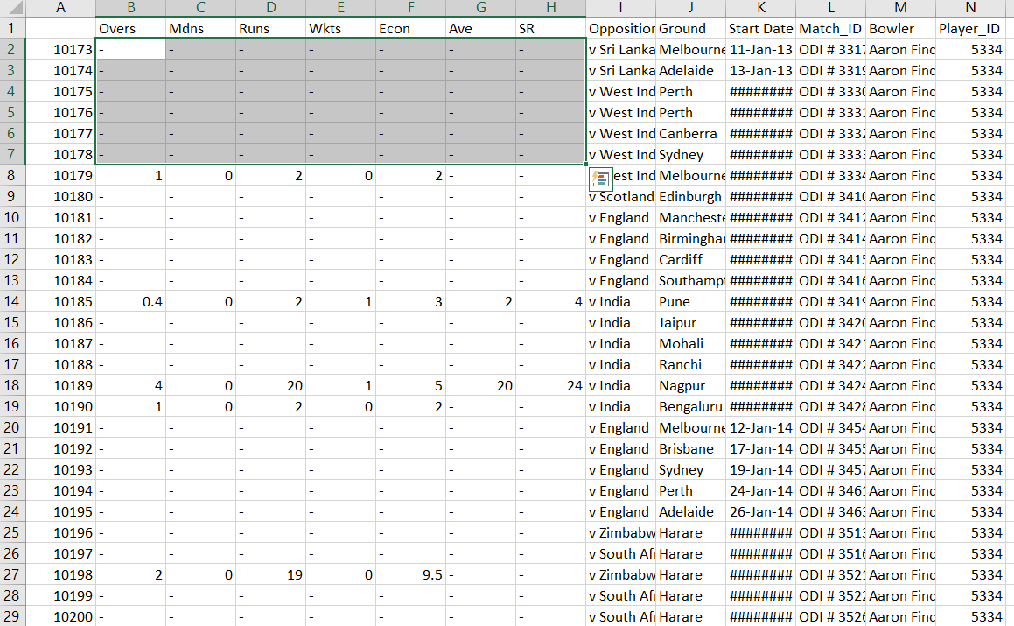

Slide 8
DATA CLEANING

Slide 9
BOWLER CLEANED
NaN values : All the NaN values are replaced with a 0
All the small teams like Hong Kong , Asia 11,etc are removed.
“-” are replaced with 0
Won,loss , tied and N/r are converted into numerical values
Few columns are dropped
Opposition column was also filtered

Slide 10
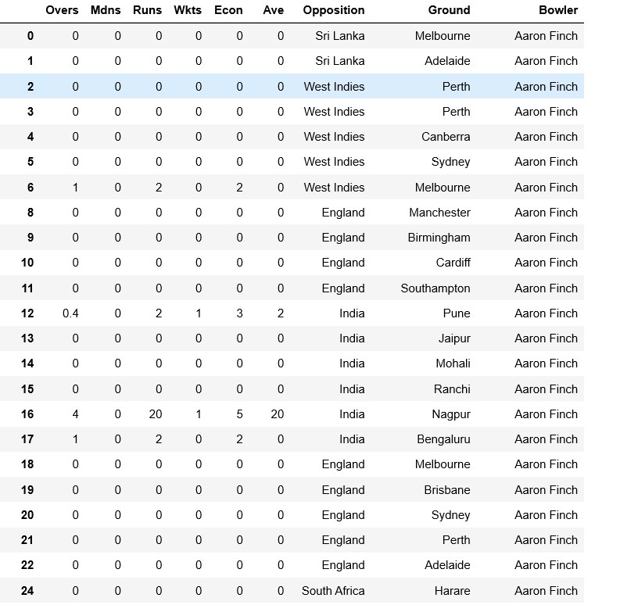

Slide 11
BATSMAN CLEANED
NaN values : All the NaN values are replaced with a 0
All the small teams like Hong Kong , Asia 11,etc are removed.
“-” are replaced with 0
Won,loss , tied and N/r are converted into numerical values
Few columns are dropped
Opposition column was also filtered

Slide 12
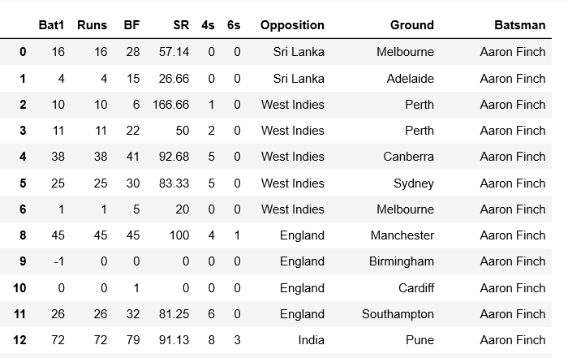
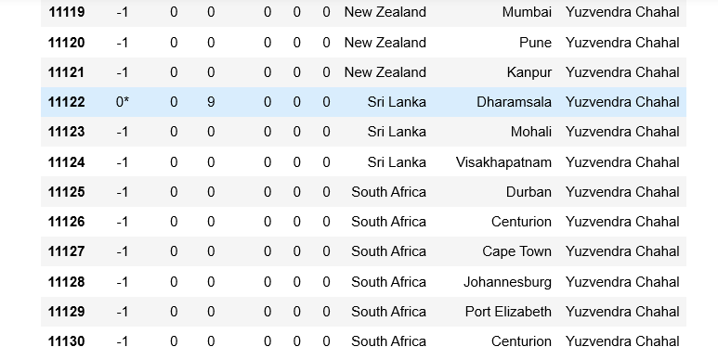

Slide 14
Standardization of dataset
All numeric columns have been standardised.
Mean shifted to 0.
Variance to 1
Importance:
To standardize features around center.
For easy comparisons of measurements having different units
Obtain dataset with common scale(without distorting differences in ranges of values).
Mean will be shifted to 0
Variance to 1
Effects on dataset:
All features in dataset are scaled between -1 and 1.

Slide 15
Code used to normalise the data column wise
a=df['Runs'].transform(lambda x: (x - x.mean())/x.std())
b=df['BF'].transform(lambda x: (x - x.mean())/x.std())
c=df['SR'].transform(lambda x: (x - x.mean())/x.std())
d=df['4s'].transform(lambda x: (x - x.mean())/x.std())
e=df['6s'].transform(lambda x: (x - x.mean())/x.std())
These statements help in scaling down all the numerical values between -1 and 1

Slide 16
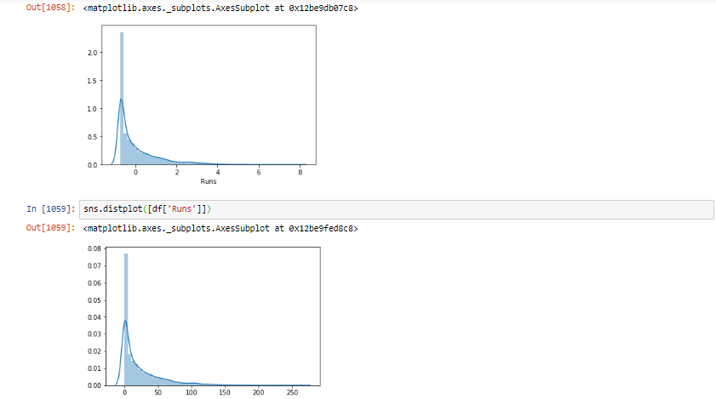
Graph to show that the standardization was accurate

Slide 17
data visualisation

Slide 18
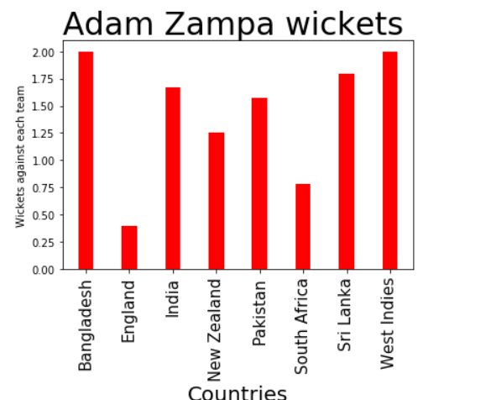

Slide 19
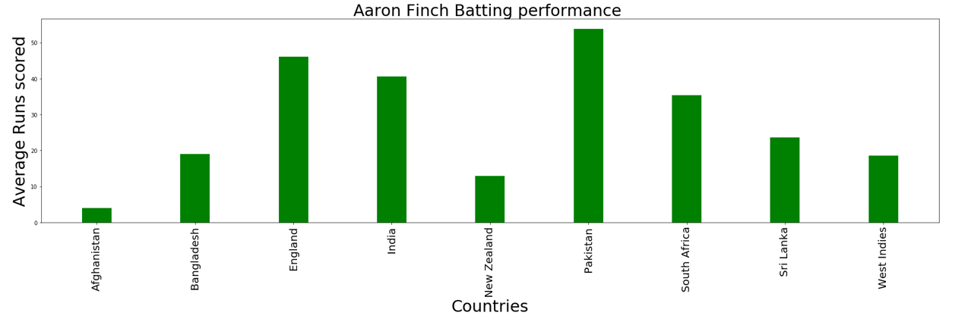

Slide 20
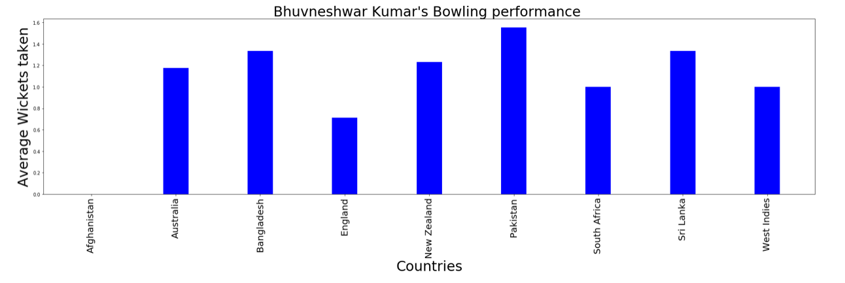

Slide 21
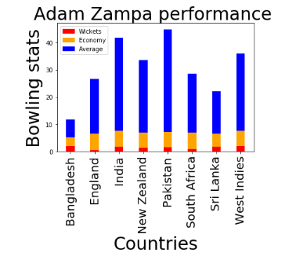

Slide 22
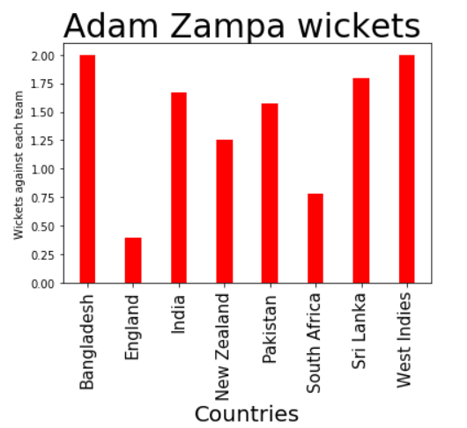

Slide 23
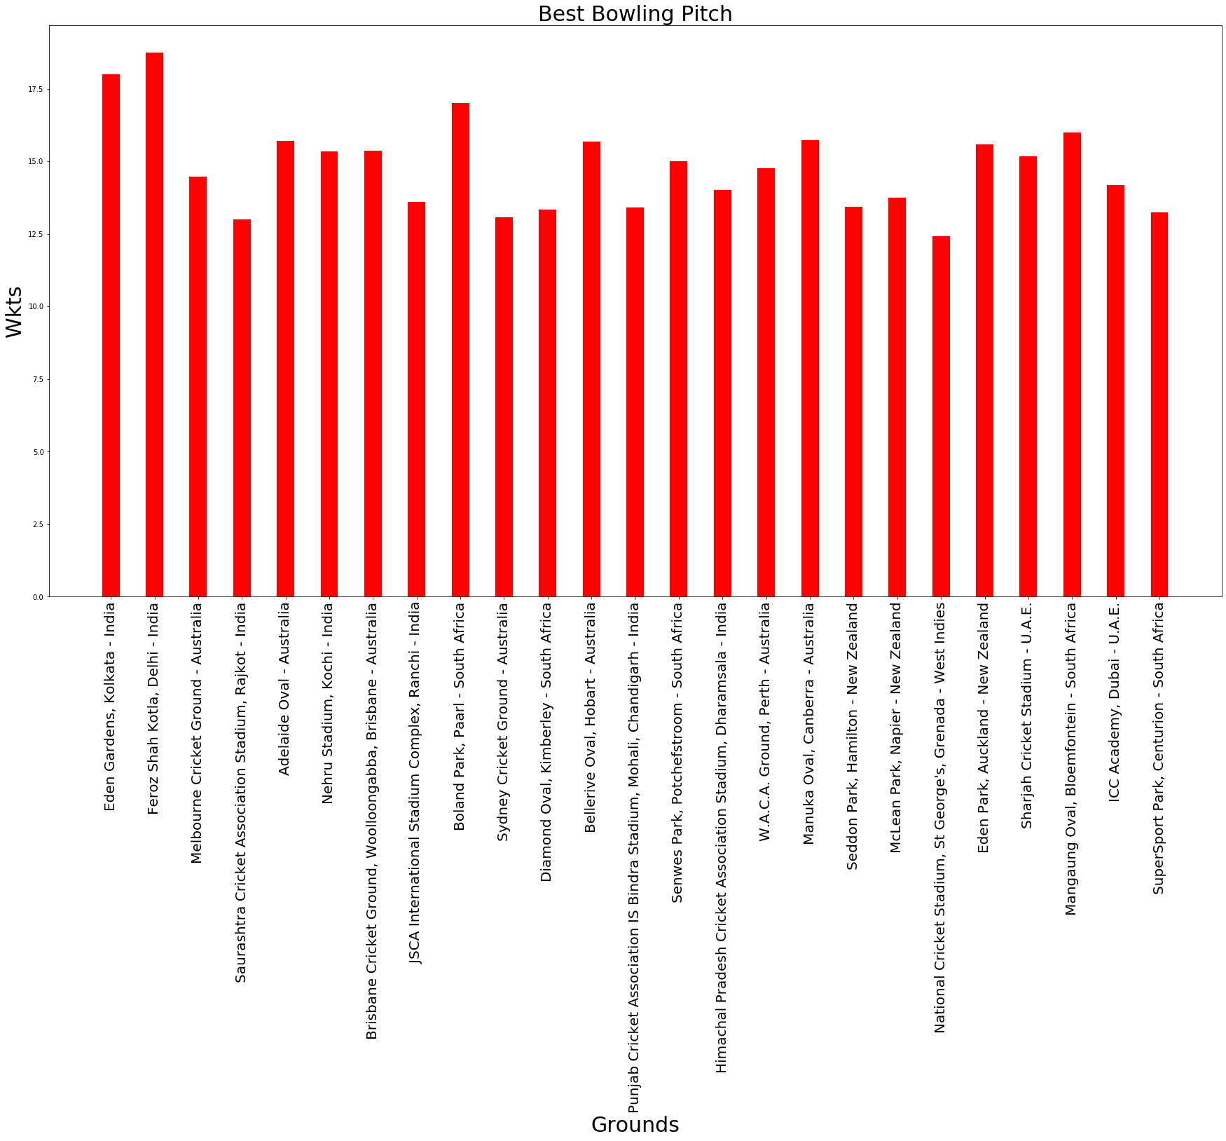

Slide 24
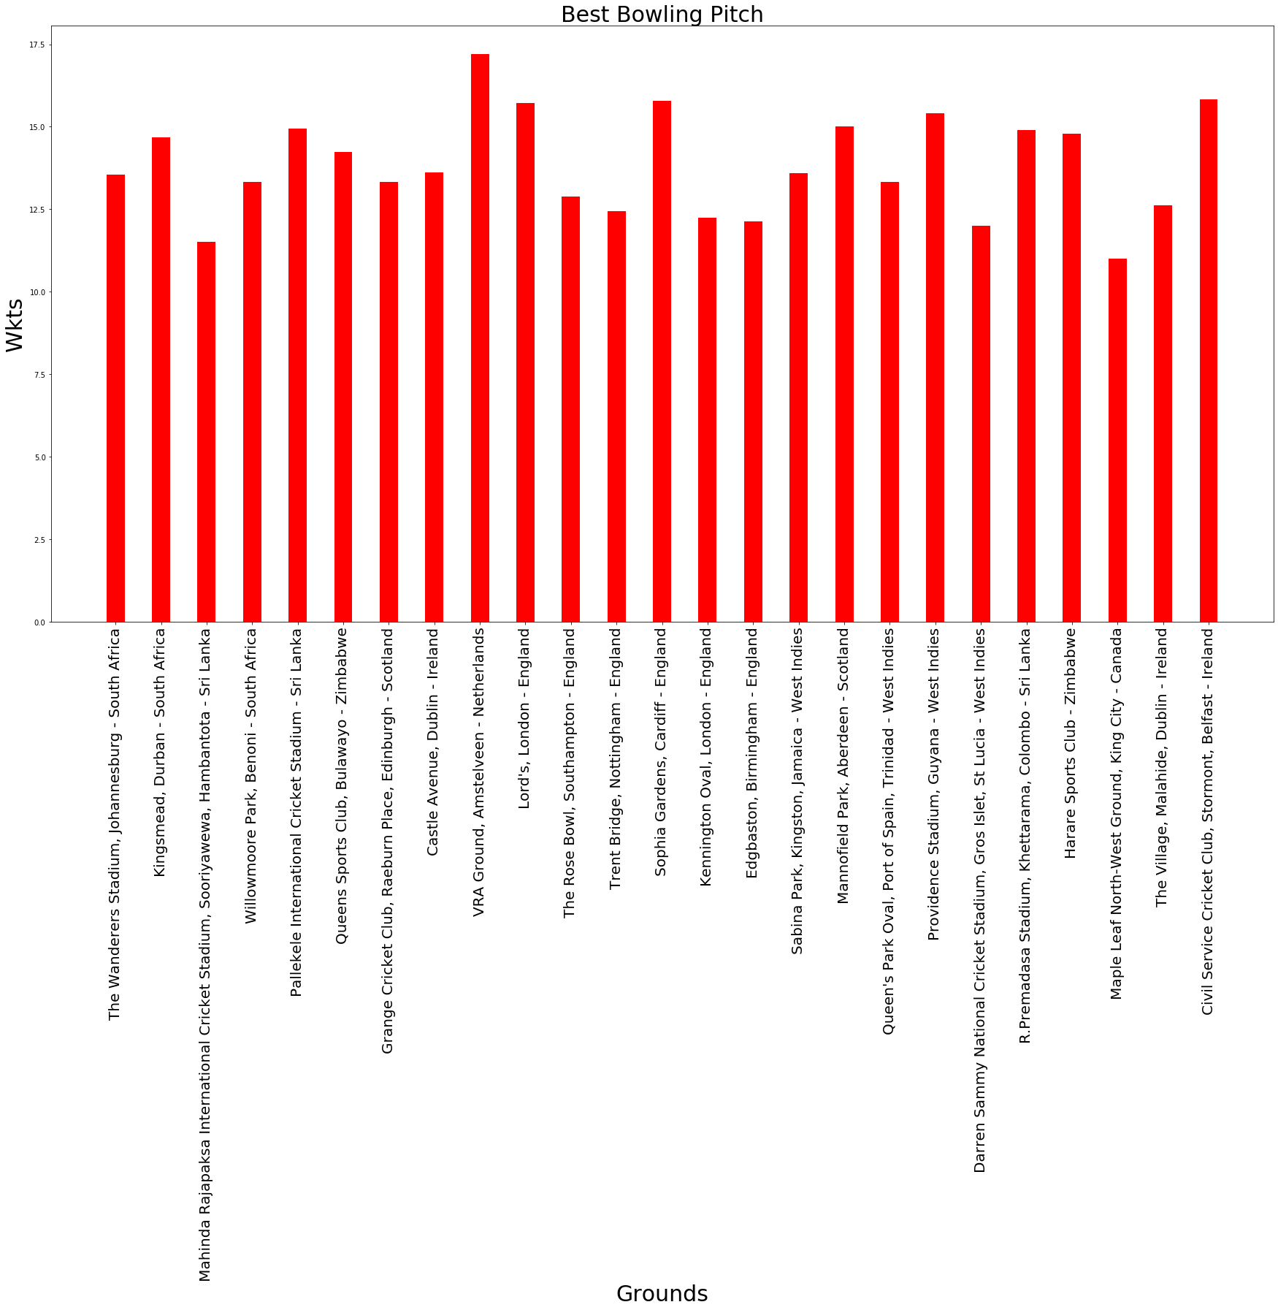

Slide 25
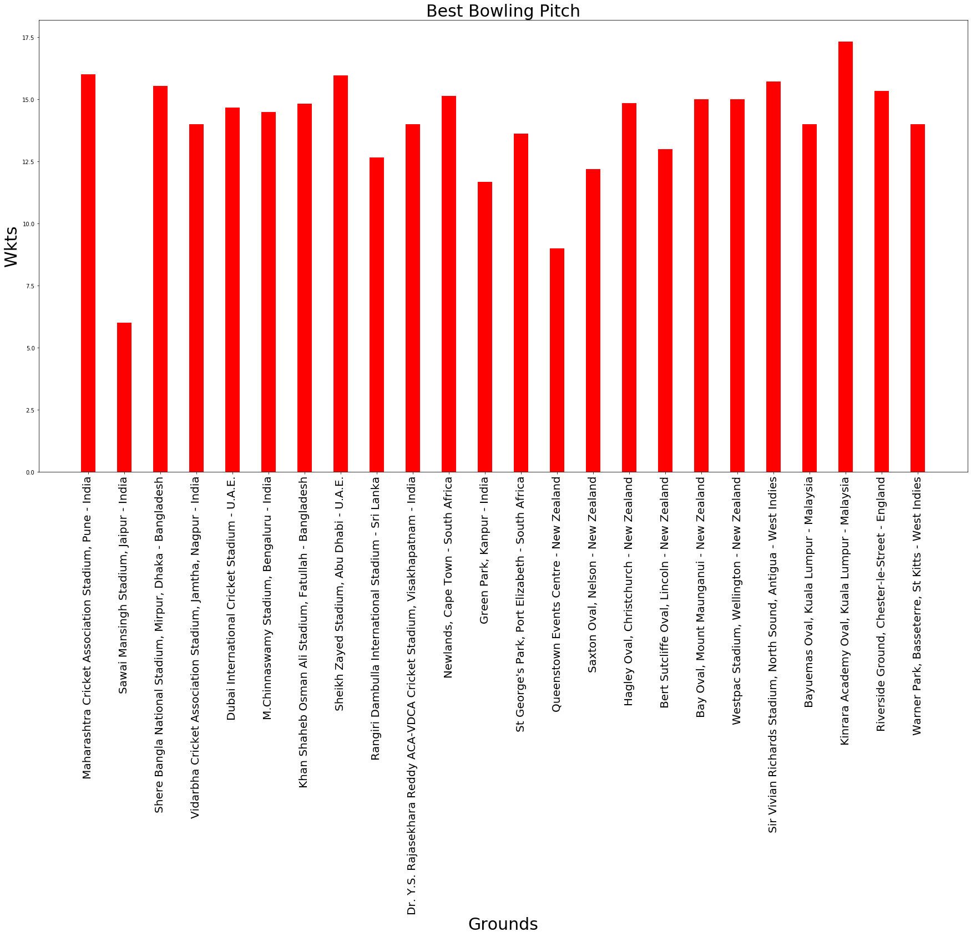

Slide 26
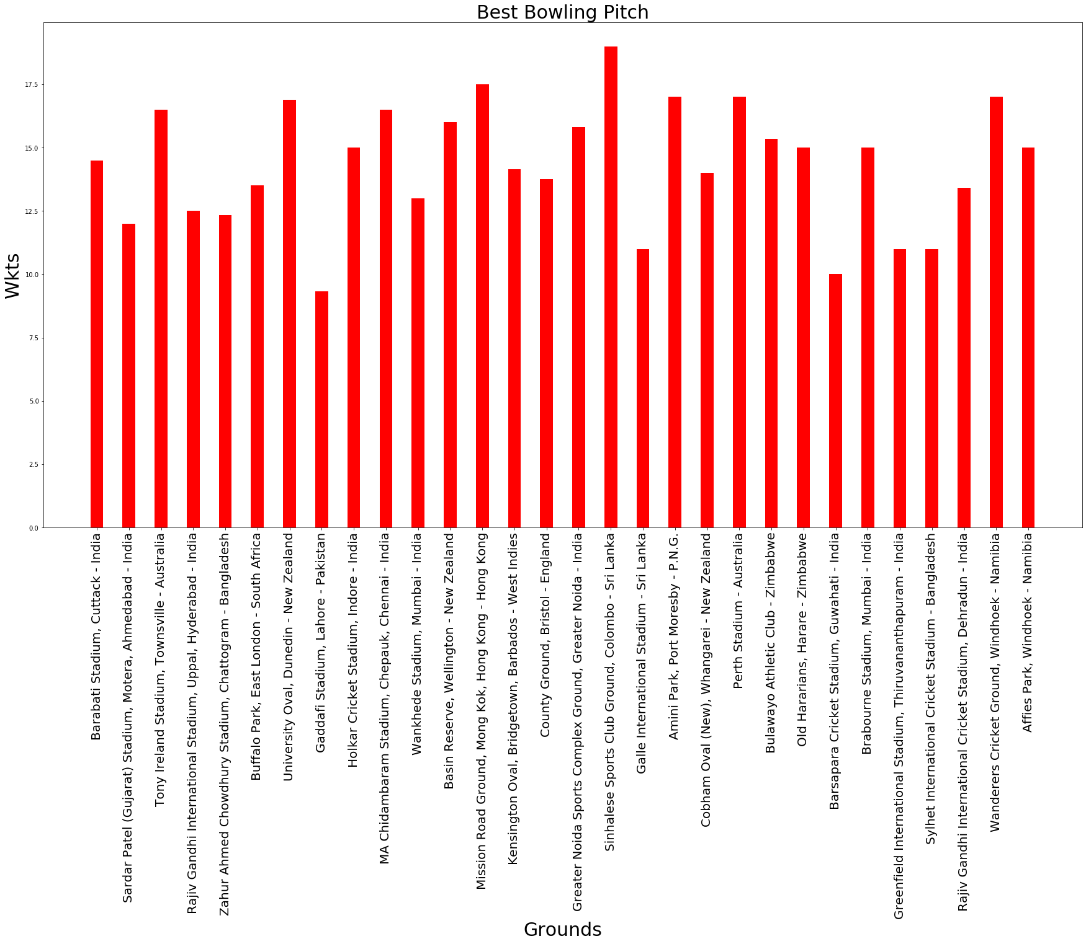

Slide 27
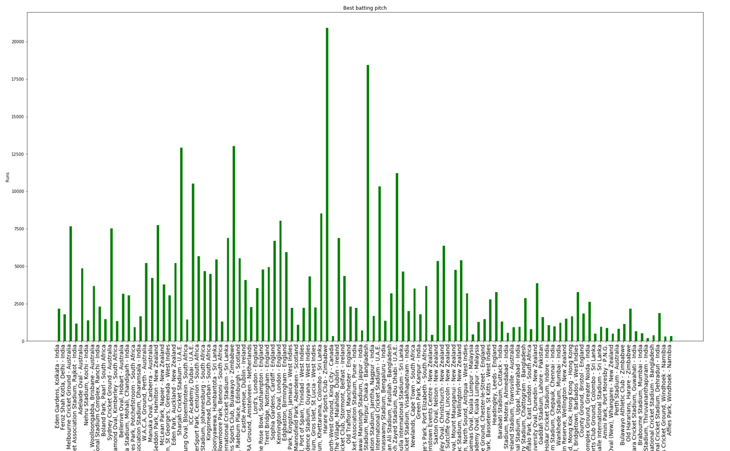

Slide 28
Hypothesis Test
The statistical test presented here is to analyse the relationship between economy rates in odi’s fast bowlers and slow bowlers in their respective matches.
2. In the sample we have taken one fast bowler and one slow bowler from each team. We have taken a pair(fastbowler,slowbowler) from 3 different countries and made two lists where one has economy of fast bowlers while the other has economies of slow bowlers(spinners)
Null Hypothesis : Average Economy of the fast bowler and slow bowler are equal
Alternative hypothesis: Average Economy of the fast bowler and slow bowler are not equal

Slide 29
Hypothesis testing
Ho= The average economy rate of fast and slow bowlers are equal.
H1= The average economy rate of fast and slow bowlers are not equal.
FAST bowler | SLOW bowler
Mean= 4.959422 | Mean= 5.244649
S.D= 0.897361 | S.D= 0.770731
MIN=3.120000 | MIN=3.250000
MAX=6.537500 | MAX=6.225556

Slide 30
Testing for equality of average ECONOMY RATES
Sample size of the fast bowler and slow bowler is 24.
T test will be used since the sample size is less than 30
 | FastBowlers | Slow Bowlers
count | 24.000000 | 24.000000
mean | 4.959422 | 5.244649
std | 0.897261 | 0.770731
min | 3.120000 | 3.250000
25% | 4.195278 | 4.737250
50% | 5.032500 | 5.555119
75% | 5.574353 | 5.743854
max | 6.537500 | 6.225556

Slide 31
Fast Bowlers economy data :
[3.12, 5.285, 5.002, 5.371, 5.513,4.121, 6.352307692307692, 4.22, 4.109999999999999, 5.063333333333333, 5.465, 4.743076923076923, 5.972727272727273, 5.095000000000001, 5.854285714285715, 6.5375, 4.0661538461538465, 4.109999999999999, 3.41, 5.997142857142857, 4.585714285714286, 4.67, 4.601111111111111, 5.758181818181819, 4.283846153846154, 4.544999999999999]
Slow bowlers economy data :
[5.625, 3.935, 4.499999999999999, 5.74125, 4.98, 5.501666666666666, 4.2, 5.333333333333333, 5.819999999999999, 5.013333333333333, 6.225, 5.651818181818182, 5.751666666666666, 5.727777777777778, 4.6930000000000005, 4.2907692307692304, 3.25, 6.029999999999999, 5.863333333333333, 5.6625, 5.6085714285714285, 6.225555555555555, 4.752000000000001, 5.489999999999999]

Slide 32
Coefficient of variance : (0.177, 0.143)
Coefficient of skewness : (-0.0341, -0.919)
t Stat = -1.40
P-value = 0.17
Assuming alpha to be 0.05
Since P-value is greater than alpha
We can say that THE NULL HYPOTHESIS IS NOT REJECTED
Therefore we can say that the average economies of the bowlers are equal.

Slide 33
Summary
1. The average economy rate of fast bowlers and slow bowlers in ODI’s are calculated as 5.18 and 4.67 respectively. It shows that there is almost no significant difference between economy rates of fast bowlers and slow bowlers.
2. The COEFFICIENT of VARIATION is 17.7% in economy rates of fast bowlers and 14.4% in economy rates of slow bowlers in ODI’s. It implies that the variation is high in both the economy rates of fast bowlers and slow bowlers and more importantly they are almost equal which shows that the variation in economy rates is almost similar.
3. The coefficient of skewness in economy rates of fast bowlers and slow bowlers is -0.035 and -0.92 respectively. The values show that the economy rates are negatively skewed for both the cases and they are approximately normal as well.
Null hypothesis is not rejected

Slide 34
Regression
In statistical modeling, regression analysis is a set of statistical processes for estimating the relationships between a dependent variable and one or more independent variables
In this project we have implemented a very simple linear regression model for Virat Kohli’s score prediction based on the number of balls faced in an inning.

Slide 35
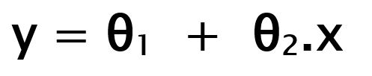
About Linear Regression Model
When training the model – it fits the best line to predict the value of y for a given value of x. The model gets the best regression fit line by finding the best θ₁ and θ₂ values. θ₁: intercept θ₂: coefficient of x
Once we find the best θ₁ and θ₂ values, we get the best fit line. So when we are finally using our model for prediction, it will predict the value of y for the input value of x.
Update θ₁ and θ₂ values in order to reduce Cost function (minimizing RMSE value) and achieving the best fit line the model uses Gradient Descent

Slide 36
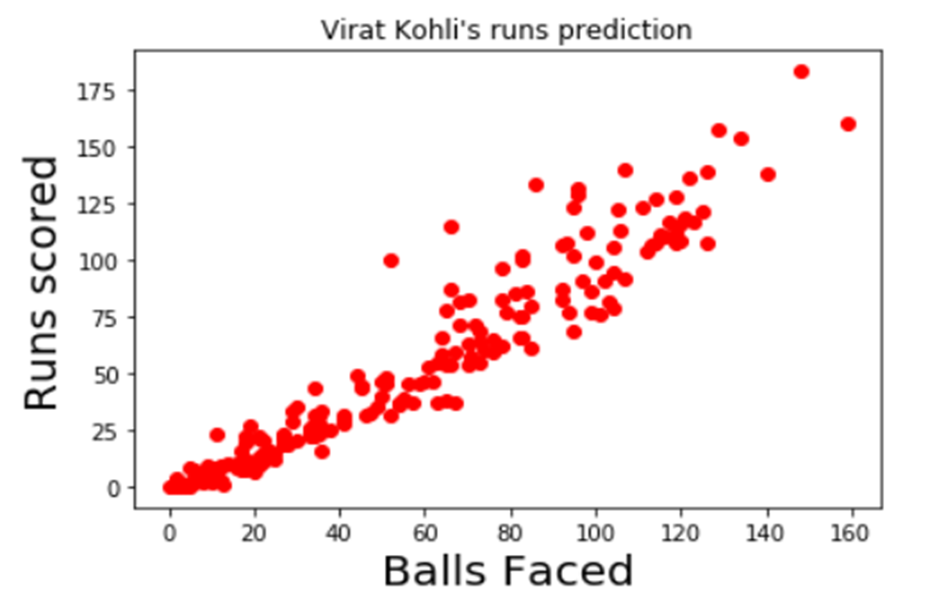
To check if the relationship between Runs and balls faced is linear or not

Slide 37
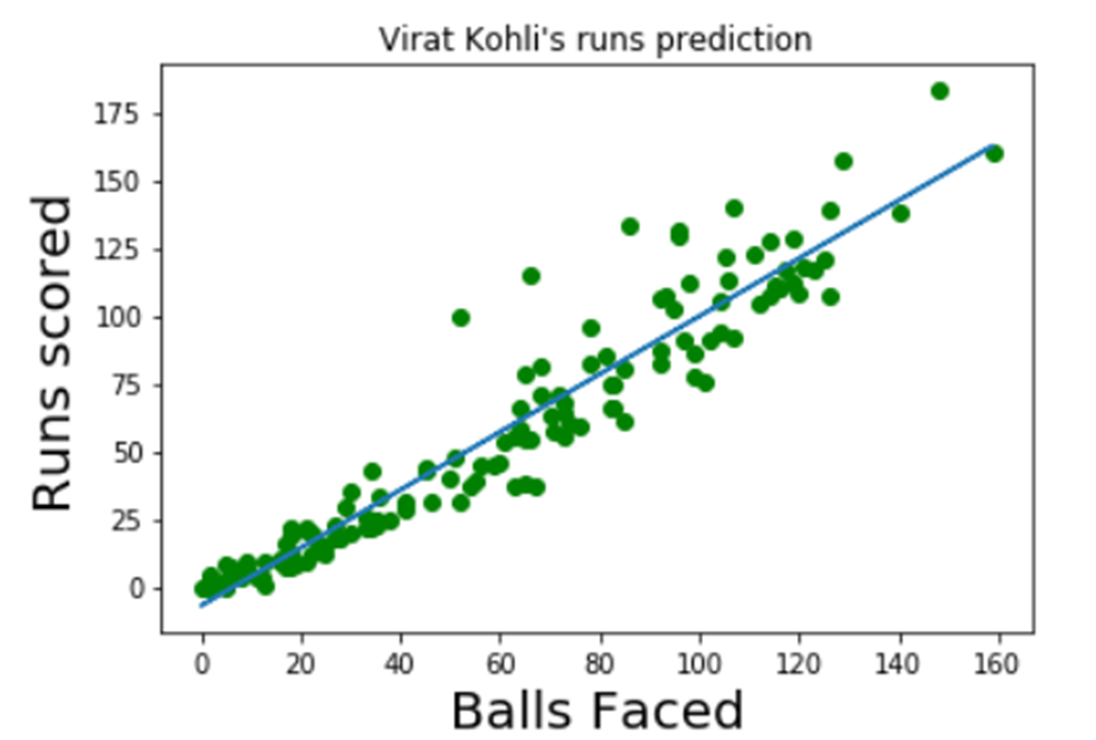
Since it’s linear we can implement linear regression model on this to predict his score
from sklearn.model_selection import train_test_split
from sklearn.linear_model import LinearRegression
bf2=[[x] for x in ballsfaced]
X_train,X_test,Y_train,Y_test=train_test_split(bf2,runsscored,test_size=0.3,random_state=3)
reg=LinearRegression()
reg.fit(X_train,Y_train)
y_predict=reg.predict(X_test)
plt.scatter(X_train,Y_train,color='green')
plt.plot(X_train,reg.predict(X_train))
plt.xlabel("Balls Faced",fontsize=20)
plt.ylabel("Runs scored",fontsize=20)
plt.title("Virat Kohli's runs prediction")
plt.show()
reg.predict([[25.0],[140.0]])
array([ 19.61431723, 142.36603866])
ACCURACY = 91.62 %

Slide 38
THANK YOU

