Slide 1

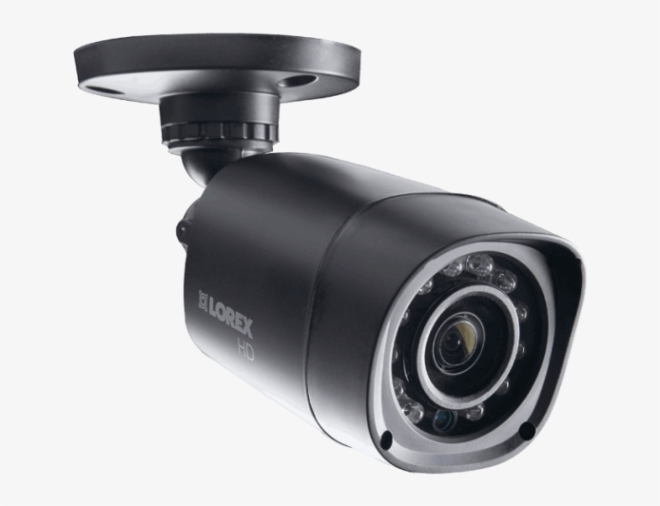
SECURITY SYSTEM BASED ON AI
Project Guide : Prof. Y. R. Bachkar
Group Members :
Akash R. Biradar EXAM NO : B150433004
Vishwajeet D. Jagtap EXAM NO : B150433 011
Soham M. Wadhonkar EXAM NO : B150433 045

Slide 2
CONTENTS
Introduction
Problem Statement
Literature Survey
Block Diagram
Methodology
Software Used
Hardware Used
Final System
Results
Applications
Conclusion
References
Future Scope

Slide 3
INTRODUCTION
AI security system is an intelligent vision-based security service designed to automatically detect humans in a visual scene and notify the property owner in real-time. This is to ensure any and all unauthorized personnel on the private property are identified as soon as possible to provide a record of intrusions. The functionality is provided using a combination of deep learning, edge computing, and , where the camera on-board the edge device continuously monitors an area. When the real-time analytics on the edge device detects one or more people in the scene, an image is immediately captured and the user is notified via email. Soon afterwards, a video clip of the scene with the person(s) is recorded and also sent to the user via email. The image and video are stored in the memory card for on-demand user access.

Slide 4
PROBLEM STATEMENT
There are some security systems available in which either users can manually monitor there property manually or the most common and traditional features of the home security system are motion detection, live monitoring, and alert notification. Systems relying only on a Passive Infrared (PIR) sensor to accommodate for motion detection have unreliable detection rate because it could trigger a false alarm due to abnormal conditions such as pet intrusion or rapid heating e.g. from sunlight exposure.
In order to overcome these limitations. this system presents an implementation of vision-based intruder detection system using Tenser flow and raspberry pi 4b module..

Slide 5
MOTIVATION
Home break-ins, porch pirates stealing deliveries, trespassers, break-ins of shops such as jwellery shops. Installation of surveillance cameras equipped with motion sensors are a common solution to this problem. However, surveillance cameras only detect motion and collect data - meaning that the user must go through frames in the video footage to discern any meaningful information. As a result, this visual information is typically inspected after an unfortunate incident, such as a package being stolen or robbery. To improve this situation, we propose AI a machine vision security system to automatically collect and analyze relevant images to identify critical and actionable information and send it to the user, in real-time.

Slide 6
LITERATURE SURVEY
Sr no. | Paper Name | Author | Description
1 | Automated security system with surveillance | P. Vigneswari, V. Indhu, R. Narmatha, Sathinisha, and J. Subashini | A PIR sensor and a camera were installed respectively to detect the presence of an intruder and capture his/her picture. The owner will be alerted through Short Message Service (SMS) using the GSM technology. At the heart of the system was an Atmega644p microcontroller, which receives and processes signals from the PIR sensor and decides whether it is necessary to send a notification message with the captured image over SMS.
2 | Home monitoring and security system | S. Suresh, J. Bhavya, S. Sakshi, K. Varun, and G. Debarshi | PIR sensor and a temperature and humidity sensor are connected to an Arduino Uno microcontroller. The system intends to apply changes in both motion and temperature in a monitored room to improve the accuracy of the intrusion detection by reducing false detections based on line of sight that can be cut by any entity and not necessarily an intruder. If the temperature is above a set threshold and a change in motion is detected, an SMS message will then be sent to the owner’s mobile phone via GSM.

Slide 7
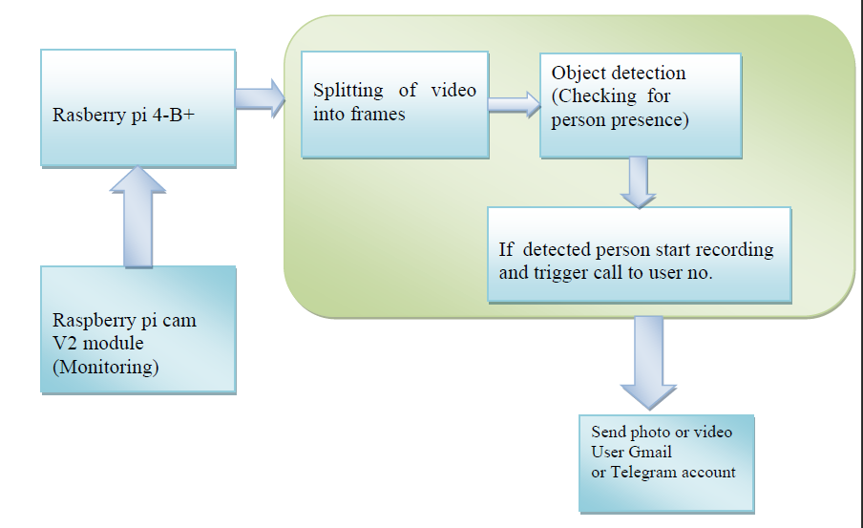
BLOCK DIAGRAM

Slide 8
METHODOLOGY :
Initially the Raspberry pi camera v2 module captures the video and then it is sent to the raspberry pi 4 module for further processing like - splitting of video into frames, Object detection etc.
In this step the video received from the camera module is divided into frames and using Tensor-flow Object Detection api the objects are detected in that frame. This api is pretrained for detecting various classes like animals, humans etc. for our system we are setting it to detect only human class.
If the human presence is detected in the frame system is set to sent a email notification with picture of intruder and a phone call will be triggered to the user.

Slide 9
SOFTWARE USED
OpenCV :- Python library required for Tensor flow
Tensor-Flow object detection API :- For object detection
Flask :- For Live streaming
SMTP :- For E-mail notification
Twilio :- For Call notification

Slide 10
HARDWARE USED
Raspberry Pi Camera Module V2 :
Raspberry pi 4 model b:

Slide 11
Specifications:
• Processor : Broadcom BCM2711, quad-core Cortex-A72 (ARM v8) 64-bit SoC @ 1.5GHz
• Memory : 8GB
• Connectivity : 2.4 GHz and 5.0 GHz IEEE 802.11b/g/n/ac wireless LAN, Bluetooth 5.0, BLE Gigabit Ethernet 2 × USB 3.0 ports 2 × Type c ports 1.
• GPIO: Standard 40-pin GPIO header (fully backwards-compatible with previous boards)
• Video & sound: 2 × micro HDMI ports (up to 4Kp60 supported) 2-lane MIPI DSI display port 2-lane MIPI CSI camera port 4-pole stereo audio and
composite video port Multimedia: H.265 (4Kp60 decode); H.264 (1080p60 decode, 1080p30 encode); OpenGL ES, 3.0 graphics SD card support: Micro
SD card slot for loading operating system and data storage Input power: 5V DC via USB-C connector (minimum 3A1 ) 5V DC via GPIO header
(minimum 3A1 ) Power over Ethernet (PoE)–enabled (requires separate PoE HAT) Environment: Operating temperature 0–50ºC

Slide 12
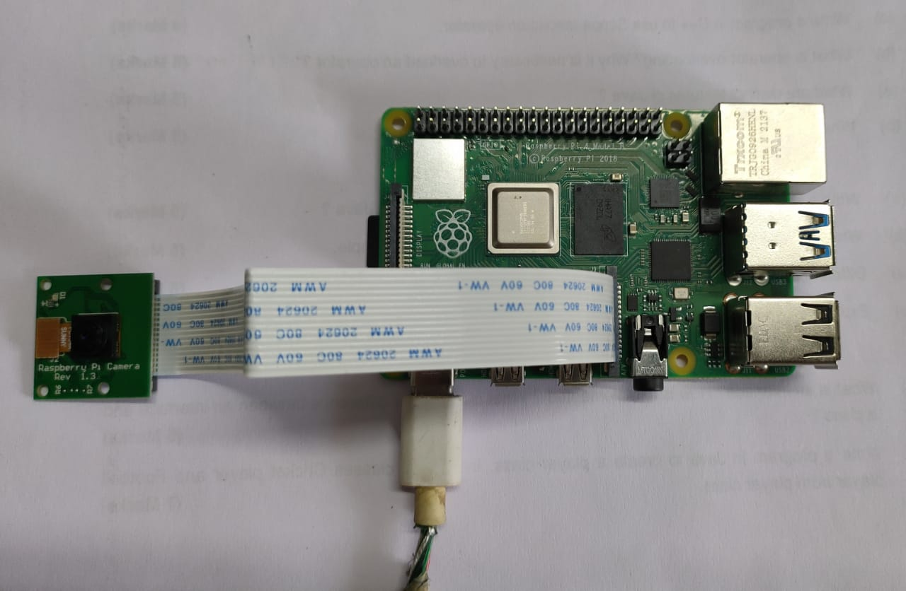

FINAL SYSTEM
SD CARD
CSI PORT
POWER SUPPLY
(Camera Serial Interface)

Slide 13
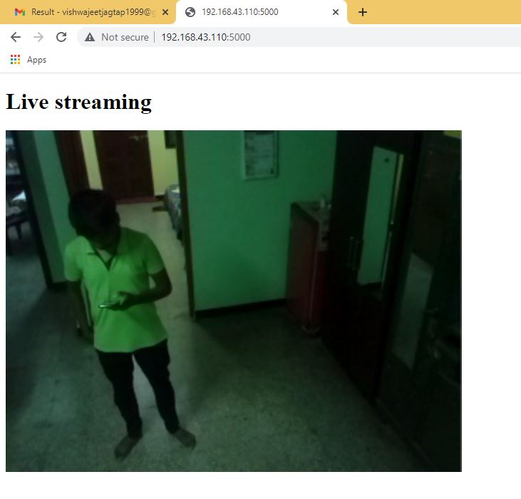
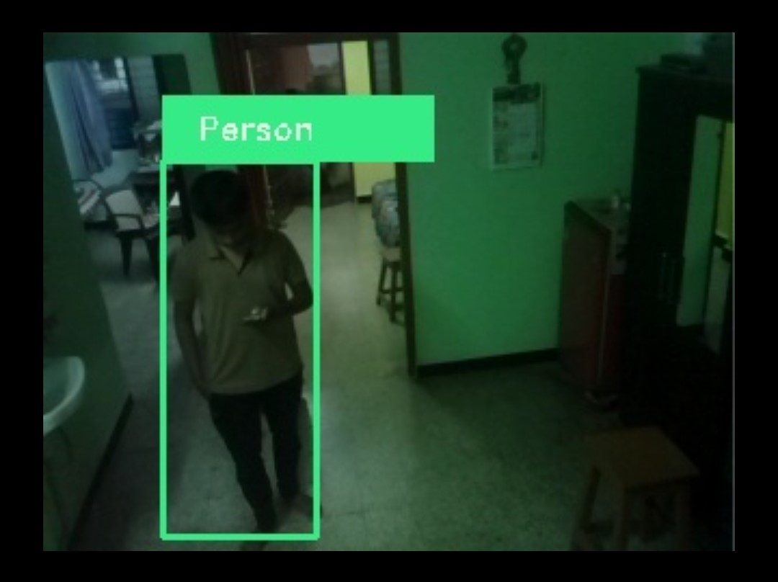
RESULTS
First picture is the snapshot of live streaming before person detection .
Second picture is the snapshot after person detection in which we can see the bounding boxes are created around the face of person with class denoting “Person ” as we set the Tensor flow api to detect only humans.

Slide 14
Figure shows the email notification received from the system once person is detected. Mail feature is working as expected. Along with image instance of video is also sent which contains positive classification.

Slide 15
Also once presence of human is detected call is triggered with the help of twilio api .
Fig shows the call generated by system once the presence of human is detected.

Slide 16
Fig shows the video and photo received with the help of telegram which as another
approach of this project.

Slide 17
APPLICATIONS
Restricted Areas: There are some places such as goverment properties or military areas where no one can enter without permission.In such places this system can be implemented ensuring that no one allowed if intruder peresence detected security authorities get notified with footage.
Private Sector: Private sector does not hold back when it comes to installing the cameras in the work environment mainly to avert unethical practices or the department where confidential files are kept.
Banking Sectors: Banking sectors such as locker rooms. Where only authorized person are allowed.
Retails Shops: There are chances of break-ins in shops such as jewellery shops, mobile shops etc and the chances of break-ins mostly at night. In such cases intruder get detected instantly and owner get notified with footage instantly.

Slide 18
CONCLUSION
This proposed system aims at enhancing the safety of property and security from intruders/burglars with the help camera integrated with Raspberry pi 4.
we have successfully tested the system in different places and conditions as the camera module is prototype it can captures upto few meters only .

Slide 19
REFERENCES
[1] M. Menon, "Innovating to zero crime rate," in Digital News Asia, ed, (2015).
[2] M. Pugh, J. Brewer, and J. Kvam, "Sensor fusion for intrusion detection under false alarm constraints," in 2015 IEEE Sensors Applications Symposium (SAS), (2015), 1-6.
[3] R. Sampson, "False burglar alarms," in Problem-Oriented Guides for Police: Problem-Specific Guides
Series No. 5, U. S. D. o. J. Office of Community Oriented Policing Services, Ed., 2 ed, (2007).
[4] P. Vigneswari, V. Indhu, R. Narmatha, A. Sathinisha, and J. Subashini, "Automated security system using
surveillance," International journal of current engineering and technology, vol. 5, no. 2, 882-884, (2015).
[5] S. Suresh, J. Bhavya, S. Sakshi, K. Varun, and G. Debarshi, "Home monitoring and security system," in
2016 International Conference on ICT in Business Industry & Government (ICTBIG, 2016), 1-5.
[6] H. U. Zaman, T. E. Tabassum, T. Islam, and N. Mohammad, "Low cost multi-level home security system
for developing countries," in 2017 International Conference on Intelligent Computing and Control Systems
(ICICCS, 2017), 549-554.

Slide 20
FUTURE SCOPE
• Implement Facial Recognition algorithm to the system. Using the facial images that the owner provides, the system will be able to recognize those faces and it can differentiate between a familiar faces and unfamiliar faces. During a burglary, the system easily recognizes the burglar because of his unfamiliar face and automatically triggers the alarm.
• Integrate Deep Learning algorithm to the system. The facial characteristics of a person will differ from time to time. Thus, it will be troublesome for the user to keep updating the latest facial images of the familiar faces. Using Deep Learning algorithm, a collection of data from the owner's smart-phone such as captured images and videos is used to train the system automatically to recognize familiar faces. This will further improve the rate of detection and accuracy of the system to make it more robust.
• The second improvement that could be made is to increase the model’s performance on person identification. For example, the model could be updated with a white-list, and then the Security system would only alert if someone was present who was not on the white-list. Another area would be to update the model to recognize people delivering packages or mail.

Slide 21
…THANK YOU...

