Slide 1

A Project Review Presentation on Brain Tumor Classification with Quantum-Augmented Deep Learning Model
Prathamesh Gole(121B1B075)
Aditya Gorane(121B1B076)
Shrikant Jadhao(121B1B084)
Vishwajeet Koshti(121B1B124)
(A. Y. 2024-25)
Under the guidance of
Dr. Asmita Manna
Department of Computer Engineering
PCET’s Pimpri Chinchwad College of Engineering, Pune

Slide 2
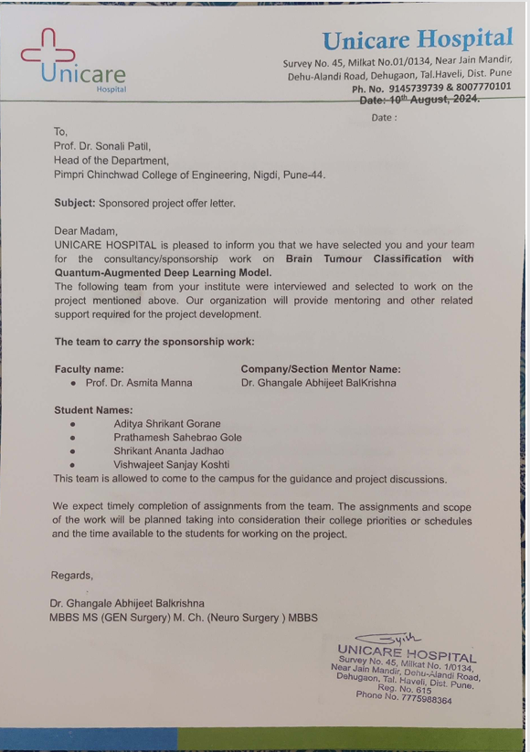
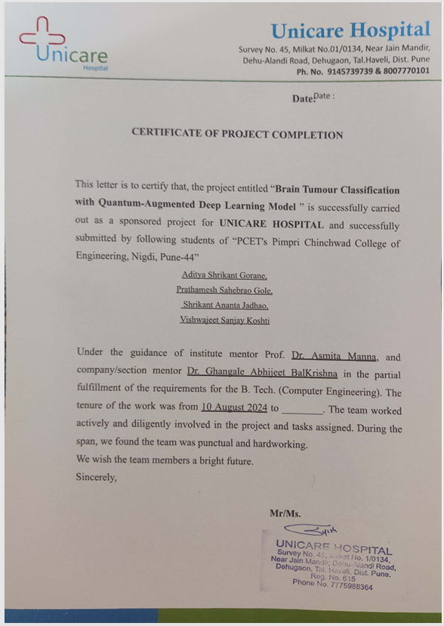
Sponsorship Details

Slide 3
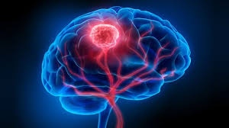
Contents
Problem Statement
Motivation
Objectives
Literature Survey
Software Requirements Specifications
Algorithms & Datasets
System Architecture
Project Plan
Results
Conclusion
Details of Publication
References

Slide 4
Problem Statement
The project addresses the challenge of accurately classifying brain tumors from MRI images, which is often hindered by data imbalance and computational limitations.
This issue is crucial because accurate diagnosis is essential for effective treatment and patient survival. By utilizing a Quantum-Augmented Deep Learning Model, the project aims to improve classification accuracy and efficiency by combining quantum computing principles with deep learning techniques.
The project benefits medical professionals with more reliable diagnostic tools, patients through timely interventions, and the research community by advancing quantum applications in healthcare.

Slide 5
Motivation
• Brain tumour is one of the most dangerous diseases which require early and accurately detection methods.
• Now most detection and diagnosis methods depend on decision of neuro specialists, and radiologist for image evaluation which possible to human errors and time consuming.

Slide 6
Scope & Feasibility
The model aims to enhance tumor classification by integrating classical deep learning with quantum computing for more accurate and efficient predictions.
The approach can be extended to other medical image classification tasks, providing a foundation for future quantum-augmented AI systems in healthcare.
The integration of quantum layers with classical models is feasible with current quantum computing frameworks (e.g., PennyLane), leveraging hybrid computing power.

Slide 7
Objectives
To Compare with Existing Methods: Test our model against traditional AI approaches to prove its accuracy, speed, and reliability.
To Handle Complex Data: Explore how quantum computing can deal with challenging MRI datasets and different imaging conditions.
To Leverage Quantum Potential for Future Advancements: Explore the application of quantum computing in medical imaging to enhance current capabilities and lay the foundation for more advanced and efficient diagnostic tools in the future.

Slide 8
Literature Survey
Websites / Paper / Article | Reviews / Findings | Limitations | Algorithms Used | Accuracy
Imam, R., & Alam, M. T. (2023) | This study investigates the impact of focal loss and oversampling methods like SMOTE and ADASYN on data imbalance. The proposed model combines VGG-16 and CNN, achieving an accuracy of 96% in classifying three brain tumor types. | The study lacks a comprehensive comparison with other models on the same dataset. | VGG-16, CNN | 96%
Talukder, M. A. et al. (2023) | Presents a deep learning model that utilizes transfer learning and fine-tuning techniques with Xception, ResNet50V4, InceptionResNetV4, and DenseNet201. Evaluated with various metrics, showcasing substantial improvements in classification. | Limited dataset diversity may affect model generalization. | Xception, ResNet50V4, InceptionResNetV4, DenseNet201 | 92%

Slide 9
Literature Survey
Websites / Paper / Article | Reviews / Findings | Limitations | Algorithms Used | Accuracy
Paul, S. et al. (2022) | Introduces a YOLOv5 deep learning model for brain tumor segmentation and detection. The model demonstrates effective real-time object detection capabilities and is suitable for brain MRI analysis. | Requires further optimization for precision in complex scenarios. | YOLOv5 | 89%
Guan, Y. et al. (2021) | Focuses on designing a brain tumor classification model aimed at achieving high accuracy with low complexity. The model efficiently classifies tumors using MRI images, showcasing good performance. | May not address specific tumor types comprehensively. | CNN, Transfer Learning | 93%

Slide 10
Literature Survey
Websites / Paper / Article | Reviews / Findings | Limitations | Algorithms Used | Accuracy
Aamir, M. et al. (2022) | This paper discusses a deep learning approach using MRI images for brain tumor classification, highlighting enhanced image quality through optimal contrast techniques. Segmentation and clustering were employed for accuracy. | The model's dependency on image quality may limit its performance in low-quality scans. | CNN | 89.53%
Ayadi, W. et al. (2021) | Proposes a deep CNN for brain tumor classification with minimum preprocessing. The model shows promising results, achieving the best classification accuracies compared to similar works. | Lack of extensive validation on diverse datasets. | Deep CNN | High accuracy compared to peers

Slide 11
Literature Survey
Summary
Most studies leverage advanced deep learning techniques and transfer learning to improve classification accuracy and reduce processing time.
Common limitations include insufficient dataset diversity, a lack of real-time application considerations, and varying levels of detail in model performance reporting.
Overall, while the algorithms demonstrate high potential, there remains room for improvement in their robustness and generalization across different datasets and clinical scenarios.

Slide 12
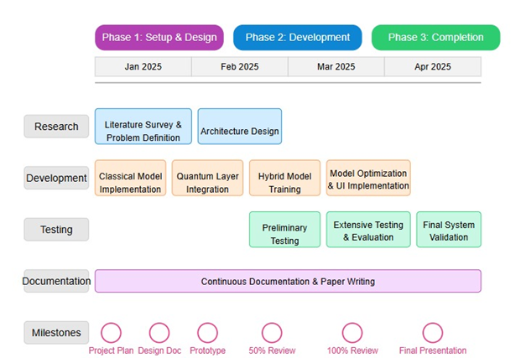
Project Plan

Slide 13
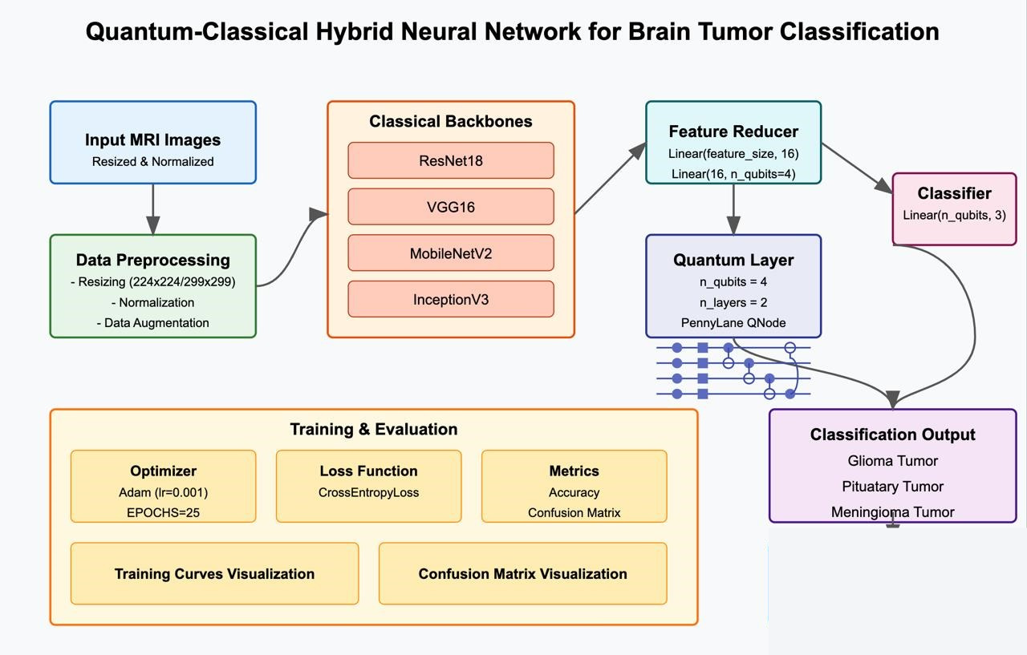
System Architecture

Slide 14
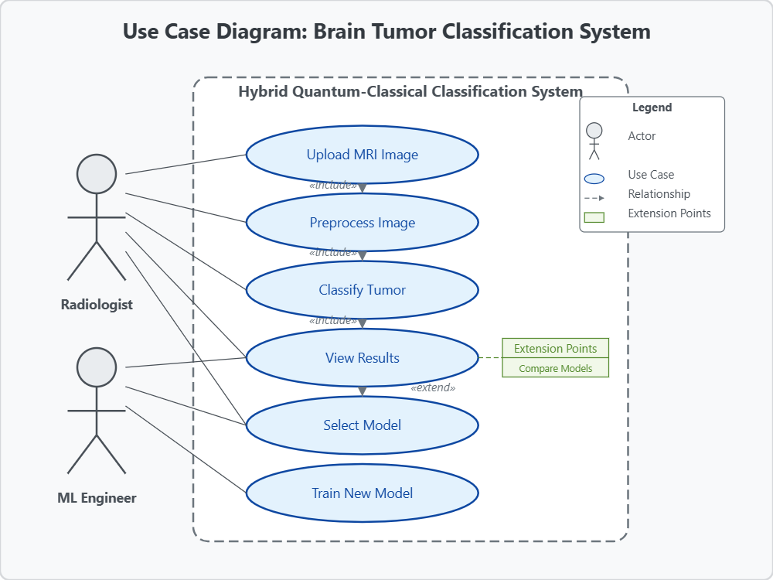
Use Case Diagram

Slide 15
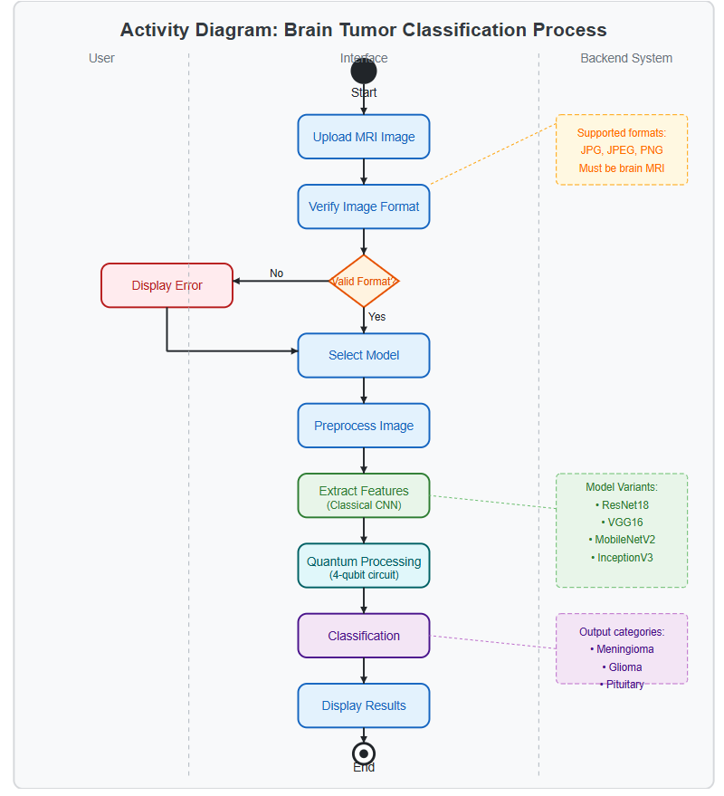
Activity Diagram

Slide 16
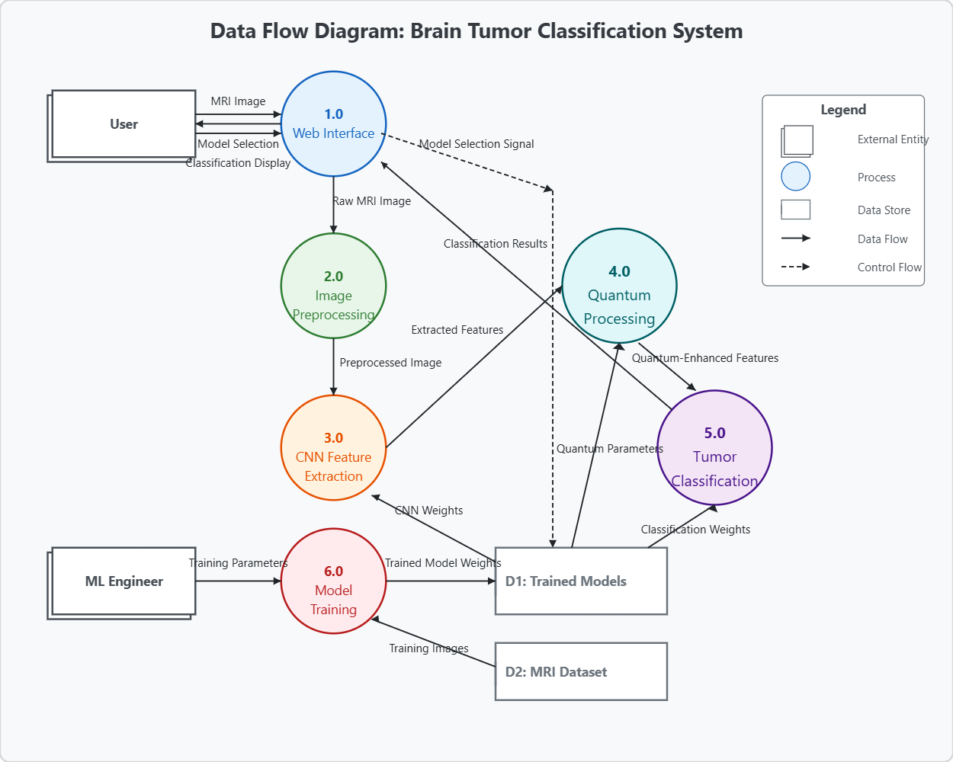
Data Flow Diagram

Slide 17
Algorithms
Resnet18
Vgg16
MobiNetV2
InceptionV3

Slide 18
Software Requirements Specification
S/W Requirements:
PyTorch, PennyLane, Python for deep learning and quantum integration.
OpenCV, PIL for image handling, CUDA for GPU acceleration.
Functional Requirements:
Preprocess medical images, train hybrid classical-quantum model, predict tumor type, evaluate performance.
Non-Functional Requirements:
Scalable, real-time predictions, easy interface, reliable, secure data handling.

Slide 19
Dataset
Diversity and Size:
The datasets primarily consist of MRI images for different types of brain tumors, including meningioma, glioma and pituitary tumors.
3024 T1-weighted contrast-inhanced images with three kinds of brain tumor
Challenges: Limited dataset size and variability are common issues in medical imaging. To address these, data augmentation techniques such as rotation, vertical flipping, and normalization are applied to enhance data diversity without collecting additional samples.
Preprocessing:
Images are resized to uniform dimensions (e.g., 256 × 256 pixels) to maintain consistency.
Techniques like normalization (scaling pixel values) ensure uniformity, improving model convergence during training.

Slide 20
Methodology
Stage 1: Classical Processing and Feature Extraction
Input: MRI Image
Process:
Preprocessing: Image normalization and augmentation.
Feature Extraction: Traditional models extracts high-dimensional feature vectors.
Stage 2: Quantum Classification
Input: Feature vectors from Traditional models.
Process:
Quantum Encoding: Classical features are encoded into quantum states.
Quantum Circuit: A quantum circuit applies quantum gates to process the quantum states.
Measurement: The quantum circuit is measured to obtain classical output probabilities.

Slide 21
Comparaison of Traditional Deep Learning Models
Model | Train Loss | Train Accuracy | Val Loss | Val Accuracy | Training Time
Inception | 0.0149 | 99.90% | 0.1304 | 95.79% | 8m 58s
MobileNet | 0.0086 | 99.95% | 0.1169 | 96.19% | 4m 56s
ResNet | 0.0186 | 99.60% | 0.1224 | 95.99% | 9m 28s
VGG16 | 0.0048 | 99.90% | 0.0929 | 96.19% | 10m 17s

Slide 22
Comparison of Hybrid Models
Model | Train Acc | Val Acc | Train Loss | Val Loss | Training Time (s)
Inception | 98.19% | 93.39% | 0.1391 | 0.2382 | 3350.57
VGG | 33.17% | 33.27% | 1.0987 | 1.0984 | 2812.86
MobileNet | 99.35% | 95.79% | 0.0547 | 0.1575 | 2270.96
ResNet | 99.45% | 94.79% | 0.0480 | 0.1682 | 2581.98

Slide 23
Comparison of Traditional vs. Quantum Integrated Results
MobileNet & ResNet18 still maintain high accuracy after QML integration.
VGG16 shows a major drop, indicating a possible issue with QML adaptation.
Quantum integration significantly increased training time (~4x to 8x for all models).
This is expected, as QML involves quantum circuit simulations which are computationally expensive.
MobileNet achieved the highest validation accuracy (96.99%)
MobileNet suffered the highest time increase (~7.7x), suggesting that MobileNet’s lightweight
nature might not fully align with QML advantages.

Slide 24
Progress with QML
Although validation accuracy slightly decreased, integrating QML into deep learning is a groundbreaking move. The experiment demonstrates:
Pioneering Quantum-Hybrid Models – Even with accuracy fluctuations, the research pushes AI towards quantum advantage.
Higher Training Accuracy (~99%) – QML seems to enhance network fitting power, which could be leveraged with more tuning.
Potential for Future Optimization – With better quantum circuit optimization and hybrid architectures, QML may outperform traditional models.
Proving Feasibility – The fact that QML was successfully integrated into complex models like ResNet & MobileNet is a big achievement.
We used QML in this project to take advantage of Quantum circuit’s ablility to represent complex pattern efficiently, leverages entaglement for learning feature(Qubit) relationship, and explain how quatum models can improve or compliment.

Slide 25
Progress with QML
Higher Expressivity with fewer parameters: Quantum Circuits(Using qubits, RY/RZ rotations, and entangling gates) – more complex functions-fewer parameters.
Quantum Parallelism & Superposition- process more information simultaneously.
Entaglement Captures Correlations-CNOT gates to capture feature interactions and correlations
Hybrid Quantum-classical Learning- benefit from quantum learning while remaining compatible with existing ML pipeline.
Early Research Opportunity

Slide 26
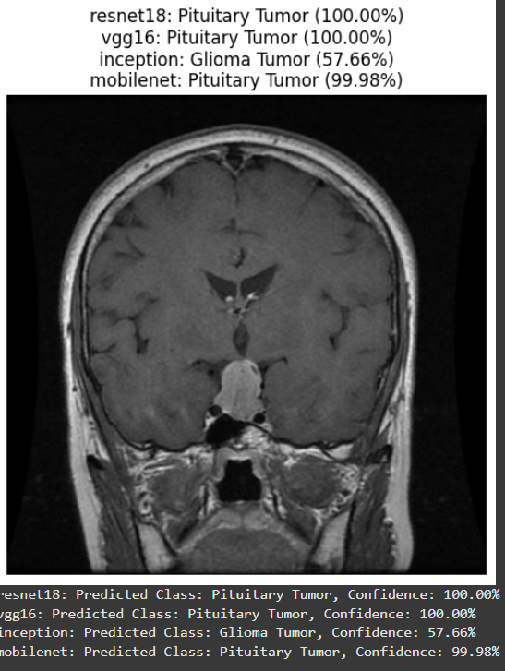
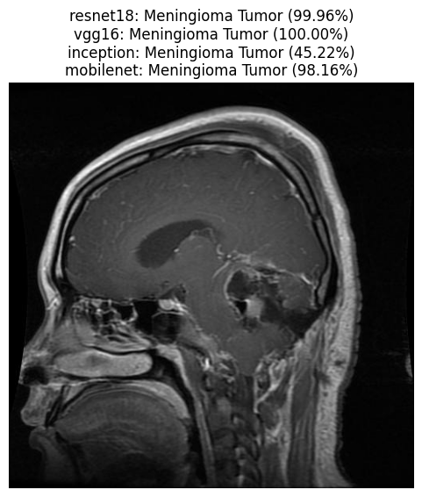
Results

Slide 27
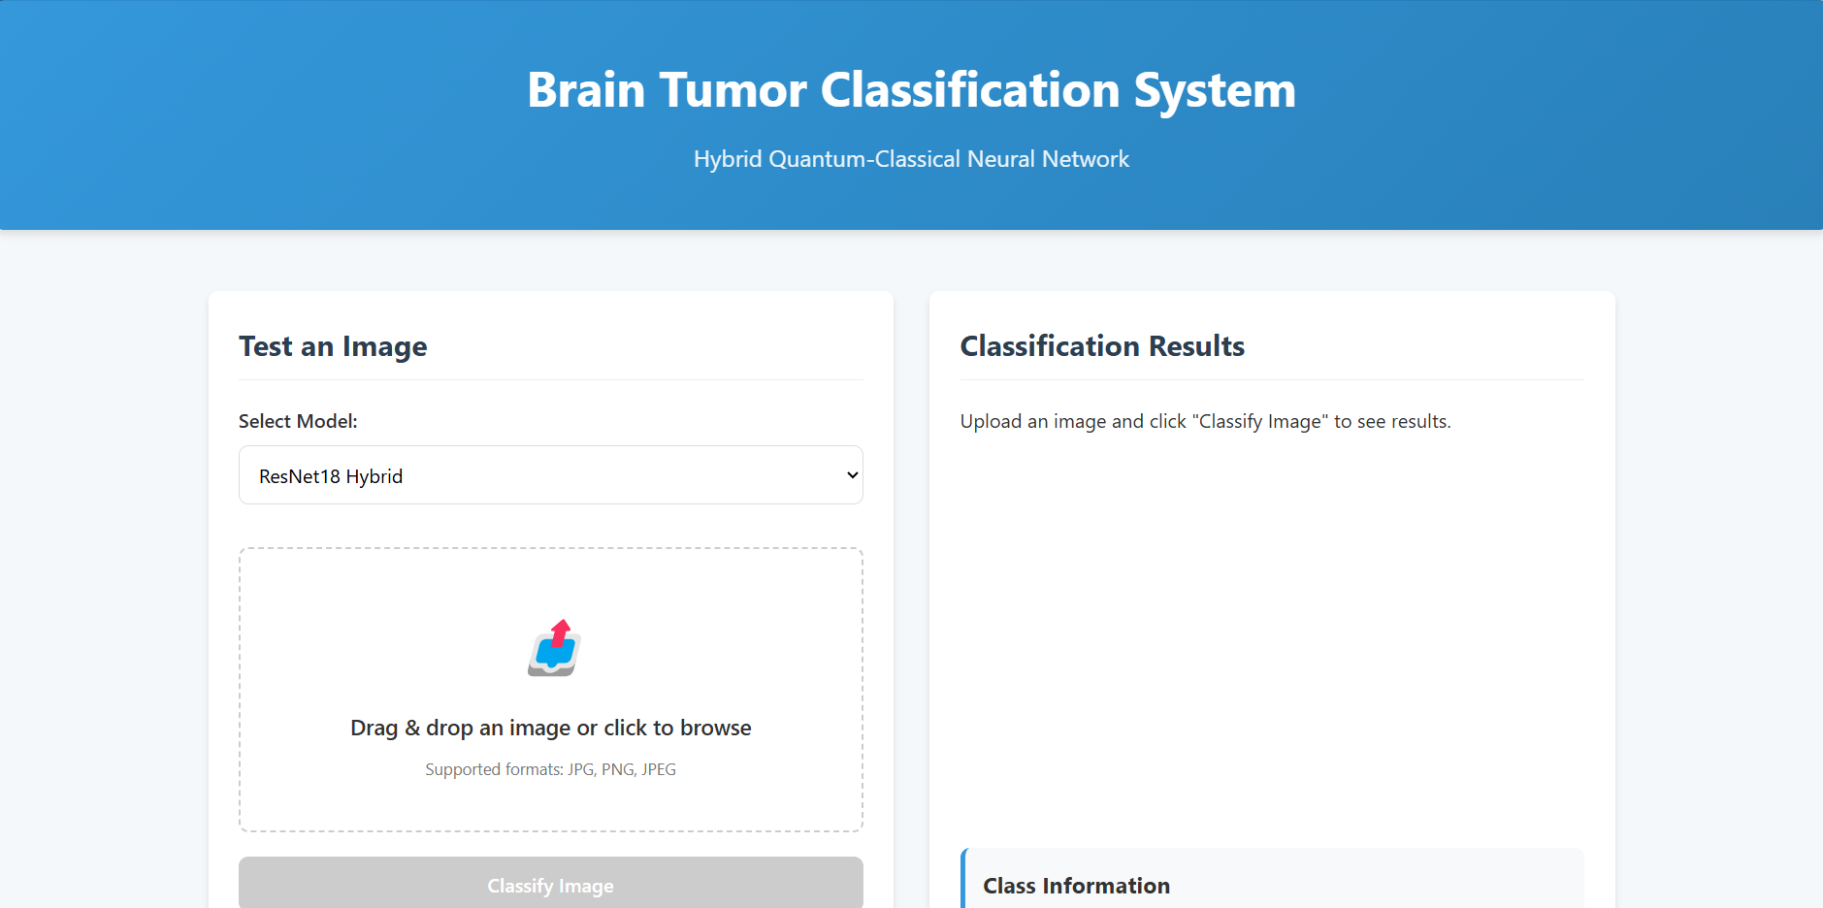
Results

Slide 28
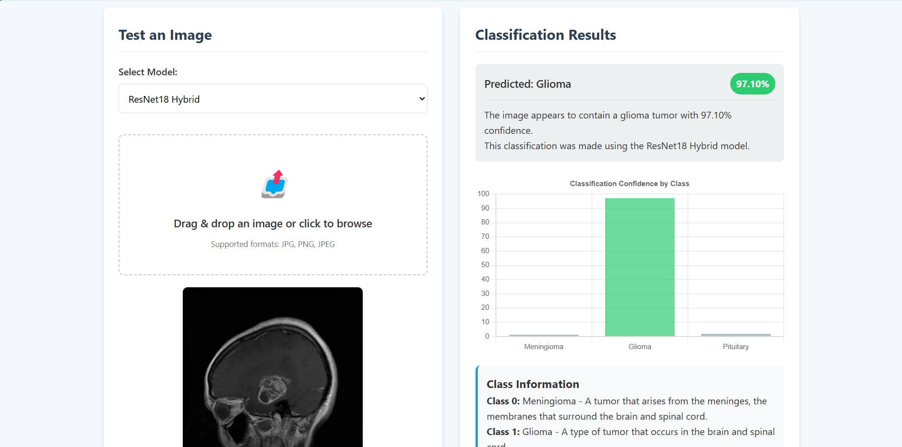
Results

Slide 29
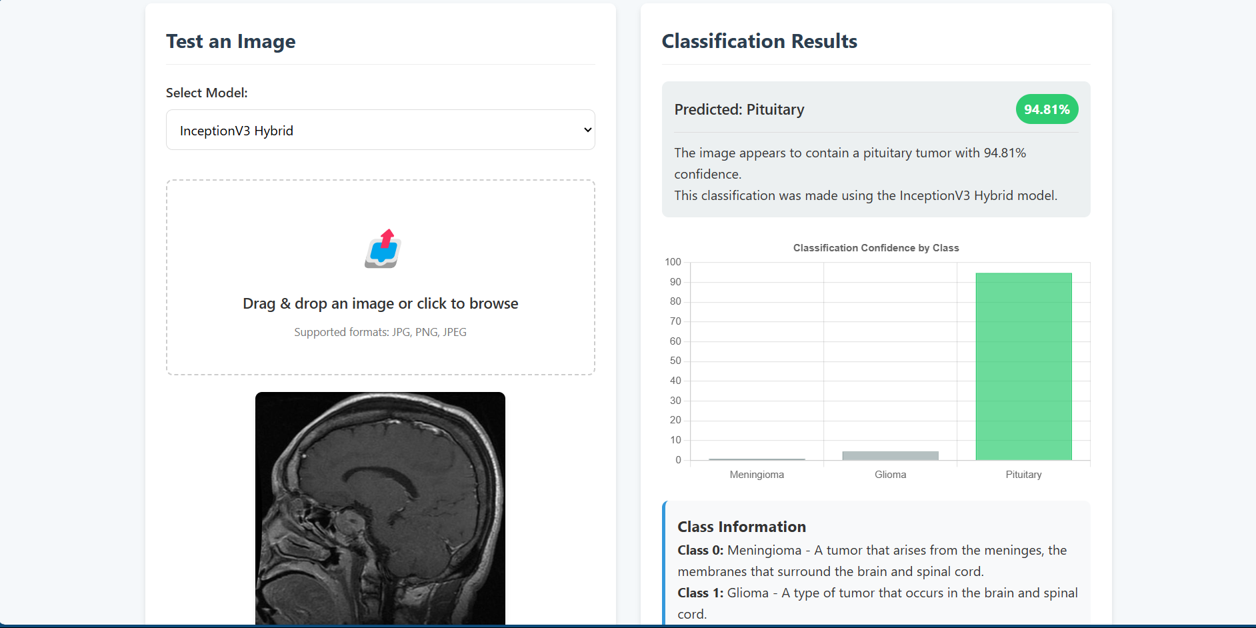
Results

Slide 30
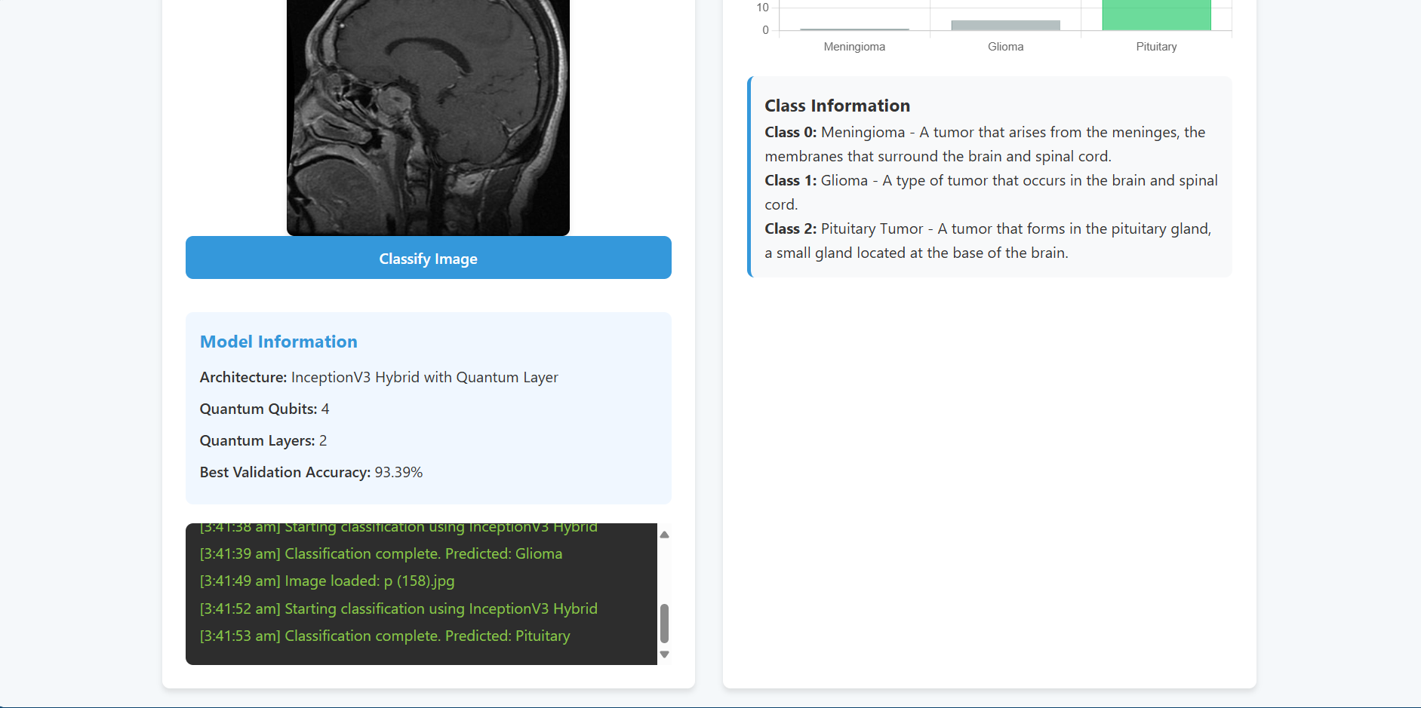
Results

Slide 31
Conclusion
In conclusion, Review I marks a significant milestone in our Quantum Transfer Learning project for patient health analytics.
The current phase demonstrated the integration of quantum techniques, achieving a best validation accuracy of 40.08%. However, classical models like Inception (96.19%) and MobileNet (96.99%) outperformed the quantum-based approach, highlighting the need for further optimization in quantum circuits.
Further experimentation with hybrid quantum-classical models and enhanced quantum encoding is needed to improve performance and match classical benchmarks.

Slide 32
Publication Details
Publication Details – CICBA 2025
📅 Conference Dates: 04 – 06 July, 2025
📍 Venue: Jadavpur University, Kolkata, India (Hybrid Mode)
🏛 Organized by: Department of Information Technology, Jadavpur University
🌐 Website: https://www.cicba.in/
📚 Proceedings Publication Partner: Springer Nature (CCIC Series)
📖 Conference Series: 7th International Conference on Computational Intelligence in Communications and Business Analytics (CICBA)Publication Details – CICBA 2025

Slide 33
References
Irmak, E. (2021). Multi-classification of brain tumor MRI images using deep convolutional neural network with fully optimized framework. Iranian Journal of Science and Technology, Transactions of Electrical Engineering, 45(3), 1015-1036.
Abdusalomov, A. B., Mukhiddinov, M., and Whangbo, T. K. (2023). Brain tumor detection based on deep learning approaches and magnetic resonance imaging. Cancers, 15(16), 4172.
Imam, R. and Alam, M. T. (2023, August). Optimizing Brain Tumor Classification: A Comprehensive Study on Transfer Learning and Im balance Handling in Deep Learning Models. In International Workshop on Epistemic Uncertainty in Artificial Intelligence (pp. 74-88). Cham: Springer Nature Switzerland.
Mercaldo, F., Brunese, L., Martinelli, F., Santone, A., and Cesarelli, M. (2023). Object Detection for Brain Cancer Detection and Localization. Applied Sciences, 13(16), 9158.
Khan, S. U. R., Zhao, M., Asif, S., and Chen, X. (2024). Hybrid-NET: A fusion of DenseNet169 and advanced machine learning classifiers for enhanced brain tumor diagnosis. International Journal of Imaging Systems and Technology, 34(1), e22975.
Shelatkar, T. and Bansal, U. (2022, March). Diagnosis of brain tumor using light weight deep learning model with fine tuning approach. In International Conference on Machine Intelligence and Signal Processing (pp. 105-114). Singapore: Springer Nature Singapore.
Paul, S., Ahad, D. M. T. and Hasan, M. M. (2022). Brain can cer segmentation using yolov5 deep neural network. arXiv preprint arXiv:2212.13599.
Guan, Y., Aamir, M., Rahman, Z., Ali, A., Abro, W. A., Dayo, Z. A., ... and Hu, Z. (2021). A framework for efficient brain tumor classification using MRI images.

Slide 34
References
9. Veeramuthu, A., Meenakshi, S., Mathivanan, G., Kotecha, K., Saini, J. R., Vijayakumar, V., and Subramaniyaswamy, V. (2022). MRI brain tumor image classification using a combined feature and image-based classifier. Frontiers in Psychology, 13, 848784.
10. Talukder, M. A., Islam, M. M., Uddin, M. A., Akhter, A., Pramanik, M. A. J., Aryal, S., ... and Moni, M. A. (2023). An efficient deep learning model to categorize brain tumor using reconstruction and fine-tuning. Expert systems with applications, 230, 120534.
11. Ayadi, W., Elhamzi, W., Charfi, I., and Atri, M. (2021). Deep CNN for brain tumor classification. Neural processing letters, 53, 671-700.
12. Abd El Kader, I., Xu, G., Shuai, Z., Saminu, S., Javaid, I., and Salim Ahmad, I. (2021). Differential deep convolutional neural network model for brain tumor classification. Brain Sciences, 11(3), 352.
13. Subbiah, Geetha & Krishnakumar, Shridevi & Asthana, Nitin & Balaji, Prasanalakshmi & Vaiyapuri, Thavavel. (2023). Quantum transfer learning for image classification. TELKOMNIKA (Telecommunication Computing Electronics and Control). 21. 113. 10.12928/telkomnika.v21i1.24103.

Slide 35
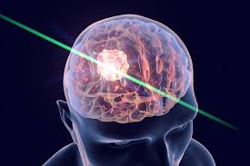
Thank You
Brain Tumour can be cured…

