Slide 1
BANK ANALYTICS
Group 3:
Polishetti Lourdu Vasantha
Mochapalli Jagannath
Vinayak Shirke
Vishwajeet Patil

Slide 2
INDEX
Excel Dashboards
Power BI Dashboard
Tableau Dashboard
SQL Syntaxes
Banking Analytics KPIs Insights
Bank Debit and Credit Data KPIs Insights
Conclusion, Challenges

Slide 3
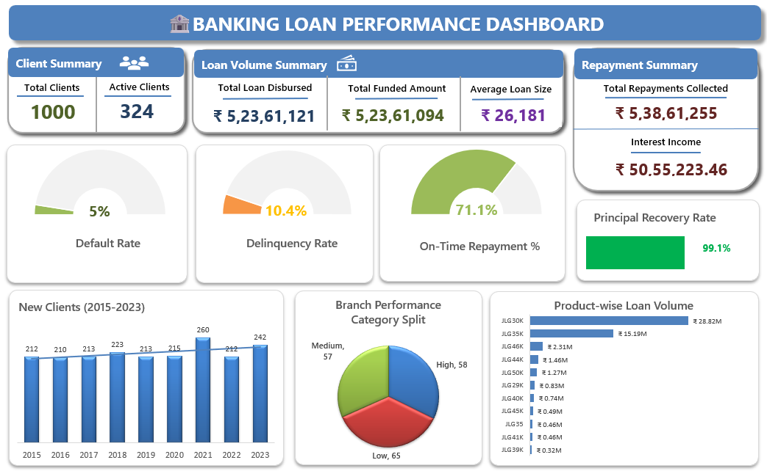
EXCEL DASHBOARD

Slide 4
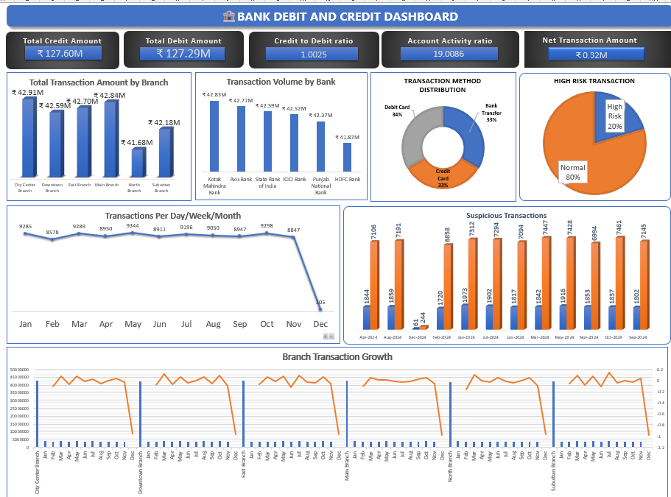
EXCEL DASHBOARD

Slide 5
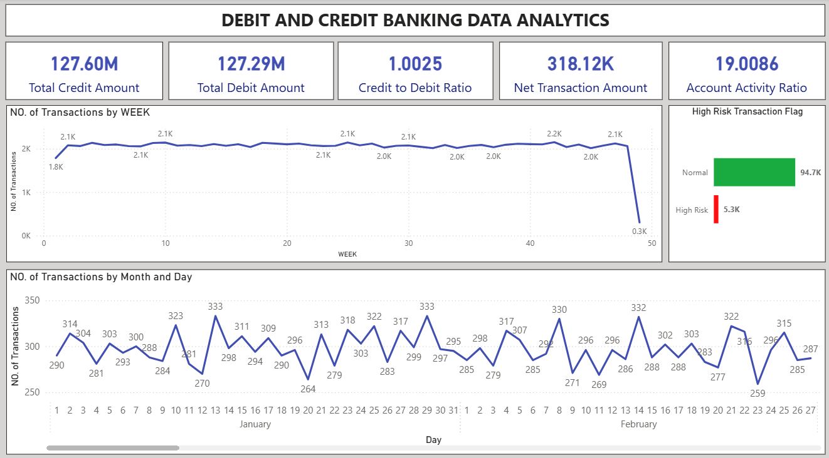
POWER BI DASHBOARD

Slide 6
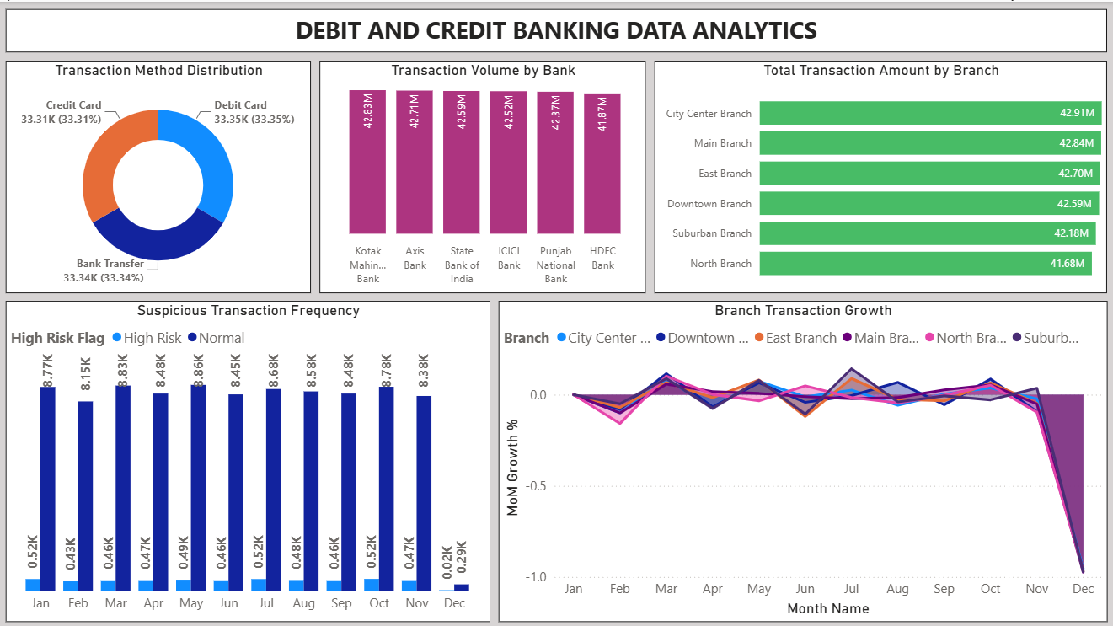
POWER BI DASHBOARD

Slide 7
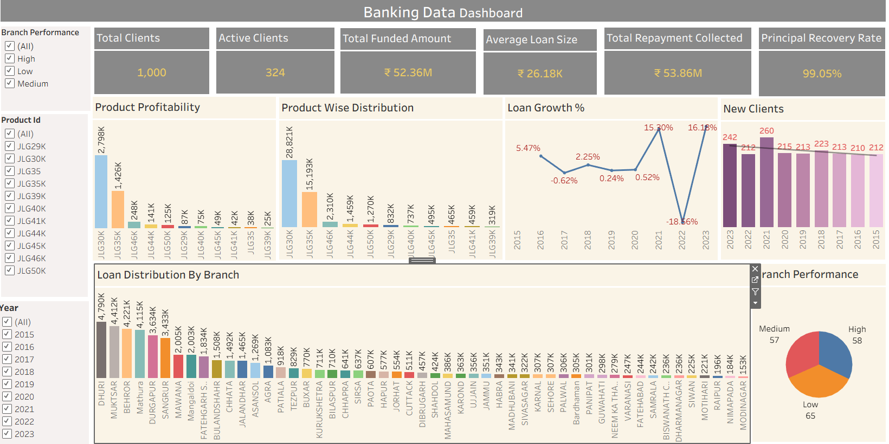
TABLEAU DASHBOARD

Slide 8
BANKING DATA ANALYSIS
1.TOTAL CLIENTS
SELECT COUNT(*) FROM dim_client;
2. ACTIVE CLIENTS
SELECT COUNT(DISTINCT Client_ID) FROM fact_loan WHERE Loan_Status NOT IN ('Default’);
3. TOTAL LOAN AMOUNT
SELECT CONCAT(ROUND(SUM(Loan_Amount) / 1000000, 1), 'M') AS Total_Loan FROM fact_loan;
4. TOTAL FUNDED AMOUNT
SELECT CONCAT(ROUND(SUM(Funded_Amount) / 1000000, 1), 'M') AS Total_Funded_Amount FROM fact_loan;
5. AVERAGE LOAN SIZE
SELECT CONCAT(ROUND(AVG(Loan_Amount) / 1000000, 2), 'M') AS Avg_Loan_Amount FROM fact_loan;
6. TOTAL REPAYMENTS COLLECTED
SELECT CONCAT(ROUND(SUM(Total_Pymnt) / 1000000, 1), 'M') AS Total_Payment FROM fact_repayment;
7. PRINCIPAL RECOVERY RATE
SELECT CONCAT(ROUND((SUM(Total_Rec_Prncp) / SUM(Loan_Amount)) * 100, 2),'%') AS Recovery_Rate FROM fact_loan JOIN fact_repayment ON fact_loan.Account_ID = fact_repayment.Account_ID;
8. INTEREST INCOME
SELECT CONCAT(ROUND(SUM(Total_Rrec_Int) / 1000000, 1), 'M') AS Total_Recovered_Interest FROM fact_repayment;
9. DEFAULT RATE
SELECT CONCAT(ROUND((SUM(CASE WHEN Is_Default_Loan = 'Y' THEN 1 ELSE 0 END) / COUNT(*)) * 100,2),'%') AS Default_Rate FROM fact_repayment;
10. DELIQUENCY RATE
SELECT CONCAT(ROUND((SUM(CASE WHEN Is_Delinquent_Loan = 'Y' THEN 1 ELSE 0 END) / COUNT(*)) * 100,2),'%') AS Delinquency_Rate FROM fact_repayment;
11. ON TIME REPAYMENT
SELECT CONCAT(ROUND((SUM(CASE WHEN Repayment_Behavior = 'On-Time' THEN 1 ELSE 0 END) / COUNT(*)) * 100,2),'%') AS On_Time_Repayment_Rate FROM fact_repayment;
12. LOAN DISTRIBUTION BY BRANCH
SELECT b.Branch_Name,CONCAT(ROUND(SUM(o.Loan_Amount) / 1000000, 1), 'M') AS Total_Loan FROM fact_loan o JOIN dim_branch b ON o.BranchID = b.BranchID GROUP BY b.Branch_Name ORDER BY SUM(o.Loan_Amount) DESC;

Slide 9
CREDIT & DEBIT DATA ANALYSIS
1.TOTAL CREDIT AMOUNT
SELECT CONCAT(ROUND(SUM(Amount) / 1000000, 1),'M') AS Total_Credit_Amount FROM debit_credit_csv WHERE Transaction_Type = 'Credit’;
2. TOTAL DEBIT AMOUNT
SELECT CONCAT(ROUND(SUM(Amount) / 1000000, 1),'M') AS Total_Debit_Amount FROM debit_credit_csv WHERE Transaction_Type = 'Debit’;
3. CREDIT AND DEBIT RATIO
SELECT CONCAT(ROUND((SUM(Amount) /(SELECT SUM(Amount)FROM debit_credit_csv WHERE Transaction_Type = 'Debit')) * 100,2),'%') AS Credit_to_Debit_Ratio FROM debit_credit_csv WHERE Transaction_Type = 'Credit’;
4. NET TRANSACTION CASHFLOW
SELECT CONCAT(ROUND((SUM(Amount) - (SELECT SUM(Amount)FROM debit_credit_csv WHERE Transaction_Type = 'Debit')) / 1000000,1),'M') AS Net_Transaction_Amount FROM debit_credit_csv WHERE Transaction_Type = 'Credit’;
5. ACCOUNT ACTIVE RATIO
SELECT CONCAT(ROUND((COUNT(Account_Number) / AVG(Balance))),'%') AS Account_Activity_Ratio FROM debit_credit_csv;
6. TOTAL TRANSACTION AMOUNT BY BRANCH
SELECT Branch,CONCAT(ROUND(SUM(Amount) / 1000000, 1),'M') AS Total_Transaction_Amount FROM debit_credit_csv GROUP BY Branch ORDER BY SUM(Amount) DESC;
7.TRANSACTIONS PER DAY/WEEK/MONTH
-- TRANSACTIONS PER DAY
SELECT DATE(`Transaction_Date`) AS Transaction_Day, COUNT(*) AS Total_Transactions FROM debit_credit_csv GROUP BY DATE(`Transaction_Date`) ORDER BY Transaction_Day;
-- TRANSACTIONS PER WEEK
SELECT YEAR(`Transaction_Date`) AS Year, WEEK(`Transaction_Date`) AS Week_No, COUNT(*) AS Total_Transactions FROM debit_credit_csv GROUP BY YEAR(`Transaction_Date`),WEEK(`Transaction_Date`)ORDER BY Year, Week_No;
-- TRANSACTIONS PER MONTH
SELECT DATE_FORMAT(`Transaction_Date`,'%Y-%m') AS Month,COUNT(*) AS Total_Transactions FROM debit_credit_csv GROUP BY DATE_FORMAT(`Transaction_Date`,'%Y-%m')ORDER BY Month;

Slide 10
CREDIT & DEBIT DATA ANALYSIS
8. TRANSACTION VOLUME BY BANK
SELECT Bank_Name,CONCAT(ROUND(SUM(Amount) / 1000000, 1),'M') AS Total_Transaction_Amount FROM debit_credit_csv GROUP BY Bank_Name ORDER BY SUM(Amount) DESC;
9. TRANSACTION METHOD DISTRIBUTION
SELECT Transaction_Method,COUNT(Account_Number) AS Transaction_count FROM debit_credit_csv GROUP BY Transaction_Method;
10.SUSPICIOUS TRANSACTION FREQUENCY
SELECT DATE_FORMAT(`Transaction_Date`,'%Y-%m') AS Month,COUNT(*) AS Suspicious_Transactions FROM high_risk_transaction_flag WHERE Risk_Flag='High Risk’ GROUP BY DATE_FORMAT(`Transaction_Date`,'%Y-%m')ORDER BY Month;
11. BRANCH TRANSACTION GROWTH
SELECT Branch,CONCAT(ROUND(Total_Amount / 1000000, 0), 'M') AS Total_Amount,CONCAT(ROUND(((Total_Amount - Previous_Amount) / Previous_Amount) * 100, 2),'%') AS Growth_Percentage FROM (SELECT Branch, SUM(Amount) AS Total_Amount, LAG(SUM(Amount)) OVER (ORDER BY Branch) AS Previous_Amount FROM debit_credit_csv GROUP BY Branch) AS t;
12. HIGH RISK TRANSACTION FLAG
SELECT Risk_Flag, COUNT(*) AS Total_Transactions FROM (SELECT CASE WHEN Amount > 4000 THEN 'High Risk’ ELSE 'Normal’ END AS Risk_Flag FROM debit_credit_csv ) AS t GROUP BY Risk_Flag;

Slide 11


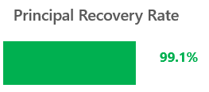
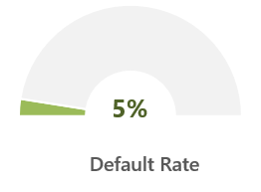
BANKING KPIs - Insights
TOTAL CLIENTS
The bank maintained a customer base of 1,000 clients during the analysis period.
ACTIVE CLIENTS
Out of 1,000 clients, 324 clients remained actively engaged with the bank.
PRINCIPA RECOVERY RATE
The bank achieved a 99.05% recovery rate, indicating timely repayment of loans.
DEFAULT RATE
Only 5% of loans are in default, indicating good credit quality,
showing strong repayment discipline.
However, the impact depends on loan size — if those 5% are large loans,
the financial risk is higher than if they’re small ones

Slide 12
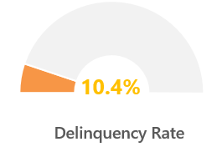
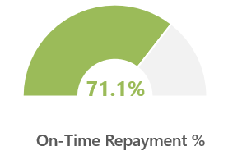
BANKING KPIs - Insights
DELINQUENCY RATE
Delinquent ≠ Default → A delinquent loan is late, but the borrower may still catch up.
A defaulted loan is considered uncollectible.
A lower delinquency rate means borrowers are paying on time,
which reflects strong repayment discipline.
A higher delinquency rate signals repayment stress and increases the risk
that some loans may eventually default.
ON TIME REPAYMENT %
It indicates that 71.1% of all loan repayments were made on or before their due dates,
while the remaining 28.9% were delayed or overdue.
Improving this metric (for example, through reminders or flexible payment plans)
can reduce delinquency and enhance cash flow stability.

Slide 13





BANKING KPIs - Insights
TOTAL AMOUNT FUNDED
The total value of loans funded is ₹52.36 M
AVERAGE LOAN SIZE
The typical loan amount per borrower is ₹26.18k
TOTAL LOAN DISBURSED
The total amount of money actually given out to borrowers by the bank is ₹52.36 M
TOTAL REPAYMENTS COLLECTED
The total amount recovered from borrowers by the bank is ₹53.86 M
INTEREST INCOME
The bank earned over ₹50 lakh from interest payments.

Slide 14
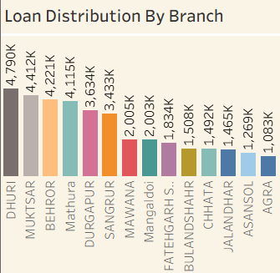
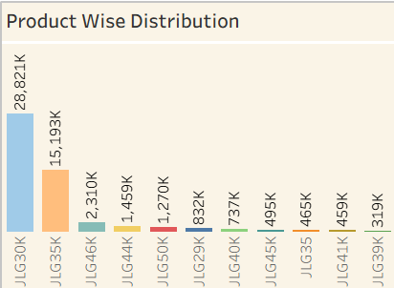
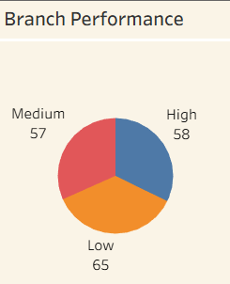
BANKING KPIs - Insights
LOAN AMOUNT BY BRANCH
Dhuri Branch recorded the highest loan amount (₹4.8M) among all branches.
Durgapur Branch recorded the lowest loan amount (₹1.1M) during the analysis period.
PRODUCT-WISE LOAN VOLUME
Service loans recorded the highest loan volume, contributing significantly to the overall portfolio.
Agriculture and Factory loans accounted for the lowest share of total loans.
BRANCH PERFORMANCE
Out of 180 branches, 36% are low-performing, while 64% are medium or high-performing.
Focusing on improving low-performing branches presents the greatest opportunity to increase overall performance.

Slide 15
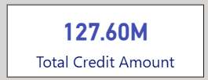
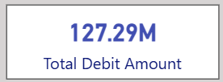
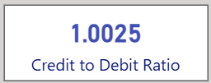
BANK DEBIT AND CREDIT DATA KPIs- Insights
Total Credit Amount
Total amount received is 127.60M. Credit volume nearly matches debit, showing balanced fund movement.
2. Total Debit Amount
Total amount debited is 127.29 M. Outflow is slightly lower than inflow, suggesting efficient fund utilization and minimal liquidity gaps.
3. Credit to Debit Ratio
A ratio close to 1 shows equilibrium between credits and debits — ideal for maintaining financial stability.

Slide 16
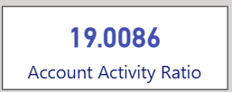
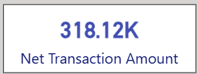
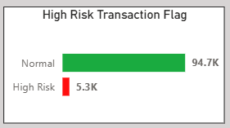
BANK DEBIT AND CREDIT DATA KPIs- Insights
4. Account Activity Ratio
Indicates how active a customer is in relation to their balance.
High activity ratio reflects frequent transactions, implying strong customer engagement and operational throughput.
5. Net Transaction Amount
Positive net value means credits slightly exceed debits, contributing to a small surplus
6. High Risk Transactions
Flag transactions that exceed a predefined amount or show irregular activity (e.g., large withdrawals or deposits).
Insight: Helps to identify potentially fraudulent transactions that need further investigation.

Slide 17
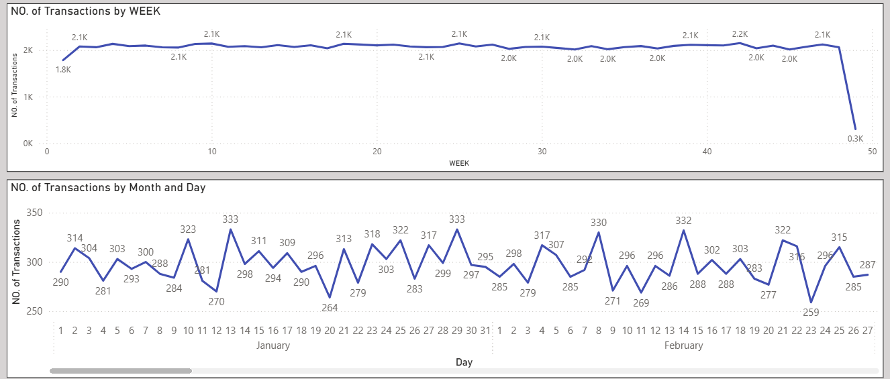
BANK DEBIT AND CREDIT DATA KPIs- Insights
7. Transactions per Day/Week/Month:
Identifies transaction volume trends over time, helping to detect periods of high or low activity

Slide 18
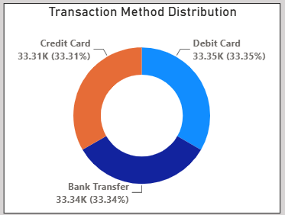
BANK DEBIT AND CREDIT DATA KPIs- Insights
8. Transaction Method Distribution
Measures the total transaction volume per branch, helping to compare branch performance.

Slide 19
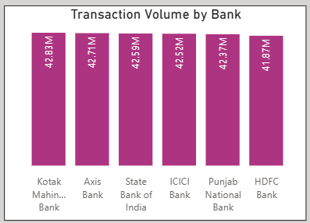
BANK DEBIT AND CREDIT DATA KPIs- Insights
9. Transaction Volume by Bank
Helps compare the performance of different banks in terms of transaction activity.

Slide 20
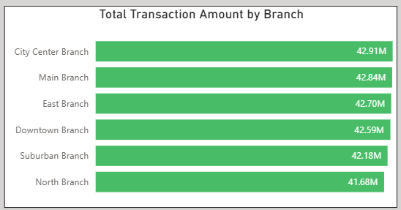
BANK DEBIT AND CREDIT DATA KPIs- Insights
10. Total Transaction Amount by Branch
Measures the total transaction volume per branch, helping to compare branch performance.

Slide 21
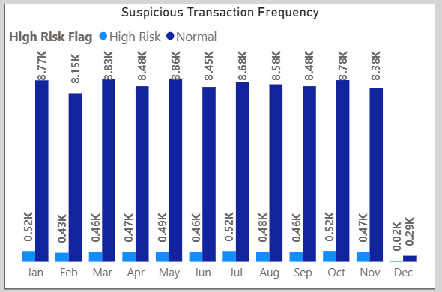
BANK DEBIT AND CREDIT DATA KPIs- Insights
11. Suspicious Transaction Frequency
Formula: Count of flagged high-risk transactions over a period.
Insight: Measures the frequency of potentially suspicious transactions

Slide 22
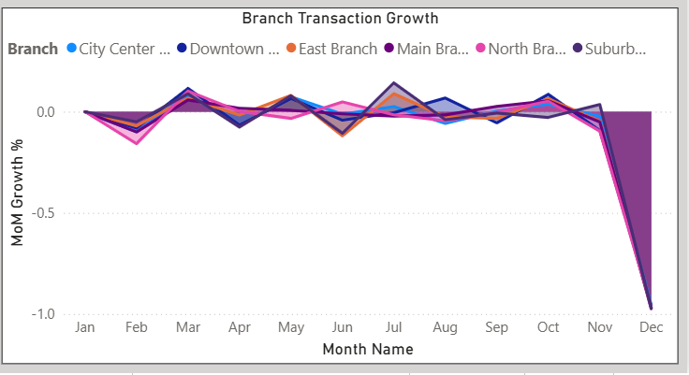
BANK DEBIT AND CREDIT DATA KPIs- Insights
12. Branch Transaction Growth
Formula: Percentage change in the total transaction amount or volume at each branch over a defined period.
Insight: Identifies whether a particular branch is growing or declining in terms of transaction volume.

Slide 23
CONCLUSION, INSIGHTS & CHALLENGES
CONCLUSION
STRONG CUSTOMER BASE
HEALTHY TRANSACTION ECOSYSTEM
ROBUST LOAN PERFORMANCE
LOW CREDIT RISK
CHALLENGES
DATA CONSISTENCY.
RISK IDENTIFICATION.
CUSTOMER BEHAVIOR ANALYSIS.
PERFORMANCE COMPARISON.
ADDING BUSINESS INSIGHTS
CUSTOMER RETENTION ANALYSIS –
Identify low-activity customers and improve customer engagement strategies.
HIGH RISK CUSTOMER TRACKING –
Monitor delayed repayment customers to reduce future default risks

Slide 24
THANK YOU

