Slide 1



HC-05
Bluetooth
Training Presentation

Slide 2

Topics
Introduction to HC-05
Specification
Features
Pin Configuration
Interfacing

Slide 3

Introduction to HC-05

Slide 4
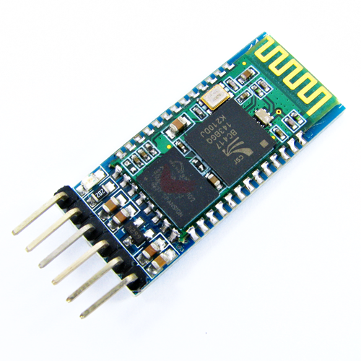
What is Bluetooth HC-05 ?
Introduction
HC-05
HC‐05 module is an easy to use Bluetooth SPP (Serial Port Protocol) module, designed for transparent wireless serial connection setup.
Serial port Bluetooth module is fully qualified Bluetooth V4.0+EDR (Enhanced Data Rate) 3Mbps Modulation with complete 2.4GHz radio transceiver and baseband.

Slide 5
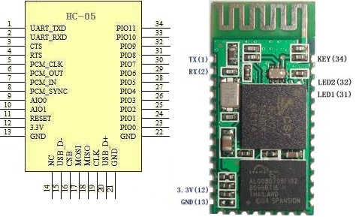
HC-05 Bluetooth Specification
Hardware
HC-05
Typical ‐80dBm sensitivity.
Up to +4dBm RF transmit power.
Low Power 1.8V Operation, 3. to 5 V I/O.
UART interface with programmable baud rate.
With integrated antenna.
With edge connector.

Slide 6
HC-05 Bluetooth Specification
Software
HC-05
Slave default Baud rate: 9600, Data bits:8, Stop bit:1,Parity:No parity.
PIO9 and PIO8 can be connected to red and blue led separately.
Auto‐connect to the last device on power as default.
Permit pairing device to connect as default.
Auto‐pairing PINCODE: “1234” as default.

Slide 7
HC-05 Bluetooth Specification
Software
HC-05
Auto‐reconnect in 30 min when disconnected as a result of beyond the range of connection.
When master and slave are paired, red and blue led blinks 1time/2s in interval, while disconnected only blue led blinks 2times/s.

Slide 8
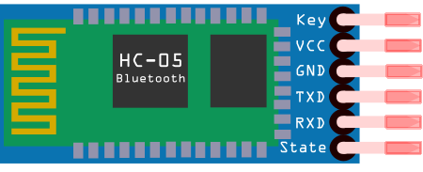
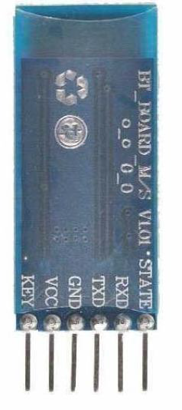
HC-05 Bluetooth Pin Configuration
Pinout
HC-05
KEY: This pin has to be pulled high to enter AT mode.
VCC: Indicated range is 3.6 to 6 volt. To be on safer side, you should connect it to 3.3 Volt.
GND: Ground.
RXD: Serial input pin.
TXD Serial output pin.

Slide 9
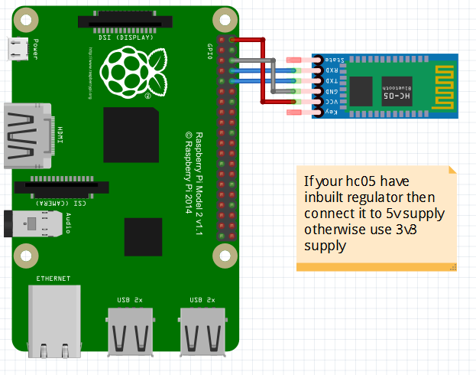
HC-05 Bluetooth Interfacing
Pinout
HC-05
HC05 RPi3
Tx -----> Rx(GPIO15)
Rx -----> Tx (GPIO14)
GND -----> GND
Vcc -----> 5v

Slide 10
HC-05 Bluetooth AT Command
AT Command
AT : Check the connection.
AT+NAME : See default name
AT+ADDR : see default address
AT+VERSION : See version
AT+UART : See baudrate
AT+ROLE: See role of bt module(1=master/0=slave)
AT+RESET : Reset and exit AT mode
AT+PSWD: see default password
AT+ORGL : Restore factory settings
HC-05

Slide 11
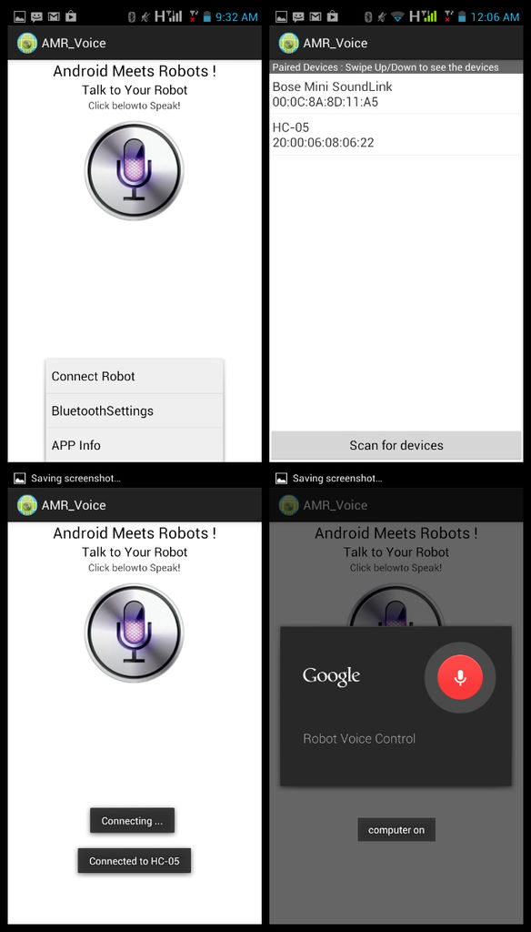
How to connect with Android App
Steps
Pair the HC-05 module with your Android Phone. Default Pairing Key is- ‘1234’
In Android App, select the device under ‘Paired Devices’ menu
Once the LED on HC-05 starts blinking in a slower manner, then it is connected to the Phone.
Ready to send the commands and control your Machine.

Slide 12


Slide 13


