Slide 1





Planning an architecture for the
Internet of Things

Slide 2

Why plan for an IoT stack?
6

Slide 3

Everything needs to connect
50,000,000,000+
connected devices
7
7

Slide 4











Connecting the physical world to the Web
Building Management
Environmental
Connected Car
Social & Local
Home Automation
Logistics & Shipping
Personalized Insurance
Identity & Tracking
Healthcare
Energy Grid
Farming
8
8

Slide 5

Architectural patterns in an
IoT stack
9

Slide 6





At a high level this is the general IoT stack
App
Data Processing and Platform
Edge
Thing / Device

Slide 7
Breaking down the IoT stack
11

Slide 8
The IoT Stack
Websites
Industry specific
( e.g., appliances, touch console etc.)
Mobile apps
Mobile aPaaS
Application PaaS ( aPaaS )
iPaaS Middle- ware
API
Design / Build
API runtime management
Data Management and Intelligence
Device Hub/Gateway
Device Management
Sensors
Hardware / Firmware

Slide 9

IoT Stack: Devices / Things
Sensors
Hardware / Firmware
13

Slide 10
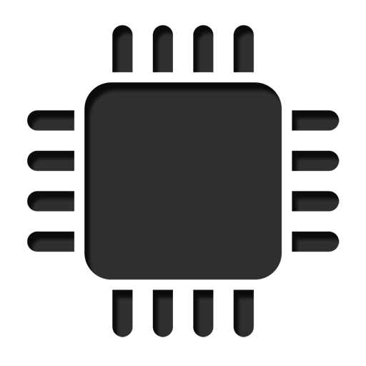







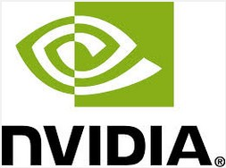

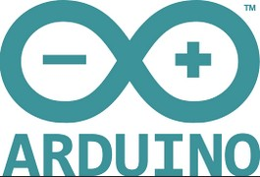

Devices: Many chipsets / platforms to choose from.
( Becoming more and more vertically integrated with software stacks).

Slide 11

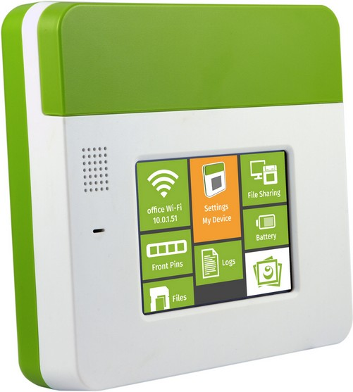
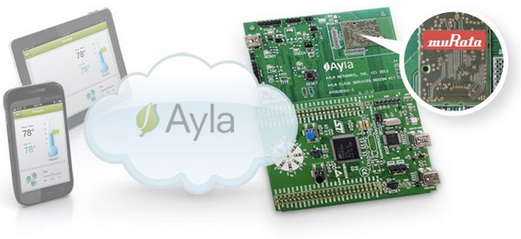
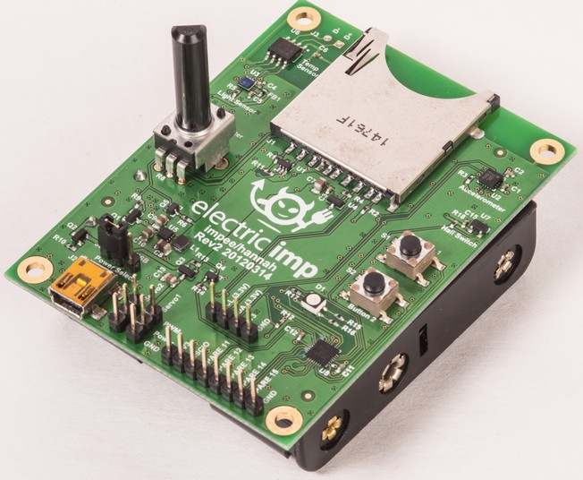
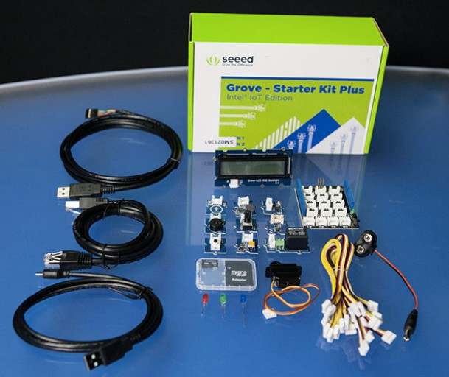
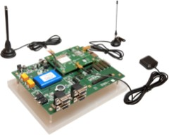
Big focus on prototyping:
Lots of tools to cater to the makers and tinkerers
Integrated SDKs to speed development, testing and optimization.

Slide 12
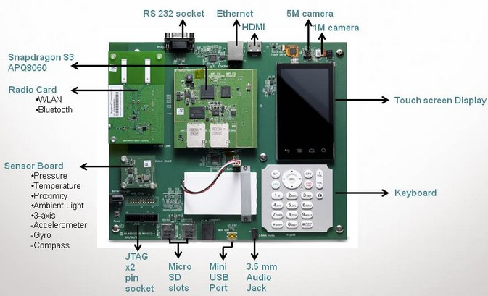
Dragonboard based on Snapdragon processor ( many more like this from many vendors )

Slide 13
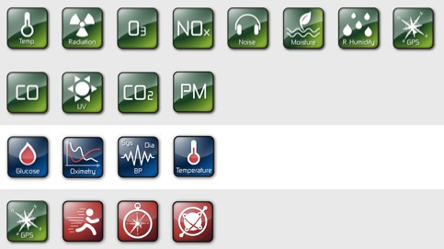
Sensors: Smart or Simple
Smart Sensors
Simple Sensors
Onboarding
Receive Notifications
Receive Config
Send Data / Events

Slide 14

IoT Stack: Device Edge
Device Hub/Gateway
Device Management
Sensors
Hardware / Firmware
18

Slide 15






IoT Stack: Device Edge
Key charter is to establish and maintain a secure, robust, fault-tolerant connection between the cloud and the edge devices in order to:
Collect and aggregate device data
Manage the device
Device Hub/Gateway
Device Management
Sensors
Hardware / Firmware
19

Slide 16
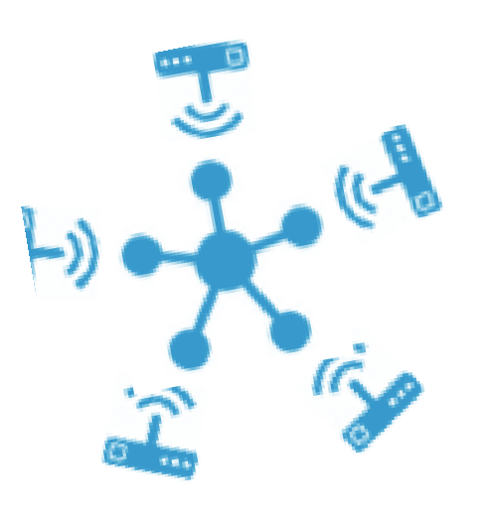







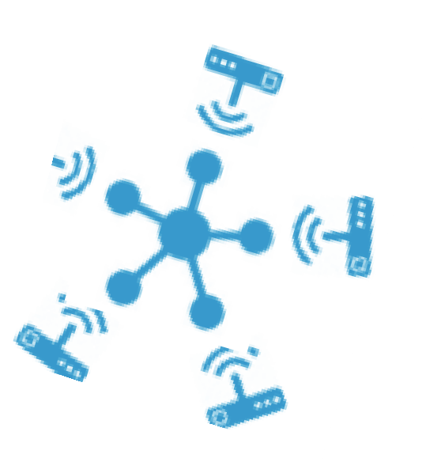



Typically a combination of a localized gateway, and a cloud based gateway, at the edge

Slide 17


Reference capabilities for a gateway
Enable scalable, real-time, dependable, high- performance and interoperable data and device management related exchanges between publishers and subscribers
Connectivity
Software mgmt
Registry
Routing
Control Events
Actuator
Aggregation
Transformation
Provisioning

Slide 18









Device, and Device gateway sprawl is going to be a challenge
Too many disparate ecosystems. Too many gateways, hubs, protocols, apps.

Slide 19
Solution to the sprawl: A hub of all hubs
Need interoperability between devices/ machines so they can all talk to each other.

Slide 20



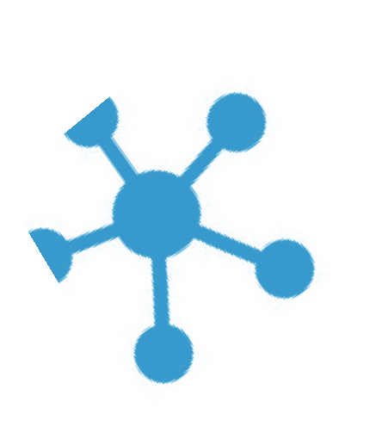






Solution to the sprawl: A hub of all hubs

Slide 21

IoT Stack: Data management and intelligence
Data Management and Intelligence
Device Hub/Gateway
Device Management
Sensors
Hardware / Firmware
25

Slide 22

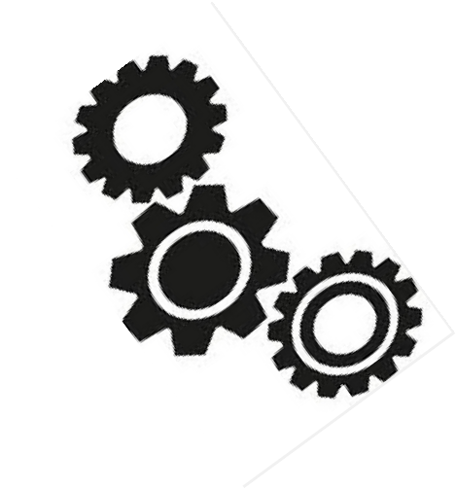
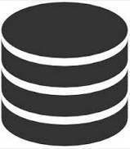

Capabilities required for Data Management and Intelligence
Data collection, storage, and analysis of sensor data
Run rules on data streams
Trigger alerts
Advanced analytics/machine learning
Expose HTTP (REST) APIs
Data, HTTP, connectivity
Data enrichment
Pattern Discovery/ Model re-training
Real time event processing
Routing and Orchestration
Driving Forces Identification
Batch processing
BigData solution connectivity
Predictive Analysis

Slide 23

IoT Stack: API lifecycle tooling and platform
API
Design / Build
API runtime management
Data Management and Intelligence
Device Hub/Gateway
Device Management
Sensors
Hardware / Firmware
.
27

Slide 24


API lifecycle tooling can be split between design time and runtime
Rapidly design, deploy and publish APIs
API
Design / Build
API runtime management

Slide 25


API lifecycle: Design time capabilities
Rapidly design, deploy and publish APIs
API
Design / Build
API runtime management
API design lifecycle
API spec creation
Reusable API patterns
API mocking/ modelling
Deployment automation

Slide 26


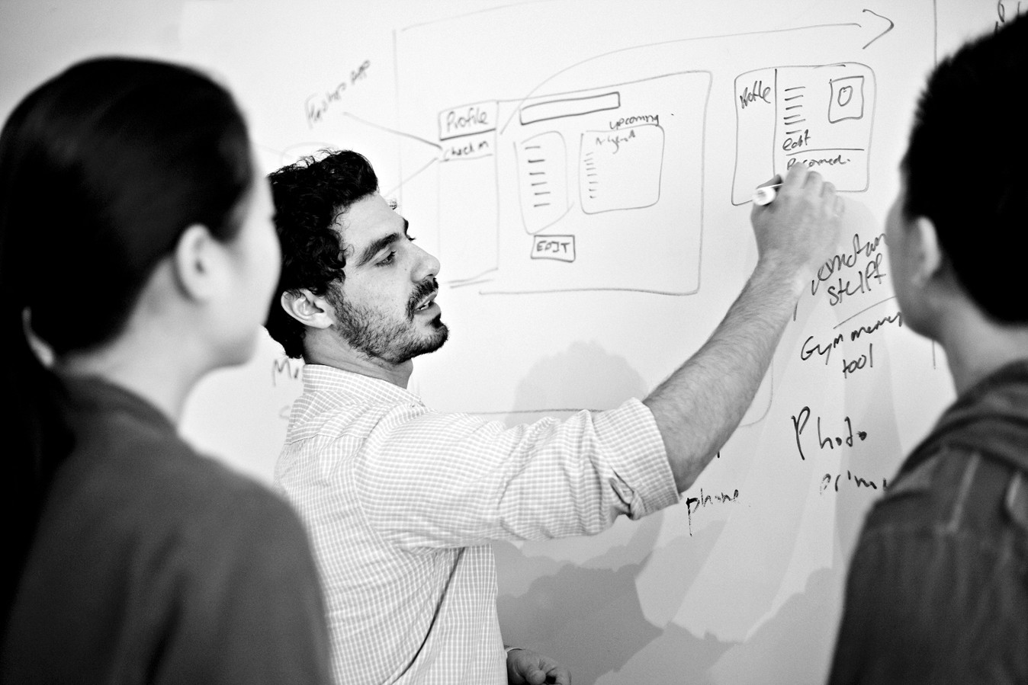
Outside In API development: What if we could whiteboard an API ? Springboard for optimizing “APX”
API
Design / Build

Slide 27


API lifecycle: Runtime capabilities
Rapidly design, deploy and publish APIs
API
Design / Build
API runtime management
Rate limiting / Throttling
Multi-tenant org / RBAC support
API SLA
management
Deployment automation
Custom policy engine
API and data security

Slide 28

















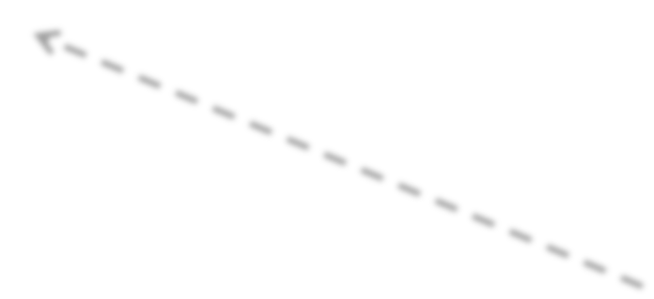



API runtime management
API runtime management
App Developer
Make app
..…
Discover, understand, and sign-up to use API
Rate limit
Throttle
OAuth2
LDAP/AD auth
IP whitelisting
Transformations etc.
API Gateway
Developer Portal
Publish, Document APIs
API
API
API
33

Slide 29

IoT Stack: Application PaaS ( aPaaS )
Application PaaS ( aPaaS )
 | API Design / Build |  | API runtime management
Data Management and Intelligence
Device Hub/Gateway
Device Management
Sensors
Hardware / Firmware
34

Slide 30



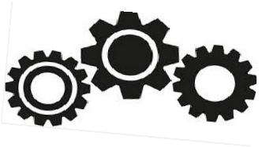
aPaaS capabilities
Application PaaS ( aPaaS )
Hosted in the cloud
Provides platform to build applications.
OS/DB, Storage, Server,
Design and Development tooling
Management and analytics tooling
Network
Routing, transform, orchestration services
Web, Database, Application Server
Administrative portal

Slide 31

IoT Stack: End applications
Websites
Industry specific
( e.g., appliances, touch console etc.)
Mobile apps
Mobile aPaaS
Application PaaS ( aPaaS )
API
Design / Build
API runtime management
Data Management and Intelligence
Device Hub/Gateway
Device Management
Sensors
Hardware / Firmware
36

Slide 32
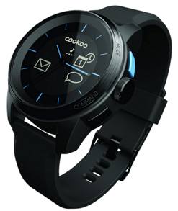
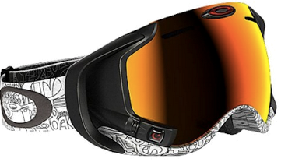
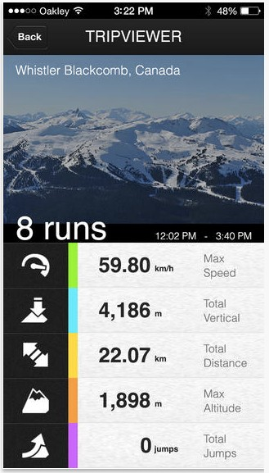

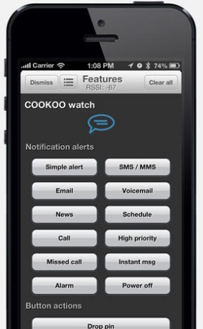
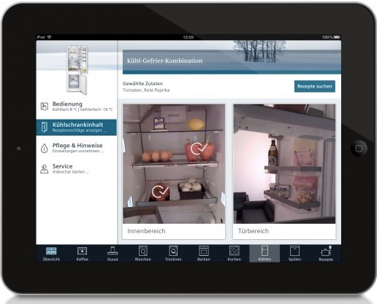
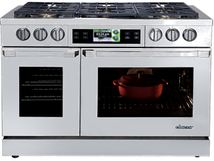
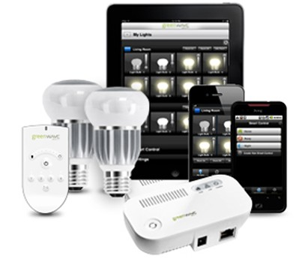
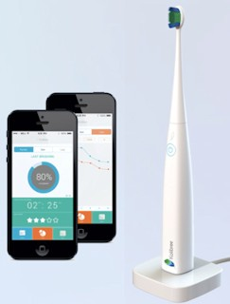
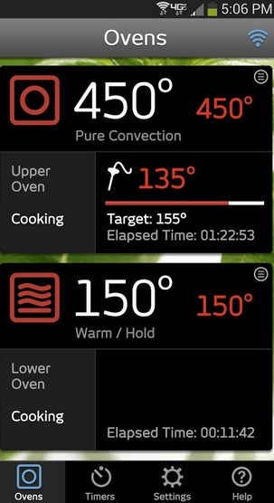
IoT/IoE is a driver of mobile / tablet interfaces
c.
37

Slide 33


IoT Stack: iPaaS integration – middleware: Don’t forget to integrate!
iPaaS middleware
Websites
Industry specific
( e.g., appliances, touch console etc.)
Mobile apps
Mobile aPaaS
Application PaaS ( aPaaS )
iPaaS Middle- ware
API
Design / Build
API runtime management
Data Management and Intelligence
Device Hub/Gateway
Device Management
Sensors
Hardware / Firmware
38

Slide 34
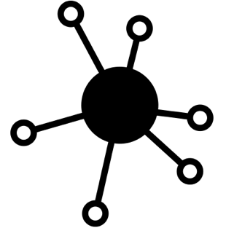


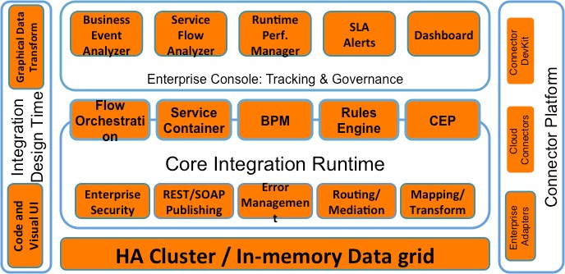
iPaaS Capabilities: Don’t forget to integrate!

Slide 35
Summary

Slide 36


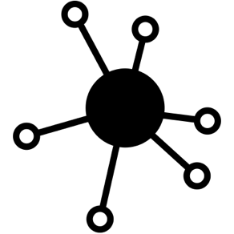

















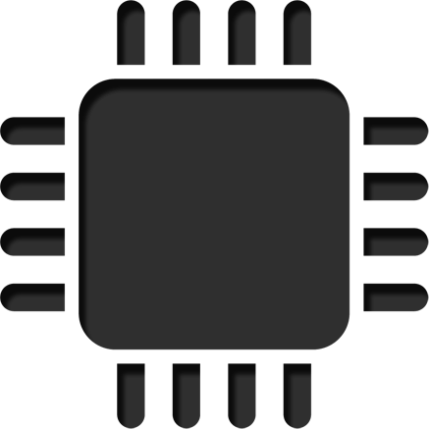

IoT Stack
Websites |  | Industry specific ( e.g., appliances, touch console etc.) | Mobile apps
 |  |  |  | Mobile aPaaS
iPaaS middleware
Application PaaS ( aPaaS )
API Design / Build |  | API runtime management
Data Management
Device Hub/Gateway
Device Management
Sensors
All contents Copyright © 2013, MuleSoft Inc.
41

Slide 37
One final thought: the stack as it exists today is also converging…
App
Data Processing and Platform
Edge
Thing / Device

Slide 38


Scenarios where the middleware and edge have converged ( i.e., MuleSoft Anypoint Edge )
App
Data Processing and Platform
Edge
Thing / Device

Slide 39



And there are also scenarios where the app layer is directly connected to the Thing/Device layer ( i.e., embedded Android, Java, Javascript etc. )
Apps
Data Processing and Platform
Edge
Thing / Device

Slide 40
Thank you!
Questions?

