Slide 1



Sensors
Training Presentation

Slide 2

Topics
Introduction to sensors
Types of sensors
Features
Pin Configuration
Interfacing

Slide 3

Introduction to Sensors

Slide 4

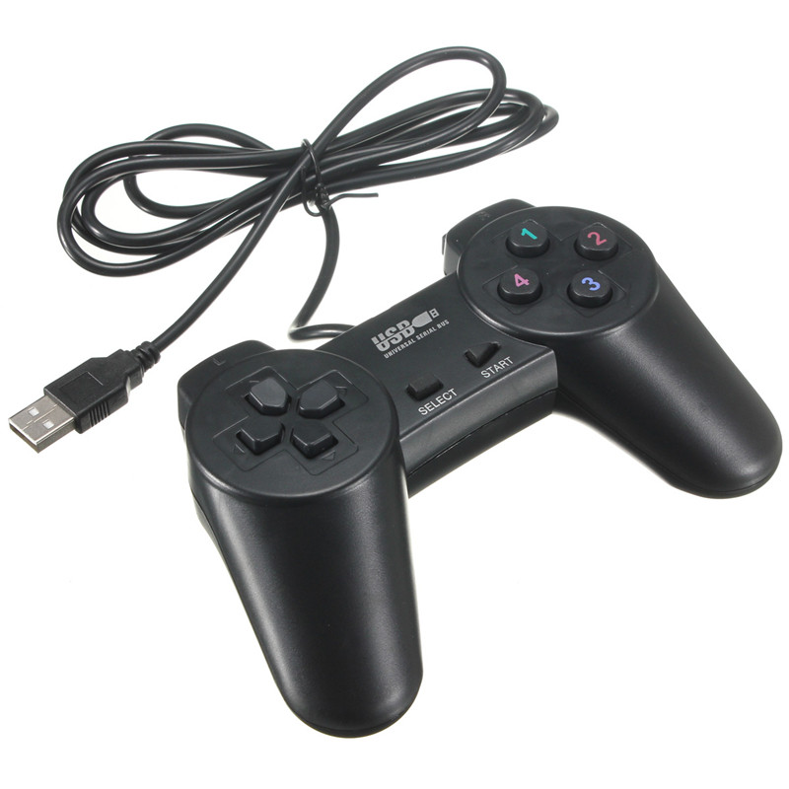
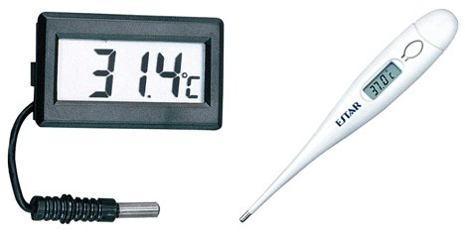
What is Sensor ?
Introduction
Example
A sensor is a device that measures a physical quantity and converts it into a signal which can be read by an observer or by an instrument.
Sensors are used in everyday objects such as touch-sensitive elevator, buttons (tactile sensor) and lamps which dim or brighten by touching the base.

Slide 5
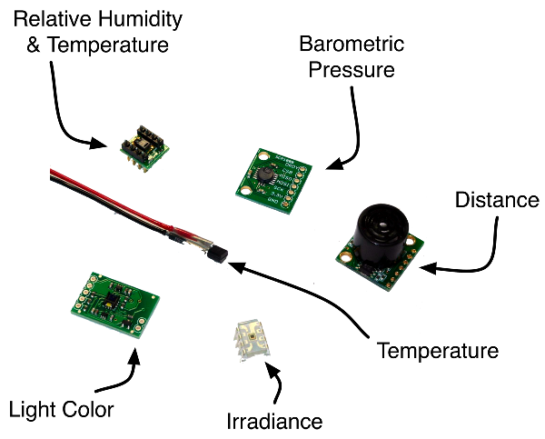
Types of Sensors
Hardware
Sensors
Infrared Proximity Sensor
Sound Sensor
Temperature Sensor
Soil Moisture Sensor
Obstacle detector
Temperature& Humidity Sensor
Pressure Sensor

Slide 6
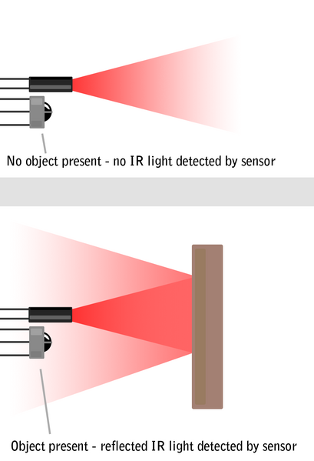
Infrared Proximity Sensor
IR Sensor
Example
IR sensor works on the principle of emitting IR rays and receiving the reflected ray by a receiver (Photo Diode).
IR source (LED) is used in forward bias.
IR Receiver (Photodiode) is used in reverse bias.

Slide 7
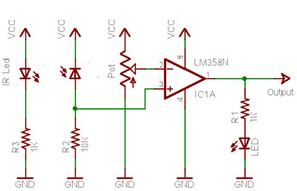
IR Sensor Circuit

Slide 8
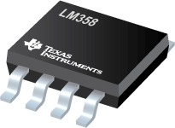
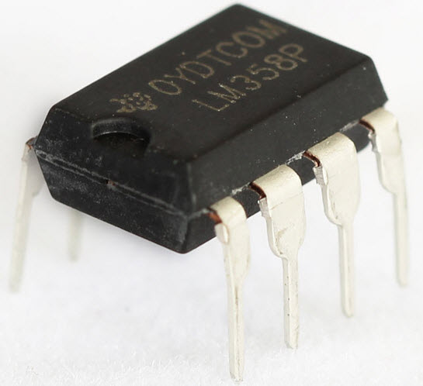
Voltage Comparator
LM358
LM358
A Comparator is a device which compares two voltages or currents and switches its output to indicate which is larger.
Comparator is also know as Op-amp.

Slide 9
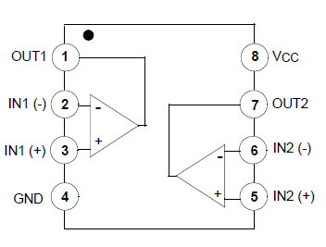
PIN Diagram LM358

Slide 10
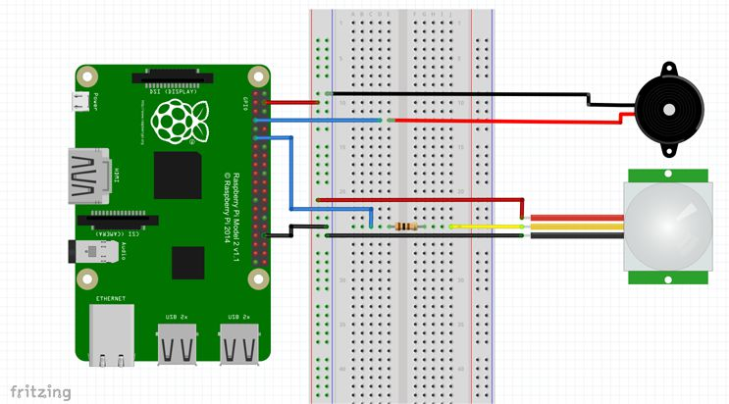
Sensor Interfacing with RPi

Slide 11
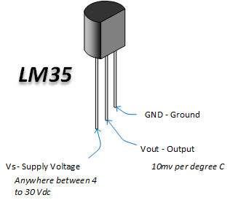
Temperature Sensor LM35
Introduction
Example
The LM35 is an integrated circuit sensor that can be used to measure temperature with an electrical output proportional to the temperature (in ºC).
The scale factor is 10mV/ºC .

Slide 12
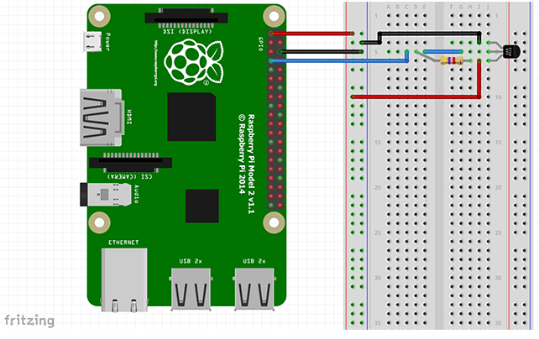
Sensor Interfacing with RPi

Slide 13
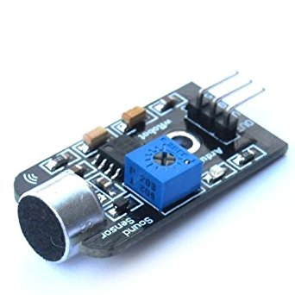
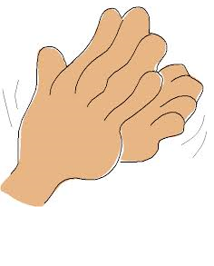
Sound Sensor
Introduction
Sound Sensor is a simple microphone transducer based sensor based on the Transistor Amplification which converts from sound energy into electrical energy.
Adjustable range of detection.
Single bit active - high output.
3 - pin male header make it ready to use for breadboard
Example

Slide 14
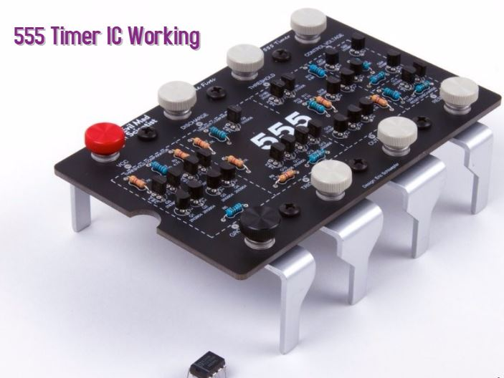
555 Timer IC
Introduction
The 555 Timer IC is an integrated circuit (chip) implementing for variety of timer and multivibrator applications.

Slide 15
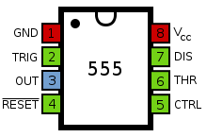
Pin Diagram
GND - Pin 1 connects the 555 timer chip to ground.
Trigger - The trigger is an active low trigger, which means that the timer starts when voltage on pin 2 drops to below 1/3 of the supply voltage.
Output - The output pin is where you would connect the load like led, motor etc.
Reset – Pin 4 is the reset pin. This can be used to reset the 555 timer’s timing operation.

Slide 16
Pin Diagram
Ctrl Voltage - This pin is simply connected to GND, usually through a small capacitor, about 0.01 µF capacitor. It helps to level out any fluctuations in the power supply.
THR - The purpose of this pin is to monitor the voltage across the capacitor that's discharged by pin 7 .
DIS - This pin is used to discharge an external capacitor
Vcc – 4.5 V to 15 V

Slide 17
Modes of Operation
Monostable Mode
Bistable Mode
Astable Mode

Slide 18
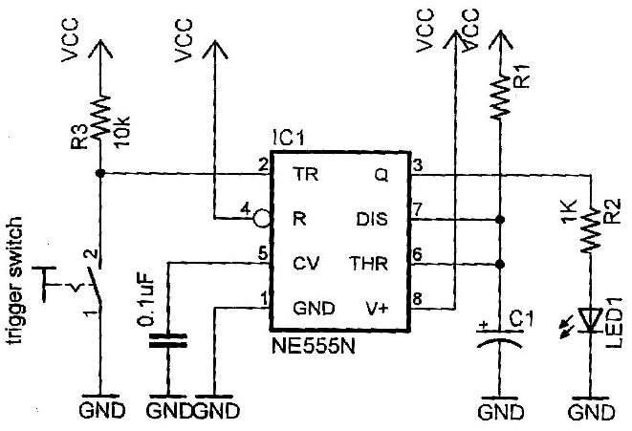
Monostable Mode
In this mode, the 555 functions as a "one-shot"
Applications include timers, missing pulse detection, bouncefree switches, touch switches, frequency divider, capacitance measurement, pulse-width modulation (PWM) etc

Slide 19
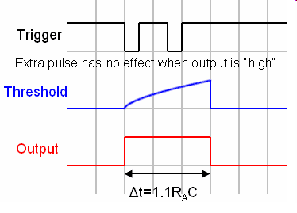
Monostable Mode
The pulse begins when the 555 timer receives a trigger signal.
The width of the pulse is determined by the time constant of an RC network, which consists of a capacitor (C1) and a resistor (R1).
The pulse width can be lengthened or shortened to the need of the specific application by adjusting the values of R and C.
^{T = 1.1 X R1 X C1}

Slide 20
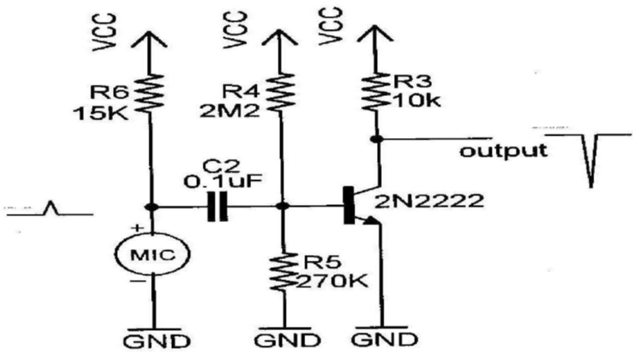
Triggering Circuit of Sound Sensor

Slide 21
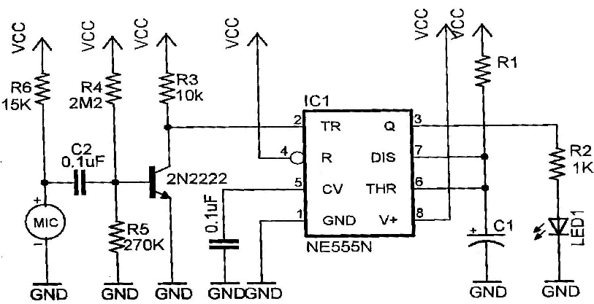
Sound Sensor circuit

Slide 22
Sensor Interfacing with RPi

Slide 23
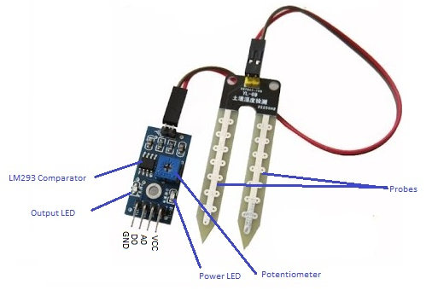
Soil Moisture Sensor
Introduction
This soil moisture sensor is used to sense the present of water in soil and gives some output voltage to the processor to execute according to the instruction given by the user.

Slide 24
Feature of Soil Moisture Sensor
Feature
Power supply: 3.3v or 5v
Output voltage signal: 0~4.2v
Current: 35mA
Output – Analog & digital both

Slide 25
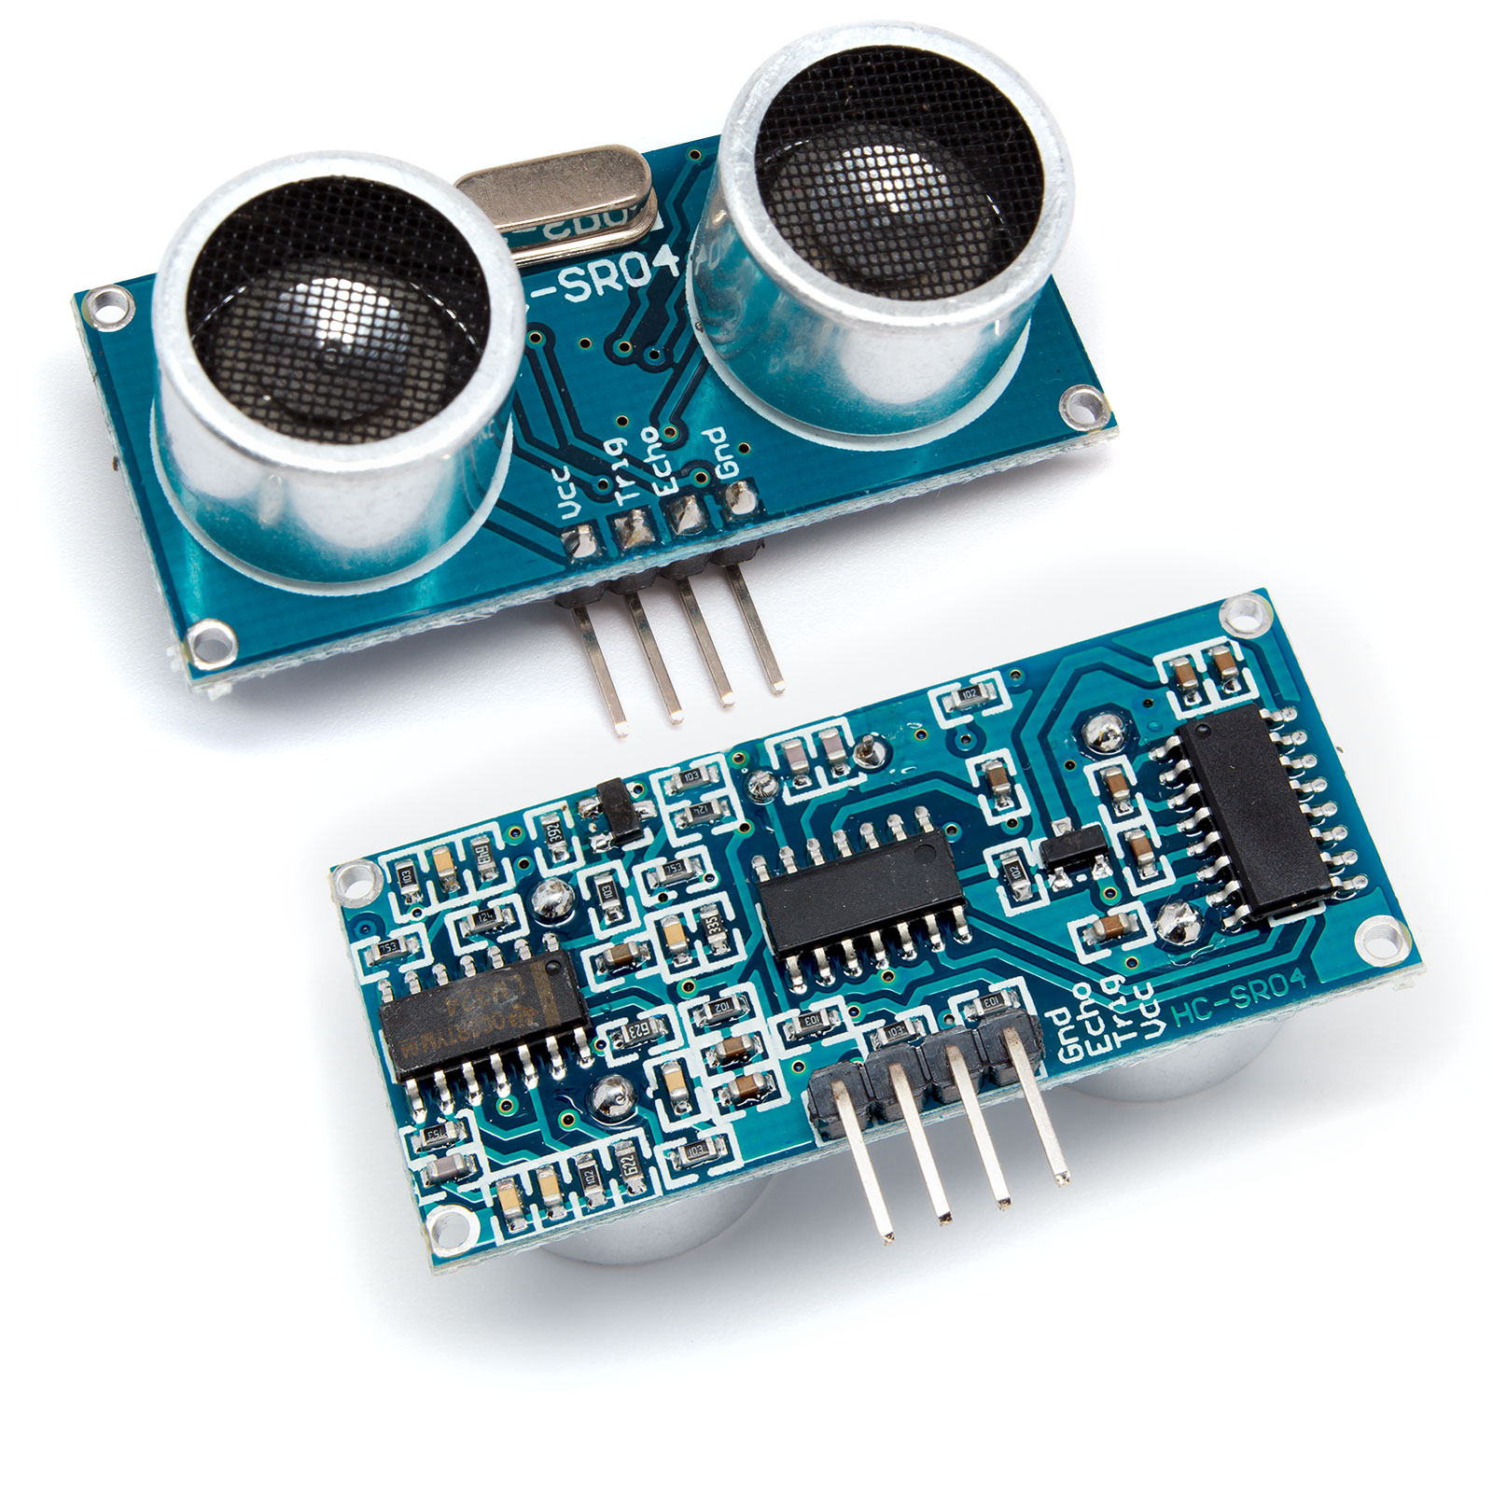
Obstacle Detector HC-SR-04
Introduction
This soil moisture sensor is used to sense the present of water in soil and gives some output voltage to the processor to execute according to the instruction given by the user.

Slide 26
Features of HC-SR-04
Feature
Power Supply :+5V DC
Working Current: 15mA
Measuring Angle: 30 degree
Ranging Distance : 2cm – 400 cm/1″ – 13ft
Trigger Input Pulse width: 10uS
Dimension: 45mm x 20mm x 15mm

Slide 27
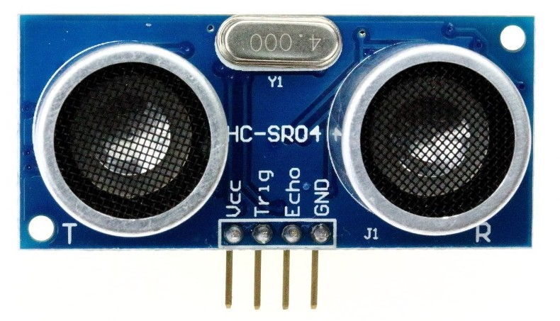
Pin Diagram of HC SR 04
Pins
VCC: +5VDC
Trig : Trigger (INPUT)
Echo: Echo (OUTPUT)
GND: GND

Slide 28
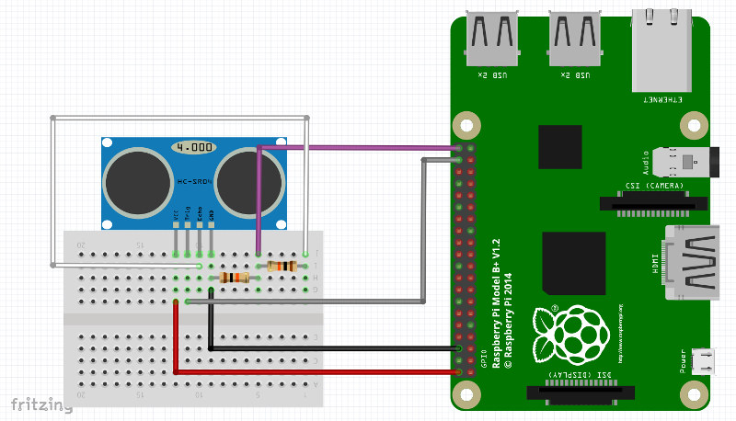
Sensor Interfacing with RPi

Slide 29
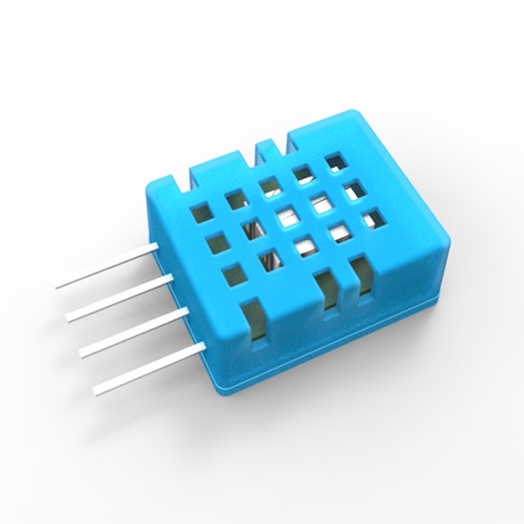
Temperature and Humidity Sensor DHT
Introduction
DHT is a low cost Temperature and humidity sensor for electronic hobbyist, who wants to do data logging.
It has on board ADC chip for analog to digital conversion of data.

Slide 30
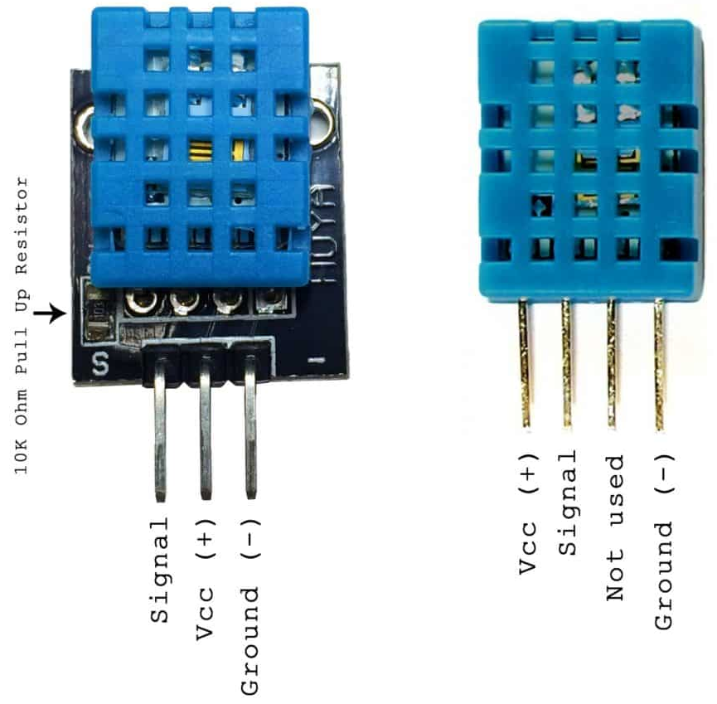
DHT 11
Features
Ultra low cost
3 to 5V power and I/O
2.5mA max current use during conversion (while requesting data)
Good for 20-80% humidity readings with 5% accuracy
Good for 0-50°C temperature readings ±2°C accuracy
No more than 1 Hz sampling rate (once every second).
4 pins with 0.1" spacing

Slide 31
DHT 22
Features
low cost
3 to 5V power and I/O
2.5mA max current use during conversion (while requesting data)
Good for 0-100% humidity readings with 2-5% accuracy
Good for -40 to 125°C temperature readings ±0.5°C accuracy
No more than 0.5 Hz sampling rate (once every 2 seconds)
4 pins with 0.1" spacing

Slide 32
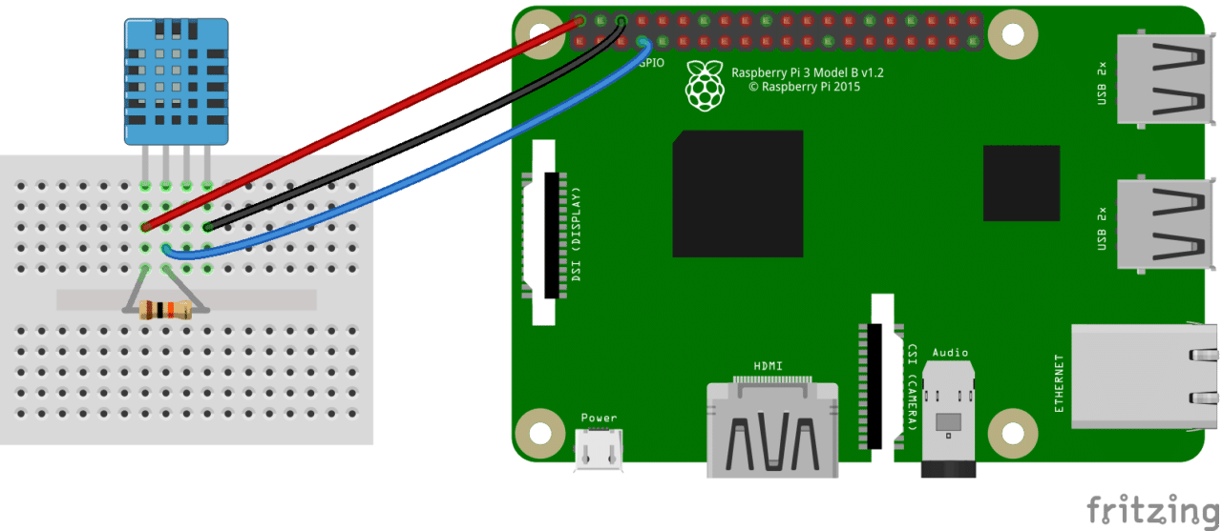
Sensor Interfacing with RPi

Slide 33


Slide 34


