Slide 1
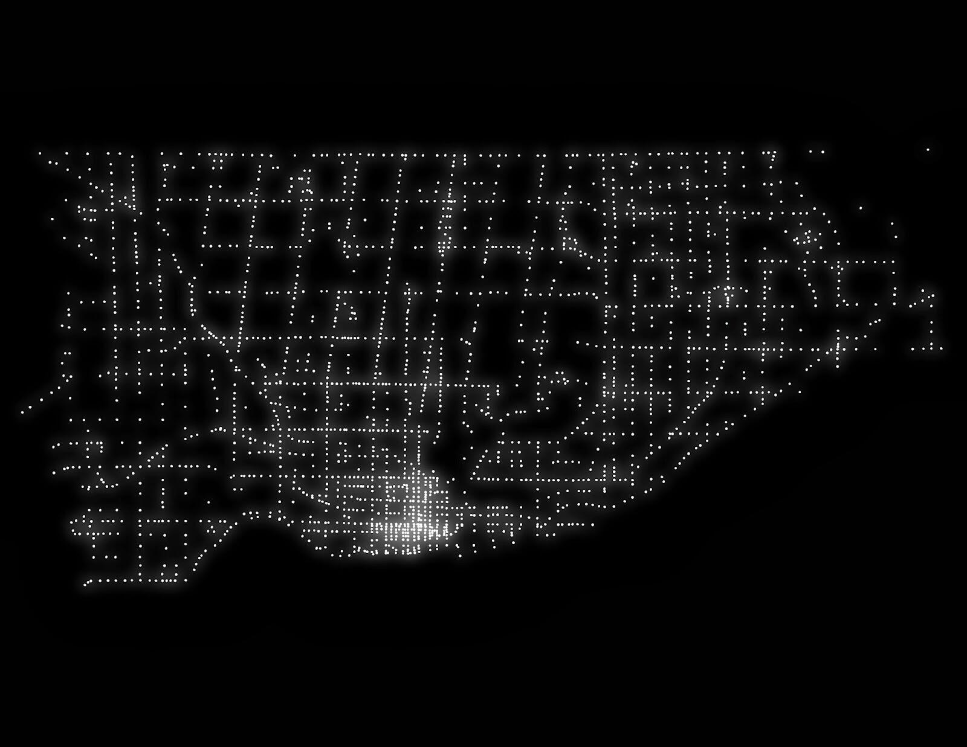
The Battle Of Neighborhoods
Neighborhood recommendation for XYZ Grocery’s first venture in Toronto.

Slide 2
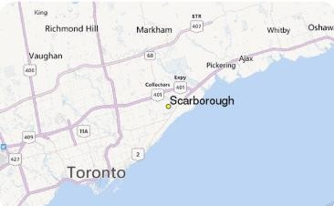
INTRODUCTION
Toronto city overview for XYZ Grocery
XYZ Grocery Strategic Plan and Overview
XYZ Grocery Business Problem
Choice of the first neighborhood to offer services.
The neighborhood should enable easy replication.
The neighborhood should have high demand.
The neighborhood should have lower competition.
Success Criteria:
Good recommendation of neighborhood that meets above points.
It should have capability to enable latest information whenever required.

Slide 3
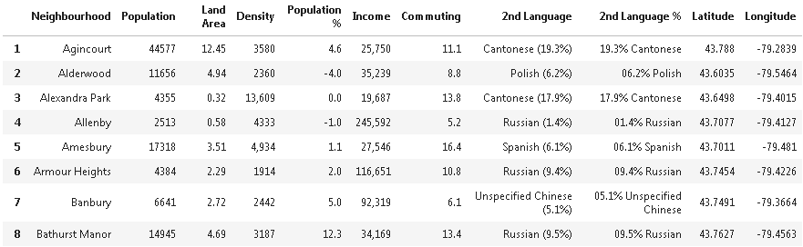
DATA DESCRIPTION
Data Requirements for this project:
Neighborhood Information (i.e. name, coordinates, populations).
Venue information (i.e. name, category, coordinates)
Data Sources for this project:
Wikipedia Pages
Foursquare.com
Data Processing for this project:
Data cleaning is required
Data needs to be in a structured format

Slide 4
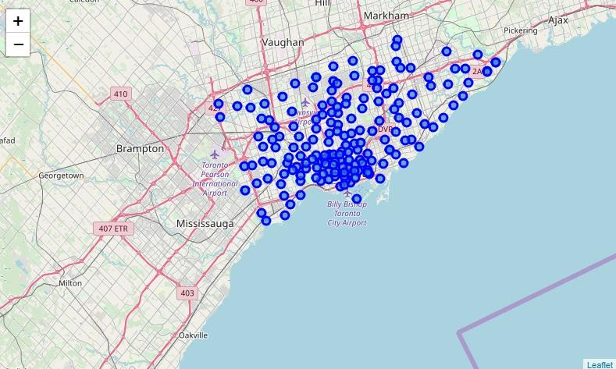
METHODOLOGY
Data Scrapping Technique
To scrap the neighborhood data from Wikipedia
To make the data into a structured format
Foursquare.com
Retrieving venue information from above API.
K-Means Machine Learning
Segment and cluster similar neighborhoods
Group them based on most common venues
Scoring Weightage
Population count has 50% weightage
Venue (fewer grocery) has another 50% weightage

Slide 5
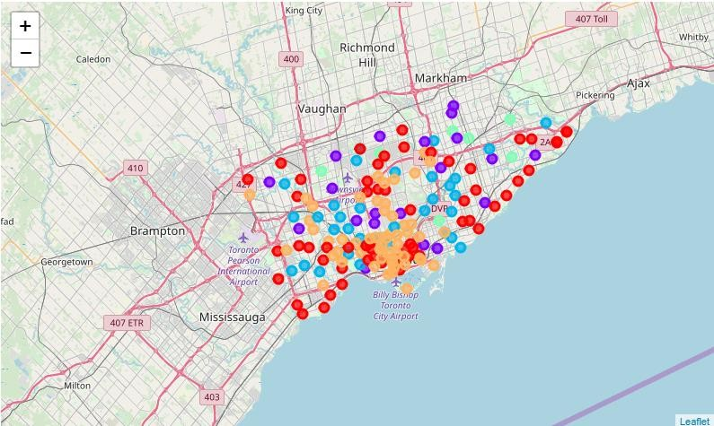
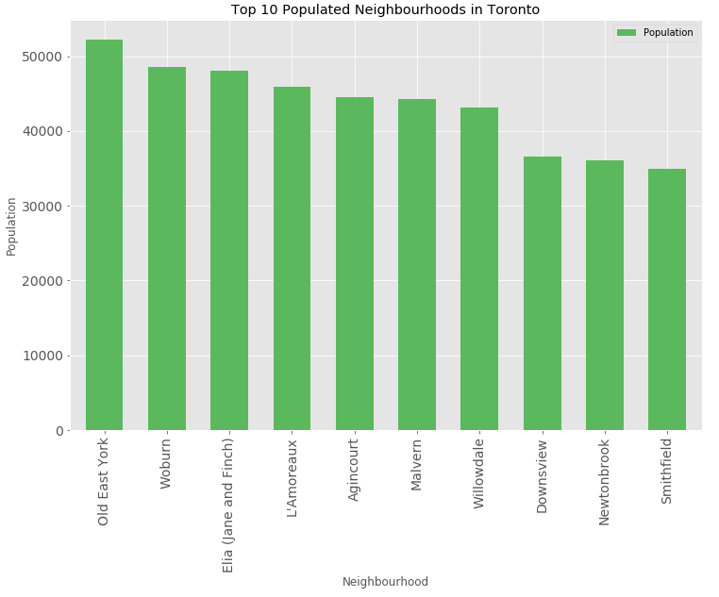
RESULT
Clustering Similar Neighborhoods
Grouping based on common venues
Neighborhood with high population
Ranking the neighborhoods based on
population count
Topmost common venue
Ranking the neighborhoods based on common venue w/o Grocery

Slide 6
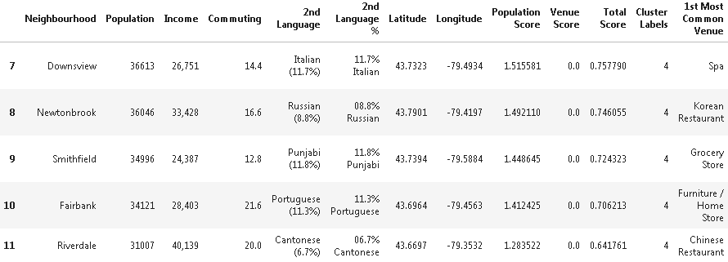
DISCUSSION
Result Review:
Fifth cluster looks to offer the best business
expansion opportunity.
Downsview neighborhood in the first cluster looks to meet the key business criteria whereby it will offer the highest demand (i.e. high population) and lowest competition (i.e. lower supply).
Additional Observation:
High number of Italian people.
Worthwhile to consider Italian food or related supplies offering in this neighborhood.

Slide 7
CONCLUSION
Recommendation Summary:
Region: Fifth Cluster.
Neighborhood: Downsview
Additional Offering: Italian food or related supplies.
Additional Note:
Re-run of the program is encouraged to get latest information.
Updated information is critical to consider as part of business expansion plan.
Thank You:
Appreciation Notes from Data Science Team for this project.

