Slide 1

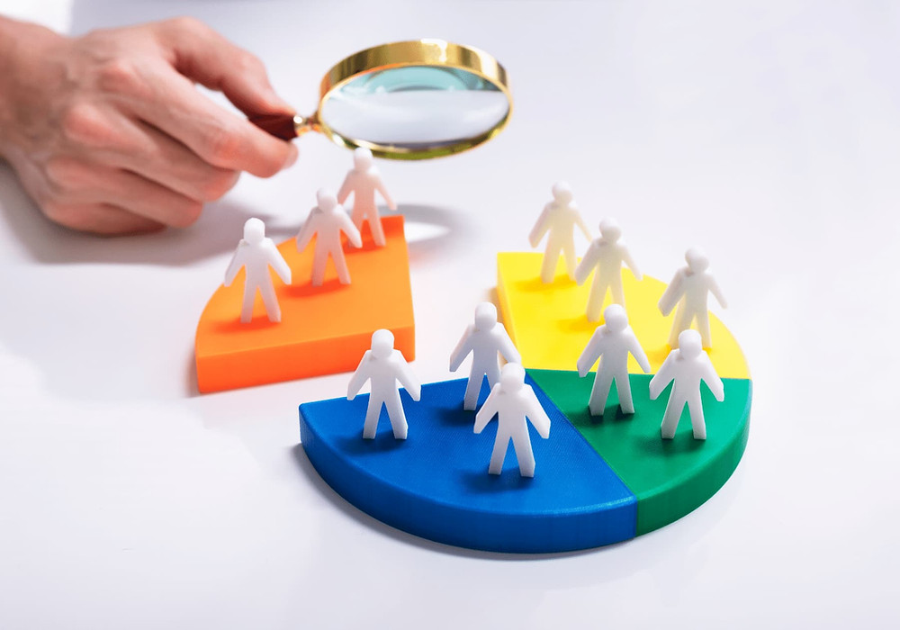
Machine Learning
Customer Segmentation
Group No. : TY 5
Group Members | Roll No. | GR No.
Vishwajit Patil | 55 | 11910948
Abhijeet Pawar | 57 | 11910908
Ashwin Pawar | 59 | 11911225
Piyush Pisal | 65 | 11911256
Guide : Prof. S.T. Patil (Sir)

Slide 2
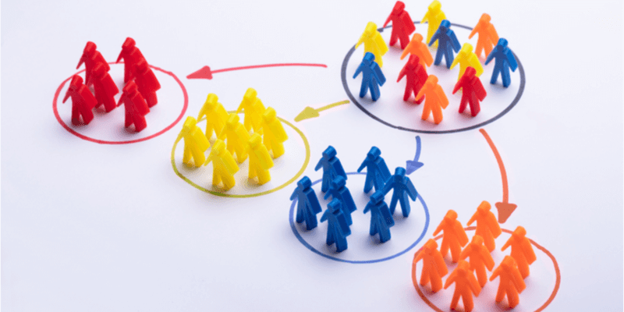
Index
Introduction
Objectives
Literature Review
Tools and Technology
Flow Diagram
K Means Clustering
Agglomerative Clustering
Advantages
Conclusion

Slide 3
Introduction
Technique of splitting customers into separate groups depending on their attributes or behavior.
Marketing responsibilities, such as up-selling methods, product recommendations, and pricing can benefit from customer segmentation.
Customer segmentation can help you save money on marketing initiatives by reducing waste.

Slide 4
Problem Statement
There is vast increase in e-commerce it deeply affects local stores.
So, to tackle this problem the local stores needs to adapt new techniques and services accordingly.

Slide 5
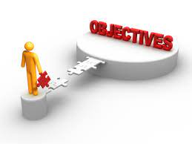
Objectives
The goal of segmenting customers is to decide how to
relate to customers in each segment in order to
maximize the value of each customer to the business.
The aim of segmentation is to increase sales through personalized content tailored to the respective segment.
To learn implementation of the machine learning principle in python.

Slide 6
Literature Review
Sr No | Author | Paper | Description
1 | Juni Nurma Sari, Lukito Nugroho, Ridi Ferdiana, Paulus Insap Santosa | Review on Customer Segmentation Technique on Ecommerce Advanced Science Letters ,Vol. 4, 400–407, 2011 | Discussed the factors affecting the customer segmentation and different methods of segmentation through their references. They discussed methods of segmentation using different factors.
2 | Mr. Abhijit Bag | Customer Segmentation & Opportunity Analysis (using R programming language), 2018. | Describes need for customer segmentation, the properties on which they are segmented both small and large scale,types of segmentation. Use of K-means clustering algorithm is discussed for segmentation.

Slide 7
Literature Review
Sr No | Author | Paper | Description
3 | Balmeet Kaur, Pankaj Kumar Sharma | Implementation of Customer Segmentation using Integrated Approach. International Journal of Innovative Technology and Exploring Engineering (IJITEE) ISSN: 2278-3075, Volume-8 Issue-6S, April 2019 | The paper describes the step wise process for customer segmentation. Use of the apriori algorithm is described. And for the purpose of segmentation k-means and associative mining is used with the analysis of apriori algorithm.
4 | Chinedu Pascal Ezenkwu, Simeon Ozuomba, Constance kalu | Application of K-Means Algorithm for Efficient Customer Segmentation: A Strategy for Targeted Customer Services (IJARAI) International Journal of Advanced Research in Artificial Intelligence, Vol. 4, No.10, 2020 | This paper has presented a MATLAB implementation of the k-Means clustering algorithm for customer segmentation based on data collected from a mega business retail outfit that has many branches in Akwa Ibom state, Nigeria. Paper describes about big data as well.

Slide 8
About Dataset
Customers information | Products
ID | MntWines
Year of birth | MntFruits
Education | MntMeatProducts
Income | MntFishProducts
Marital status | MntSweetProducts

Slide 9
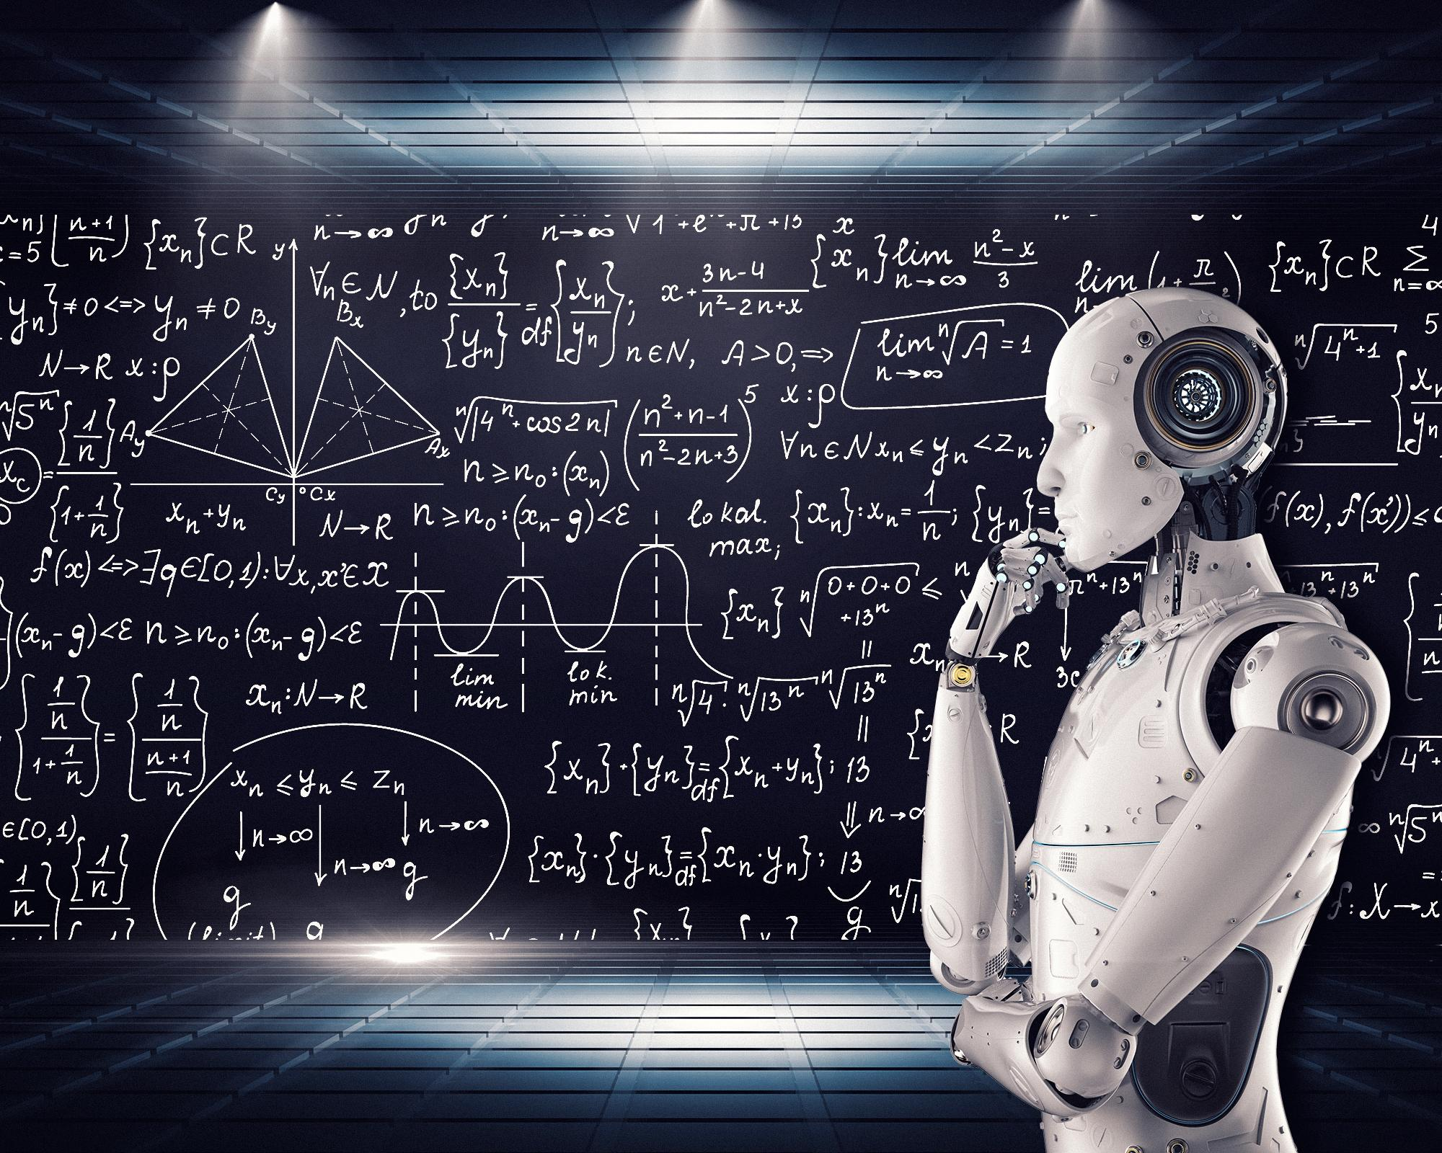
Tools and technology
Domain : Machine Learning
Tool : google collab
Language : python

Slide 10
Flow Diagram
Selecting problem statement
Searching and selecting database
Data preprocessing for clustering
Data Cleaning and modification (Currently completed)
Comparing and implementing clustering algorithms
Applying selected algorithms and observing the outcomes

Slide 11
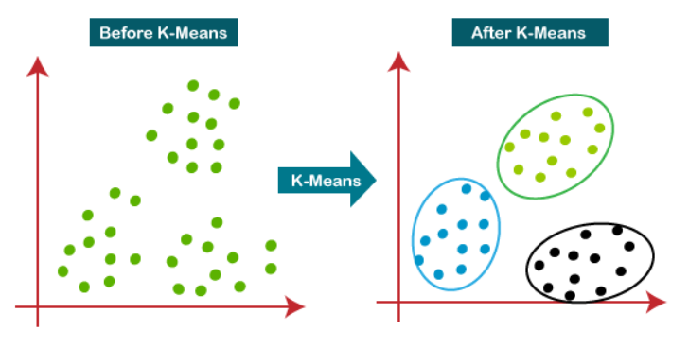
K Means Clustering
Unsupervised machine learning algorithm.
k-means group data into clusters that are more similar.

Slide 12
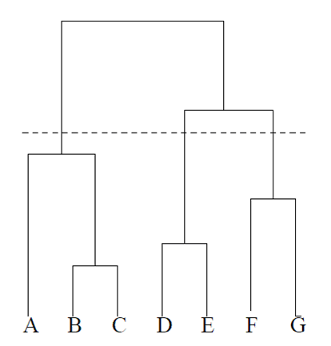
Agglomerative Clustering
It is a unsupervised learning.
Starts from individual cluster.
every cluster calculates their distance with each other.
The two clusters with the shortest distance merge each other.

Slide 13
Mean - Shift Clustering
It is a clustering algorithm.
It is a centroid-based algorithm that helps in various use cases of unsupervised learning.
One of the best algorithms to be used in image processing and computer vision.

Slide 14
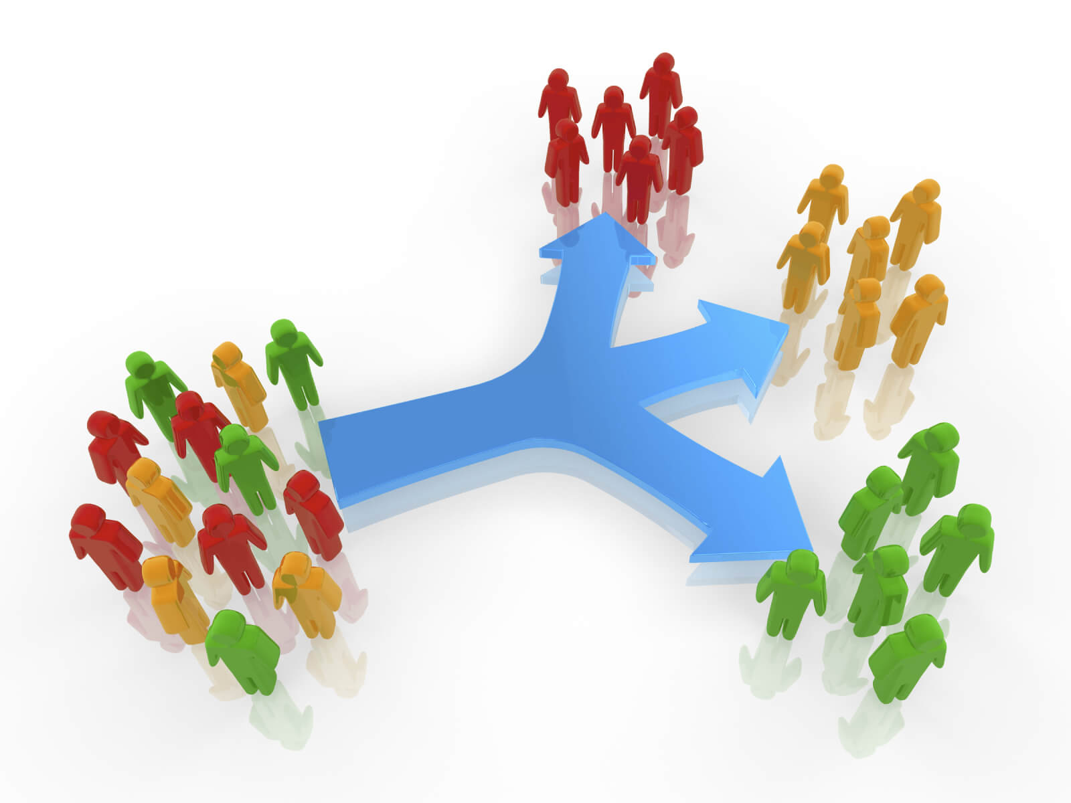
Benefits of customer segmentation
Help identify least and most profitable customers.
Build loyal relationships with customers by developing and offering them the products and services.
Helps to improve customer service,maximize the use of your resources.

Slide 15
Conclusion
Product and service needs of individual customers differ.
Segmentation to help the market to pick up the market targets.

Slide 16
References
Review on Customer Segmentation Technique on E-commerce Advanced Science Letters ,Vol. 4, 400–407, 2019
Customer Segmentation & Opportunity Analysis (using R programming language), 2018.
Application of K-Means Algorithm for Efficient Customer Segmentation: A Strategy for Targeted Customer Services (IJARAI) International Journal of Advanced Research in Artificial Intelligence, Vol. 4, No.10, 2018

Slide 17
Thank you

