Slide 1
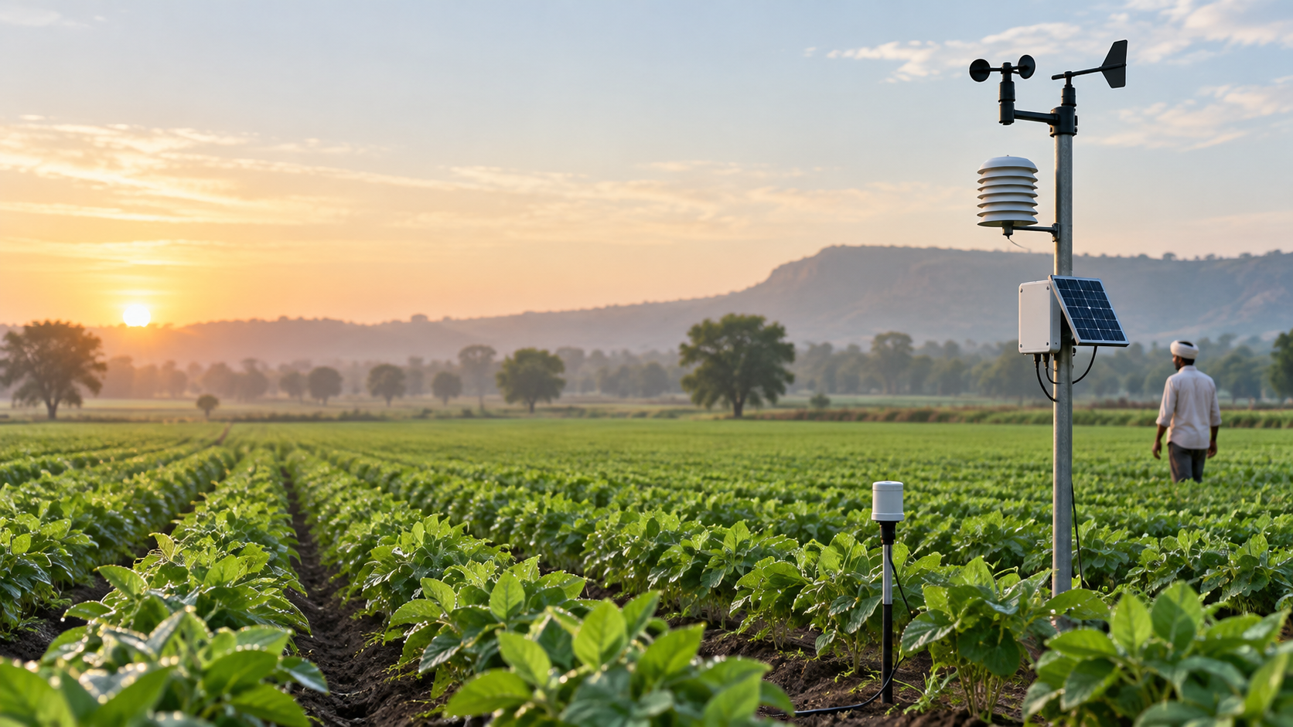
Presented by:
P Vishwak
Crop Disease
Detection Using
Machine Learning
Multi-class classification for AgriTech sensor data
Capstone Project Presentation

Slide 2

Project objective
Build a classifier that predicts crop-health status from field, soil and sensor data.
PROBLEM TO SOLVE
Predict whether a crop observation is healthy or affected by fungal disease, bacterial disease, or pest damage.
The prediction is based on environmental readings, soil measurements, crop information and farm-management records.
Healthy
Fungal
Bacterial
Pest Damage
Crop Disease Detection Using Machine Learning
02

Slide 3
Dataset snapshot
A deliberately messy 5,000-row dataset with 17 predictors and 1 target variable.
5,000
18
4
17
Rows
Columns
Disease classes
Predictors
FEATURE FAMILIES
TARGET CLASSES
Crop & farm context: crop type, region, season
Healthy — routine monitoring
Soil properties: soil type, pH, N-P-K nutrients
Fungal — fungicide action
Environment: temperature, humidity, rainfall, leaf wetness
Bacterial — bactericide + quarantine
Management: pesticide and fertilizer application
Pest Damage — pesticide + bio-control
Crop Disease Detection Using Machine Learning
03

Slide 4
End-to-end workflow
The project was structured to move from raw data diagnosis to model recommendation.
1
2
3
4
5
6
Understand
Audit
Clean
Engineer
Model
Evaluate
Problem, target, classes
Missing values, types, outliers
Standardise and impute
HTI, drought, maturity
DT, KNN, RF
F1, accuracy, confusion matrix
Professional workflow decision: clean and impute before feature engineering so engineered variables are not built from unreliable values.
Crop Disease Detection Using Machine Learning
04

Slide 5
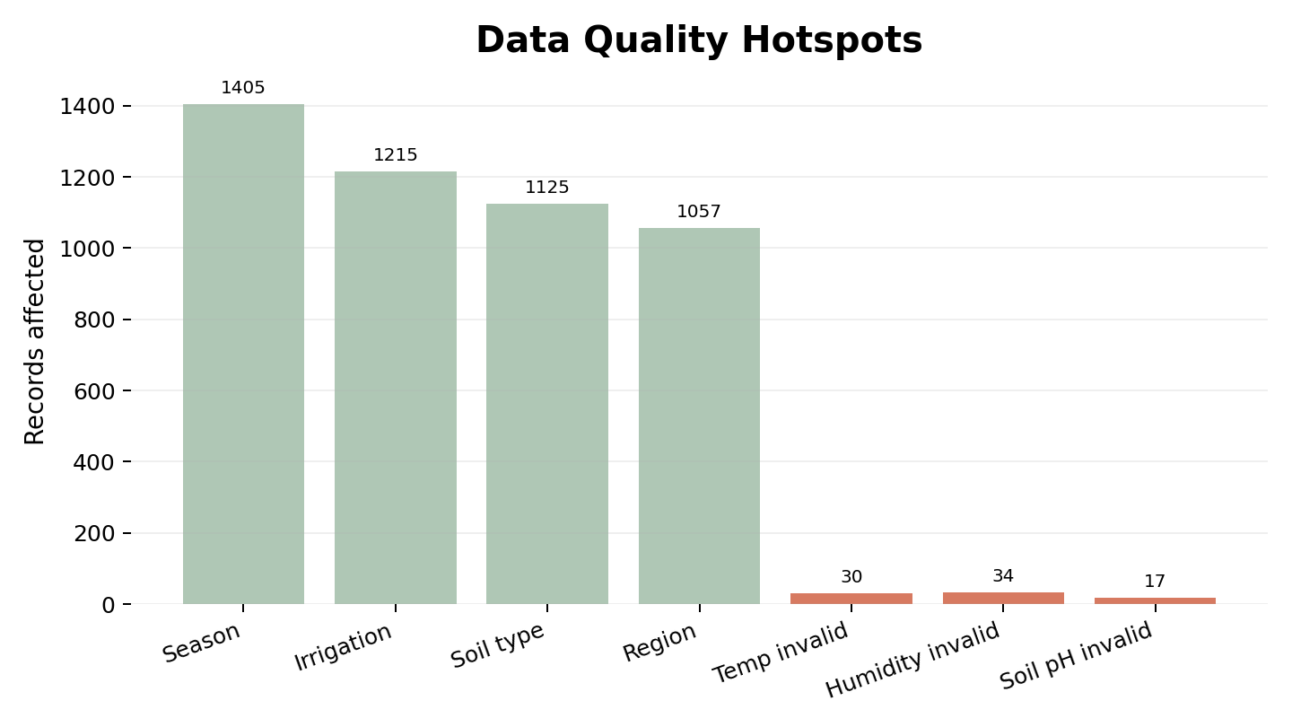
Data quality findings
The raw dataset had missing values, inconsistent categories and physically implausible records.
WHAT NEEDED ATTENTION
High categorical missingness in season, irrigation, soil type and region
Inconsistent capitalisation such as WHEAT / wheat / Wheat
Invalid temperature values such as -5, 99 and 120°C
Humidity records below 0% or above 100%
Soil pH outside the expected 3–10 range
Crop Disease Detection Using Machine Learning
05

Slide 6
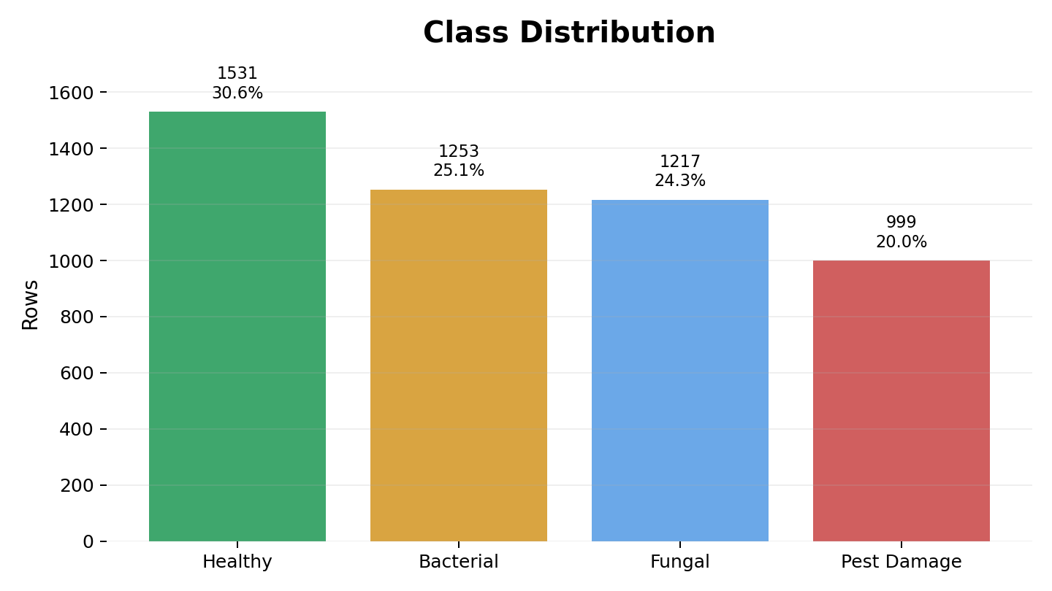
EDA highlights
The target is moderately imbalanced, while most numerical relationships are weak.
KEY OBSERVATIONS
Healthy is the largest class; Pest Damage is the smallest
Class imbalance is moderate, not extreme
soil_pH medians across classes are very close
Correlation heatmap shows no strong multicollinearity
Evaluation should not rely only on accuracy; Macro F1 is important because it gives equal weight to each class.
Crop Disease Detection Using Machine Learning
06

Slide 7
Cleaning and feature engineering
The cleaned dataset preserved all 5,000 rows and added domain-inspired predictors.
CLEANING ACTIONS
NEW FEATURES
Standardised categorical values to Title Case
HTI
(humidity × temperature) / 100
Converted invalid temperature, humidity and pH values to NaN
Mean used for near-symmetric numerical columns
drought_stress
1 when rain gap > 20 days and rainfall < 10mm
Median used for strongly skewed rainfall and fertilizer
maturity_stage
Seedling → Vegetative → Reproductive
Mode used for categorical and binary values
22
Final cleaned feature-engineered columns
Crop Disease Detection Using Machine Learning
07

Slide 8
Modelling setup
Three baseline classifiers were trained and evaluated under the same 80/20 split.
1
2
3
Decision Tree
KNN
Random Forest
Unscaled data
Scaled data
Unscaled data
Interpretable baseline
k = 3, 5, 7 tested
Ensemble of trees
Stratified sampling was used so the train and test sets preserve similar disease-label proportions.
Crop Disease Detection Using Machine Learning
08

Slide 9
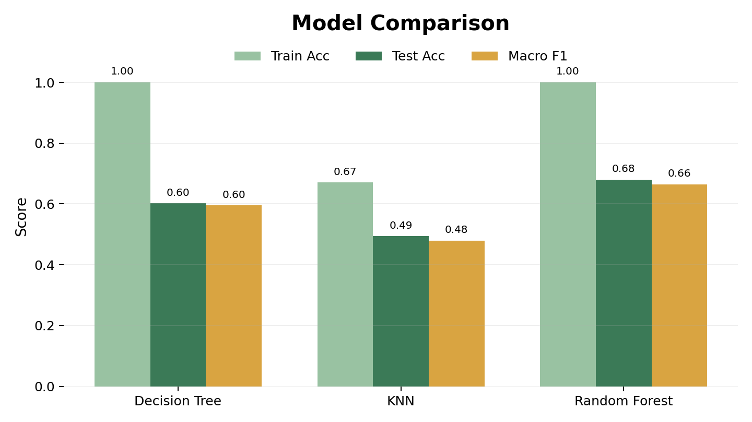
Model comparison
Random Forest delivered the strongest test performance among the evaluated models.
RESULT SUMMARY
68.0%
0.665
Random Forest test accuracy
Random Forest Macro F1
Decision Tree overfit with 100% train accuracy and 60.2% test accuracy
KNN had the weakest test performance at 49.4%
Random Forest also shows overfitting, but generalised best among the three
Crop Disease Detection Using Machine Learning
09

Slide 10
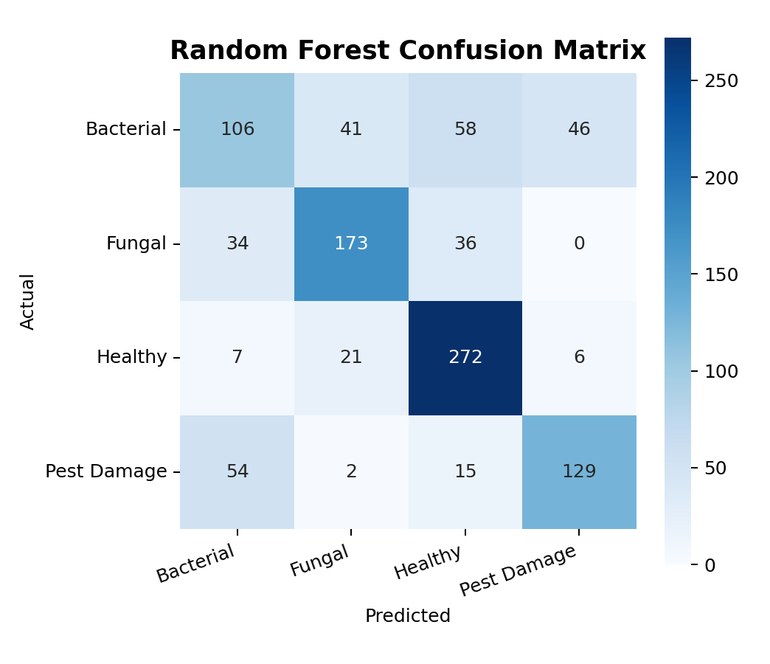
Error analysis
The confusion matrix reveals where the selected model struggles.
MAIN ERROR PATTERN
Bacterial → Healthy
58 cases
Bacterial has the lowest F1-score at ~0.469
Recall for Bacterial is ~0.422, meaning many actual Bacterial cases are missed
Healthy has the strongest class-wise performance due to high recall
Misclassifications suggest overlap in patterns between bacterial stress and healthy readings
Crop Disease Detection Using Machine Learning
10

Slide 11
Recommendation and next steps
Random Forest is the best candidate from the current experiment, with clear scope for improvement.
RECOMMENDATION
NEXT STEPS
Use Random Forest as the selected baseline model for deployment discussion.
Tune max_depth, min_samples_split and min_samples_leaf
Review Bacterial class errors with domain experts
Reason: highest test accuracy and Macro F1 among the three evaluated models.
Try class weights or balanced sampling if recall remains low
Validate on fresh field data before operational use
Caution: training accuracy is 100%, so further tuning is needed before production use.
Track model performance after deployment
Crop Disease Detection Using Machine Learning
11

