Slide 1

Seasonal Agriculture Performance Analysis
Presented by – Aahan Vishwakarma
College – JSS Academy of technical education
AICTE STU ID : STU6a328c8ef379b1781697678

Slide 2

PROBLEM STATEMENT
Agricultural activities are deeply influenced by seasonal variations in environmental conditions, farming practices, resource availability, and market conditions. As a result, agricultural performance differs significantly from one season to another.
However, raw agricultural data does not clearly explain how agricultural performance changes across seasons or what patterns can be observed under different seasonal conditions.
The Objective: Analyze the provided dataset and investigate seasonal differences in agricultural performance by identifying meaningful patterns, trends, relationships, and variations

Slide 3
Project Description Data-Driven Farming Insights This project is based on the requirements defined in "Major Project Seasonal Agriculture Performance Analysis " and utilizes the "seasonal agriculture performance dataset". The dataset represents agricultural activities across different seasons, geographical areas, and farming conditions. It tracks resource usage, environmental factors, and economic performance. By performing comprehensive data cleaning, exploratory data analysis (EDA), and statistical comparisons, this project aims to support evidence-based agricultural planning and identify significant areas requiring further investigation.

Slide 4

WHO ARE THE END USERS?
Farmers & Agronomists. Leveraging seasonal insights to optimize resource allocation, planting schedules, and crop rotation strategies for maximum yield.
Agricultural Planners - Utilizing data trends to support evidence-based regional planning, supply chain management, and sustainable farming initiatives.
Gov. Policymakers - Understanding changing environmental conditions to frame better agricultural policies and provide targeted subsidies based on seasonal performance.

Slide 5

Technology Used
Python 3.x - Core programming language
Pandas - Data cleaning and manipulation
NumPy - Numerical and mathematical operations
Matplotlib & Seaborn - Data visualization
Google Colab - Interactive coding and narrative text
GitHub - Version control and project repository

Slide 6
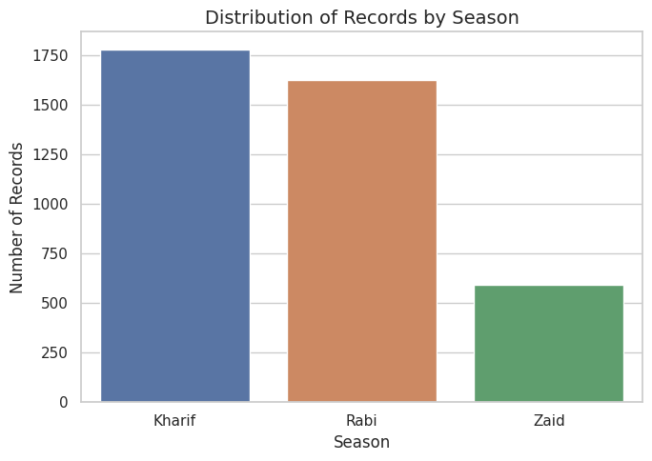
RESULTS
This bar chart illustrates the frequency of farming activities across different seasons. The data shows that the majority of agricultural records occur during the Kharif and Rabi seasons, with significantly fewer activities recorded during the Zaid season.

Slide 7
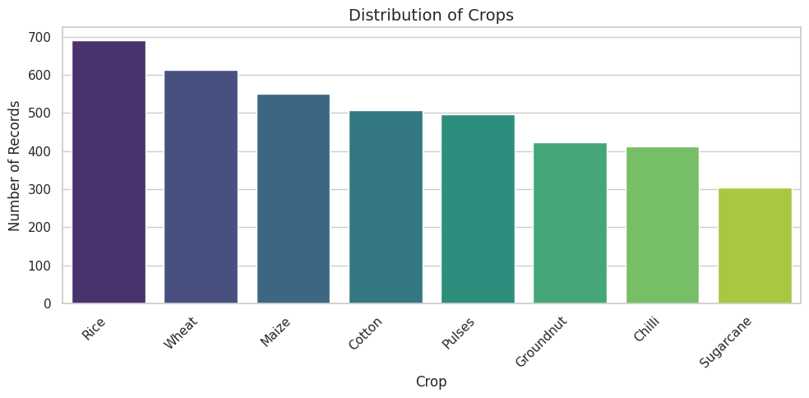
RESULTS
This visualization displays the variety of crops cultivated in the dataset. Rice and Wheat are the most widely grown crops, followed closely by Maize and Cotton, indicating a strong preference or environmental suitability for these staple crops among the recorded farms.

Slide 8
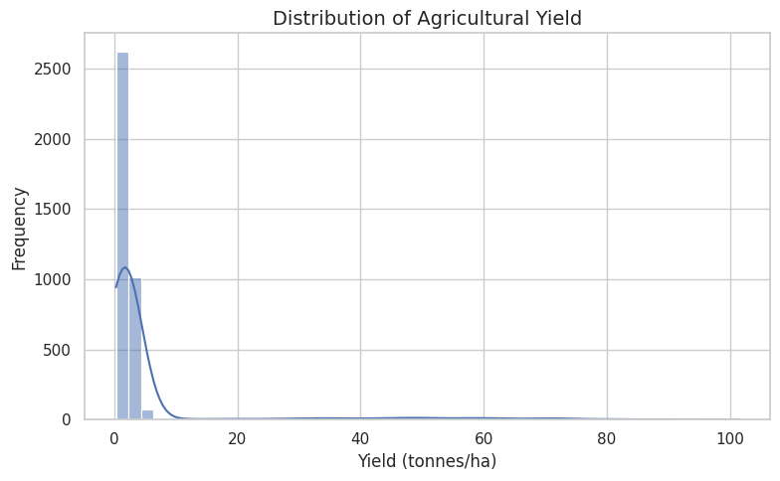
RESULTS
This histogram highlights the yield output in tonnes per hectare. The distribution is heavily right-skewed, meaning that while most farms produce a moderate-to-low yield per hectare, there is a small segment of highly productive farms achieving exceptionally high yields.

Slide 9
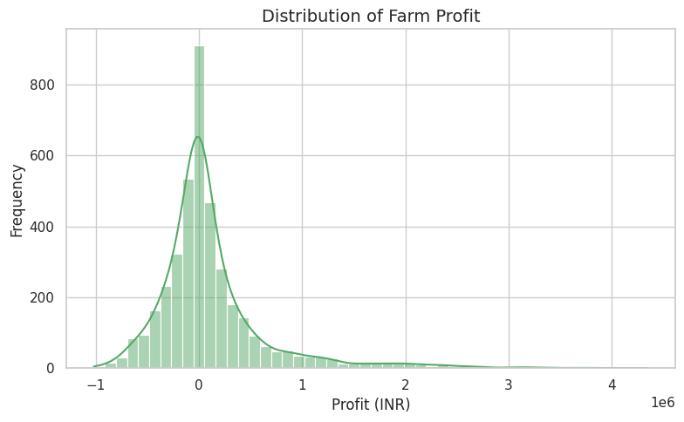
RESULTS
This chart shows the economic performance of the farms in INR. The profit distribution peaks near the zero mark, indicating that a large number of farms are just breaking even or making a marginal profit. However, the wide "tails" on both sides show high variance, meaning there are instances of both severe financial losses and substantial profits

Slide 10
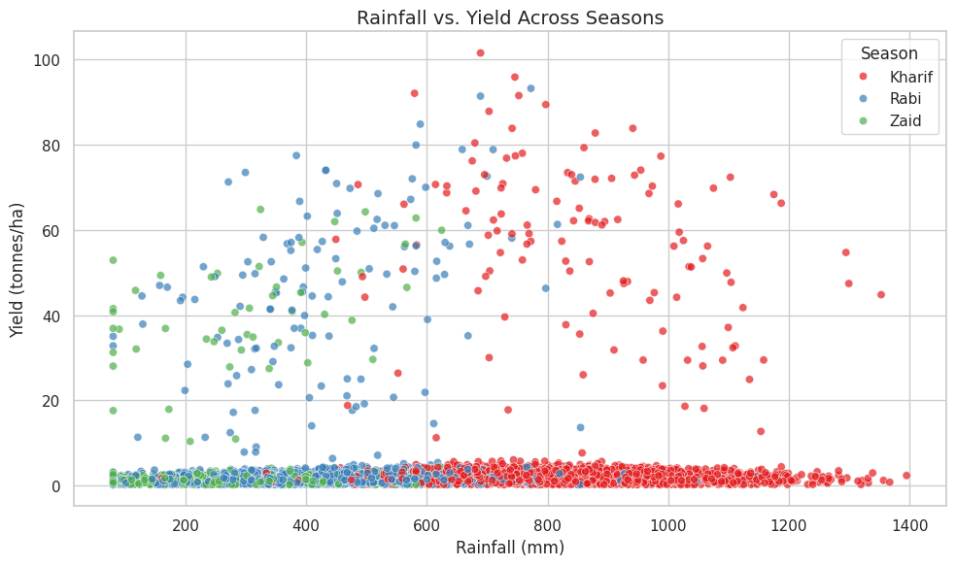
RESULTS
This scatter plot explores the relationship between environmental conditions (rainfall) and agricultural performance (yield). It highlights distinct weather patterns, such as the Kharif season experiencing significantly higher rainfall. Crucially, the chart demonstrates that maximum rainfall does not guarantee the highest yield; many of the peak yields occur at moderate rainfall levels.

Slide 11
Future scope
Predictive Modeling - Implementing Machine Learning algorithms to forecast future crop yields based on historical seasonal data and environmental variables.
Real-time Integration - Connecting the analysis pipeline with live IoT sensor data for real-time monitoring of soil moisture, temperature, and weather.
Interactive Dashboards - Developing dynamic BI dashboards (e.g., using Tableau or PowerBI) to allow stakeholders to filter patterns by region and season interactively.

Slide 12
GitHub Link
https://github.com/vishwakarmaaahan954-dot/Seasonal_Agriculture_Performance_Analysis.git

Slide 13
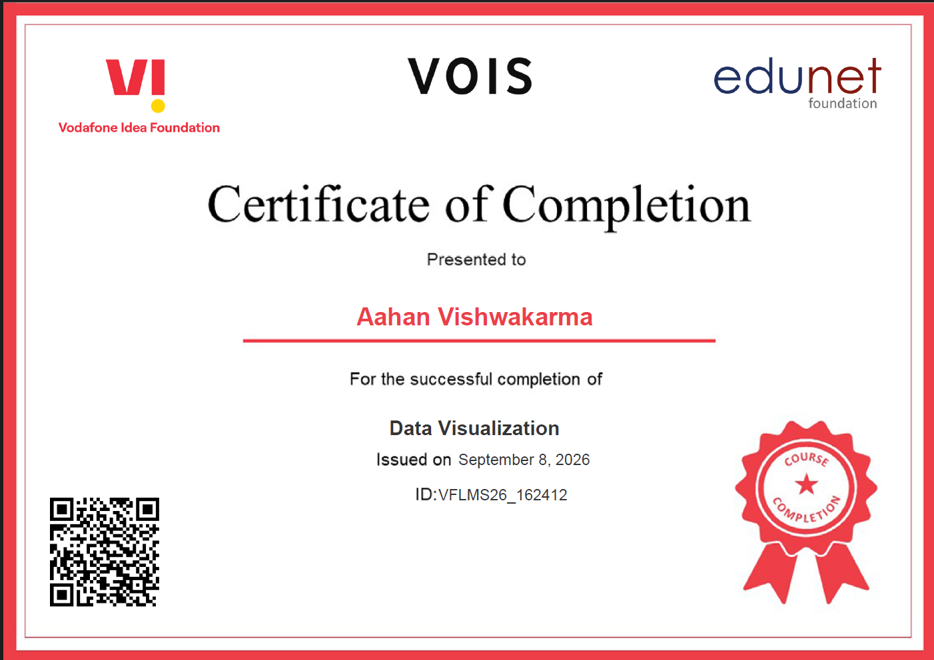
VOIS Course completion certificate - Course name- Data Visualization

Slide 14
Thank you
.
.

