Slide 1
HIERARCHICAL REINFORCEMENT LEARNING FOR AUTONOMOUS PARKING
Combining A* Path Planning with PPO Control
MSML 642 ROBOTICS
Vishwaksena Dingari
121113764

Slide 2
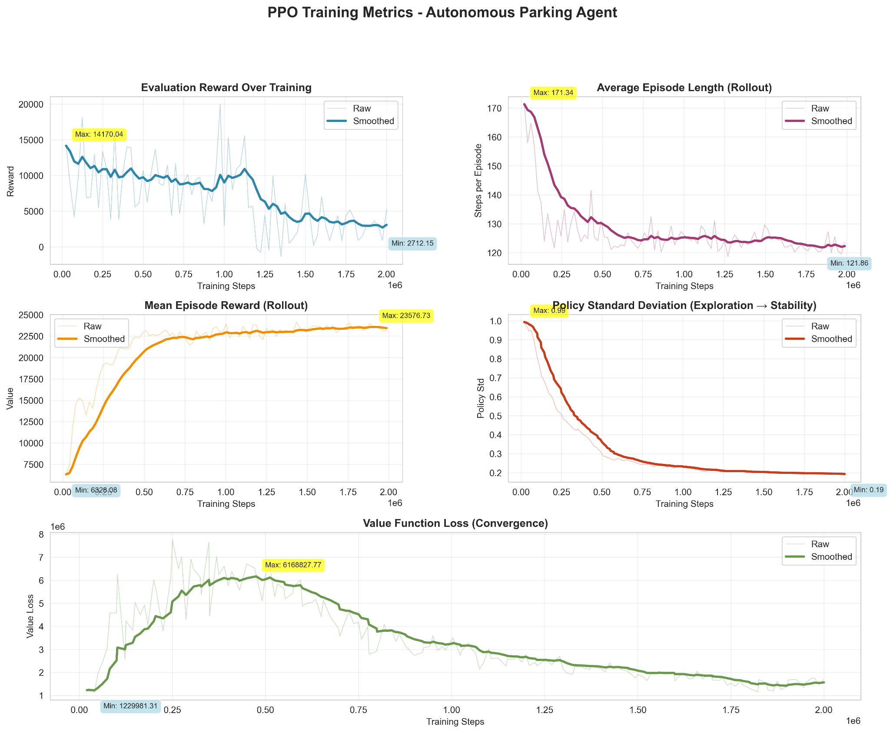
CURRENT RESULTS
Training Summary (2M steps, ~12 hours)
Episode Reward increased from 6K → 23K
Episode Length stable at ~125 steps (efficient navigation)
Policy Std decreased 0.99 → 0.19 (exploration → control)
Value Loss converged from 6M → 1.7M
Interpretation:
Agent is consistently improving, stabilizing, and following A* waypoint plans with high precision.

Slide 3
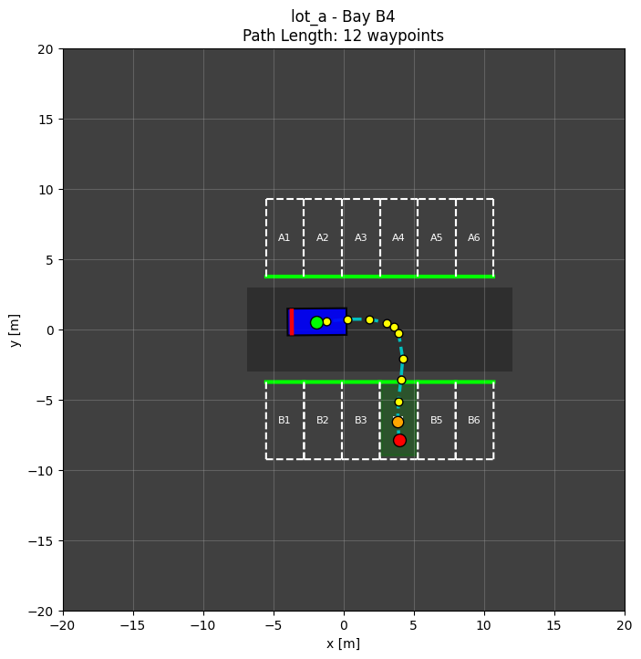
AUTONOMOUS PARKING IN LOTS
INPUT:
  Robot state (x, y, yaw, v)
  Goal bay location, yaw
  64-ray Lidar scan (360°, 20m)
OUTPUT:
  Steering ∈ [-1, 1]
  Throttle ∈ [-1, 1]
CHALLENGES
  Long Horizon: 10-25 meter navigation, 500-2000 timesteps/episode
  Multi-Orientation: Bays face different directions, Rotation-invariant parking, Progressive curriculum
  Precision Parking: Position: <0.5m error, Orientation: <10° error, Must stop completely

Slide 4
HIERARCHICAL ARCHITECTURE
HIGH-LEVEL PLANNER (A*)
0.25 m grid-based search
Collision + corridor checks
  Prevent cutting through parking bays
  Forces path to stay inside driving lanes
B-Spline smoothing
  Removes sharp A* corners
  Produces drivable curvature (car-like motion)
LOW-LEVEL CONTROLLER (PPO)
Observation (~80 dims):
  64-ray lidar
  Vehicle state (x, y, yaw, v)
  Bay geometry (cx, cy, yaw error)
  Waypoint tracking (distance + heading)
  Corridor offset + progress signals
Actions (continuous):
  Steering ∈ [−1, 1]
  Throttle ∈ [−1, 1]

Slide 5
REWARD FUNCTION DESIGN
NAVIGATION PHASE (r_nav) (dist > 3.0m) | PARKING PHASE (r_park) (dist < 3.0m)
Waypoint Progress: +0.1 per meter (only if moving forward) | Lateral Alignment: +20.0 (1 - |cy|/0.8)
Path Velocity: +0.5 × v_path (reward approaching goal) | Yaw Alignment: +15.0 (1 - |Δθ|/1.5)
Backward Penalty: -2.0 × |v| (strong discouragement) | Depth Progress: +10.0 × Δcx (drive deeper into bay)
Anti-freeze: -0.01 (keep moving) | Success Bonus: +500.0 (dominates episode return)
Distance Penalty: -0.002 × dist
Corridor Drift Penalty: −corridor_weight × |lateral_offset|
UNIVERSAL PENALTIES
Collision: -100
Timeout: -50
Phase Blending:r_total =
α(d) × r_nav + (1-α(d)) × r_park
where α(d) = d / 3.0 (weight decreases as approach)

Slide 6
CURRICULUM LEARNING
Stage 0 - Aligned Spawn
Aligned Start,
Lot A
6 Bays
Learn Basics and Park
Stage 2 - Lot A
Stage 1 + Other side
Spawns Along the road
Random spawn
Navigate the space and Park
S1
S3
S0
S2
Stage 1 - Lot A - Side A
Add Cars in Other Bays
Spawns along the road
Random Spawn 22m max
Navigate the space and Park
Stage 2 - Lot A + Lot B
Stage 2 + Lot B
Added Lot B, a t-shaped lot
Random spawn along the roads
Navigate the space and Park

Slide 7
FUTURE WORK & BROADER IMPACT
IMMEDIATE NEXT STEPS
Complete curriculum, Expected: 10-30% success rate
Sim-to-real transfer with TurtleBot3
Multi-agent coordination
KEY LESSONS
Hierarchical RL works (20x speedup)
Curriculum essential (300x improvement)
Reward engineering critical

Slide 8
REFERENCES
https://arxiv.org/html/2407.01333v1
https://github.com/Harish-Balaji-B/Ros2_humble_Autonomous_Parking_System_using_Turtlebot3_Waffle/
https://github.com/aatmaj28/Autonomous-Car-Parking-RL
https://arxiv.org/abs/1707.06347
https://arxiv.org/abs/1805.08296

